Slide 1


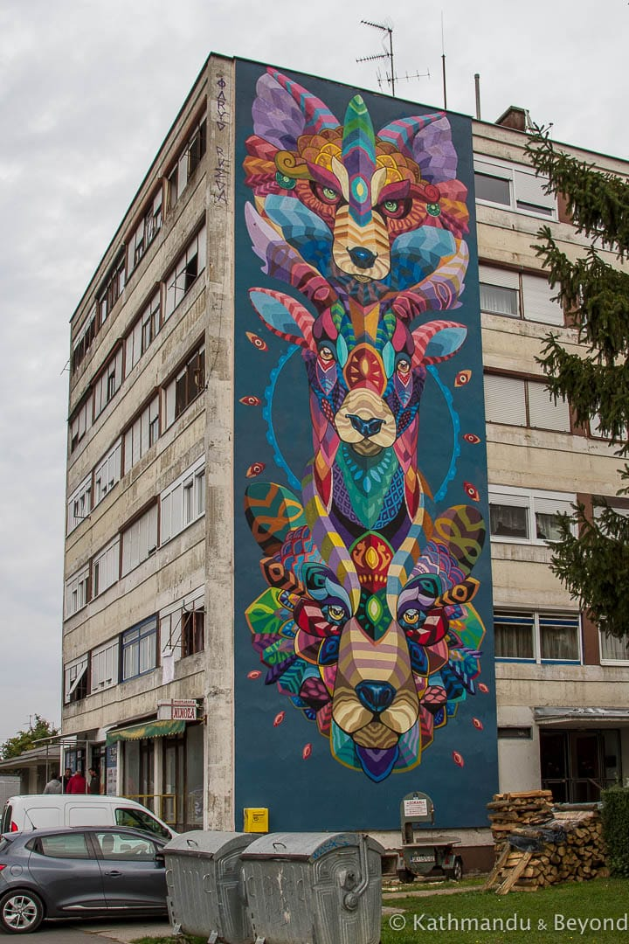
Limerick Street Art
Ruchi Devi
Software Development
K00214120

Slide 2
What is Street ART

Slide 3

What is NOT Street ART
Vandalism
Graffiti

Slide 4
Project Aim
Explore and promote street art through out the city.
Connect and share Street Art with people.
Give recognition to the artist.
Increase Tourisms value of the city.
Notes:
With this application, it is easy to

Slide 5
Technical And Education AIMs
Project Management
Develop a CRUD website
Source Control
Feature Development
Maps and GPS*
Mobile App**
Notes:
Project Management Delegate
Feature Development, take about *branching in git hub*
Switch between working version and work in progress WIP
time constraints never got to mobile app, load GPS from Map not finished
CRUD, Create Read Update Delete

Slide 6
Software development environment
ASP.NET Core, C#
GitHub
Google Maps JavaScript API
MySQL
Visual Studio 2019
Notes:
Mention Alan Ryan’s Java Beer Project

Slide 7
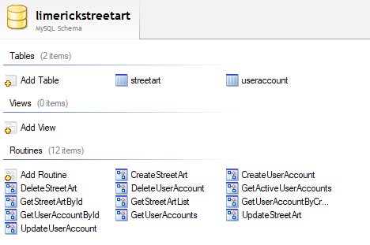
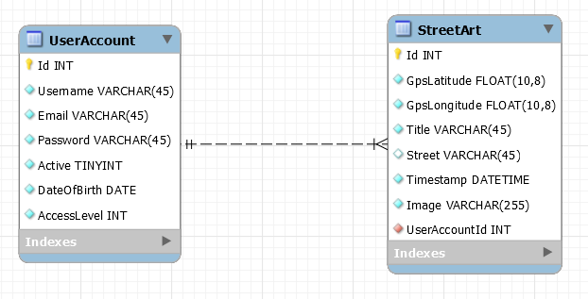
Database

Slide 8
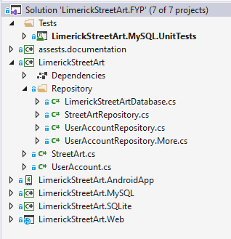
Software Components
Coupling and Cohesion
Interfaces and Repository
DETAILS
IF YOU CANT EXPLAIN THE TERMS REMOVE THE SLIDE OKAY?
Notes:
Database, MySQL or SQLite switch example

Slide 9
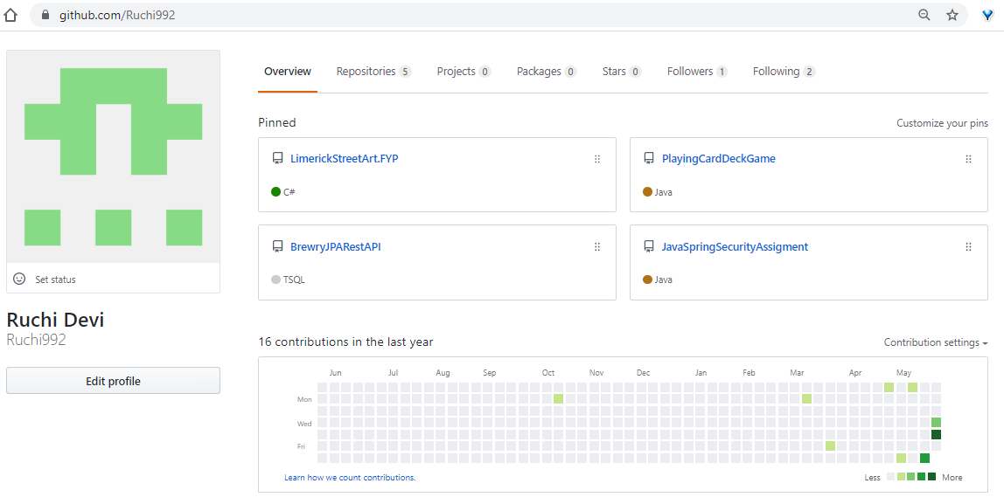
GitHub

Slide 10
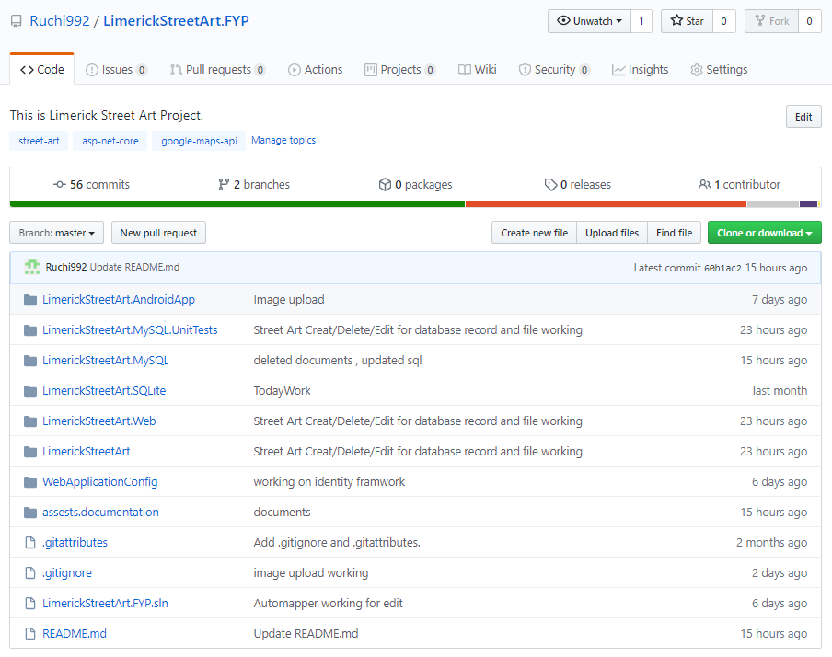
Repository
Notes:
https://github.com/Ruchi992/LimerickStreetArt.FYP

Slide 11
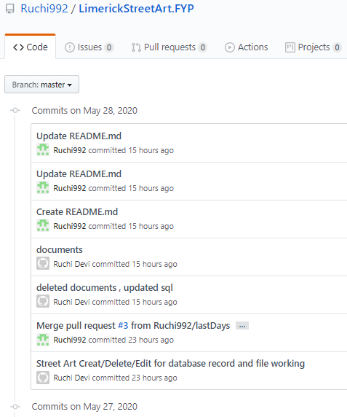
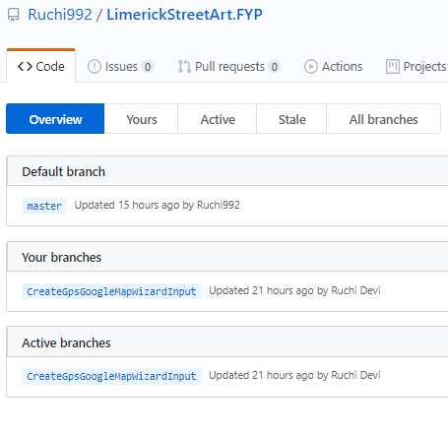
GITHUB Commits/Branching

Slide 12
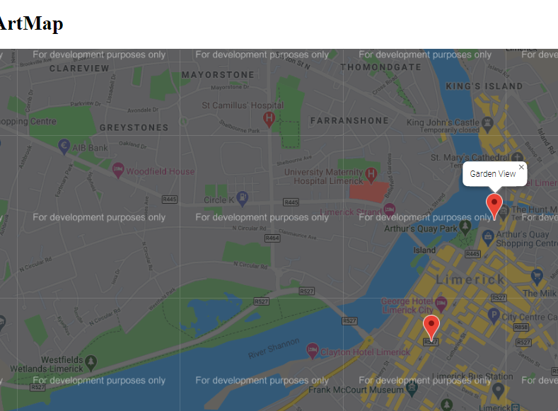
Google Maps
TALK ABOUT GOOGLE MAPS AND the Code

Slide 13
ASP.NET Core Razor Pages
Model
Controller
Views
Validation

Slide 14
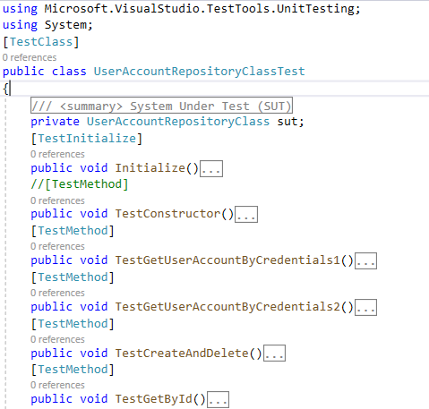
Testing
SUT
Test Methods
Asserts
Notes:
System Under Test SUT

Slide 15
More to Do
Project Management, Tasks and Story boards
Security, Authentication and Authorization
Maps and GPS
Mobile App
Testing

Slide 16
Thank you For Attending
Question and Answers

