Slide 1
Project Title :
Oil Price Prediction
Name of the Team | P_269 -> Group 4
Mentor | Aishwarya Mate
Team Members | RUCHI HARDAHA RISHI KANT GUPTA VIDYA S THILAK RAJU S MINAL DHARAMDIP INGLE AKSHAY SUDHAKAR SASANE

Slide 2

Business Objective:
Develop a forecasting model to accurately predict the future prices of crude oil based on historical data, market trends, and other relevant variables. The model should consider the impact of various factors such as geopolitical events, economic indicators, supply and demand dynamics, and changes in government policies. The goal of this model is to provide reliable and accurate forecasts of crude oil prices, enabling stakeholders in the energy industry to make informed decisions regarding production, investment, trading, and risk management.

Slide 3
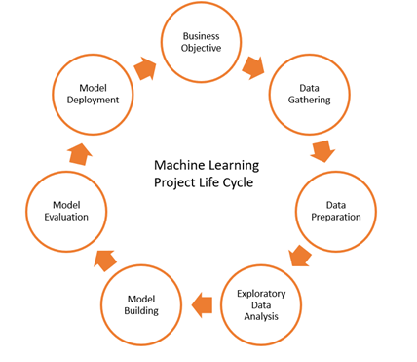
Project Architecture/ Project Flow

Slide 4
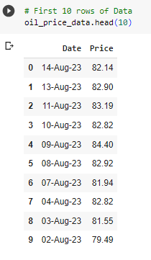

Data Set Details
Data Set has 6054 rows and 2 columns: Date & Price.
Data has daily records except Saturdays and Sundays.

