Slide 1
Recommending Similar Items In Large-scale Online Marketplaces

Slide 2
Agenda
Item similarity recommendation problem
Architecture
Comparison with related Algorithms
Performance monitoring
Shortcomings and Future work

Slide 3
Item Similarity Recommendation Problem

Slide 4
Scale Of Business At eBay
Need a recommendation system that can :
Handle large volumes of dynamic inventories
Scalable
Computationaly effective
Captures relative importance of item features based on aggregate user queries and other user behaviour metrics
Provide right balance in item similarity and other quality factors trade-off depending on the context
Total active buyers : 171million+
U.S. customer statisfaction(ASCI rating) : 81 points
Number of items : 1billion+
Max number of live listing at one time : 1billion
Avg monthly time spend per user on ebay app : 150min
Challenges :
Dymanic inventories
Large scale marketplace
Different recommendation models based on different scenarios
Item similarity is subjective

Slide 5
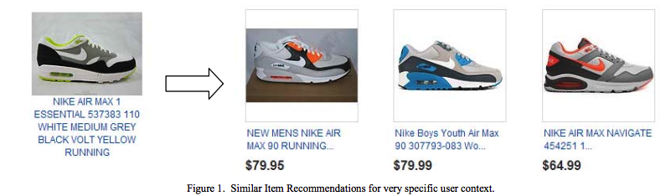
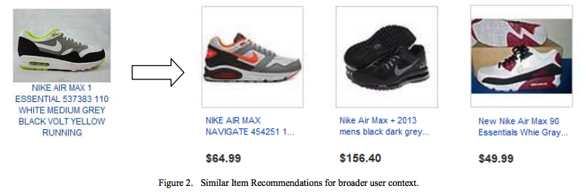
Item Similarity Use Cases
Recommending similar item after user lost a bid. User is more interested in comparable items.
User visits the page of an item by selecting the item on a search page. Similarity can be compromised in some dimensions.

Slide 6
Architecture

Slide 7
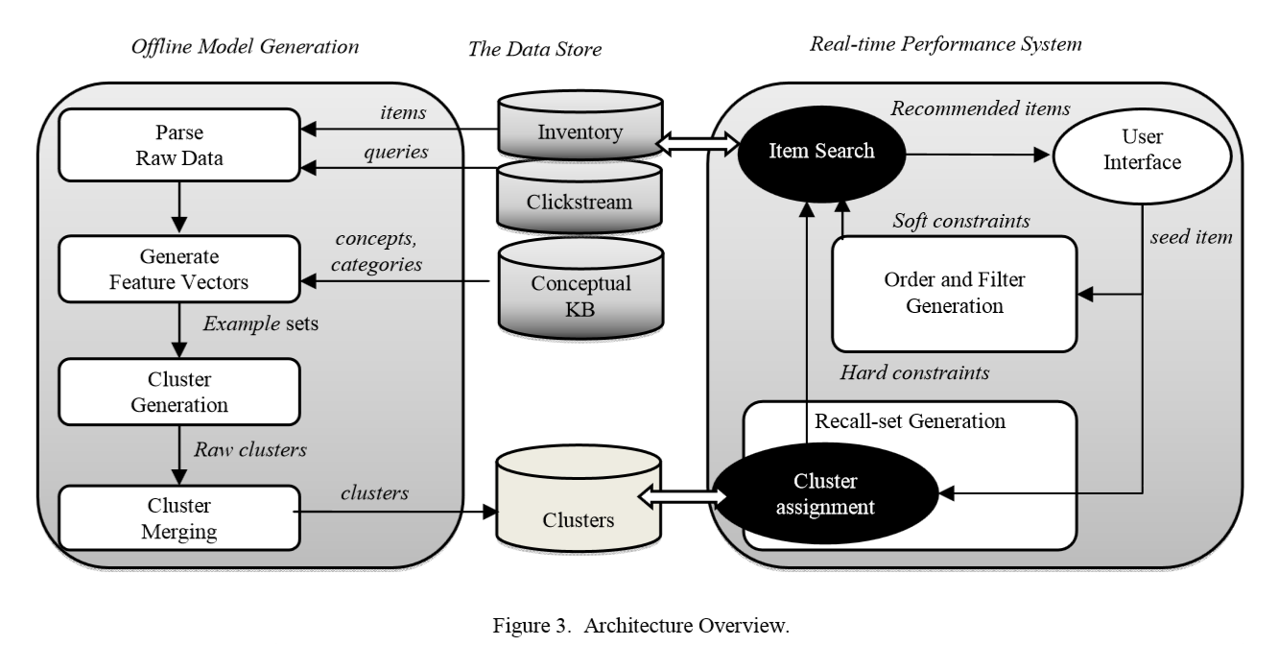
Overview

Slide 8
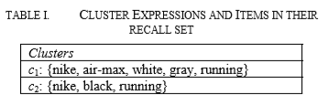
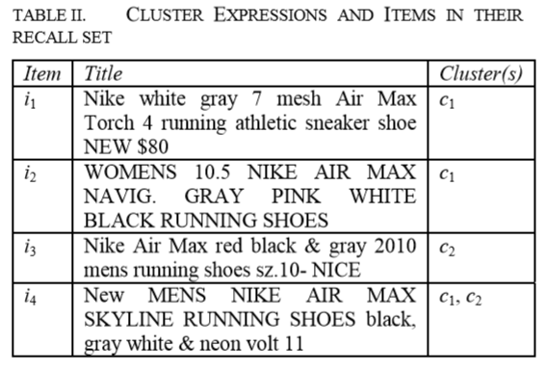
The Data Store
Input Information Sources
Inventory data
Clickstream data
Generalized models like spell correction rules, TF models etc.
Output Generative Cluster Model
Each cluster is represented with explicit definition, like bag of words.
Generative models consists of cluster expressions for grouping set of similar items

Slide 9
Real-time Performance System
Input : seed item, Output : set of items that are similar to the seed item
Motive : Three way trade-off balance between similarity to seed item, quality factors, and response efficiency
Cluster Based Hard Constraints for Recall
Used to retrieve best matching clusters
recall constraint expression : (t₁₁ and t₁₂ and …) or (t₂₁ and t₂₂ and …)
t_{ij} = j^{th} matching token of the i^{th} best matching cluster
Soft Constraints for Ordering
Used to determine the order of retrieved items
Ranking function or Score(seed,reco) = w₁*Sim(seed,reco)+w₂*Quality(reco)
Sim = similarity function considering all tokens in the seed item title as well as the dynamic item features

Slide 10

Clusters Generation
User Query Selection
Selects queries whose frquency and average number of items available for a that query meet a minimum threshold
Item Feature Vector Generation
Create a dictionary of attribute-value pairs that frequently occur in each category using item titles
Uses this dictionary to mark the attributes in the title tokens
Weights are assigned to feature vectors using the Mutual Information shared by the feature and the category in which the item is listed:
F = feature , C = category in the category hierarchy

Slide 11
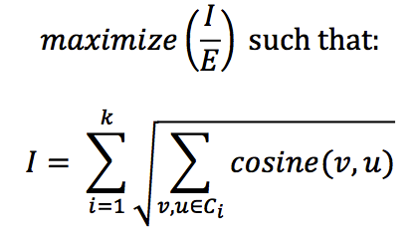
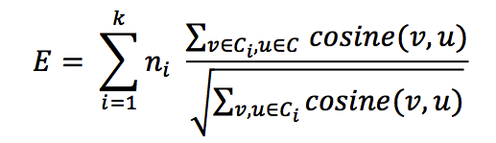
Clusters Generation(cont.)
Parallel Clustering of Queries
A separate clustering process run for each user query using bisecting K-means clustering algorithm.
I = intra-cluster similarity, E = inter-cluster distortion
C_{i} = set of items assigned to the i^{th} cluster, C = set of all items that are to be clustered, n_{i} = number of items in the i^{th} cluster
Merging Clusters
Non-overlapping clusters
Overlapping clusters : Keep both clusters if they capture significant inventory that is not overlapping with any other clusters
Duplicates or near duplicates : Remove the smaller cluster
Parent-child : Keep both clusters and mark the parent-child relationship

Slide 12

Cluster Assignment Service
Assigns one or more clusters to an input item
For an input item i represented as a set of tokens features f, the score for a cluster c is described by:
C(i,c) = rewards matching features by measuring the number of features matching from the input item
idf(f) = captures the importance or rarity of the feature f in the corpus of clusters
B(f) = boosting factor capturing relative importance of the
N(f,c) = index time boosting factor to penalize cluster c for its non-matching features

Slide 13
Comparison With Related Algorithms

Slide 14
Comparison
Algorithmic Feature | Similar Item Recommendation(SIR) | Naïve Information Retrieval (NIR) | Item-Item Collaborative filtering
Use user behavioral data | Yes | No | Yes
Trade-off between quality and similarity | Yes | No | No
Consider all items in inventory as candidates | No | Yes | Yes
Computationally effective for large scale and dynamic system | Yes | Poor processing load optimization | Pre-computing recommendations using traditional item-to-item collaborative filtering is not feasible

Slide 15
Performance Monitoring

Slide 16
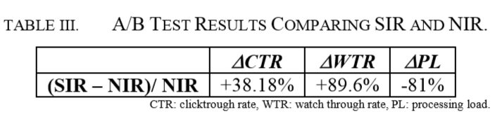
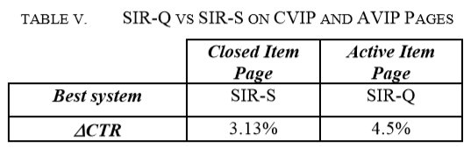
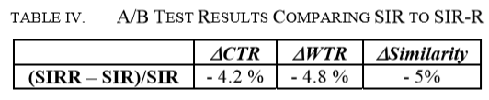
Experimental Results
Comparison with NIR on Closed View Item Page
Contribution of Ranking Function
SIR-Q = quality baised SIR SIR- S = similarity baised SIR
Cluster Contribution
SIR with zero clusters put 57 times more CPU load on the backend system compared to SIR.
SIR-R = SIR with reduced clusters

Slide 17
Shortcomings And Future Work

Slide 18
Shortcomings And Future Work
SIR could fail or perform poorly in the following scenarios:
If clusters are not good in reflecting important similarity factors
Cluster weights do not reflect user preference for important features of items
Use a bad quality measure
If the ranking function does a poor job capturing average user preference for the balance between quality and similarity
Improvements/Future Work:
Using structured representations in clusters in the form of attribute-value pairs to more accurately represent differences
Using natural language parsing to better retrieve important group of words
Personalize recommendations for individual users based on their past activities

