Slide 1


A concise Review of Pothole Detection Techniques Presented by Mitali Javadekar
Ruchi Jha
Vedant Nawange
International Conference on
Emerging Trends in Digital Technologies-2024
(ICETDT-2023)
organized by
SVKM's Usha Pravin Gandhi College of Arts, Science and Commerce
Paper ID: (ICETDT#43)

Slide 2
INTRODUCTION
Our paper offers an overview of techniques used for pothole detection highlighting advancements as well as challenges.
The review encompasses sensing technologies, methods for processing data, and machine learning approaches that have been applied to tackle the issue of pothole detection.
It explores limitations and unresolved questions in this field such as the need for real-time detection reliability in weather conditions and the development of cost-scalable solutions.

Slide 3
PROBLEM STATEMENT
By providing a summary of the state-of-the-art research and identifying areas for further investigation this review aims to be a valuable resource, for both researchers and practitioners working on pothole detection systems.
Using Machine learning and Deep Learning potholes are detected using image dataset

Slide 4
LITERATURE REVIEW
PAPER CITED | METHOD | MERITS | CHALLENGES
1 | YOLOv3,YOLOv4,CNN | Can alert the driver 5 seconds in advance when pothole is about 50 m. | Mapping the potholes and alerting driver about next pothole in advance
2 | InceptionV3 CNN,SGD,ConvNet | High detection rate of 95.2% and F1 score of 0.91 | Dataset should be augmented to enhance accuracy and resilence of CNN
3 | CNN and YOLO v7 | High accuracy and speed due to YOLO v7 | More training dataset needed
4 | YOLO v3, YOLO v2, YOLO v1 | The performance of YOLO v3 is better than the others | Integrating pothole detection system with smart transportation systems to enhance overall road safety.
5 | YOLO v5m, YOLO v5s, YOLO v5n | YOLO v5n performs better than other with 82.5% classification accuracy | Classification accuracy needs to be improved
6 | SimAM-C3 module, YOLO v5s, CARAFE | SimAM-C3 attached YOLO v5s model gives better accuracy than YOLO v5s. | The model doesn't classify different weather and pavement conditions
7 | YOLOv7, YOLOv4, YOLOv5 | YOLOv7 has better accuracy and faster inference process than R-CNN. | Training model for different types of potholes
8 | R-CNN, SSD mobile net algorithm | 93% confidence level | Failed in low quality images/videos
9 | YOLO, Darknet-53 | 68% classification precision | Classification accuracy needs to be improved
10 | ResNet50, ResNet | Accuracy of ResNet 50 is 98.05% and ResNet model is 97.08%. | The severity of the pothole needs to be detected with the region
11 | YOLOv3 and YOLOv5 | YOLOv5 model outperforms the YOLOv3 model with accuracy of 97.22% | the model can be trained by hyper tunning the training parameter like Faster RCN
12 | YOLOv3, Darknet 53, Rasberrypi 4, Tensorflow | Detects boundary boxes and potholes with highscore | Model needs to be trained to detect more objects.
13 | Filtering technique, Edge detection, Morphological imaging | 77% classification accuracy | Model needs to be trained and classification accuracy needs to be improved
14 | YOLO family and SSD Mobilenettv | YOLOv4 with accuracy of 90% and 31.76 FPS | Detect road depressions, classify roads as per quality, and depth estimation of potholes

Slide 5
LITERATURE REVIEW
15 | Using vehicle Accelometer along it's z-axis | 60% classification accuracy | Classification accuracy needs to be improved
16 | YOLOv5 algorithm | Better detection results through YOLOv5 network under different networks | The computational efficiency can be optimized to reduce the processing time.
17 | Machine learning algorithms | RF Tree and KNN showed the accuracy of 89%. Accuracy after hyperparameter tuning is 94% | More samples are required.Further annotation is needed to categorize potholes.
18 | Rasberry Pi 3, Open CV, | 90% classification accuracy | Single axis Gyroscopes needs to be used for increasing accuracy
19 | Laser based methods | 5.2% and 14.4% depth error in static and dynamic conditions respectively | The depth error in dynamic conditions needs to be decreased and classification accuracy needs to be improved
20 | YOLOv5, faster-RCNN, Deep Learning | Better mean precision and shorter inference time. | Developing a sustainable model to address extreme conditions in pothole detection.
21 | YOLO v3, Sparse R-CNN | Sparse R-CNN achieved better results than YOLO v3 | The performance of selected models on different hardware configurations
22 | Machine learning models | SVM, Random Forest Tree, and KNN provides best accuracies of 82%, 80% and 78%. | Additional annotation is required to develop a model that categorize potholes in details
23 | CNN, Mask RCNN, YOLOv3 | YOLO family is faster and consumes less time than CNN or R-CNN | Model needs to be trained with diverse dataset.
24 | vision based, vibration method and 3D construction based methods | Model predicts shape of potholes and measure their volume using sterio vision technology | Improvements in pothole detection accuracy and real-time pothole detection is to be done
25 | R-CNN, DAISS, HMS | Model accurately reflected the level of risk due to road surface damage | Limitations of using data from smartphone. Model doesn't take speed into consideration
26 | Smartphone GPS sensors, K-means | 65% accuracy classification | The positioning accuracy of smartphone GPS sensors was limited
27 | CNN | Optimized pre-pooling CNN achieved recognition precision of 98.95% | Additional comparison with other existing models is missing
28 | CNN | 97.08% accuracy using pre-trained CNN model | Drawback of using thermal imaging as weather condition may change the accuracy and results

Slide 6
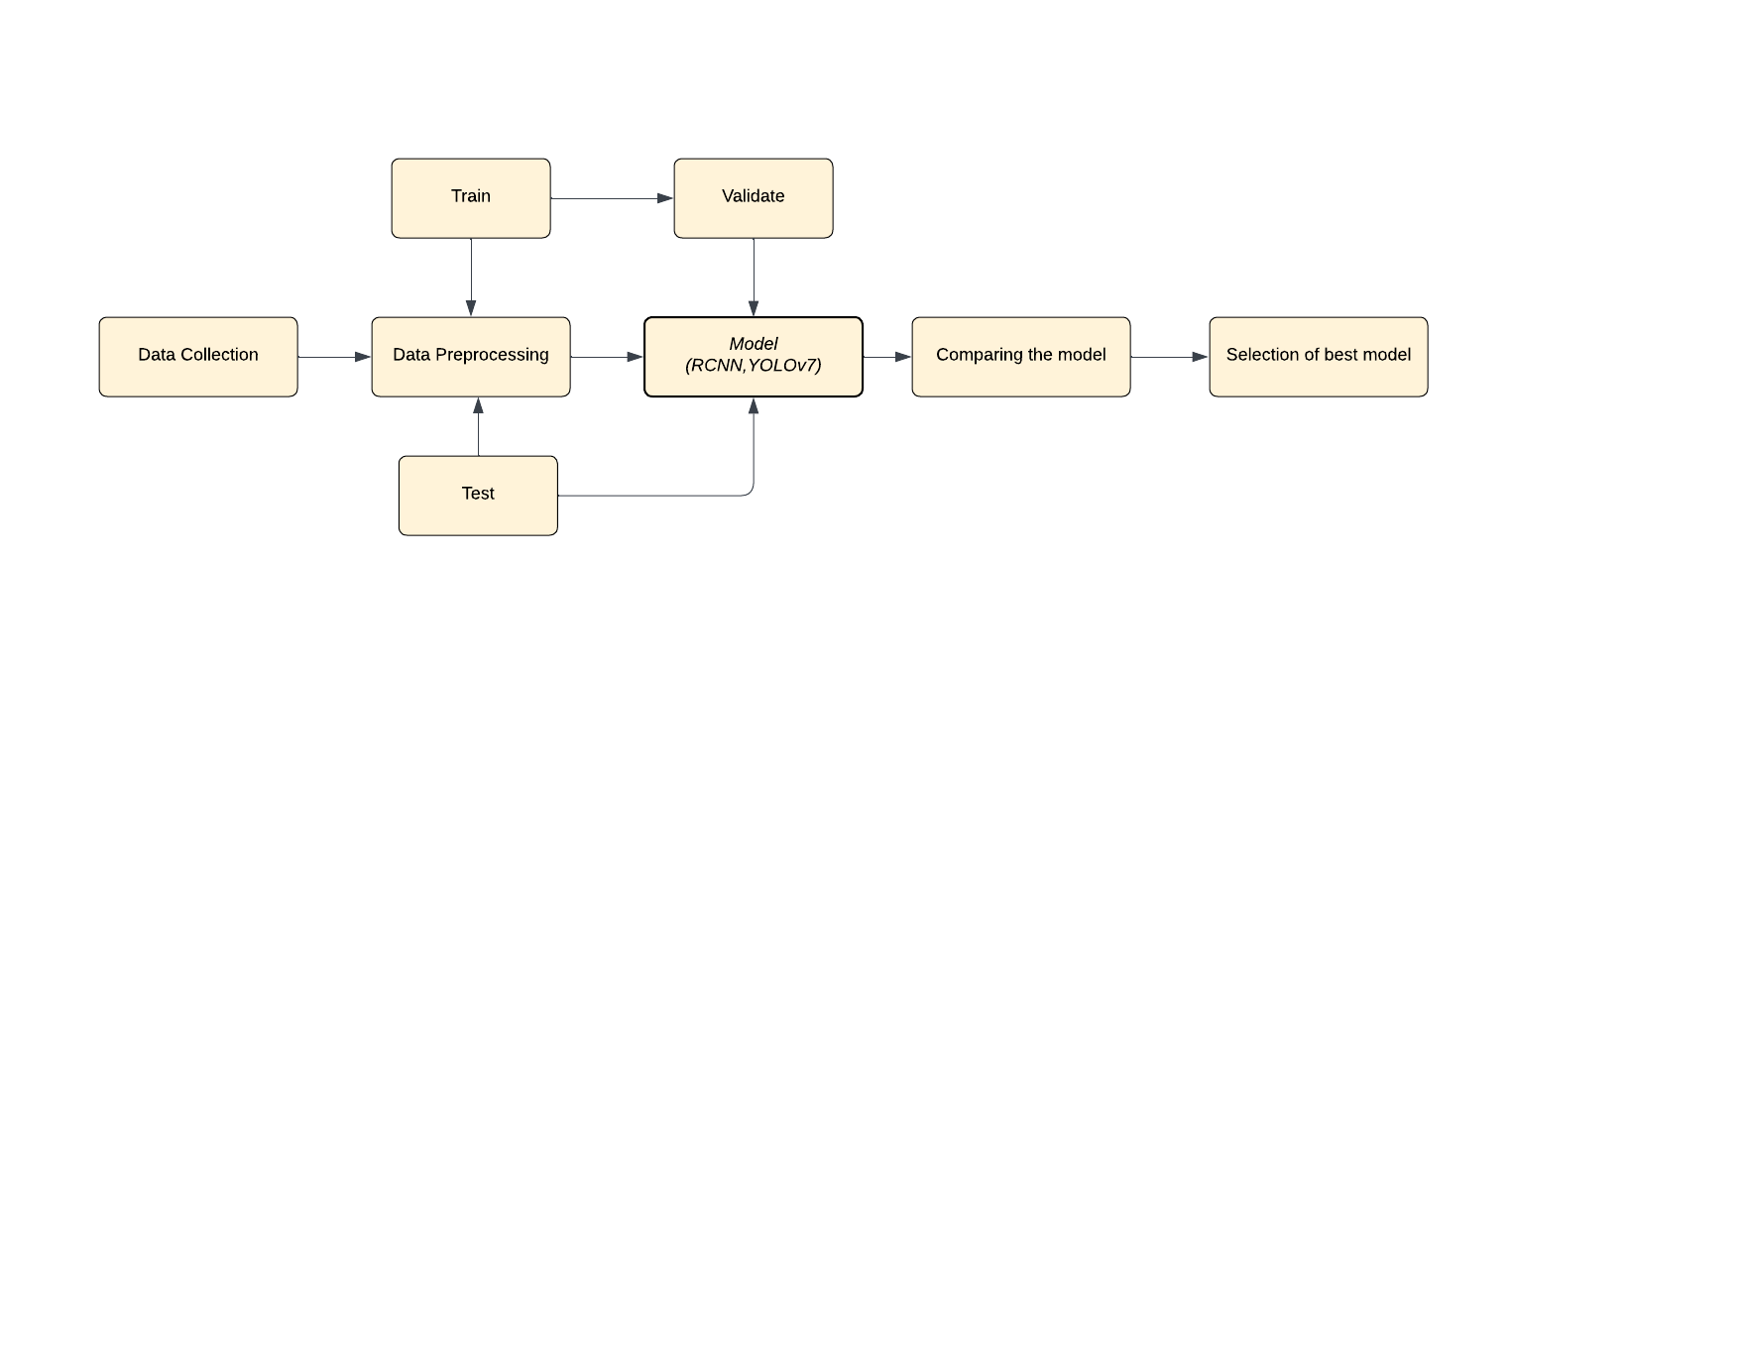
METHODOLOGY/PROCESS-FLOW

Slide 7
METHODOLOGY/PROCESS-FLOW
According to several authors, determining the accurate dimensions of the potholes and assessing their level of severity posed to be a significant challenge which was later overcome using Darknet CNN and Tiny YOLO on a diverse dataset.
Tracking and storing the coordinates of the potholes using a camera feed which can be plotted on a map is a promising advancement in this research field.
The limitations in accuracy can be resolved in the case of YOLOv5 by improving the classification of potholes to detect distant potholes.
Pothole detection using Random forest can be remarkably improved by hyperparameter tuning.
In future, the implementation of detailed datasets of various other conditions of roads other than potholes can help to detect humps and cracks as well.
The lack of a proper dataset proves to reduce the accuracy of the model which can be solved by using data augmentation.
Issues arising due to the usage of datasets with images of potholes under challenging conditions like low-intensity lights and different weather conditions can be conquered using computer-vision techniques.

Slide 8
CONCLUSION
We have studied a wide range of methodologies for object detection and image processing.
The study depicts different models having different accuracies which depend on the parameters used in the training and testing dataset.
The key findings include
real-time detection for timely alert systems
analyzing their depth
increased classification accuracy by using YOLOv5.

Slide 9
REFERENCES
1.Shrinjoy Sen, Deep Chakraborty, Biswanil Ghosh, Bhabnashre Dutta Roy, Krittika Das, Jyoti Anand, Prof. Aniket Maiti, “Pothole Detection System Using Object Detection through Dash Cam Video Feed”, International Conference for Advancement in Technology (ICONAT) Goa, India. Jan 24-26, 2023.
2.Rohan Chorada, Hitesh Kriplani, Biswaranjan Acharya, “CNN-based Real-time Pothole Detection for Avoidance Road Accident”, 7th International Conference on Intelligent Computing and Control Systems, 2023.
3.E Sai Tarun Kumar Reddy, Rajaram V, “Pothole Detection using CNN and YOLO v7 Algorithm”, Proceedings of the Sixth International Conference on Electronics, Communication and Aerospace Technology (ICECA 2022), 2022
4.R.Sathya, B.Saleena, B. Prakash, “Pothole Detection Using YOLOv3 Model”, 2023 IEEE International Students' Conference on Electrical, Electronics and Computer Science, 2023.
5.Au Yang Her, Weng Kean Yew, Pang Jia Yew, Melissa Chong Jia Ying, “Real-time pothole detection system on vehicle using improved YOLOv5 in Malaysia”, IECON 2022 – 48th Annual Conference of the IEEE Industrial Electronics Society, 2022
6.Yang Zou, Jiangcheng Wan, Binjie Wang, “Lightweight pothole detection method based on improved YOLOv5”, 2023 IEEE 3rd International Conference on Information Technology, Big Data and Artificial Intelligence, 2023.
7.Madarapu Sathvik, G.Saranya, S.Karpagaselvi, “An Intelligent Convolutional Neural Network based Potholes Detection using Yolo-V7”, International Conference on Automation, Computing and Renewable Systems, 2022.
8.Aaquib Javed, Md. Sayem Mahmud, Md. Takbir Alam, Md. Foysal Bin Ohab, Khandakar Ratul Ali, Abdullah Al Jobaer, M. Monir Uddin, “Pothole Detection System Using Region-Based Convolutional Neural Network” 2021 IEEE 4th International Conference on Computer and Communication Engineering Technology, 2021
9.M. Vasudev Rao, Satish Kumar Dubey, Abhishek Badholi, “Pothole Identification and Dimension Approximation with YOLO Darknet CNN” Proceedings of the International Conference on Inventive Research in Computing Applications (ICIRCA 2022), 2022
10.Priyanka Gupta, Manish dixit, "Image-based Road Pothole Detection using Deep Learning Model" 14th IEEE International Conference on Computational Intelligence and Communication Networks, 2022
11.Savita Chougule, Alka Barhatte, “Smart Pothole Detection System using Deep Learning Algorithms” International Journal of Intelligent Transportation Systems Research, 2023, https://doi.org/10.1007/s13177-023-00363-3
12.Kavitha R, Nivetha S, “Pothole and Object Detection for an Autonomous Vehicle Using YOLO” 5th International Conference on Intelligent Computing and Control Systems, 2021.
13.Aketi Aajy, S.Revathy, Bheemireddy Naga Vijay Siva Surya Prakash Reddy, Mary Posonia, B. Ankayarkanni, “Application of Image Processing Techniques for Pothole Detection ”Proceedings of the Sixth International Conference on Intelligent Computing and Control Systems (ICICCS 2022),2022
14.Muhammad Haroon Asad, Saran Khaliq, Muhammad Haroon Yousaf , Muhammad Obaid Ullah , Afaq Ahmad, “Pothole Detection Using Deep Learning: A Real-Time and AI-on-the-Edge Perspective ”Advances in Civil Engineering, Volume 2022, Article ID 9221211, 13 pages, 2022

Slide 10
REFERENCES
15.Maheshwari Kotha, Mounika Chadalavada, Sri Harshitha Karuturi, Hrishikesh Venkataraman, “PotSense - Pothole Detection on Indian Roads using Smartphone Sensors” In Proceedings of the 1st ACM Workshop on Autonomous and Intelligent mobile systems (AIMS’20), January 11, 2020. https://doi.org/10.1145/3377283.3377286
16.Yongjin Zeng, Jie Chen, and Jian Mao, “Deep Learning-based Road Crack Detection Technology”, 6th International Conference on Electronic Information Technology and Computer Engineering (EITCE), 2022 https://doi.org/10.1145/3573428.3573530
17.Oche Alexander Egaji, Gareth Evans, Mark Graham Griffiths, Gregory Islas, “Real-time machine learning-based approach for pothole detection”, Expert Systems With Applications 184 (2021) 115562, 2021.
18.Tejas B S, V Pavan, Rohith H, Pranam J, “Realtime Detection of Humps and Potholes”, 2023 International Conference on Smart Systems for applications in Electrical Sciences(ICSSES), 2023
19.Adeel Ahmed, Moeez Ashfaque , Muhammad Uzair Ulhaq , Senthan Mathavan, Khurram Kamal, and Mujib Rahman, “Pothole 3D Reconstruction With a Novel Imaging System and Structure From Motion Techniques”, IEEE TRANSACTIONS ON INTELLIGENT TRANSPORTATION SYSTEMS, VOL. 23, NO. 5, 2022.
20.Khaled R. Ahmed, “Smart Pothole Detection Using Deep Learning Based on Dilated Convolution”, MDPI Open Journal,2021, DOI: https://doi.org/10.3390/s21248406
21.Boris Bucko, Eva Lieskovska, Katarina Zabovska, Michal Zabovsky, “Computer Vision Based Pothole Detection under Challenging Conditions”, Sensors, EISSN 1424-8220, Published by MDPI, 2022
22.Oche Alexander Egaji, Gareth Evans, Mark Graham Griffiths, Gregory Islas, “Real-time machine learning-based approach for pothole detection”, Expert Systems With Applications 184, 2021.
23.Rohitaa R, Sangoju Shreya, Amutha R, “Intelligent Deep Learning based Pothole Detection and Reporting System”, 2021 Fourth International Conference on Electrical, Computer and Communication Technologies (ICECCT), 2021
24.Young-Mok Kim, Young-Gil Kim, Seung-Yong Son, Soo-Yeon Lim, Bong-Yeol Choi, Doo-Hyun Choi, “Review of Recent Automated Pothole-Detection Methods”, MDPI Open Journal, 2022
25.Choong Heon Yang, Jin Guk Kim, Sung Pil Shin, “Road Hazard Assessment Using Pothole and Traffic Data in South Korea”, Journal of Advanced Transportation, vol. 2021, Article ID 5901203, 10 pages, 2021.
26.Shahram Sattar, Songnian Li, Michael Chapman, “Developing a near real-time road surface anomaly detection approach for road surface monitoring”, Measurement Volume 185, 2021.
27.Wanli Ye, Wei Jiang, Zheng Tong, Dongdong Yuan & Jingjing Xiao (2021) Convolutional neural network for pothole detection in asphalt pavement, Road Materials and Pavement Design, 22:1, 42-58, DOI: 10.1080/14680629.2019.1615533
28.Aparna a, Yukti Bhatia a, Rachna Rai a, Varun Gupta a, Naveen Aggarwal b, Aparna Akula, “Convolutional neural networks based potholes detection using thermal imaging”, Journal of King Saud University - Computer and Information Sciences.

Slide 11
QUESTIONS AND ANSWERS (font size: 36)

