Slide 1
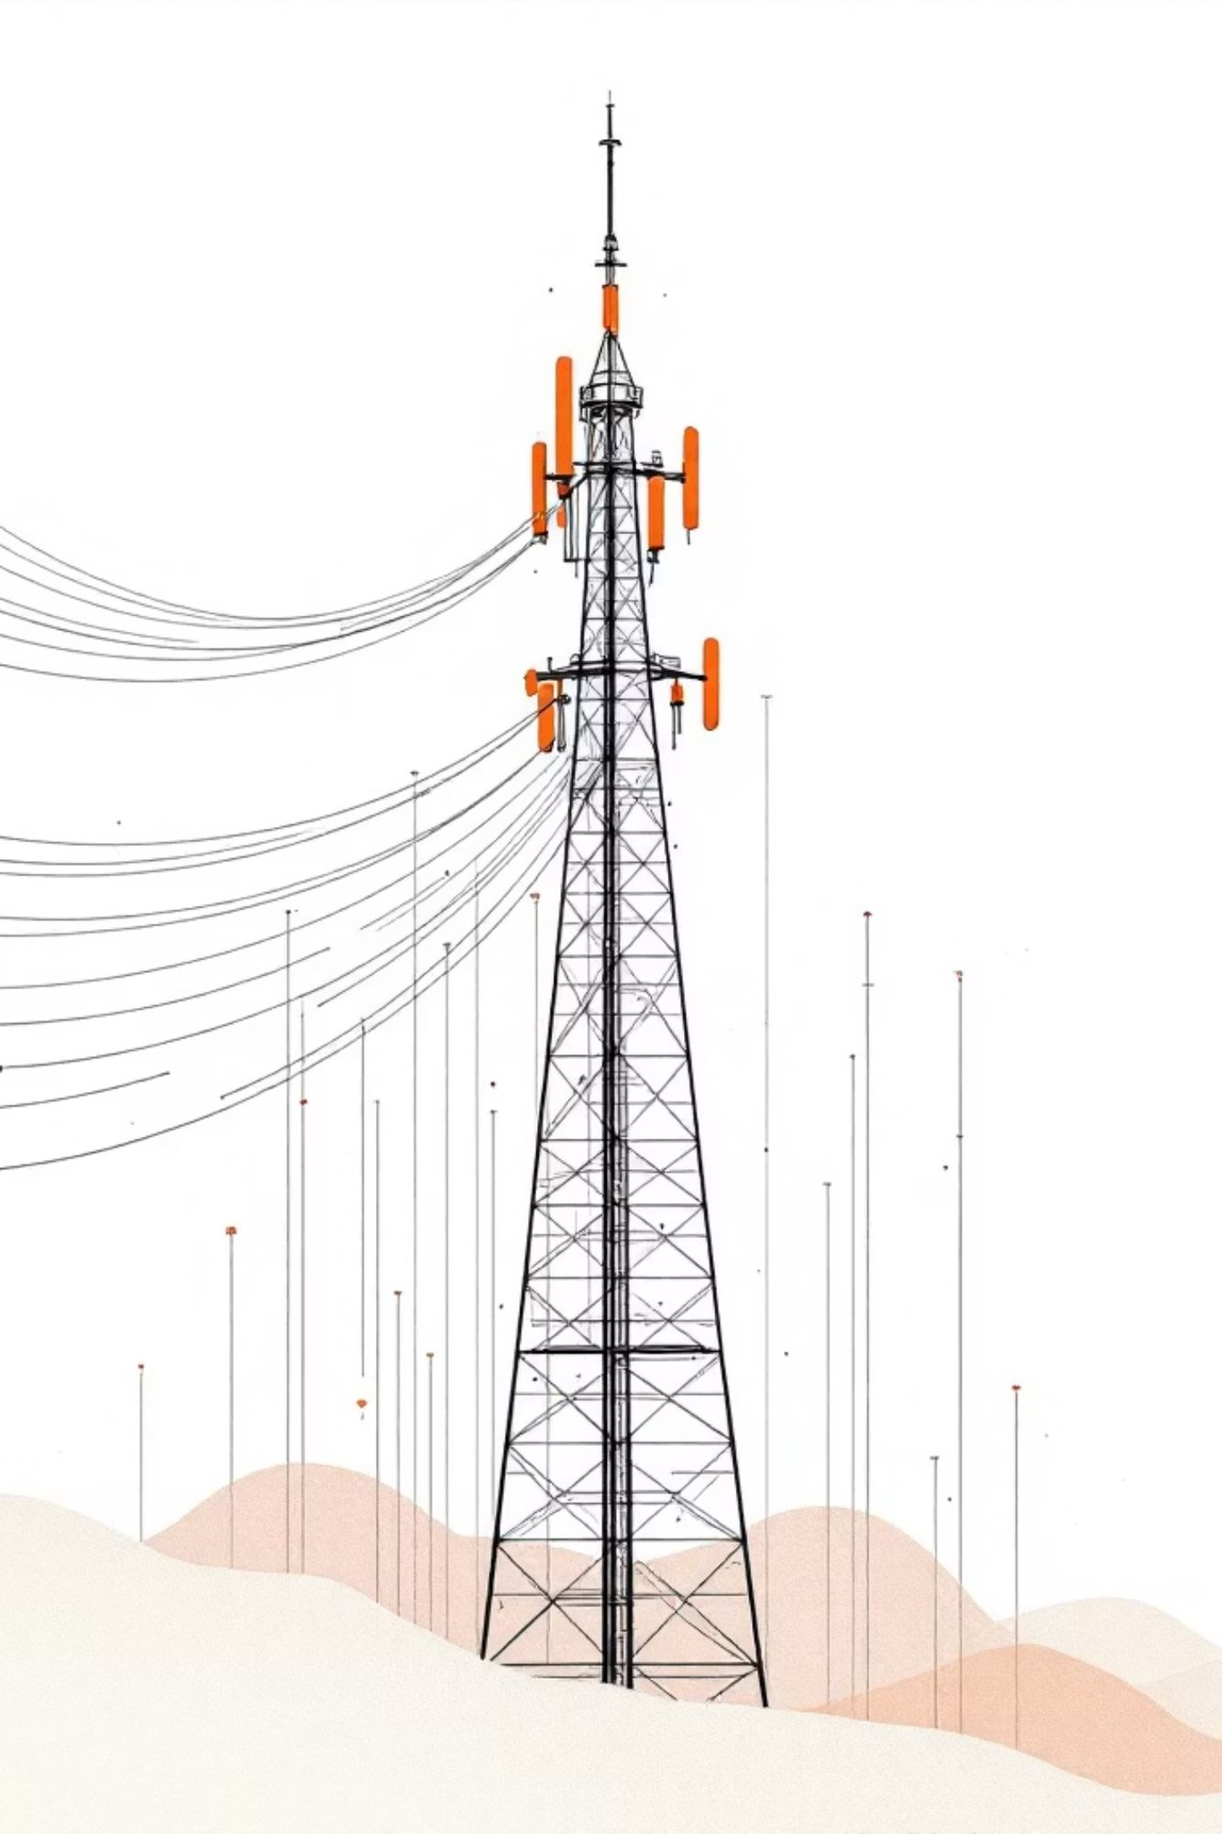
Telecom Customer Churn Prediction
Building machine learning models to identify at-risk customers and reduce revenue loss in the telecommunications industry.

Slide 2
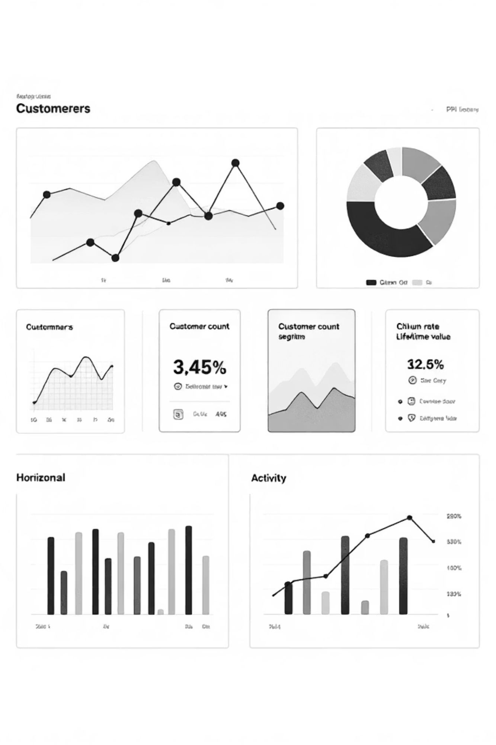

Dataset Overview
33 Features
Geospatial Data
Demographics, subscription plans, payment behavior, and churn data
Latitude, longitude, city, state, and zip code for regional analysis
Rich Churn Insights
Churn reasons, CLTV, and likelihood scores included

Slide 3
Problem Statement
Binary Classification Challenge
Modeling Objective
Predict whether a telecom customer will churn (Yes/No) based on demographic details, subscription information, and payment behavior.
Build a predictive model that flags at-risk customers early, allowing proactive intervention to reduce churn rates.
Business Impact
Telecom companies lose significant revenue when customers churn. Identifying high-risk customers enables targeted retention strategies and improved Customer Lifetime Value (CLTV).

Slide 4

Exploratory Data Analysis
25%
40%
0.839
Churn Rate
Month-to-Month Churn
ROC-AUC Score
Imbalanced dataset with 25% churn vs 75% non-churn customers
Good discrimination power across both models
Customers on month-to-month contracts show highest churn risk

Slide 5

Churn by Contract Type
Key Finding
Month-to-month customers have 40% churn rate — significantly higher than one-year or two-year contracts.
Strategic Insight
Encouraging customers to commit to longer contracts could dramatically reduce churn. Month-to-month customers represent the highest-risk segment requiring immediate retention efforts.

Slide 6
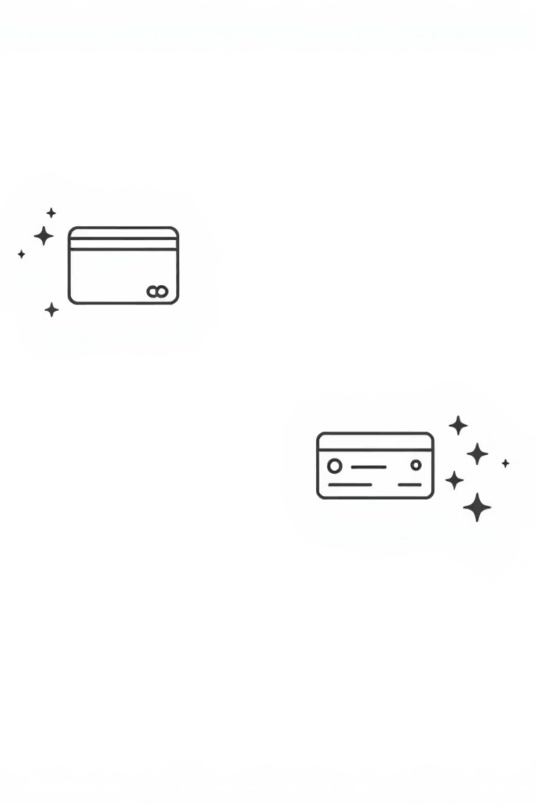
Churn by Payment Method
Electronic Check Users
Show higher churn rates compared to other payment methods. May indicate less engaged customers or payment friction.
Bank Transfer & Credit Card
Lower churn rates suggest more stable, committed customers with automated payment preferences.

Slide 7

Top Churn Reasons
1
Competitors Offering Better Deals
Price competitiveness remains the primary driver of customer attrition
2
Service Dissatisfaction
Quality issues and poor customer experience leading to churn
3
Moving to New Location
Geographic changes forcing service discontinuation

Slide 8




Key Numeric Variable Insights
Monthly Charges
Customers with higher monthly charges show increased churn probability
Tenure
Low tenure customers are at highest risk — early intervention critical
Total Charges
Cumulative billing amount shows correlation with churn likelihood

Slide 9
Model Performance Comparison
Metric
Logistic Regression
Random Forest
Accuracy
80%
80%
ROC-AUC
0.839
0.840
Churn Recall
54%
50%
Churn Precision
63%
68%
Both models perform nearly identically. Logistic regression catches slightly more churn customers (higher recall), while Random Forest is more precise. ROC-AUC scores show excellent discrimination power.

Slide 10

Strategic Recommendations
Target Month-to-Month Customers
Address Price Concerns
Competitive pricing analysis and personalized offers to prevent deal-seeking churn
Focus retention efforts on 40% high-risk segment with contract conversion offers
Improve Early Experience
Low tenure customers need proactive engagement to prevent early attrition

