Slide 1

Monitoring Electrolyte State of Health in Lithium-ion Batteries Using Quartz Crystal Microbalance (QCM)
Ruchika Verma
Master’s Programme in Embedded System
Uppsala University
Supervisor: Erik J. Berg
Co-supervisor: Lukas Lindén Thöming
Notes:
Hello Everyone,
My name is Ruchika and today I will present my Master’s Thesis tiltled – monitoring Electrolyte the SOH in Lithium-Ion Batteries Using Quartz Crytsal MicroBalance.
This work was carried out at Uppsala University under the supervision of Professor Erik Berg , with co-supervisoion of Lukas Thöming

Slide 2
Motivation
Commercial QCM systems are –
  Expensive
  Complex
Experiments are time consuming
Difficult to integrate into compact systems
Need for:
  Low-cost solution
  Fast systems.
Notes:
Al though QCM-D systems are accurate , they are expensive and require controlled lab environments.
They are not easily scalable or integrated into compact sytems.
This creates the need for simpler and more flexible approach.
In this work, we explore whether an FPGA-based platform can be used for QCM acquisition and analysis.

Slide 3
Objective
Develop FPGA-based QCM system
Implement signal-processing pipelines:
  Multi-level Analysis (MLA)
  Ring-down Method
Analyze resonance and signal quality.
Compare the feasibility with commercial QCM system.
Notes:
The main objective of this thesis is to investigates whether QCM signals can be acquired and analysed using a low-cost FPGA-based platform.
Two analysis methods were implemented : MLA and ring-down method.
The goal is not to replace commercial systems, but to evalute whether such a system can detect and analyse key QCM signal characteristics.

Slide 4
OUTLINE
Background
QCM Principle
System Overview
MLA and Ring Down Method
Experimental Results
Discussion
Conclusion & Future Work
Notes:
I will start with the background and motivation for this work.
Then I will briefly explain the working principle of QCM.
After that, I will present the system and the two signal processing approaches used in this thesis, which are MLA and ring-down.
I will then show the experimental results, followed by a discussion of the system performance.
Finally, I will conclude the work and present future directions.

Slide 5
Background- QCM
QCM measures surface interactions
Based on piezoelectric quartz crystal oscillation.
Resonance frequency changes with mas loading
Dissipation indicates energy loss (viscoelastic effect)
Used in electrochemical studies
Notes:
QCM is a measurement technique where a quartz crystal oscillates when an electrical signal is applied.
When mass or interactions occur at the surface , the resonance frequency changes,
In addition, dissipation provides information about energy loss and viscoelastic behavior
Because of this, QCM is widely used to study surface processes, including in battery systems.

Slide 6
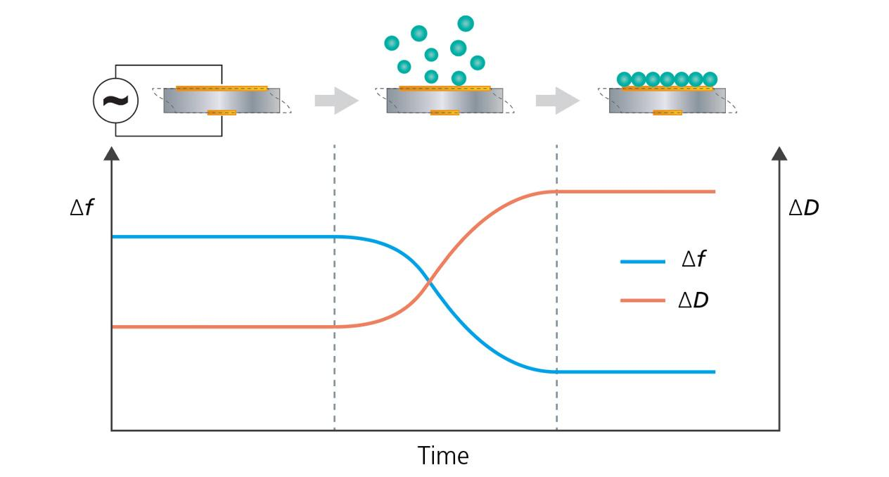
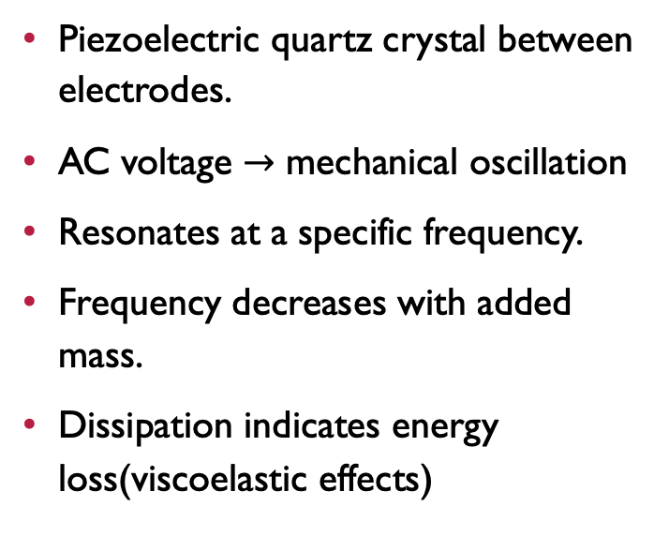
QCM working Principle
Piezoelectric quartz crystal between electrodes.
AC voltage $→$ mechanical oscillation
Resonates at a specific frequency.
Frequency decreases with added mass.
Dissipation indicates energy loss(viscoelastic effects)
Notes:
The QCM works based on the piezoelectric effect.
When an alternating voltage is applied, the QCM oscillates at its resonance frequecny
If a mass is added to the surface, the oscillation slow down, which causes a decrease in frequency.
In addition, dissipation represents energy loss and gives information about how soft the layer is , especially in liquid environment.

Slide 7
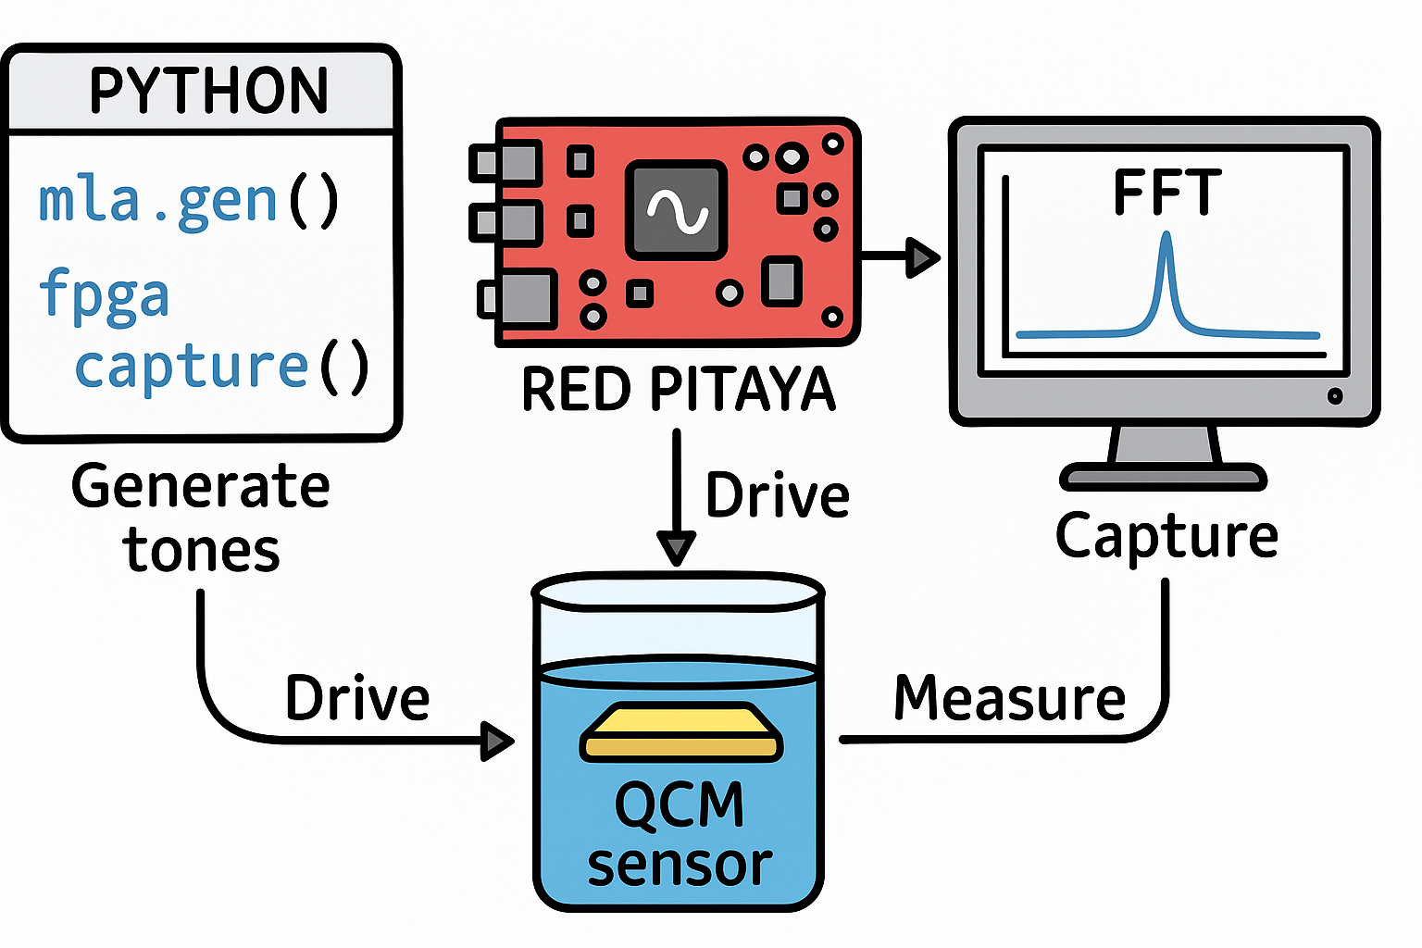
System Overview
Digital signal generated in FPGA
Converted to analog using DAC
Excites QCM Sensor
Response signal captured via ADC.
Processed using MLA / Ring-down pipelines.
FPGA → DAC → QCM → ADC → FPGA → Processing
Notes:
The system consists of a QCM sensor connected to an FPGA-based platform.
A digital signal is generated in the FPGA and converted into an analog signal using the DAC. This signal excites the QCM sensor.
The sensor responds with an oscillation signal, which is captured and converted back into digital form using the ADC.
This signal is then processed using the MLA or ring-down pipelines to analyze the resonance behaviour.

Slide 8
Multi - tone Lock-in Amplifier Method
Continuous excitation near resonance frequency.
Frequency-domain analysis of response.
Detect resonance peak.
Robust in noisy condition.
Notes:
The MLA method uses continuous excitation of the QCM near its resonance frequency.
The response is analyzed in the frequency domain using FFT to identify the dominant resonance peak.
Because the signal is continuously driven, MLA is more robust in noisy environments and allows reliable detection of resonance behaviour.

Slide 9
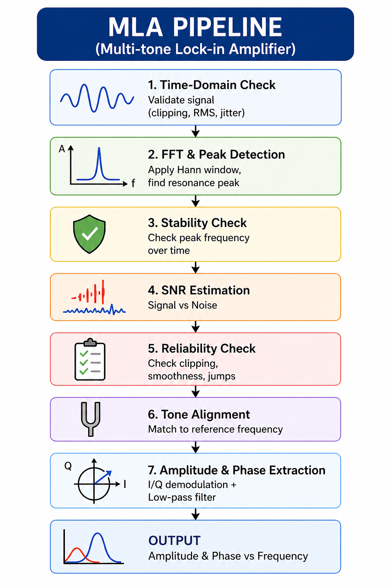
MLA Processing Pipeline
Time-Domain signal validation.
FFT → resonance Peak Detection
Frequency Tracking (stability check)
SNR estimation
Signal reliability Check
Amplitude and Phase extraction (I/Q)
Notes:
The MLA pipeline processes the signal step-by-step.
First, the signal is validated in the time domain to ensure it is usable.
Then FFT is applied to detect the resonance peak.
The system checks stability over time and evaluates the signal-to-noise ratio.
Additional checks like clipping and smoothness ensure signal reliability.
Finally, I/Q demodulation is used to extract amplitude and phase.

Slide 10
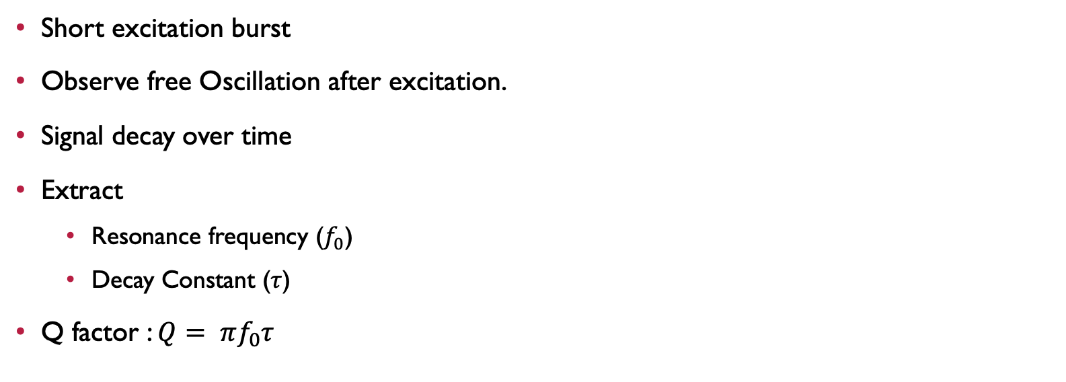
Ring-Down method
Short excitation burst
Observe free Oscillation after excitation.
Signal decay over time
Extract
  Resonance frequency ($f_{0}$)
  Decay Constant ($τ$)
Q factor : $Q= πf_{0}τ$
Notes:
In the ring-down method, the QCM is excited with a short signal and then allowed to oscillate freely.
The signal gradually decays over time due to energy loss.
This decay follows an exponential behaviour, from which parameters like resonance frequency, decay constant, and quality factor can be extracted.
However, because the signal becomes weaker over time, this method is highly sensitive to noise.

Slide 11
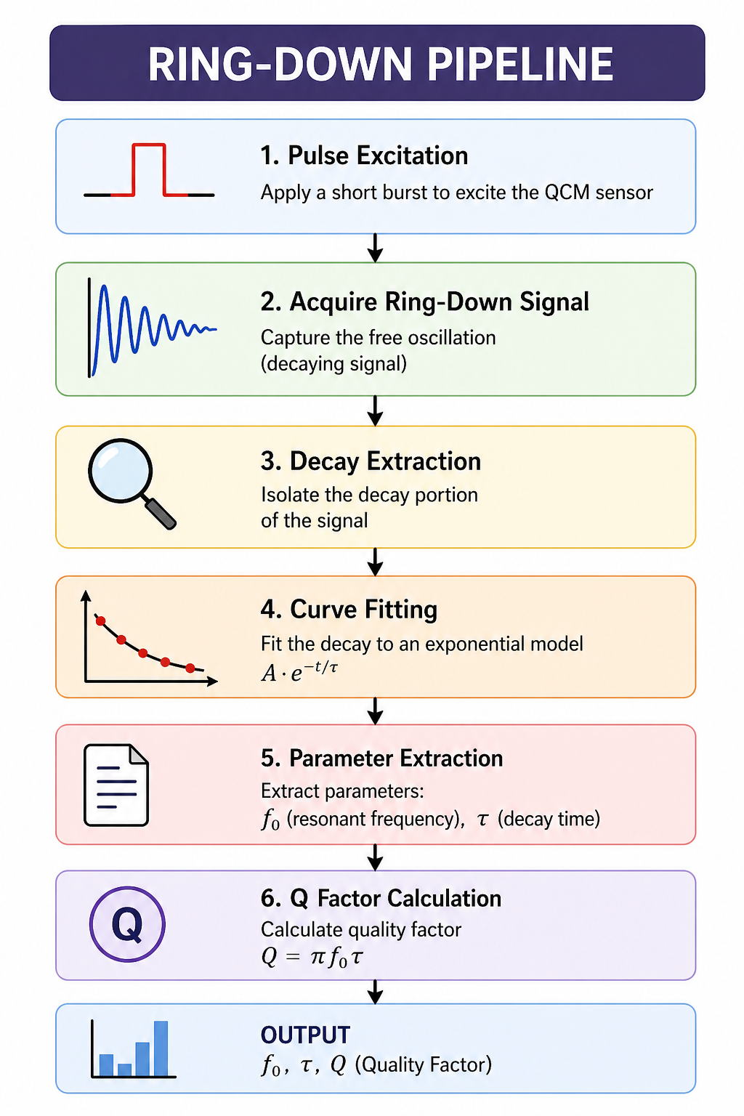
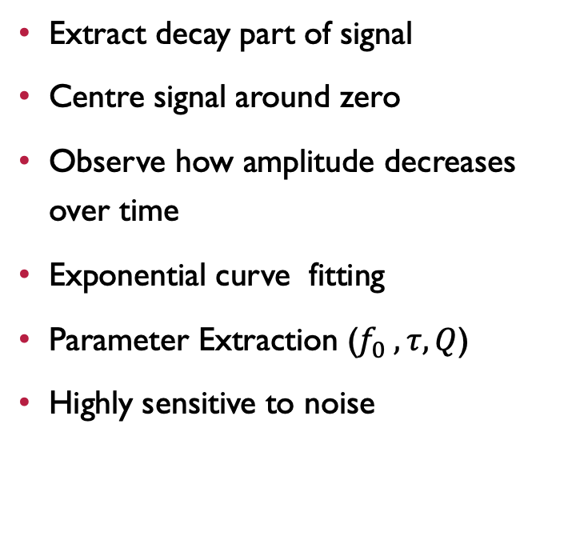
Ring-down Pipeline
Extract decay part of signal
Centre signal around zero
Observe how amplitude decreases over time
Exponential curve fitting
Parameter Extraction ($f_{0} ,τ,Q$)
Highly sensitive to noise
Notes:
First, we take the part of the signal where the oscillation is decaying.
Then we center the signal around zero so that it is properly aligned.
Since the signal is oscillating up and down, we extract a smooth curve that shows how the amplitude decreases over time.
This curve is then fitted to an exponential function to calculate the decay constant.
From this, we can estimate parameters like frequency and quality factor.
However, this method is very sensitive to noise because the signal becomes weak over time.

Slide 12
MLA RESULTS
Resonance peak detected near expected frequency.
Amplitude and phase successfully extracted
Signal affected by noise → irregular and less smooth
Notes:
In the MLA results, a clear resonance peak was detected near the expected frequency, which shows that the system is able to capture the QCM response.
I was also able to extract amplitude and phase using I/Q demodulation.
However, the signal quality was affected by noise and hardware limitations, resulting in an irregular and less smooth response.

Slide 13
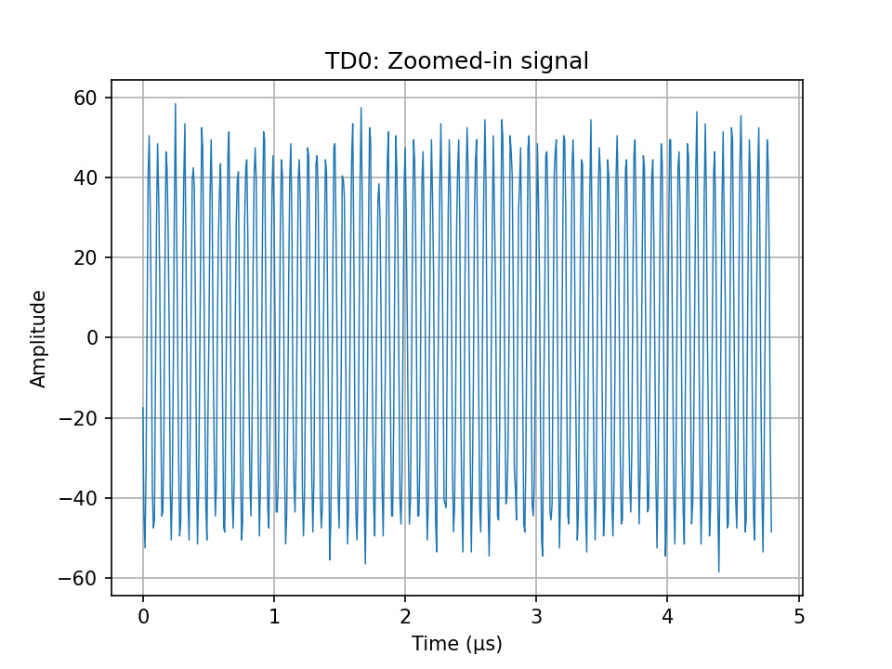
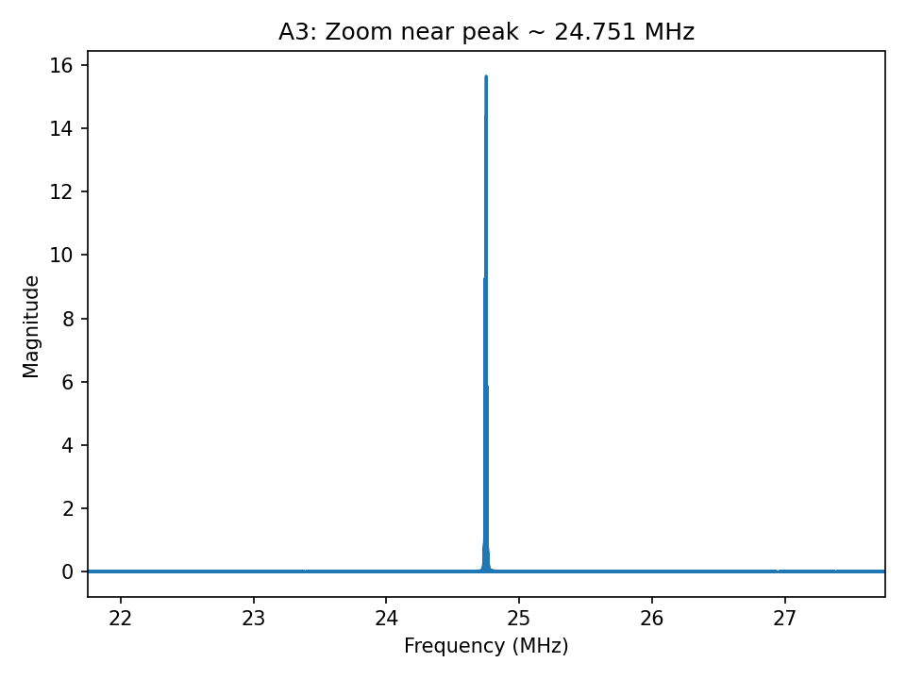
MLA RESULTS

Slide 14
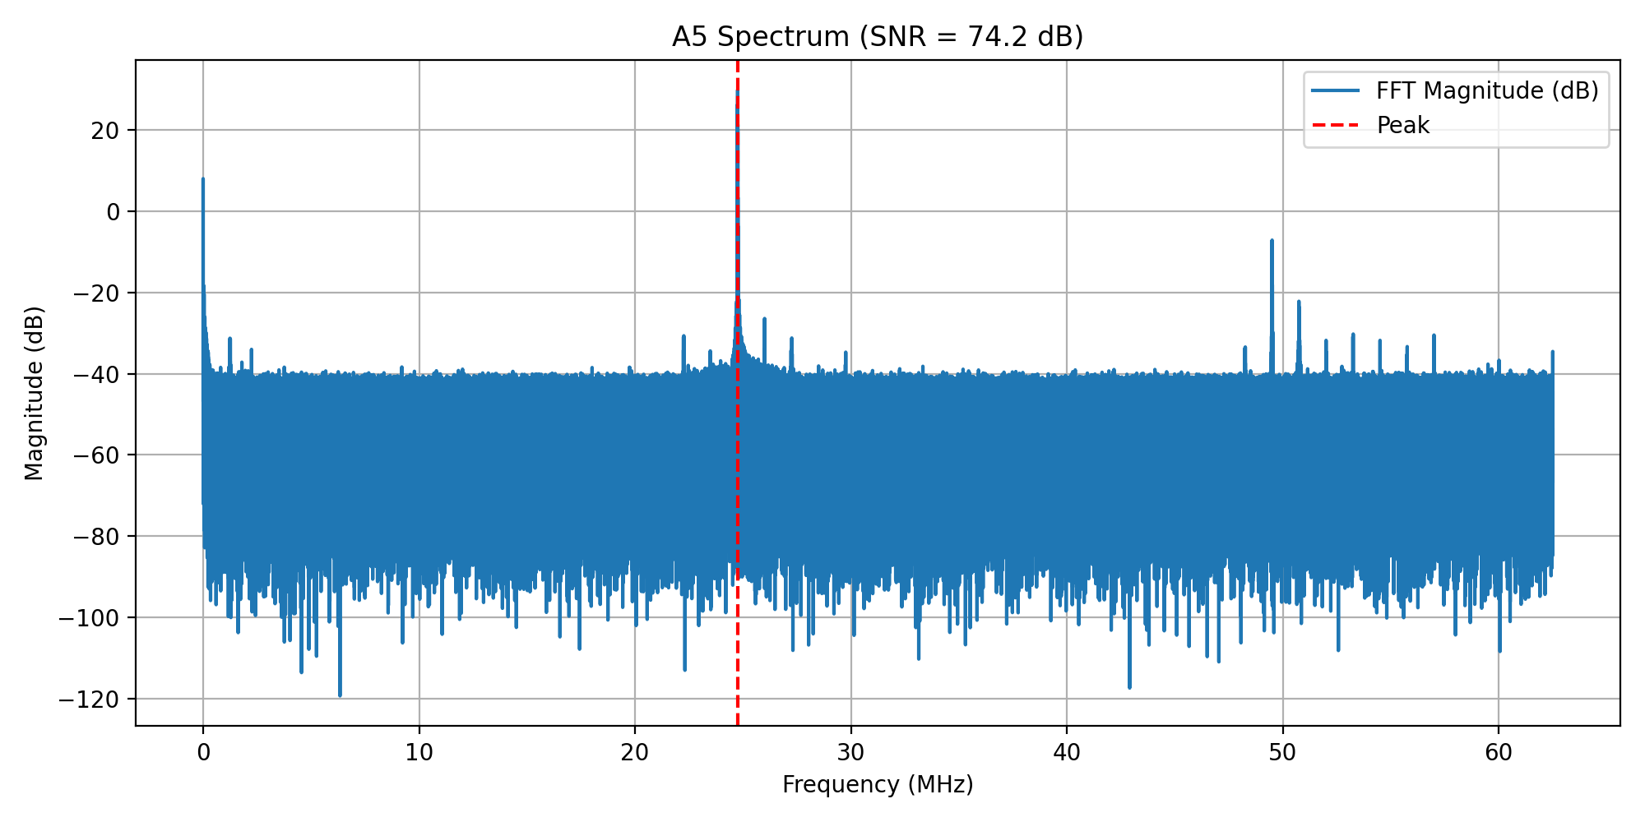
MLA-Results

Slide 15
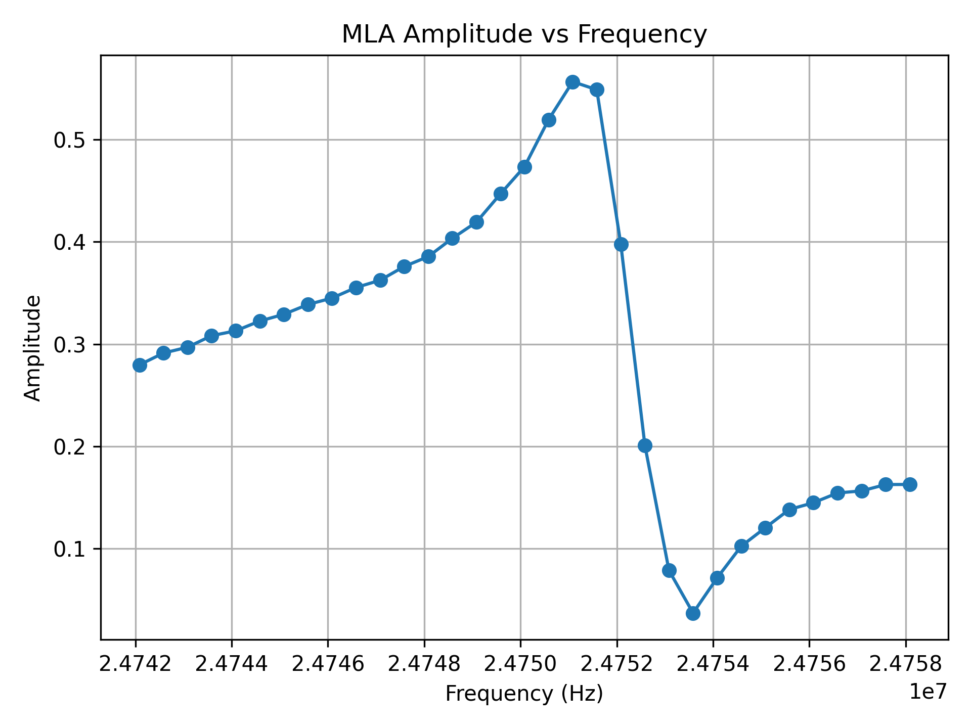
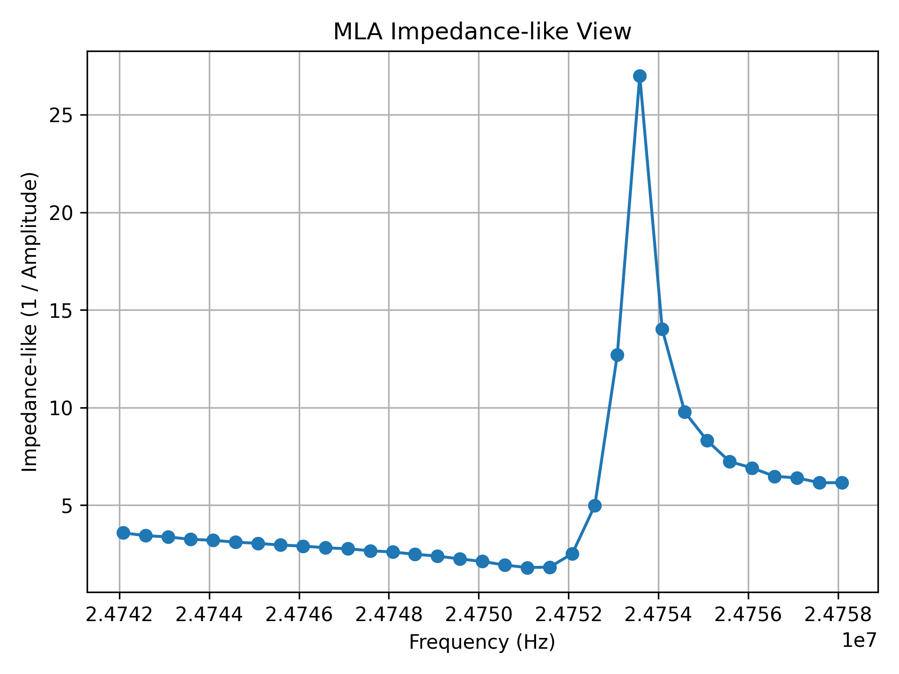
MLA REsULTS

Slide 16
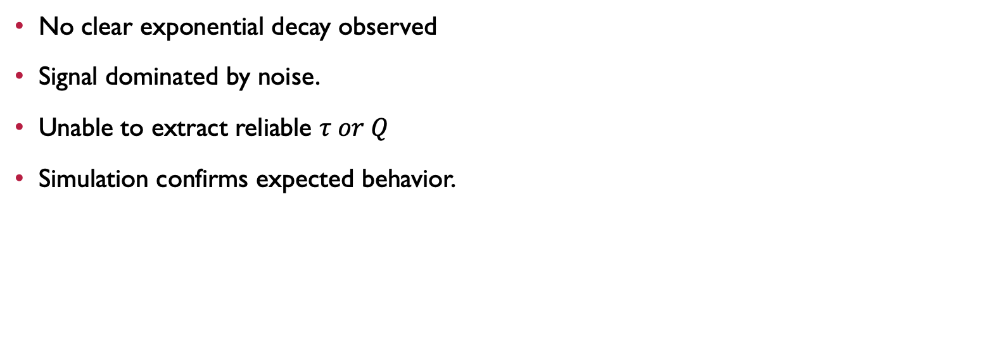
Ring-down results
No clear exponential decay observed
Signal dominated by noise.
Unable to extract reliable $τ or Q$
Simulation confirms expected behavior.
Notes:
In the ring-down results, a clear exponential decay was not observed in the measured signal.
The signal was dominated by noise, which made it difficult to extract meaningful information.
As a result, parameters like decay constant and quality factor could not be reliably calculated.
However, when tested in simulation, the expected decay behaviour was clearly observed, confirming that the method itself is valid.

Slide 17
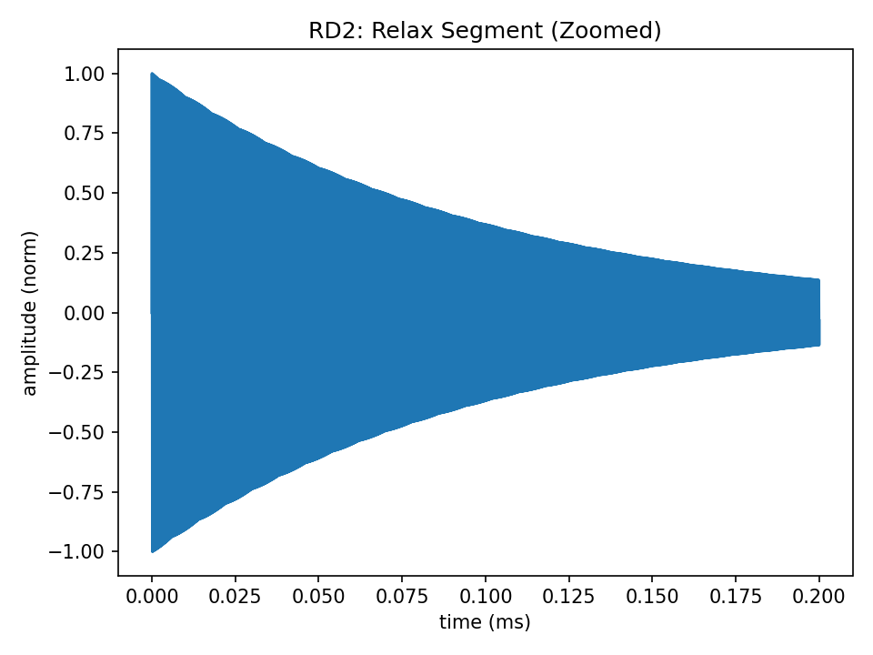
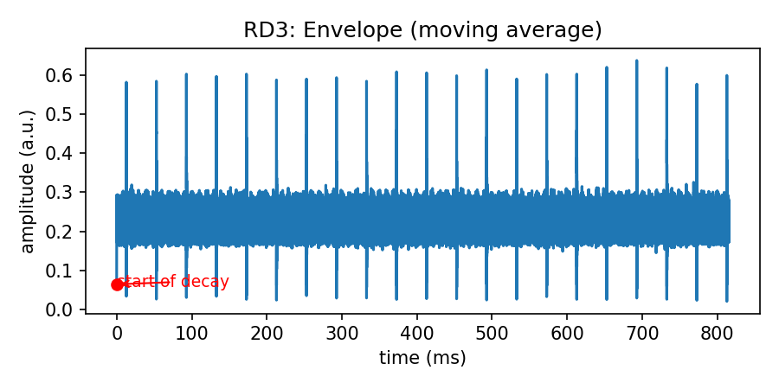
Ring-down results

Slide 18
Commercial qcm results
Frequency decreases over time → indicates mass deposition
Dissipation changes → indicates viscoelastic (soft) layer.
Consistent behaviour across multiple overtones.
Correlates with electrochemical activity (current changes)
Notes:
In the commercial QCM measurements, a decrease in resonance frequency is observed over time, which indicates mass deposition on the sensor surface.
At the same time, dissipation changes, showing increased energy loss, which suggests that the deposited layer is more viscoelastic or soft.
This behaviour is consistent across multiple overtones, confirming that the observations are reliable.
Additionally, the changes in frequency and dissipation correlate with the electrochemical activity, indicating that the QCM is capturing real surface interactions.

Slide 19
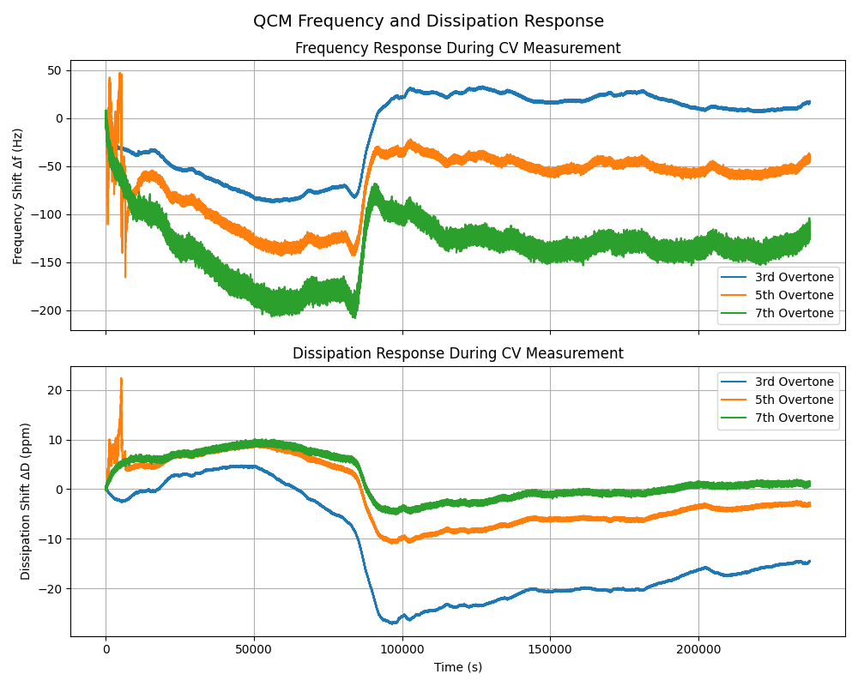

Slide 20
comparison
Commercial QCM | FPGA-Based System
Hight accurate & Stable | Noisy, less stable
Expensive | Low-Cost
Long measurements time (hours-days) | Faster signal analysis
Fixed system | Flexible & customizable
Laboratory dependent | Portable potential
Notes:
The commercial QCM system provides highly accurate and stable measurements, but it is expensive and requires long experimental times, often ranging from several hours to days.
In contrast, the FPGA-based system is low-cost and allows faster signal acquisition and analysis. It also offers flexibility, as the signal-processing pipeline can be modified easily.
However, the current implementation has limitations in terms of signal quality and stability compared to the commercial system.

Slide 21
Limitation
Signal affected by noise → reduced accuracy
Limited signal stability and quality
Ring-down method unsuccessful under current conditions.
Hardware setup needs improvement.
Notes:
The main limitation is that the signal is noisy, which affects the quality of the results.
Because of this, the results are not very stable or smooth.
The ring-down method did not work properly because the signal was too weak.
Also, the hardware setup, such as impedance matching and signal acquisition, needs improvement.

Slide 22
Future work
Improve Signal quality and reduce noise.
Optimize hardware (eg. Impedance matching suing LC circuit )
Develop dedicated FPGA design for ring-down
Test system in real electrochemical environment
Notes:
In future work, the main focus would be to improve signal quality by reducing noise and improving the measurement setup.
Hardware optimization, such as better impedance matching using LC networks, can help improve signal strength.
A dedicated FPGA design for the ring-down method can improve accuracy.
Finally, the system can be tested in real electrochemical conditions for validation.

Slide 23
Conclusion
MLA captured resonance behaviour, but with noisy and unstable signals
Ring-down method was unsuccessful due to weak signal and hardware limitations
FPGA-based system demonstrates feasibility of a low-cost QCM measurement approach.
Notes:
In conclusion, the MLA method was able to capture resonance behaviour, although the signal was affected by noise and lacked stability.
The ring-down method was not successful, mainly due to weak signals and hardware limitations.
Overall, this work demonstrates that an FPGA-based system can capture QCM signal behaviour and shows the feasibility of a low-cost alternative, although further improvements are required.

Slide 24
Thank You !

