Slide 1

CAPSTONE PROJECT Telecom Churn Analysis
Ruchika Nayak

Slide 2
Key Points
Introduction
Data Summary
Feature Description
Project Objectives
Univariate Analysis
Influence of Numerical Features on Churn
Influence of Categorical Features on Churn
Correlation matrix & Outlier detection
Findings and Suggestions
How to reduce customer churn
Conclusion

Slide 3

Introduction
A churn is defined as the percentage of subscribers moving from a specific service in a given period of time.
Churn is a problem for telecom companies because it is more expensive to acquire a new customer than to keep existing one from leaving.
Telecom companies apply machine learning models to predict churn on an individual customer basis and take counter measures such as discounts, special offers or other gratifications to keep their customers.

Slide 4
Data Summary
Source dataset is in csv format.
Dataset contains total 3333 rows and 20 columns.
The dataset compose of categorical and numerical features.
Each row indicates the data of a single customer whereas columns indicates different features of customers.
Churn is the variable which shows whether a customer is churned or not.
There are no missing values and duplicate values in the dataset.

Slide 5
Feature description
Columns | Data Types
State | Object
Account length | Int64
Area code | Int64
International plan | Object
Voice mail plan | Object
Number vmail messages | Int64
Total day minutes | Float64
Total day calls | Int64
Total day charge | Float64
Total eve minutes | Float64
Total eve calls | Int64
Total eve charge | Float64
Total night minutes | Float64
Total night calls | Int64
Total night charge | Float64
Total intl minutes | Float64
Total intl calls | Int64
Total intl charge | Float64
Customer service calls | Int64
Churn | Bool
State: Indicates the state where the customer resides.
Account length: Indicates duration of account (in days).
International plan/Voice mail plan: Indicates whether a customer opted for these plans or not.
Total minutes: There are total 4 columns which indicates time spent on calls during day, evening, night and on international calls.
Total calls: There are total 4 columns which indicates number of calls during day, evening, night and international calls.
Total charges: There are total 4 columns which indicate charges on calls during day, evening, night and on international calls.
Customer service calls: Indicates how many times a customer contacted customer service.
Churn: Indicates whether a customer churned or not.

Slide 6
Project objectives
To visualize and manipulate the data without any assumptions in order to help assessing the quality of the data.
To find the hidden insights of the data by different visualization tools.
To highlight the main variables/factors influencing customer churn.
To come up with ways/recommendations to ensure customer retention.

Slide 7
Univariate analysis

Slide 8
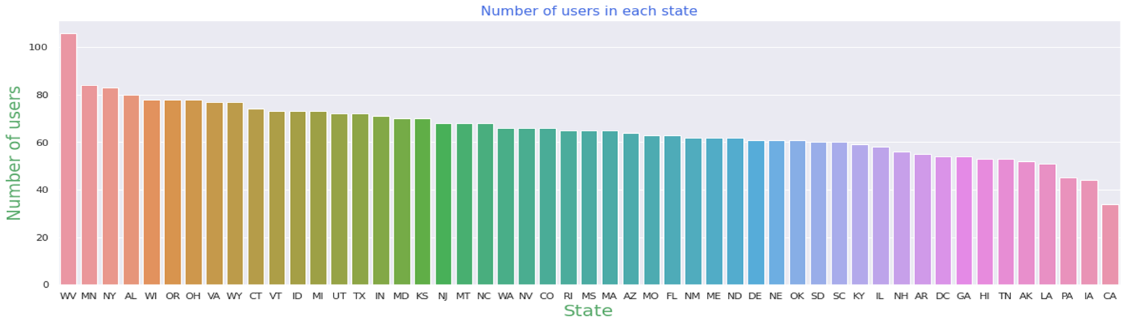
Analysis of state column
Bar plot
This plot shows number of users in each state.
There are more customers in WV, MN and NY states and less customers in CA, LA and PA states.

Slide 9
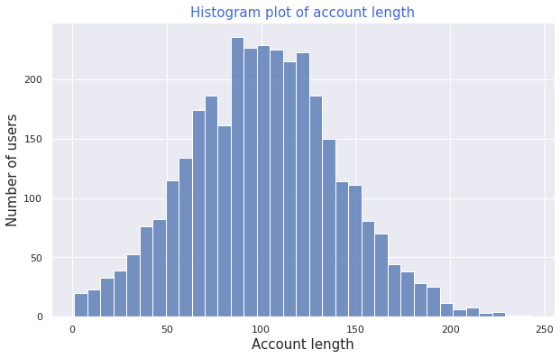
Analysis of Account length
Histogram
This plot shows the account length of each customers.
Most of the customers have account for a duration of 100 to 150 days.

Slide 10
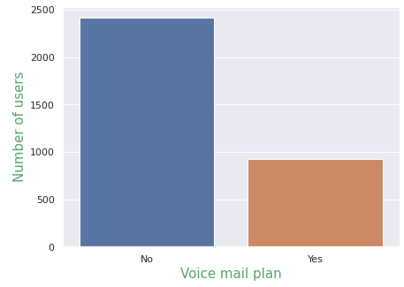
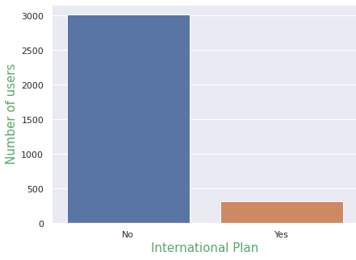
Analysis of Voice mail plan and International plan columns
Bar plot
This plot shows number of customers opted for Voice mail plan and International plan.
There are very few customers who have opted for international plan. And also there are not many customers who have opted for voice mail plan.

Slide 11
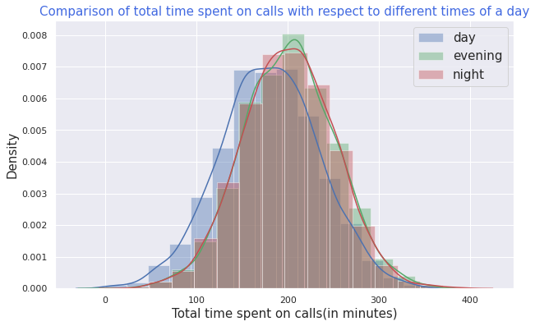
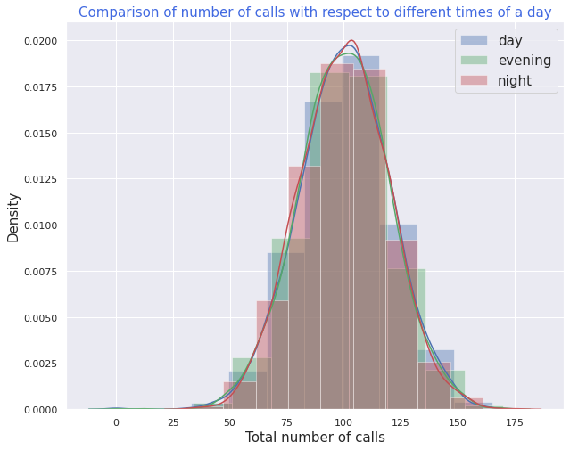
Analysis of Total time spent and total number of calls column
Distribution plot
These plots show the distributions of total time spent on calls and total number of calls.
Total time spent on calls in evening and night are a bit higher and Total number of calls are nearly same for all 3 times of a day.

Slide 12
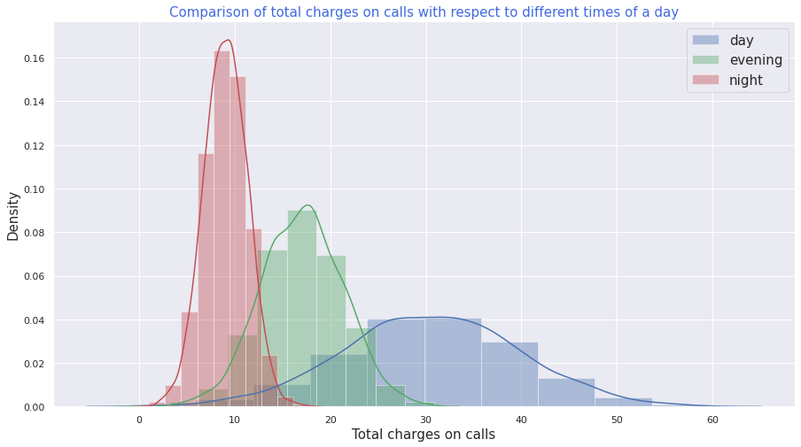
Analysis of total charges on calls column
Distribution plot
This plot shows the distributions of total charges on calls.
The charges in night are less as compared to other times of the day.

Slide 13
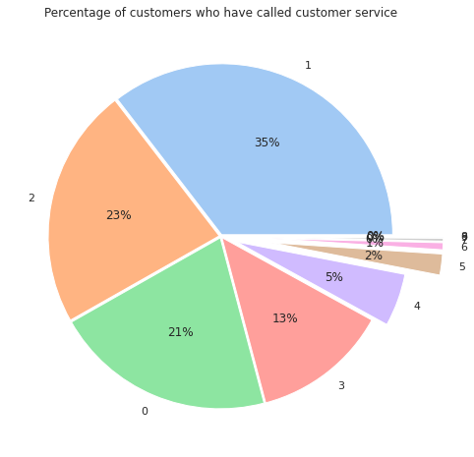
Analysis of customer service calls column
pie plot
This plot shows the percentage of customers who have called customer service.
There are very few customers(around 8%) who have called customer service more than 3 times.

Slide 14
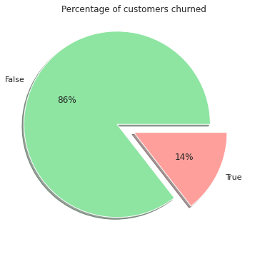
Analysis of churn column
pie plot
This plot shows percentage of customers who have churned.
There are 14% customers who have churned and 86% have not churned from this telecom company.

Slide 15
Influence of numerical features with customer churn

Slide 16
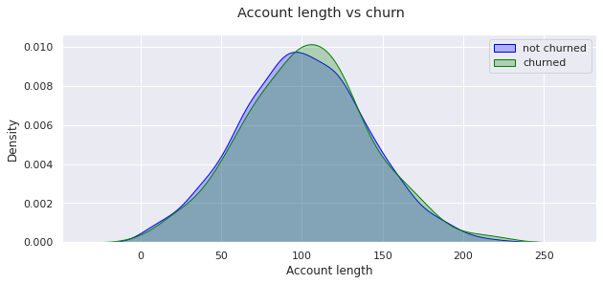
Account length vs. Churn
kernel density estimate (KDE) plot
This plot shows the density plot of account length vs. churn.
Clearly there is no effect of account length on customer churn.

Slide 17
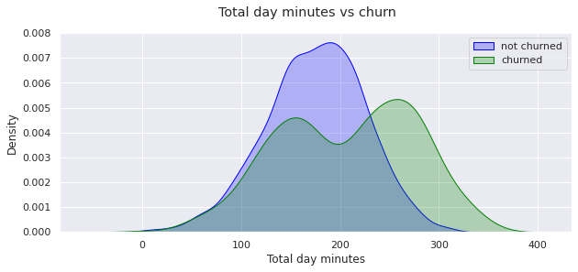
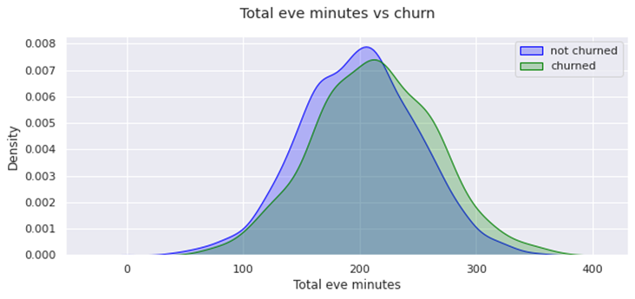
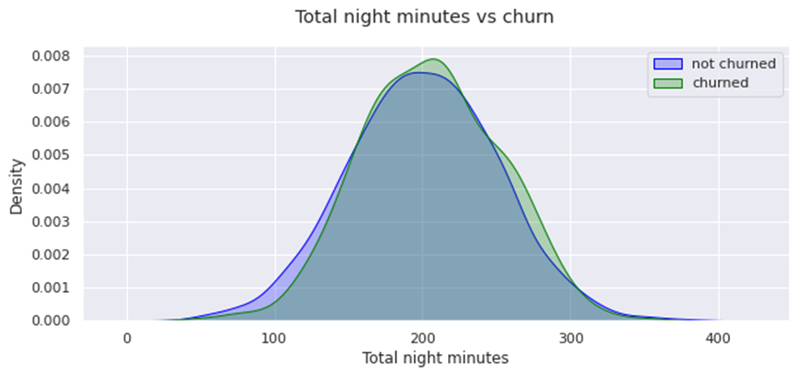
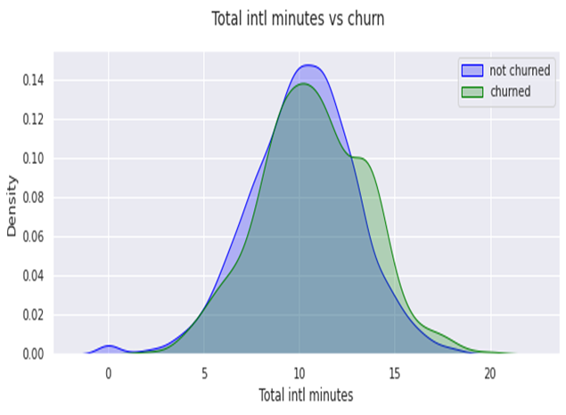
Total minutes vs. Churn
kernel density estimate (KDE) plot
Churn is high when total day minute is high.
Whereas there is no significant effect of total evening minutes, total night minutes and total international minutes on churn.

Slide 18

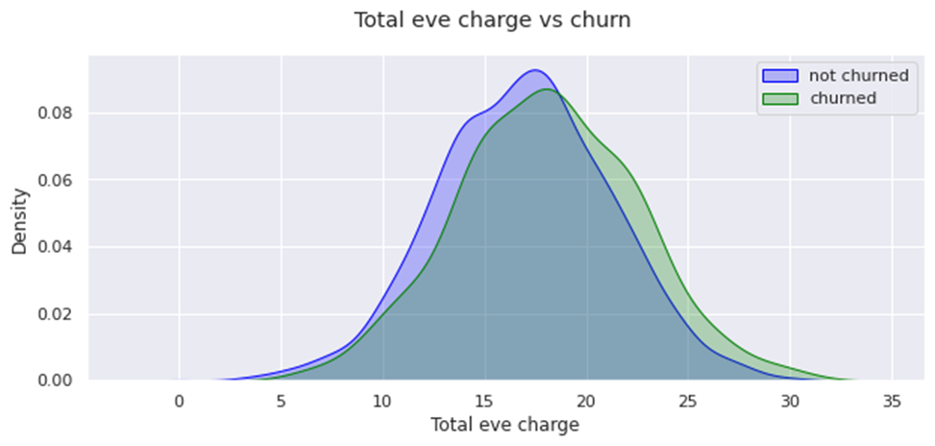
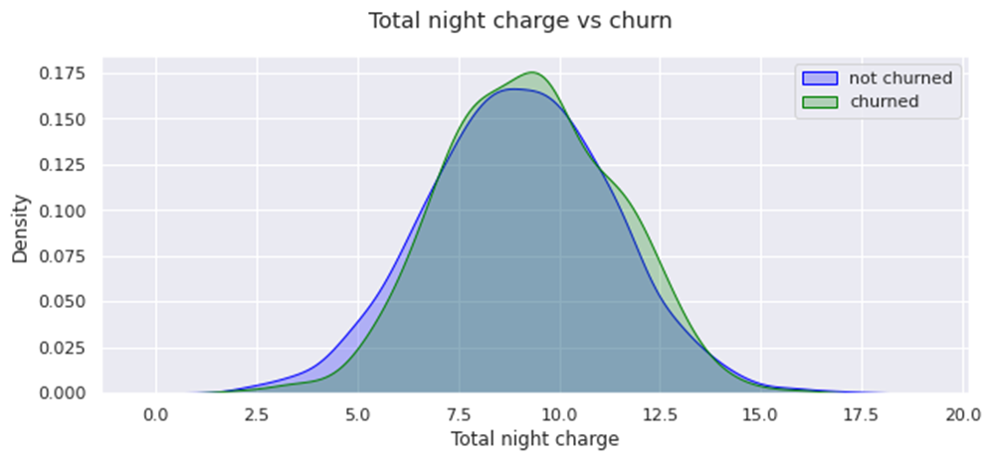

Total charge vs. Churn
kernel density estimate (KDE) plot
Churn is high when total day charge is high.
Whereas there is no significant effect of total evening charge, total night charge and total international charge on churn.

Slide 19
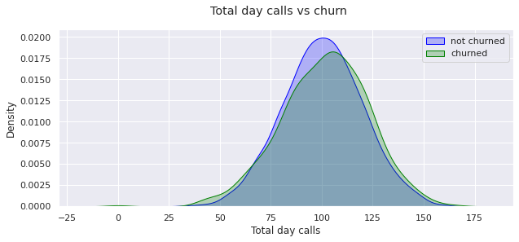
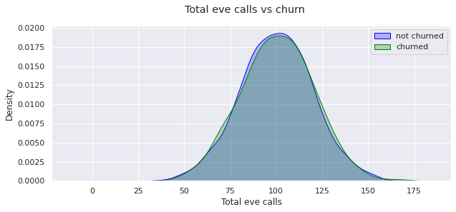
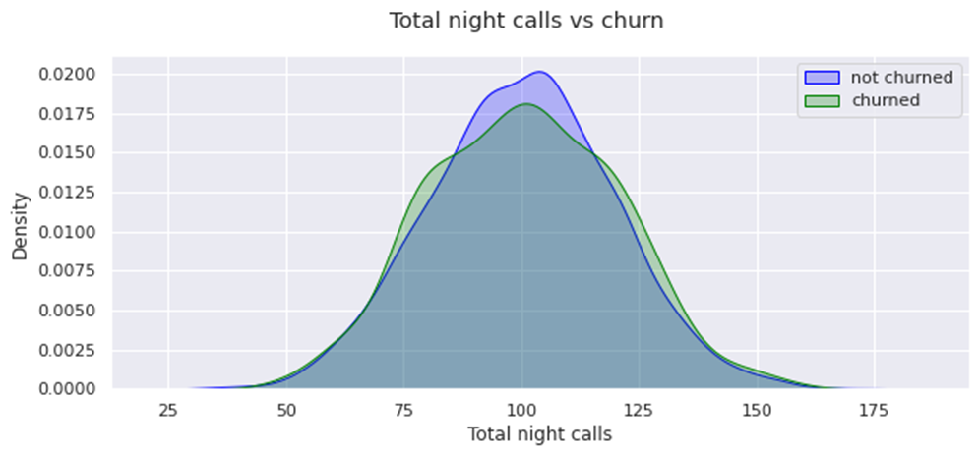
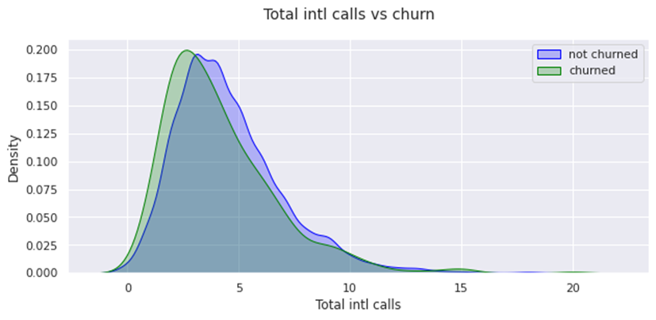
Total number of calls vs. Churn
kernel density estimate (KDE) plot
Churn is high when total international calls are less.
Whereas there is no significant effect of total day calls, total evening calls and total night calls on churn.

Slide 20
Influence of categorical features on customer churn

Slide 21
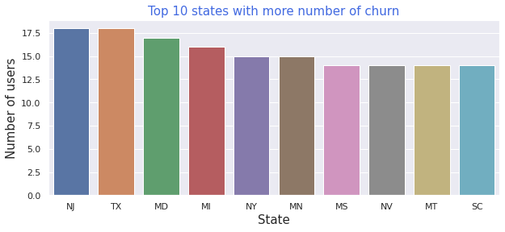
State vs. Churn
Bar plot
This plot shows top 10 states where the churn is more.
NJ, TX and MD are the states where customer churn is relatively high.

Slide 22
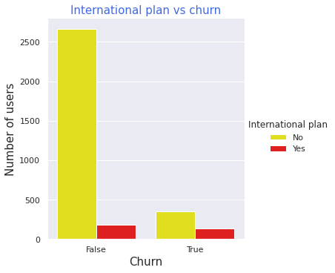
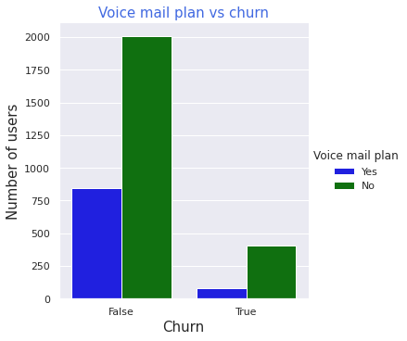
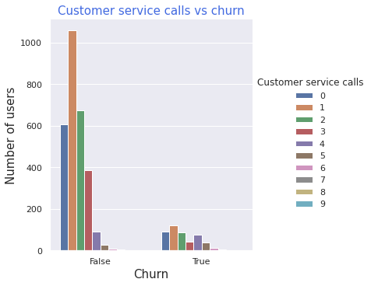
Other categorical features vs. churn
Cat plot
Customers who have churned among those most of them have not opted for international plan.
Customers who have churned among those most of them have not opted for voice mail plan.
Customers who have churned among those most of them have called customer service once.

Slide 23
Correlation matrix
&
Outlier detection

Slide 24
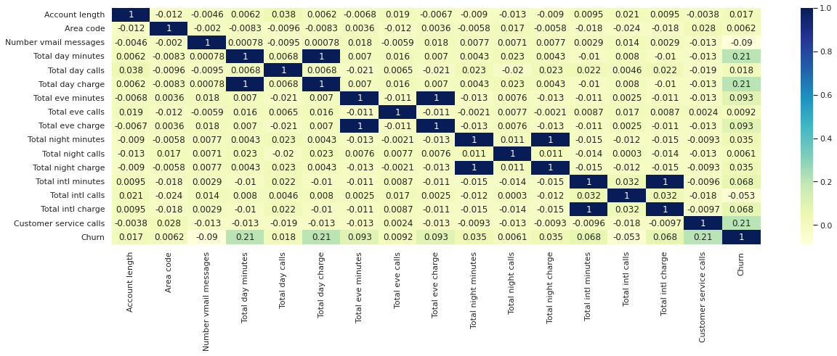
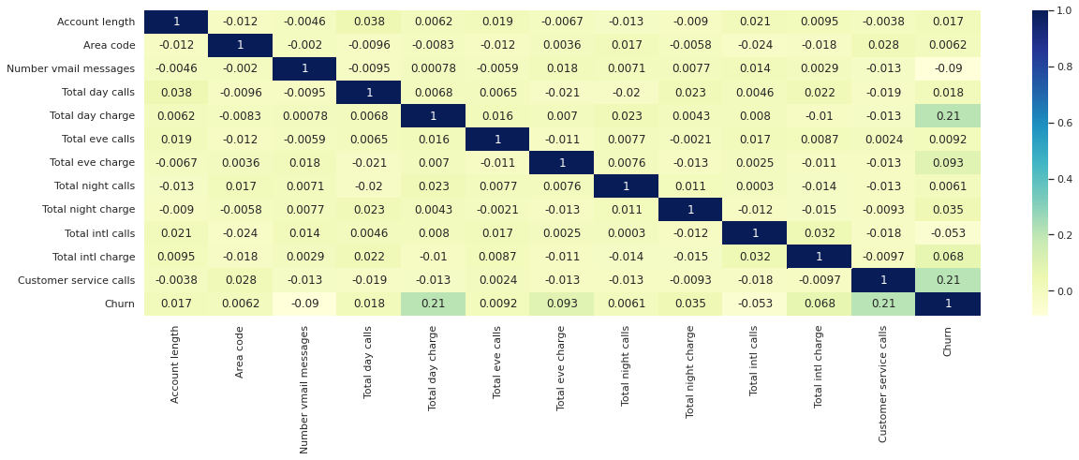
Correlation matrix
Heatmap
These plots show the interdependency between the numerical variables.
Here total charge and total minutes for day, evening, night and international calls are highly correlated.

Slide 25
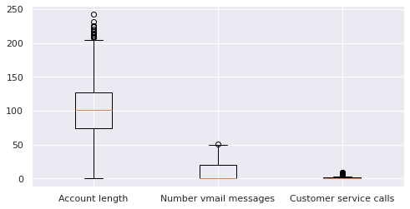
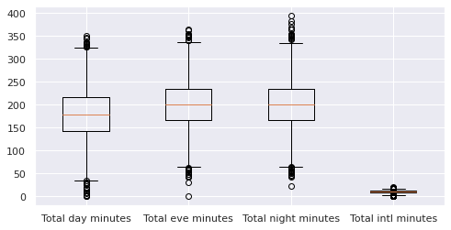
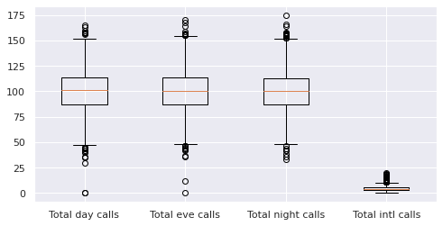
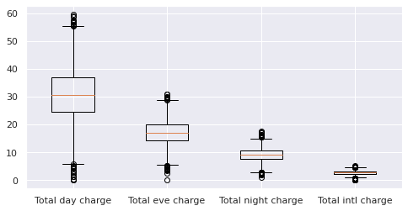
Outlier detection
boxplot
There are some outliers present in both sides of every variables. We can remove or replace these values with suitable statistical metric for further analysis to get better results.
It can be concluded from the plot that the charges in days are higher

