Slide 1


Programming with Java
RAHUL P AHIRE
9604430489

Slide 2
History of Java
Conceived as Programming language for embedded systems like microwave ovens, televisions etc
One of the first projects developed using Java
    personal hand-held remote control named Star 7.
The original language was called Oak
Java was developed in the year 1991 at Sun Microsystems
  Java is a simple, object oriented, ,interpreted distributed, robust, secure, architecture neutral, portable high-performance, multithreaded, and dynamic language
Notes:
Java was conceived by a team of engineers in Sun Microsystems in 1991 as a part of a research project, which was led by James Gosling and Patrick Naughton. It took 18 months to develop the first working version. This language was initially called “Oak” but was renamed as “Java” in 1995.
Modeled after C++, the Java language was designed to be small, simple, and portable across platforms and operating systems, both at the source and at the binary level, which means that Java programs (applets and applications) can run on any machine that has the Java virtual machine installed.

Slide 3
The Architecture
Java's architecture arises out of four distinct but interrelated technologies:
  the Java programming language
  the Java class file format
  the Java Application Programming Interface
  the Java virtual machine
Notes:
When you write and run a Java program, you are tapping the power of these four technologies. You express the program in source files written in the Java programming language, compile the source to Java class files, and run the class files on a Java virtual machine. When you write your program, you access system resources (such as I/O, for example) by calling methods in the classes that implement the Java Application Programming Interface, or Java API. As your program runs, it fulfills your program's Java API calls by invoking methods in class files that implement the Java API.

Slide 4
Application and Runtime Environment
The JRE of the SDK contains the complete set of class files for all the Java technology packages, which includes basic language classes, GUI component classes, and so on.
The Java Application Programming Interface (API) is prewritten code, organized into packages of similar topics.
Applet and AWT packages include classes for creating fonts, menus, and buttons. The full Java API is included in the Java 2 Standard Edition

Slide 5
Application and Runtime Environment
J2SE includes the essential compiler, tools, runtimes, and APIs for writing, deploying, and running applets and applications in the Java programming language.
JDK is the short-cut name for the set of Java development tools, consisting of the API classes, a Java compiler, and the Java virtual machine interpreter, regardless of which version.
The JDK is used to compile Java applications and applets. The most current version is the J2SE is 6.0

Slide 6
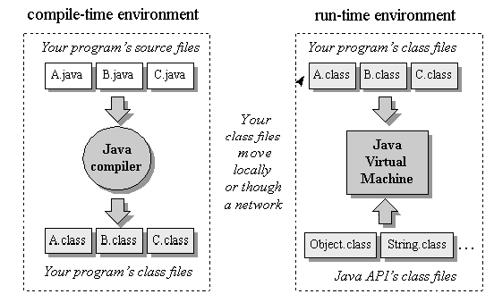
Compile time and Runtime Environment

Slide 7
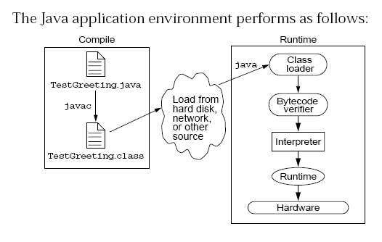
Java Run Time Environment

Slide 8
Java Features
Some features of Java:
  The Java Virtual Machine
  Garbage Collection

Slide 9
The Java Virtual Machine
Executes instructions that a Java compiler generates.
This runtime environment, is embedded in various products, such as web browsers, servers, and operating systems
Its Imaginary machine that is implemented by emulating software on a real machine
Bytecode
  a special machine language that can be understood by the JVM independent of any particular computer hardware,

Slide 10

Garbage Collection
Garbage collection thread is responsible for freeing any memory that can be freed. This happens automatically during the lifetime of the Java program.
Programmer is freed from the burden of having to deallocate that memory themselves

Slide 11
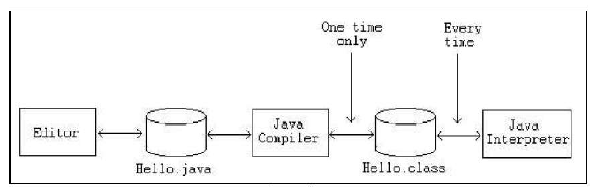
Phases of a Java Program
The following figure describes the process of compiling and executing a Java program

Slide 12
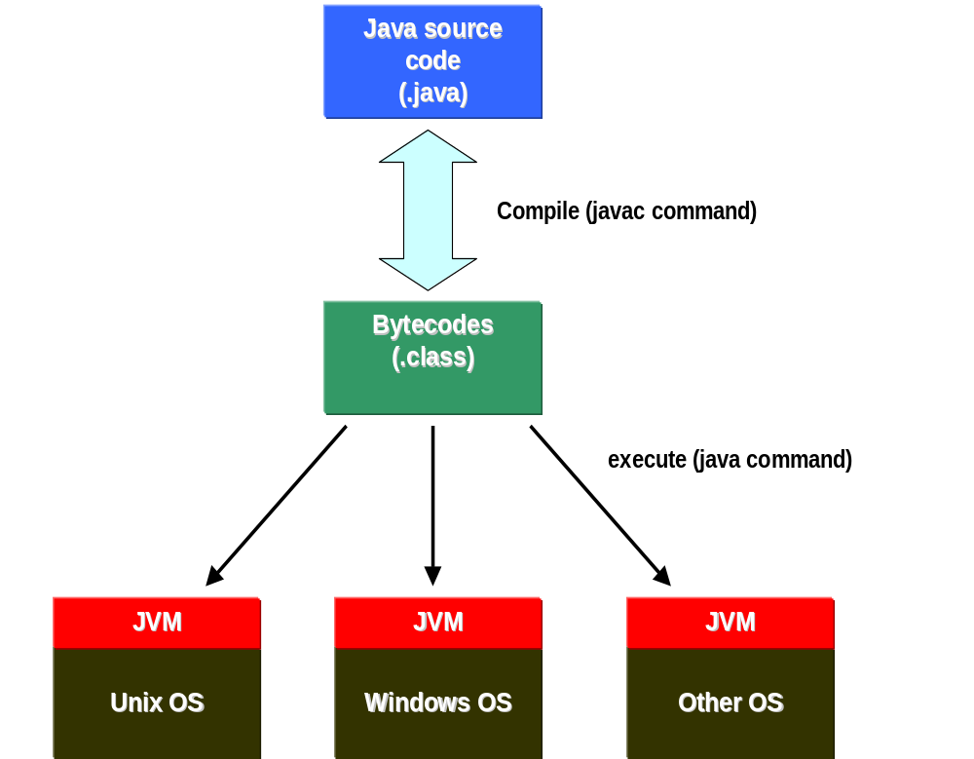

Slide 13
Integrated Development Environments
An IDE is the high-productivity tool
Used to edit, compile, and test programs, manage projects, debugging, building GUI interfaces, etc.
IDE provides extensive programming support for editing and project management,
The Popular IDE’s
  Eclipse
  NetBeans
  JDeveloper

Slide 14
Java language syntax

Slide 15
Objectives
Identify the basic parts of a Java program
Differentiate among Java literals, primitive data types,
variable types ,identifiers and operators
Develop a simple valid Java program using the concepts learned in this chapter

Slide 16
Program structure
A program in Java consists of one or more class definitions
One of these classes must define a method main(), which is where the program starts running
Java programs should always end with the .java extension.
There can be More than one Class Definition in a class ,but only one public class
Source Filenames should match the name of the public class.

Slide 17
Example 1.1
  package com.training;
  public class Greetings {
  public String getMessage() {
  return "Welcome to Java Programming";
  }
  }

Slide 18
Example 1.1 (contd)
  package com.training;
  public class TestGreetings {
  public static void main(String[] args) {
  Greetings grtObj = new Greetings();
  System.out.println(grtObj.getMessage());
  }
  }

Slide 19
The System Class
Its part of the java.lang package
The classes in this package are available without the need for an import statement
This class contains several useful class fields and methods.
It can’t be Instantiated
It also Provides facilities for
  Standard Input
  Standard Output
  Error Output Streams
  Access to externally defined properties

Slide 20
Comments
Java supports three forms of comments
  // single line comments
  /* multi
    line
    comment
    */
  /** a
    * Javadoc
    * comment
    */

Slide 21
Variables and Methods
A variable, which corresponds to an attribute, is a named memory location that can store a certain type of value.
Variable is a kind of special container that can only hold objects of a certain type.
Primitive type Variable
    Basic, built-in types that are part of the Java language
    Two basic categories
      boolean
      Numeric
        Integral - byte, short, int, long, char
        Floating point - float, double

Slide 22
Instance Variables and Methods
Variables and methods can be associated either with objects or their classes
An instance variable and instance method belongs to an object.
They can have any one of the four access levels
  Three access modifies – private, public , protected
  Can be Marked final, transient
They have a default value
A class variable (or class method) is a variable (or method) that is associated with the class itself.

Slide 23
Example for Variables
  public class VariableTypes {
  private int inst_empid;
  private static String cls_empName
  public void getData() { }
  public static void getSalary() { }
  public void showData(int a)
  {
  int localVariable ;
  }
  }
Instance Variable
Class Variable
Parameter Variable
Local Variable

Slide 24
Identifiers
Identifiers are used to name variables, methods, classes and interfaces
Identifiers
  start with an alphabetic character
  can contain letters, digits, or “_”
  are unlimited in length
Examples
  answer, total, last_total, relativePoint, gridElement, person, place, stack, queue

Slide 25
Initialization
Local variables
  must be explicitly initialized before use
Parameter variables
  Pass by value
Class and instance variables
  Instance variables Have a Default Value

Slide 26
Local Variable needs to Be Initialized
  public class LocalVariable {
  private String name;
  public void display()
  {
  int age;
  System.out.println("Age"+age);
  System.out.println("Name"+name);
  }
Age Should be Initialized before Use

Slide 27
Instance Variable have Default Values
class Values
{
private int a;
private float b;
private String c;
public void display()
{
System.out.println("integer"+a);
System.out.println("float"+b);
System.out.println("String"+c);
}
public class DefaultVales {
public static void main(String[] args) {
Values v = new Values();
v.display();
}
}

Slide 28
Assignment of reference variables
int x = 7;
int y = x;
String s = “Hello”;
String t = s;
x
y
s
t
7
7
0x01234
0x01234
Hello

Slide 29
Pass-by-Value
The Java programming language only passes arguments by value for primitive data types.
When an object instance is passed as an argument to a method, the value of the argument is a reference to the object
The contents of the object can be changed in the called method, but the object reference is never changed
For primitives, you pass a copy of the actual value.
For references to objects, you pass a copy of the reference
You never pass the object. All objects are stored on the heap.
Notes:
The Java programming language only passes arguments by value.
When an object instance is passed as an argument to a method, the value of the argument is a reference to the object.
The contents of the object can be changed in the called method, but the object reference is never changed .

Slide 30

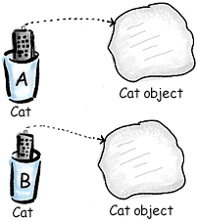
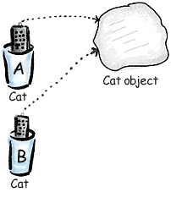
Pass By Value

Slide 31
Casting Primitive Types
Casting creates a new value and allows it to be treated as a different type than its source
JVM can implicitly promote from a narrower type to a wider type
To change to a narrow type explicit casting is required
Byte -> short -> int -> long -> float -> double

Slide 32
Casting Primitive Types
  public class PrimCasting {
  public static void main (String [] args){
  int x = 99;
  double y = 5.77;
  x = (int)y; //Casting
  System.out.println("x = "+ x);
  double y1 = x; //No Casting
  int i =42;
  byte bt;
  bt= (byte)i;
  System.out.println("The Short number"+ bt);
  }
  }

Slide 33
Wrapper Classes
Primitives have no associated methods
Wrapper Classes are used encapsulate primitives
They also provide some static utility methods to work on them
Primitive Type | Wrapper class
-boolean | Boolean
-byte | Byte
-char | Character
-double | Double
-float | Float
-int | Integer
-long | Long
short | Short

Slide 34
Wrapping Primitives
Wrapping a value
  int i = 288
  Integer iwrap = new Integer(i);
unWrapping a value
  int unwrapped = iwrap.intValue();
Methods In Wrapper Class
  parseXxx()
  xxxValue()
  valueOf()

Slide 35
Wrapper Class Method
Convert String to Numbers
public class ParsingStrings
{
public static void main(String args[])
{
int ino=Integer.parseInt(args[0]);
floatfno = Float.parseFloat(args[1]);
double dno = Double.parseDouble(args[2]);
Long lno = Long.parseLong(args[3]);
System.out.println("Integer value" +ino );
String strIno = Integer.toString(ino);
System.out.Println(“String Value”+strIno);
}
}

Slide 36
Auto Boxing
Java 5.0 provided autoboxing
Integer n = new Integer(123) Int m = n.intValue() m++; n=new Integer(m); System.out.println(n); | Integer n = new Integer(123); n++; System.out.println(n);

Slide 37
Auto Boxing
public class ABoxing {
  public void show(int a, float b)
  {
  System.out.println("Integer"+a*2);
  System.out.println("Float"+b*2);
  }
  public static void main(String[] args) {
  ABoxing abObj =new ABoxing ();
  Integer a = 10;
  Float b =20f;
  abObj.show(a,b);
  }
  }

Slide 38
Command Line Arguments
  class CommandLineArgs
  {
  public static void main(String args[])
  {
  System.out.println("hello, welcome to the java world "+args[0]+" to all "+args[1]);
  System.out.println("it is "+args[2]+" a high level language" +args[0]);
  }
  }

Slide 39
java.util.Scanner Class
A simple text scanner which can parse primitive types and strings using regular expressions.
A Scanner breaks its input into tokens using a delimiter pattern, which by default matches whitespace.
The resulting tokens may then be converted into values of different types using the various next methods.
  Scanner sc = new Scanner(System.in);
  int i = sc.nextInt();

Slide 40
java.util.Scanner Class
  public void show()
  {
  Scanner sc = new Scanner(System.in);
  System.out.println("Enter The Number");
  int number = sc.nextInt();
  System.out.println("Enter the Name");
  String name = sc.next();
  System.out.println(number + ":"+name);
  }

Slide 41
java.util.Scanner Class
  public static void main(String[] args) {
  String line="Java,is,in,OOP,Language";
  Scanner sc1 = new Scanner(line);
  sc1.useDelimiter(",");
  while (sc1.hasNext())
  {
  System.out.println(sc1.next());
  }
  }

Slide 42
Flow Control

Slide 43
Objectives
Decision control structures (if, else, switch)
Repetition control structures (while, do-while, for)
Branching statements (break, continue, return)

Slide 44
Control Structures
To change the ordering of the statements in a program
Two types of Control Structures
decision control structures ,
  allows us to select specific sections of code to be executed
    if -- else , if – else if
    switch -- case
repetition control structures
  allows us to execute specific sections of the code a number of times
    while
    do -- while
    for

Slide 45
Decision Control Structures
Types:
  if-statement
  if-else-statement
  If-else if-statement
If Specifies that a statement or block of code will be executed if and only if a certain boolean statement is true.
      if( boolean_expression )
      statement;
    or
      if( boolean_expression ){
      statement1;
      statement2;
      }
boolean_expression : can be an expression or variable.

Slide 46
if-else statement
if( boolean_exp ){
Statement(s)
}
else {
Statement(s)
}
  if(boolean_exp1 )
  statement1;
  else if(boolean_exp2)
  statement2;
  else
  statement3;
For Comparison == used instead =
= being an assignment operator
equals Method Should Be Used for Objects comparison

Slide 47
switch-statement
Allows branching on multiple outcomes.
switch expression is an integer ,character expression or variable
case_selector1, case_selector2 and unique integer or character constants.
If none of the cases are satisfied, the optional default block if present is executed.
    switch( switch_expression ){
    case case_selector1:
    Statement(s);
    break;
    case case_selector2:
    Statement(s);
    break;
    default:
    statement1;
    }

Slide 48
switch-statement
When a switch is encountered,
  evaluates the switch_expression,
  jumps to the case whose selector matches the value of the expression.
  executes the statements in order from that point on until a break statement is encountered
  break statement stops executing statements in the subsequent cases, it will be last statement in a case.
  Used to make decisions based only on a single integer or character value.
  The value provided to each case statement must be unique.

Slide 49
switch-statement
  public double CalculateDiscount(int pCode)
  {
  double discountPercentage=0.0d;
  switch(pCode)
  {
  case 1:
  discountPercentage=0.10d;
  break;
  case 2:
  discountPercentage=0.15d;
  break;
  case 3:
  discountPercentage=0.20d;
  break;
  default:
  discountPercentage=0.0;
  }
  return discountPercentage;
  }

Slide 50
Switch-Case in a Method
Can have Either Return or Break if present inside a Method, but should provide a default Value
    public String switchExample(int key) {
    switch (key) {
    case 1:
    return "Good Morning";
    case 2:
    return "Good AfterNoon";
    case 3:
    return "Good Evening";
    default:
    return "Good Night";
    }

Slide 51
Repetition Control Structures
while-loop
  The statements inside the while loop are executed as long as the Boolean expression evaluates to true
do-while loop
  statements inside a do-while loop are executed several times as long as the condition is satisfied, the statements inside a do-while loop are executed at least once
Watch this
  while(boolean_expression){
  statement1;
  statement2;
  }
do{
statement1;
statement2;
}while(boolean_expression);

Slide 52
for-loop
Same code a number of times.
for(Initialexpr;LoopCondition;StepExpr) {
  statement1;
  }
InitialExpression -initializes the loop variable.
LoopCondition - compares the loop variable to some limit value.
StepExpr - updates the loop variable.
  for( ; ; ) {
    System.out.println("Inside an endless loop");
  }
Declaration parts are left out so the for loop will act like an endless loop.

Slide 53
Enhanced For Loop
The enhanced for loop, simplifies looping through an array or a collection.
Instead of having three components, the enhanced for has two.
declaration
  The newly declared block variable, of a type compatible with the elements of the array being accessed.
expression
  This must evaluate to the array you want to loop through. This could be an array variable or a method call that returns an array
int [] a = {1,2,3,4};
for(int n : a)
System.out.print(n);.

Slide 54
Branching Statements
Branching statements allows to redirect the flow of program execution.
  break
  continue
  return.
System.exit() All program execution stops; the VM shuts down.

Slide 55
Branching Statement
continue
Unlabeled
  skips to the end of the innermost loop's body and evaluates the Boolean expression that controls the loop,
  skipping the remainder of this iteration of the loop.
Labeled :
  skips the current iteration of an outer loop marked with the given label.
return
  Used to exit from the current Method
  Control returns to the statement that follows original method call
  The value to be returned is included after the “return” statement.
  The data value returned by return must match the type of the method's declared return value
    return ++count; or return "Hello";

Slide 56
Continue
  public static void main(String[] args) {
  for(int i=0;i<=2;i++)
  {
  for(int j=0;j<=3;j++)
  {
  if(j % 2==0)
  continue;
  System.out.println("I ,"+i+",J "+j);
  }
  }
I ,0,J 1
I ,0,J 3
I ,1,J 1
I ,1,J 3
I ,2,J 1
I ,2,J 3

Slide 57
break
  public static void main(String[] args) {
  for(int i=0;i<=2;i++)
  {
  for(int j=0;j<=5;j++)
  {
  System.out.println(i+","+j);
  if(j==3)
  break;
  }
  }
0,0
0,1
0,2
0,3
1,0
1,1
1,2
1,3
2,0
2,1
2,2
2,3

Slide 58
Arrays

Slide 59
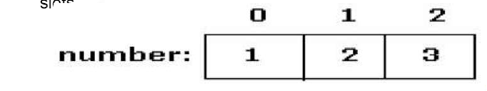
Introduction to Arrays
Array is one variable is used to store a list of data and manipulate
This type of variable is called an array.
It stores multiple data items of the same data type, in a contiguous block of memory, divided into a number of slots.
The new keyword to create an array object.
Need to tell the compiler how many elements will be stored in it.

Slide 60
Creating Arrays
There are three steps to creating an array,
declaring
  int[] k;
  float[] yt;
  String[] names;
allocating
  k = new int[3];
  yt = new float[7];
  names = new String[50];
initializing
  int[ ] k = {1, 2, 3};
  float[ ] yt = {0.0f, 1.2f, 3.4f, -9.87f, 65.4f, 0.0f, 567.9f};

Slide 61
Array Bounds
All array subscripts begin with 0 and ends with n-1
In order to get the number of elements in an array, can use the length field of an array.
The length field of an array returns the size of the array.
  int list [] = new int[10];
  for (int i = 0; i< list.length; i++)
  {
    System.out.println(list[i]);
    }
There is no array element arr[n]! This will result in an array-index-out-of bounds exception.
Notes:
Special care should be taken while accessing an array element, using the length variable of array objects. In the example shown above list.length gives 10, and if we try to access list[10], we will get an exception.

Slide 62
Array of Objects
public class Book
{
private int bookno;
private String bookname;
public Book(int bookno,String bookname)
{
this.bookno=bookno;
this.bookname=bookname;
}
public int getBookno()
{
return this.bookno;
}
public String getBookname()
{
return this.bookname;
}
}

Slide 63
Array of Objects
public class ArrayofObject {
public void displaybooks(Book[] bks)
{
for(int i=0;i<bks.length;i++)
{
System.out.println("Book Number :="+bks[i].getBookno());
System.out.println("Book Name :="+bks[i].getBookname());
}
}
public static void main(String args[])
{
Book[] bk = new Book[2];
Book b1 = new Book(100,"java");
Book b2= new Book(101,"j2ee");
bk[0]=b1;
bk[1]=b2;
ArrayofObject ab= new ArrayofObject();
ab.displaybooks(bk);
}
}

Slide 64
Classes

Slide 65
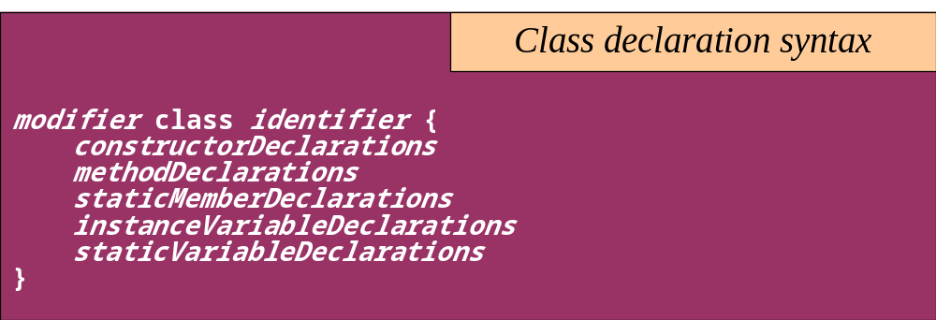
Classes
The class declaration introduces a new class
  A class describes the structure and behavior of its instance objects in terms of instance variables and methods
  Like variables, classes may be declared at different scopes. The scope of a class directly affects certain properties of the class

Slide 66
Classes
Top-level classes can be declared as
  public
    a public class is globally accessible.
    a single source file can have only one public class or interface
  abstract
    an abstract class cannot be instantiated
  final
    a final class cannot be subclassed
  Default
    With any Modifier
They can’t be declared as protected and private

Slide 67
Constructors
Have no return type
Have the same name as the class
If we don't’ put a constructor the compiler puts a default one
  The default constructor has the same access modifier as the class.
  The default constructor has no arguments.
  The default constructor is always a no-arg constructor, but a no-arg constructor is not necessarily the default constructor
  The default constructor includes a no-arg call to the super constructor (super()).
They are not inherited and hence they are not overridden
It can be Overloaded
It can have any of the Four Access Modifies
It cannot be synchronized
It can have throws clause

Slide 68
Instantiation with new
It is the process by which individual objects are created.
  Class objectReference = new Constructor();
Declaration
  Employee empObj;
Instantiation
  empObj = new Employee()
Declaration and Instantiation
  Employee empObj = new Employee()
  new operator allocates memory for an object.

Slide 69
Constructor Overloading
One constructor can call another overloaded constructor of the same class by using this keyword.
this() is used to call a constructor from another overloaded constructor in the same class
The call to this() can be used only in a constructor ,and must be the first statement in a constructor
A constructor can call its super class constructor by using the super keyword.
A constructor can have a call to super() or this() but never both

Slide 70
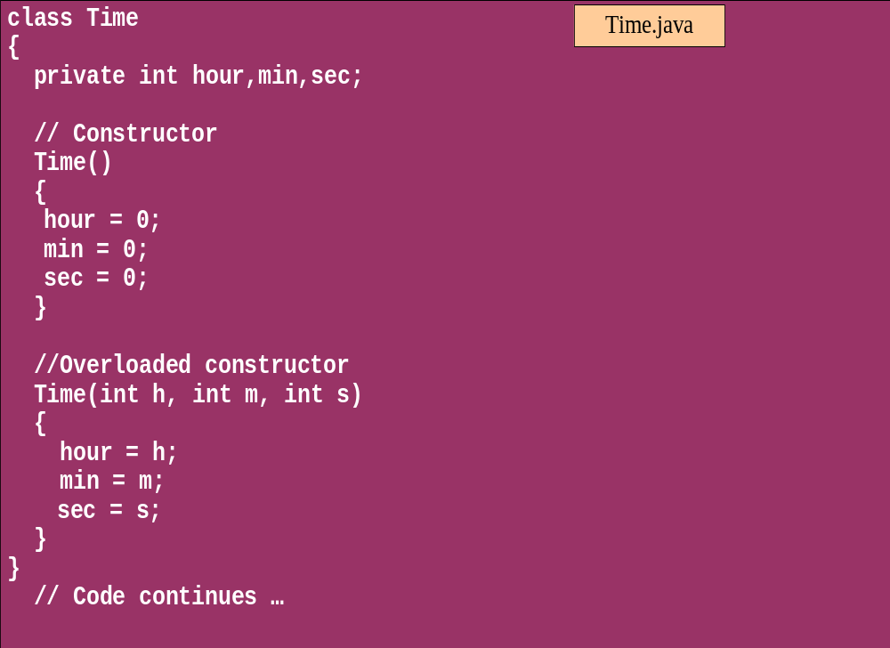
Overloaded Constructor

Slide 71
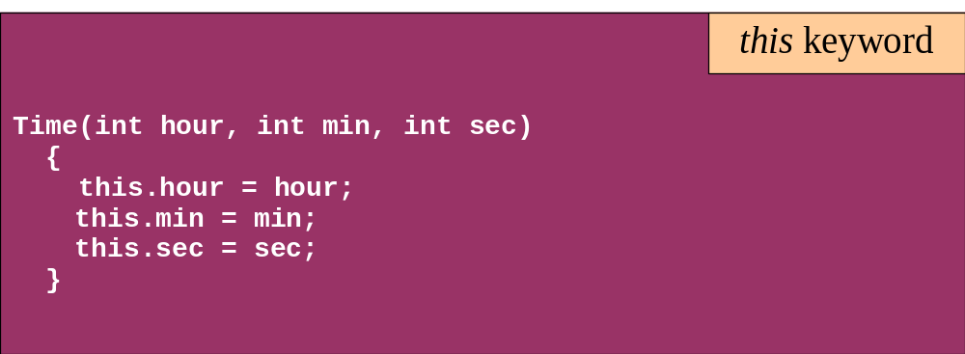
this keyword
Is a reference to the object from which the method was invoked

Slide 72
Modifiers for declarations
There are Four Access Level and 3 Modifiers
Any declaration can be preceded by
  public
    a declaration is accessible by any class
  protected
    Accessible by any class in the same package as its class, and accessible only by subclasses of its class in other packages.
    Works just like default , Except it also allows subclasses outside the package to inherit the protected thing.
  default(no modifier)
    Only accessible by classes, including subclasses, in the same package as its class(package accessibility).
  private
    a declaration is only accessible within the class in which it is declared

Slide 73
Method Overloading
If two (or more) methods of a class have the same name but different signatures, then the method name is said to be overloaded.
The signature of a method consists of the name of the method and the number and types of formal parameters in particular order.
Method overloading is method name overloading.
Several methods that implement similar behavior but for different data types.
They are independent methods of a class and can call each other just like any other method.
A method can be overloaded in the same class or in a subclass.

Slide 74
Overloading Methods
Overloaded methods MUST change the argument list.
Overloaded methods CAN change the return type.
Overloaded methods CAN change the access modifier.
Overloaded methods CAN declare new or broader checked exceptions.

Slide 75
Overloading and AutoBoxing
public class Overloading {
public Integer add(Integer a , Integer b)
{
Integer c = a+b;
return c+100;
}
public int add(int a , int b)
{
return a+b;
}

Slide 76
Main Method
  public static void main(String[] args) {
  Overloading olObj = new Overloading();
  System.out.println(olObj.add(45, 55));
  }
  Output will be 100 and Not 200

Slide 77
Static Variables and Methods
A static method belongs to a class and not to its instance objects and hence they are shared between Objects
Static Methods can not be overridden
They can only call other static methods
They can access only static variables and not instance Variables
They cannot refer to this or super
Instance variable : 1 per instance and Static variable : 1 per class
Static final variables are constants
main( ) is defined to be a static method so as to be invoked directly

Slide 78
Static Method access only static
  public class StatClass {
  private int id;
  private static String name;
  private void instMethod()
  {
  staticMethod();
  System.out.println(id);
  System.out.println(name);
  }
  private static void staticMethod()
  {
  System.out.println(id);
  System.out.println(name);
  instMethod();
  }
  }
Can Access Static from Instance Method
Cannot Access Instance Variable From Static
Cannot Access Instance Method From Static

Slide 79
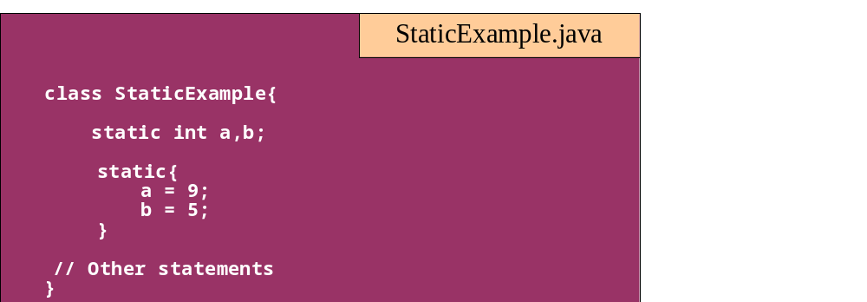
Static block
Used to initialize static variables
  Gets executed only once when the class is first loaded

Slide 80
Static Import
  import java.util.*;
  import static java.lang.System.out;
  import static java.lang.System.in;
  public class StaticImport {
  public static void main(String[] args) {
  Scanner kb = new Scanner(in);
  out.print("Enter an integer ");
  int x = kb.nextInt();
  out.print("Enter a double ");
  double d = kb.nextDouble();
  out.println("The sum is " + (x+d));
  }
  }

Slide 81
INHERITANCE

Slide 82
Overview
  A class can inherit from another class
    Original class is the “superclass”
    New class is called the “subclass”
Inheritance is a fundamental OO concept
Superclass
Car
Subclasses
SportsCar
Taxi
PoliceCar

Slide 83
Example of Inheritance
  The Car class defines certain methods and variables
  Taxi extends Car, and can:
    Add new variables
    Add new methods
    Override methods of the Car class
Car
Taxi

Slide 84
Specifying Inheritance in Java
  Inheritance is achieved by specifying which superclass the subclass
  “extends”
Taxi inherits all the variables and methods of Car
public class Car {
…
}
public class Taxi extends Car {
…
}

Slide 85
Aspects of Inheritance
  Objects
    What does a subclass object look like?
  Construction
    How do constructors work now?
  Methods
    What methods can be called?
    How can methods be overridden?

Slide 86
What Does an Object Look Like?
A subclass inherits all the instance variables of its superclass
Car object
public class Car {
String regNum;
int engineSize; …
}
regNum
engineSize
Taxi object
public class Taxi extends Car {
private int cabNum; …
}
regNum
engineSize
cabNum

Slide 87
Default Initialization
  What happens when a subclass object is created?
  If no constructors are defined:
  No-arg constructor is called in superclass
    No-arg constructor called in subclass
Taxi object
regNum
engineSize
Taxi taxi1 = new Taxi();
cabNum

Slide 88
Nondefault Initialization
Specific initialization can be performed as follows:
public class Car {
Car(String r, int e) {
regNum = r;
engineSize = e;
} …
public class Taxi extends Car {
Taxi(String r, int e, int c) {
super(r, e);
cabNum = c;
} …
Use super() to call superclass constructor

Slide 89
Specifying Additional Methods
  The superclass defines methods that are applicable for all kinds of Car
  The subclass can specify additional methods that are specific to Taxis
public class Car {
public int getReg()…
public void changeOwner()…
…
public class Taxi extends Car {
public void renewCabLicense()…
public boolean isBooked()…
…

Slide 90
Overriding Superclass Methods
  A subclass inherits all the methods of its superclass
  The subclass can override a method with a specialized version, if it needs to:
public class Car {
public String details() {
return "Reg:" + getReg();
}
public class Taxi extends Car {
public String details() {
return "Reg:" + getReg() + cabNum;
}

Slide 91
Overriding
When a sub-class defines a
  “method with same method name, argument types, argument order and return type as a method in its super class, its called method overriding. “
Methods declared as final, static and private cannot be overridden.
An overriding method can be declared as final
The method can’t be less accessible
  Public => only public
  Protected => Both Public and Protected
  Default => default, public and protected

Slide 92
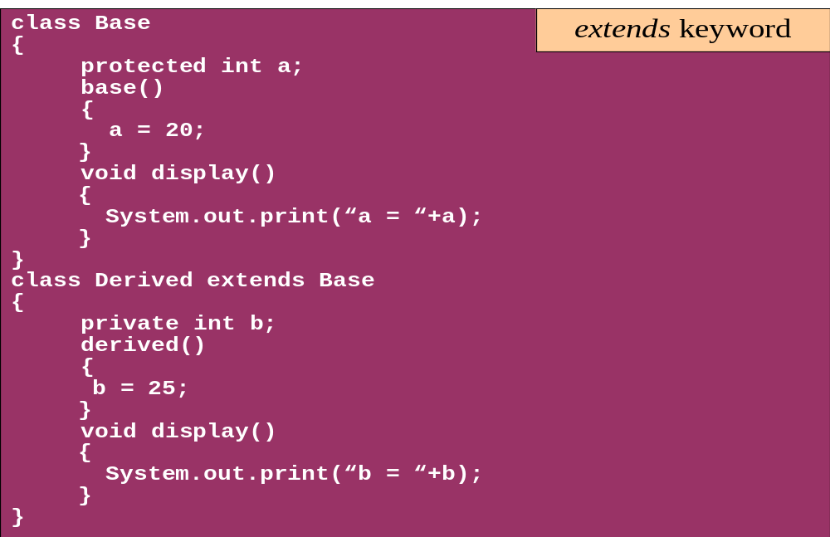
Overriding

Slide 93
Overriding –When Method Has Exceptions
Any exceptions declared in overriding method must be of the same type as those thrown by the super class, or a subclass of that type.
  class MyBase {
  public void method1() throws Exception
  { }
  public void method2() throws RuntimeException
  { }
  }
  class Sub extends MyBase
  {
  public void method1() throws Throwable {
  }
  public void method2() throws ArithmeticException {
  }
  }
This is compile Time Exception
This is Allowed

Slide 94
Overriding with Compatible Return type
Arguments must be same and return type must be compatible
  class Base
  {
  private int i = 5;
  public Number getNumber()
  {
  return i;
  }
  }
  class Derived extends Base
  {
  @Override
  public Integer getNumber()
  {
  return new Integer(10);
  }
  }

Slide 95
Invoking Superclass Methods
  If a subclass overrides a method, it can still call the original superclass method
  Use super.method()to call a superclass method from the subclass
  Though keyword super is used to refer super class, method call super.super.method() is invalid.
public class Car {
public String details() {
return "Reg:" + getReg();
}
public class Taxi extends Car {
public String details() {
return super.details() + cabNum;
}

Slide 96
super keyword
The keyword super refers to the base class
  super( )
    invokes the base class constructor
    base class constructors are automatically invoked
  super.method( )
    invokes the specified method in the base class
  super.variable
    to access the specified variable in the base class
super must be the first statement in a constructor

Slide 97
Hiding-Fields and Static Members
A Sub Class can hide the fields but cannot override that of the super class, its done by defining fields with the same name as in the super class.
Code in the subclass can use the keyword super to access such members
A static method can hide a static method from the Super Class
A hidden super class static method is not inherited., will result in compile time Exception

Slide 98
Hiding-Fields and Static Members
Variable Hiding
class MyBase
{
int var1=100 ;
public static void method1()
{
System.out.println(“Super Class Method1");
}
public void method2()
{
System.out.println(“Super Class method2 ");
}
}
class Mysub extends MyBase
{
int var1 =200;
public static void method1()
{
System.out.println(“Sub Class Method1");
}
public void method2()
{
System.out.println(“Sub Class Method2");
System.out.println(“Var"+var1
+"superclass Var"+super.var1);
} }
Method Hiding

Slide 99
Abstract Class
An abstract class is a shared superclass
  Provides a high-level partial implementation of some concept
  Cannot be instantiated
Use the abstract keyword to declare a class as abstract
Vehicle
Vehicle
Abstract superclass
Concrete subclasses
Car
Car
Truck

Slide 100
Defining Abstract Classes in Java
  Use the abstract keyword to declare a method as abstract
    Only provide the method signature
    Class must also be abstract
  Must be implemented by a concrete subclass
    Each concrete subclass can implement the method differently
public abstract class Vehicle {
private String regNum;
public String getRegNum()…
public abstract boolean isRoadWorthy();
}
public class Car
extends Vehicle{
private int numSeats;
public void fitRack()…
public class Truck
extends Vehicle{
private int axles;
public void setLoad()…

Slide 101
The Abstract Class-Super Class
Note
this
  public abstract class BankAccount {
  public abstract void deposit(float amount);
  public abstract void withdraw(float amount);
  public void sayHello() {
  System.out.println("Thanks-Come Again");
  }
  }

Slide 102
Child Class –Its alsoAbstract
  public abstract class Savingaccount extends BankAccount {
  public abstract void getClientdetails();
  }

Slide 103
The Concrete Class
  public class Supersavings extends Savingaccount {
  float balance,amount ;
  String custname;
  int accno;
  public void deposit(float amt)
  {
  balance+=amt;
  }
  public void withdraw(float amt)
  {
  balance-=amt;
  }
  public void getClientdetails()
  {
  System.out.println(custname);
  System.out.println(accno);
  System.out.println(amount);
  System.out.println(balance);
  }
  }

Slide 104
Interfaces & Polymorphism

Slide 105
Interfaces
  An interface is like a fully abstract class
    All of its methods are public and abstract
    No instance variables if present they are public static final
  An interface defines a set of methods that other classes can implement
    A class can implement many interfaces, but can extend only one class
  Can extend other interfaces and extend multiple interfaces
  Extends another sub interface inherits everything from super interface

Slide 106
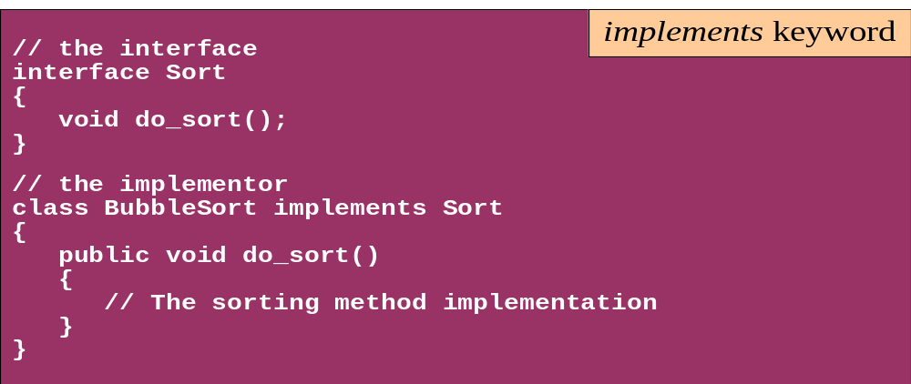
Interface
Interfaces define types in an abstract form
  An interface declaration allows the specification of a reference type without providing an implementation
  The class that implements the interface decides how to implement

Slide 107


Example of Interfaces
  Interfaces describe an aspect of behavior that different classes can support
  For example, any class that supports the “Steerable” interface can be steered:
Steerable
Not Steerable

Slide 108
Defining an Interface in Java
  Use interface keyword instead of class
public interface Steerable {
int maxTurn = 135;
void turnLeft(int deg);
void turnRight(int deg);
}

Slide 109
Implementing an Interface
public interface Steerable {
int maxTurn = 135;
void turnLeft(int deg);
void turnRight(int deg);
}
public class Car
extends Vehicle
implements Steerable {
public void turnLeft(int deg)
{…}
public void turnRight(int deg)
{…}

Slide 110
Partial Implementation of an Interface
Declare the class as abstract if the class does not implement all the methods of an interface
Implement the methods in the sub class level
Public abstract class Car
extends Vehicle
implements Steerable {
public void turnLeft(int deg)
{…}
}

Slide 111
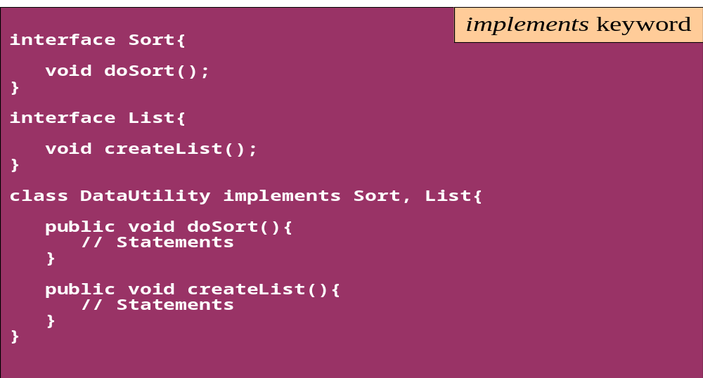
Interface
A single class can implement many interfaces

Slide 112
Using instanceof with Interfaces
  The instanceof operator can be used to check if an object implements an interface
  Downcasting can be used if necessary, to call methods defined in the interface
public void aMethod(Object obj) {
…
if (obj instanceof Steerable)
((Steerable)obj).turnLeft();
}

Slide 113
Extending an Interface
One Interface can extend another Interface
public interface Steerable {
int maxTurn = 135;
void turnLeft(int deg);
void turnRight(int deg);
}
public interface Navigator
extends Steerable {
void calcSpeed(int distance);
}

Slide 114
Polymorphism
This OO Principle allows the programmer to program abstractly
Objects of a subclass can be treated as objects of its superclass
The base class of a hierarchy is usually an abstract class or an Interface
  They define the common behavior (functionality)
Classes and Subclasses inherit this behavior and extend it according to their own properties by overriding the methods of the super class
Subclass objects can be treated as super class objects through references,
  But, super class objects are not subclass objects

Slide 115
Polymorphism
Allows for hierarchies to be highly extensible
New classes can be introduced and can still be processed without changing other parts of the program
Same method can do different things, depending on the class that implements it.
Method invoked is associated with OBJECT and not with reference.
Types of Polymorphism -
  Method Overloading.
  Method Overriding.

Slide 116
Polymorphism
  class SuperClass
  {
  int value = 100;
  void callMe()
  {
  System.out.println("I am in Super Class");
  }
  }
  class SubClass extends SuperClass
  {
  int value = 10;
  void callMe()
  {
  System.out.println("I am in Sub Class");
  }
  }

Slide 117
Polymorphism
This Object Reference is polymorphic
  public class TestDMD
  {
  public static void main(String s[])
  {
  SuperClass objSuperClass = new SubClass();
  objSuperClass.callMe();
  System.out.println(objSuperClass.value);
  }
  }
This means object variables are polymorphic , A variable of type Super Class can refer to an object of type Super class as well as subclass.

Slide 118
Substitution of Object References in Method Calls
A subclass object can be passed into any method that expects a superclass object
The method that got invoked, is the version that's present in the object type and NOT the reference type.
public static void main(String[] args) {
Taxi t = new Taxi("ABC123", 2000, 79);
displayDetails(t);
public static void displayDetails(Car c) {
System.out.println(c.details());
}
Notes:
The same object reference (that is, an object reference of the same reference type) is capable of behaving differently at runtime, depending on the object that it points to.

Slide 119
Dynamic Method Dispatch
Related Through Inheritance
superclass = subclass
  always valid
subclass=(subclass)superclass
  valid at compile time, checked at runtime. if is invalid then the exception ClassCastException is thrown.
subclass = superclass
  not valid at compile time, needs a cast
Unrelated Classes – Not Allowed
someClass = someUnrelatedClass
  not valid, won’t compile
somcClass = (someClass)someUnrelatedClass
  not valid, won’t compile

Slide 120
Dynamic Method Dispatch
subclass=
(subclass)superclass
Valid at both Compile ,RunTime
  class First
  {
  public void show()
  {
  System.out.println("ShowFirst");
  }
  }
  class Second extends First
  {
  public void show()
  {
  System.out.println("Show Second");
  }
  }
First fst = new Second();
Second sec = (Second)fst;
sec.show();
First fst2 = new First();
Second sec2 = (Second)fst2;
sec2.show();
subclass=
(subclass)superclass
Valid at Compile time exception at ,RunTime

Slide 121
final keyword
A final method or class is Java’s way of prohibiting inheritance and/or overriding
Final methods cannot be overridden by subclasses
All private methods are implicitly final
Final classes Cannot be extended and their methods are implicitly final
Can be applied to variables too
  The value of a final variable cannot be altered
  final int max_limit = 23
  final void method( )
  final class last_class

Slide 122
Interface vs Abstract Class
A class may implement several interface
An interface cannot provide any code at all
Interfaces are often used to describe the peripheral abilities of a class, not its central identity,
A class may extend only one class
An abstract class can provide complete or partial code
An abstract class defines the core identity of its descendants.

Slide 123
Interface, Abstract Class,Subclass,Class
A plain class is designed when in doesn't pass the “is-a” test.
A Plain class is designed when its not extending any other class other than object class
Make a subclass , when it needs to extend a super class
Make a subclass, when it needs to override or add new behaviors
Make an abstract class , when there is a requirement for a kind of “template” for a group of subclasses, and there are some implementation in the class which the subclass can use .
Make an abstract class , to guarantee that nobody can make objects of that type.
Design an interface , to define a role that other classes can play, regardless of the inheritance tree,

Slide 124
Packages

Slide 125
Packages
Packages are containers of classes
An organized collection of classes that are logically related
Mechanism for partitioning the class name space
Helps Distributed Computing
Some of Packages in Java are
  java.lang
  java.io
  java.util
  java.net
User defined classes can also be organized into packages

Slide 126
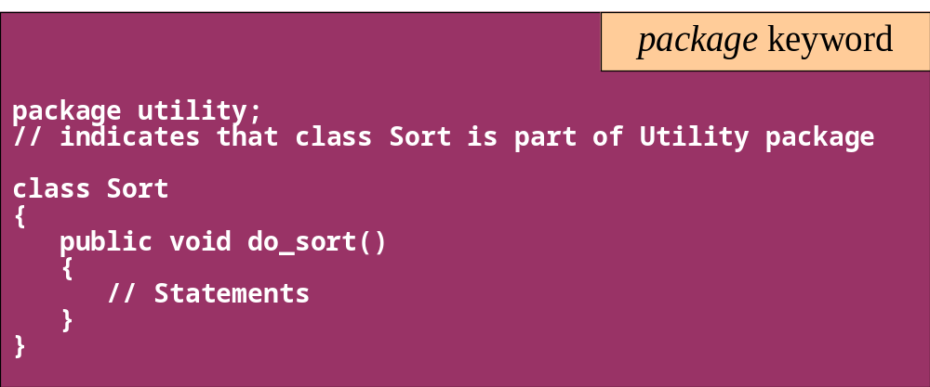
Package
In the following example, the class class1 is part of the package pack1
Use the javac -d option to compile

Slide 127
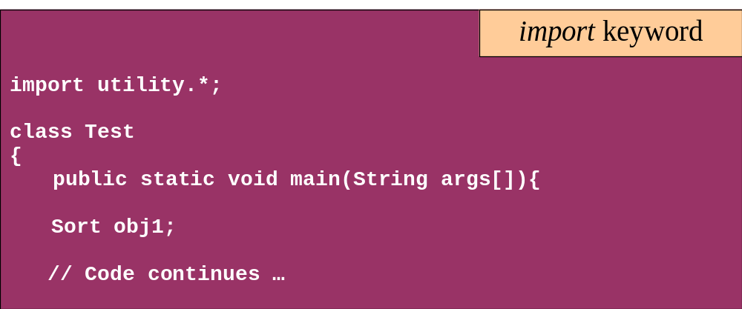
Package
Use the import keyword to access the classes in a package

Slide 128
CLASSPATH
Is an environment variable which specifies the location of the class files
For compiling the Sort.java (listed earlier)
  javac -d c:\packages Sort.java
  this would create a sub-directory Utility under c:\packages and store Sort.class over there
While compiling test.java (listed earlier), set
  CLASSPATH = . ; c:\packages
Any package can be included in the working package
Include all packages in CLASSPATH
    import package_name.class_name;
    import package_name.subpackage_name.class_name;
    import package_name.*;

Slide 129
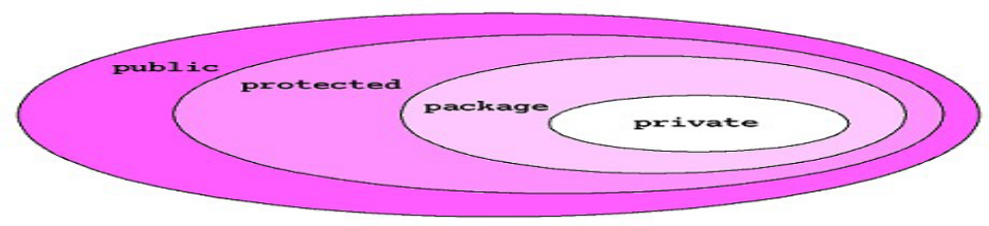
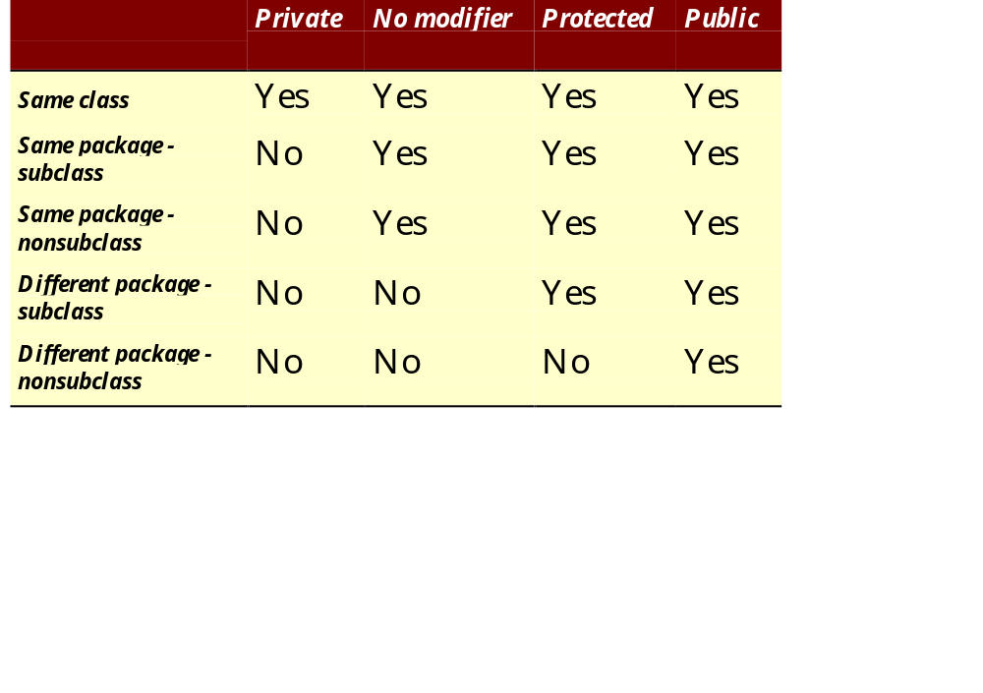
Package - Access modifiers

Slide 130
Creating And Running Executable Jar Files
Java .jar files are archive files, like .zip files, that can contain a collection of Java artifacts including class files, source code, supporting documentation, etc.
They can be executed by adding a manifest to the .jar file that specifies the name of the main application class.
Steps involved in Creating a Executable Jar files
  Create Java program/(s) and save the resulting .class files in the proper package structure
  Create a manifest file specifying the fully-qualified name of the main application class
  Use the jar command to create the .jar file

Slide 131
Create An Executable Jar File
In the Mainfest.mf File of the Project Add
  Manifest-Version: 1.0
  Main-Class: package_name.className
Jar Files are created using the command :
  jar cmf mainclass MyApp.jar
The Files can be executed by invoking java command with the -jar switch :
  java -jar MyApp.jar

Slide 132
Object Class and Its Methods

Slide 133
Object Class
Every class in java extends class Object.
If a class doesn’t explicitly extend any class ,implicitly extends Object class
  boolean equals()
  int hashCode()
  String toString()
  Object.clone()

Slide 134
equals( ) method
The equals operator (==) can be used to test primitives
When its objects –
  it simply compares two object references to see if they refer to the same object, which is not the same as comparing the objects themselves.
The inherited equals( ) method can be used on the object
  It doesn't it does not compare fields
  It just returns the value of an == comparison on the two objects involved

Slide 135
Rules for an equals( ) method
It is reflexive:
    x.equals(x) must be true.
It is symmetrical:
    x.equals(y) must be true if and only if y.equals(x) is also true.
It is transitive:
    if x.equals(y) is true and y.equals(z) is true, then x.equals(z) must also be true.
It is repeatable:
    multiple calls on x.equals(y) return the same value (unless state values used in the comparison are changed, as by calling a set method).
It is cautious:
    x.equals(null) must return false rather than accidentally throwing a NullPointerException .

Slide 136
Overriding Equals Methods
  public boolean equals(Object otherObject)
  {
  // check objects are identical
  if(this==otherObject)
  return true ;
  //check for null
  if(otherObject==null)
  return false;
  // check for the class of the object
  if(getClass()!=otherObject.getClass())
  return false;
  // cast the object to the right type
  Exampleobject eobj = (Exampleobject)otherObject;
  //check the instance variables
  return customername.equals(eobj.customername)
  && orderno==(eobj.orderno);
  }

Slide 137
The hashCode( ) method
It returns an integer that should uniquely identify different objects.
A properly written hashCode( ) method will follow these rules:
It is repeatable:
  hashCode(x) must return the same int when called repeatedly, unless set methods have been called.
It is consistent with equality:
  if x.equals(y), then x.hashCode( ) must == y.hashCode( ).

Slide 138
Overriding HashCode
Acceptable Overriding but not Efficent
  public int hashCode()
  {
  return this.orderno + (7 * this. orderno);
  }
Violates Hashcode Rule
  public int hashCode()
  {
  int no = (int)Math.random()* 100 ;
  return this.orderno+no ;
  }

Slide 139
toString( )
The objectS can be passed to
  System.out.println( )
  Methods
  Or Can be used string concatenation,
Java automatically calls its toString( ) method.
The toString() just prints the class name, an @ sign, and the object's memory address -hashCode) value
toString( ) implementation prints the state of the object which will result in formatting control in println( ) and anywhere objects get referred to in a String context.

Slide 140
Object.clone( )
Need for cloning
  While method-calling ,the called method can modify the state of constructed object!
Cloning the input object before calling the method allows to pass a copy of the object, keeping the original safe.
The two steps to make a class cloneable:
  Override Object's clone( ) method.
  Implement the empty Cloneable interface
The Protected clone( ) method in Object throws CloneNotSupportedException .
Convention, the Cloned object should be obtained by calling super.clone.
it may be necessary to modify one or more fields of the object returned by super.clone before returning it

Slide 141
Clone Method
  public class Employee implements Cloneable {
  public Object clone()
  {
  try {
  return super.clone( );
  }
  catch (CloneNotSupportedException e )
  {
  e.printStackTrace();
  }
  }
  }
Note this

Slide 142
GC of Object
Objects become eligible for garbage collection
  Reference goes out of permanently
    void add()
    {
    Employee e = new Employee();
    }
  Reference assigned to another object
    Class EmpTest {
    Employee e = new Employee();
    void add()
    {
    e=new Employee();
    }

Slide 143
GC of Object
  The Reference is explicitly set to null
    Class EmpTest {
    Employee e = new Employee();
    void add()
    {
    e=null;
    }

Slide 144
Finalize Method()
  public class Book {
  String bookName;
  Book(String bookName)
  {
  this.bookName=bookName;
  }
  public String toString()
  {
  return this.bookName;
  }
  public void finalize()
  {
  System.out.println("Inside Finlize“+this);
  }

Slide 145
Finalize Method()
  public static void main(String[] args) {
  Book textbook = new Book("Java");
  System.out.println(textbook);
  textbook =new Book("J2EE");
  System.gc();
  System.out.println(textbook);
  textbook=null;
  System.gc();
  System.out.println(textbook);
  }

Slide 146
Math Class
The methods in the Math class don’t use any instance variable values
The Methods are “static” methods , and they don’t need to have an instance of the Math class
Some of the Methods in the class are
  Math.random() – returna double number between 0.0 to 1.0
  Math.abs() – absolute value of the argument
  Math.round() – returns int or long based on float,double rounded to nearest integer value
  Math.min() and Math.max() – maximum or minimum of two args
  Math.sqrt() – return the sqaure root of the given argument

Slide 147
Exception handling

Slide 148
Topics
Define exceptions
Use try, catch, and finally statements
Describe exception categories
Identify common exceptions
Develop programs to handle your own exceptions
Use assertions
Distinguish appropriate and inappropriate uses of assertions
Enable assertions at runtime

Slide 149
Relevance
In most programming languages, how do you resolve runtime errors?
If you make assumptions about the way your code works, and those assumptions are wrong, what might happen?
Is it always necessary or desirable to expend CPU power testing assertions in production programs?

Slide 150
Exception and Assertions
Exceptions handle unexpected situations – Illegal argument, network failure, or file not found
Assertions document and test programming assumptions – This can never be negative here
Assertion tests can be removed entirely from code at runtime, so the code is not slowed down at all.

Slide 151
Exceptions
Conditions that can readily occur in a correct program are checked exceptions.
These are represented by the Exception class.
Severe problems that normally are treated as fatal or situations that probably reflect program bugs are unchecked exceptions.
Fatal situations are represented by the Error class.
Probable bugs are represented by the RuntimeException class.
The API documentation shows checked exceptions that can be thrown from a method

Slide 152

Exception Example

Slide 153
Try-catch Statement

Slide 154
Call Stack Mechanism
If an exception is not handled in the current try-catch block, it is thrown to the caller of that method.
If the exception gets back to the main method and is not handled there, the program is terminated abnormally.

Slide 155
The finally Clause
The finally clause defines a block of code that always executes.
    try {
      startFaucet();
    waterLawn();
    } catch (BrokenPipeException e) {
    logProblem(e);
    } finally {
    stopFaucet();
    }

Slide 158
Handle or Declare Rule
Use the handle or declare rule as follows:
Handle the exception by using the try-catch-finally block.
Declare that the code causes an exception by using the
throws clause.
void trouble() throws IOException { ... }
void trouble() throws IOException, MyException { ... }
Other Principles
You do not need to declare runtime exceptions or errors.
You can choose to handle runtime exceptions

Slide 159
Method Overriding and Exceptions
The overriding method can throw:
No exceptions
One or more of the exceptions thrown by the overridden method
One or more subclasses of the exceptions thrown by the overridden method
The overriding method cannot throw:
Additional exceptions not thrown by the overridden method
Superclasses of the exceptions thrown by the overridden method

Slide 160
User Defined Exceptions
public class ServerTimedOutException extends Exception {
private int port;
public ServerTimedOutException(String message, int port) {
super(message);
this.port = port;
}
public int getPort() {
return port;
}
}
Use the getMessage method, inherited from the Exception class, to get the reason for which the exception was made.

Slide 161
Handle user defined Exception
A method can throw a user-defined, checked exception:
1 public void connectMe(String serverName)
2 throws ServerTimedOutException {
3 boolean successful;
4 int portToConnect = 80;
5
6 successful = open(serverName, portToConnect);
7
8 if ( ! successful ) {
9 throw new ServerTimedOutException("Could not connect",
10 portToConnect);
11 }
12 }

Slide 162
Assertions
• Syntax of an assertion is:
assert <boolean_expression> ;
assert <boolean_expression> : <detail_expression> ;
• If<boolean_expression> evaluates false, then an
AssertionError is thrown.
• The second argument is converted to a string and used

Slide 164
Example of Exception
public class ExceptionDemo {
public static void main(String [] args) {
System.out.println(3/0);
System.out.println(“Hi”);
}
}
}
Default exception handler
  Provided by Java runtime ,Prints out exception description
  Prints the stack trace
Hierarchy of methods where the exception occurred
  Causes the program to terminate

Slide 165
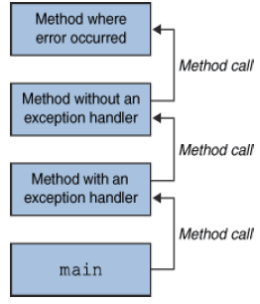
What Happens When an Exception
Occurs
When an exception occurs within a method,
  the method creates an exception object and hands it off to the runtime system - “throwing an exception”
  These Exception object contains information about the error, including its type and the state of the program when the error occurred
  The runtime system searches the call stack for a method that contains an exception handler

Slide 166
What Happens When an Exception
Occurs
When an appropriate handler is found, the runtime system passes the exception to the handler
  An exception handler is considered appropriate if the type of the exception object thrown matches the type that can be handled by the handler
  The exception handler chosen is said to catch the exception.
If appropriate exception handler is not found by the runtime system the application terminates and uses the default exception handler

Slide 167
Exception Handling
java.lang.Object
java.lang.Throwable
java.lang.Error
java.lang.Exception
java.io.IOException
java.lang.RuntimeException
Notes:
The class Object is the root of the class hierarchy. Every class has Object as a superclass. All objects, including arrays, implement the methods of this class.
The Throwable class is the superclass of all errors and exceptions in the Java language. Only objects that are instances of this class (or of one of its subclasses) are thrown by the Java Virtual Machine or can be thrown by the Java throw statement. Similarly, only this class or one of its subclasses can be the argument type in a catch clause.
An Error is a subclass of Throwable that indicates serious problems that a reasonable application should not try to catch. Most such errors are abnormal conditions. The ThreadDeath error, though a "normal" condition, is also a subclass of Error because most applications should not try to catch it.
The class Exception and its subclasses are a form of Throwable that indicates conditions that a reasonable application might want to catch.
RuntimeException is the superclass of those exceptions that can be thrown during the normal operation of the Java Virtual Machine. A method is not required to declare in its throws clause any subclasses of RuntimeException that might be thrown during the execution of the method but not caught.
IOException signals that an I/O exception of some sort has occurred. This class is the general class of exceptions produced by failed or interrupted I/O operations.

Slide 168
Checked and Unchecked
Checked exceptions include all subtypes of Exception, excluding classes that extend Runtime Exception.
Checked exceptions are subject to the handle or declare rule; any method that might throw a checked exception
  must either declare the exception using the throws keyword, or handle the exception with an appropriate try/catch.
Subtypes of Error or Runtime Exception are unchecked, so the compiler doesn’t enforce the handle or declare rule.

Slide 169
Catching Exceptions
  class DivByZero {
  public static void main(String args[]) {
  try {
  System.out.println(3/0);
  System.out.println(“Please print me.”);
  } catch (ArithmeticException exc) {
  //Division by zero is an ArithmeticException
  System.out.println(exc);
  }
  System.out.println(“After exception.”);
  }
  }

Slide 170
Catching Exception –Multiple Catch
  class MultipleCatch {
  public static void main(String args[]) {
  try {
  int den = Integer.parseInt(args[0]);
  System.out.println(3/den);
  }
  catch (ArithmeticException exc)
  {
  System.out.println(“Divisor was 0.”);
  }
  catch (ArrayIndexOutOfBoundsException exc2)
  {
  System.out.println(“Missing argument.”);
  }
  System.out.println(“After exception.”);
  }
}
}

Slide 171
Catching Exception –Nested Try’s
    public static void main(String args[]){
  try {
    int a = Integer.parseInt(args[0]);
    try {
    int b = Integer.parseInt(args[1]);
    System.out.println(a/b);
    }
    catch (ArithmeticException e1)
    {
    System.out.println("Div by zero error!");
    }
  }
  catch(ArrayIndexOutOfBoundsException e2)
  {
    System.out.println("Need 2 parameters!");
    }
    }
  }

Slide 172
err Field in the System Class
  public class Example_ErrField {
  public static void main(String[] args) {
  PrintStream prt;
  System.setErr(prt);
  try {
  prt = new PrintStream(new File("a.err"));
  }
  catch (FileNotFoundException e)
  {
  System.err.println("printed using Error Field");
  }
}
}

Slide 173
Redirecting Output
  public static void main(String[] args) {
  OutputStream outs = System.out;
  PrintStream dos = new PrintStream(outs);
  try {
  PrintStream ps =
  new PrintStream(
  new FileOutputStream("MyOutput.txt",true));
  System.setOut(ps);
  System.out.println("Hello World");
  ps.flush();
  System.out.close();
  System.setOut(dos);
  System.out.println("I am Back");
  }
  catch(FileNotFoundException e)
  {
  System.out.println("Inside Exception Block");
  } }

Slide 174
Finally block
Its optional and will always be invoked,
  whether an exception in the corresponding try is thrown or not,
  whether a thrown exception is caught or not.
finally-will-always-be-called except if the JVM shuts down. When the try or catch blocks may call System.exit();
Block of code is always executed despite of different scenarios:
  Forced exit occurs using a return, a continue or a break statement
  Normal completion
  Caught exception thrown
  Exception was thrown and caught in the method
Uncaught exception thrown
Exception thrown was not specified in any catch block in the method

Slide 175
Throwing Exceptions
The throw Keyword
Java allows you to throw exceptions (generate exceptions)
  throw <exception object>
An exception you throw is an object
  You have to create an exception object in the same way you create any other object
Example:
  throw new ArithmeticException(“testing...”);

Slide 176
Throws Clause
A method is required to either catch or list all exceptions it might throw
  Except for Error or RuntimeException, or their subclasses
If a method may cause an exception to occur but does not catch it, then it must say so using the throws keyword
Applies to checked exceptions only
  <type> <methodName> (<parameterList>) throws <exceptionList>
  {
  <methodBody>
}

Slide 177
Uncaught Exception
Uncaught exceptions propagate back through the call stack,
Starting from the method where the exception is thrown and ending with either the first method that has a corresponding catch for that exception type or a JVM shutdown

Slide 178
Effective Exception Hierarchy
The exception classes are arranged in a hierarchy.
Catches for specific exceptions should always be written prior to the generic handler.
FileNotFoundException is a child of IOException, a catch for FileNotFoundException should occur before the one for IOException.
A generic handler for Exception would cover any missing situation.

Slide 179
Assertions
Allow the programmer to find out if an assumption was met
  Example: month
Extension of comments wherein the assert statement informs the person reading the code that a particular condition should always be satisfied
Running the program informs you if assertions made are true or not
  If an assertion is not true, an AssertionError is thrown
User has the option to turn it off or on at runtime

Slide 180
What are Assertions
Allow the programmer to find out if an assumption was met
Extension of comments wherein the assert statement informs the person reading the code that a particular condition should always be satisfied
  Running the program informs you if assertions made are true or not
  If an assertion is not true, an AssertionError is thrown
User has the option to turn it off or on at runtime

Slide 181
Enabling or Disabling Assertions
Program with assertions may not work properly if used by clients not aware that assertions were used in the code
Compiling
  With assertion feature:
  javac –source 1.4 MyProgram.java
Without the assertion feature:
  javac MyProgram.java
Enabling assertions:
  Use the –enableassertions or –ea switch.
  java –enableassertions MyProgram

Slide 182
Assert Syntax
assert <expression1>;
  where <expression1> is the condition asserted to be true
assert <expression1> : <expression2>;
  <expression1> is the condition asserted to be true
  <expression2> is some information helpful in diagnosing why the statement failed

Slide 183
Assert Syntax
  class AgeAssert {
  public static void main(String args[]) {
  int age = Integer.parseInt(args[0]);
  assert(age>0);
  if (age >= 18) {
  System.out.println(“You're an adult! =)”);
  }
}
}

Slide 184
Use & Miss Use of Assertions
Use
  To validate Arguments of Private Method
  In Public Methods to check for cases that you know are never ever supposed to happen
Miss Use
  To validate Arguments of a Public Method
  To validate Command Line Arguments
  Don’t use Assertions that can cause side effect

Slide 185
Don’t Use assertion to validate Arguments of a Public Method
A public method has to be called from code that you don’t control for from code you have never seen,
public methods are interface to the outside word , that should guarantee that any constraints on the arguments will enforced by the method itself.
Assertions aren’t guaranteed to actually run , the enforcement won’t happen if assertions are not enabled ,
  Public void doStuff()
  {
  Assert (x>0)
  }
Same Principle applicable for command Line Arguments

Slide 186
Asserting in the Right Way
Use Assertions to validate Arguments of Private Method
  Private void doStuff()
  {
  Assert(x>0)
  }
Don’t use Assertions that can cause side effect
  public void doStuff()
  {
  Assert(modifythings());
  }
  public boolean modifythings()
  {
  y= x++;
  return true
  }

Slide 187
Asserting in the Right Way
Use , Even in Public Methods to check for cases that you know are never ever supposed to happen
Example in a case block that should never be reached , including a default switch statements as given
  Switch(x)
  {
  case 1: y-3;break;
  case 2: y=y-5;break;
  default
  Assert false;
  }

Slide 188
Enums
Previously, the standard way to represent an enumerated type was to use the
int Enum pattern:
public static final int WINTER = 0;
Not TypeSafe
  you could add seasons or pass an arbitrary season
No Namespace
  With other enum types
Uninformative printed values
Can not add methods to enum values

Slide 189
Enums
Enums are classes that extend java.lang.Enum.
Each declared value is an instance of the enum.
Enum values are public, static and final.
Enums can be compared with == or equals().
Enums are Comparable and Serializable
The Enum type can be declared with a constructor, and each enum constant is declared with parameters to be passed to the constructor.

Slide 190
Enums
enum Season{
WINTER, SPRING, SUMMER, FALL
}
Using the enum…
if (type == Season.WINTER)
System.out.println (…)

Slide 191
ENUM -Examples
  enum language {JAVA,J2EE,FORTRAN}
  public class Enum_Ex1 {
  enum dbprds {ORACLE,DB2,MYSQL}
  private dbprds database;
  private language prglang;
  public static void main(String[] args) {
  Enum_Ex1 myObj = new Enum_Ex1();
  myObj.database = dbprds.ORACLE;
  myObj.prglang = language.JAVA;
  System.out.println(myObj.database);
  System.out.println(myObj.prglang);
  }
  }

Slide 192
public class Enum_Ex2 {
flashDrive usbDrives;
enum flashDrive {SANDISK(1) ,SONY(2),PHILIPS(3);
private int size;
flashDrive(int size)
{
this.size=size;
}
public int getCap()
{
return this.size;
}
}
public static void main(String[] args) {
Enum_Ex2 myObj = new Enum_Ex2();
myObj.usbDrives = flashDrive.SANDISK;
System.out.println("Capacity :"+myObj.usbDrives.size+" Mb");
} }

Slide 193
  public class Enum_Ex5 {
  enum Servers {WEBLOGIC,WEBSPHERE,ORACLE,APACHE};
  public static void main(String[] args) {
  Servers myserver=Servers.WEBLOGIC;
  switch (myserver)
  {
  case WEBLOGIC:
  System.out.println("BEA");
  break;
  case WEBSPHERE:
  System.out.println("IBM");
  break;
  case APACHE:
  System.out.println("Open Source");
  break;
  }

Slide 194
  for(Servers s:Servers.values())
  {
  System.out.println(s);
  }
  myserver = Servers.APACHE;
  if(myserver==Servers.APACHE)
  {
  System.out.println("Good Choice for WEB Applications");
  }
  if(Servers.APACHE.equals(Servers.ORACLE))
  System.out.println("equals");
  else System.out.println("not equal");
  }
  }

