Slide 1
TEAM NEXUS
AI DUNGEON MASTER
Ruchir Sharma
Sathvik Prabhu

Slide 2
INTRODUCTION
Large Language Models are creative storytellers, but they have one major flaw: they forget. Our project, the AI Dungeon Master, solves this.
Our AI Dungeon Master tackles this problem directly with a multi-layered memory architecture ensuring long term narrative coherence

Slide 3
BASIC MEMORY ARCHITECHTURE
Our model uses :
  Short-Term (Working) Memory: A fixed-size buffer that holds the last few conversational turns for immediate, turn-by-turn context.
  Long-Term Episodic Memory: A vector store that embeds the entire narrative history, allowing for intelligent semantic search to recall past events based on their meaning.
  Long-Term Factual Memory: A Neo4j knowledge graph that stores structured facts about the world's entities (characters, items, locations) and their current relationships.

Slide 4
LOW LEVEL ARCHITECTURE
Our model is built on modular architecture with the following core modules:
vector_store.py
graph_store.py
llm_client.py
memory_manager.py
and main.py to handle the player input.

Slide 5
vector_store.py: This module is used to store all the interactions made between the Dungeon Master and the player in json format including their embeddings.
graph_store.py: This module uses neo4j, a graph database that can store complex relations between various entities in a knowledge graph.
llm_client.py: This module uses two groq llms. One is used to generate the storyline while the other is used to find out the important relations between entities to be retrieved and stored into the knowledge graph.
memory_manager.py: This module is used to manage all the memory both in the graph and the json file. This also generates the storyline and automatically updates the memory.

Slide 6
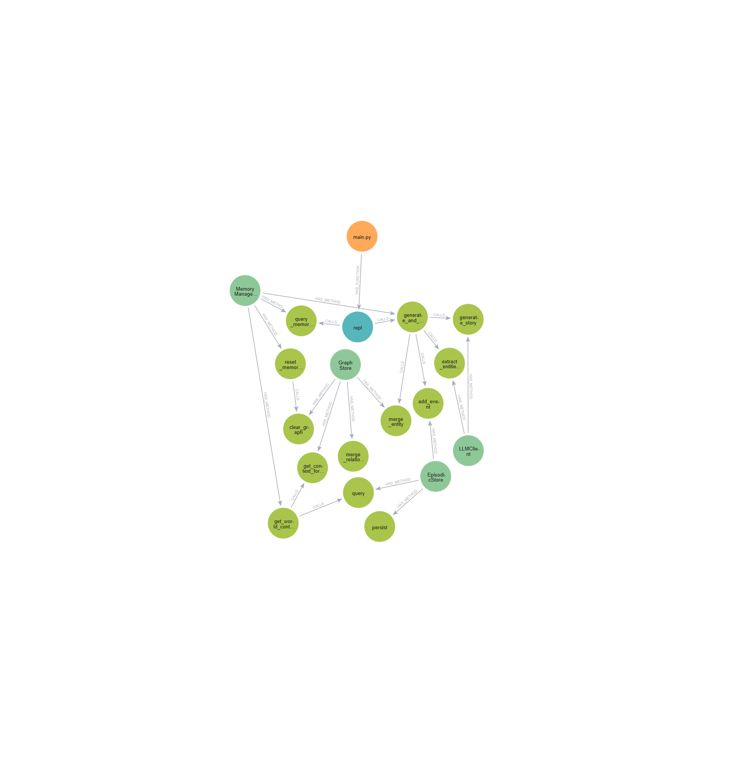
BASIC MODULAR STRUCTURE

Slide 7
DATAFLOW
In the next few slides lets see how our model functions.

Slide 8
MEMORY READ AND RETRIVAL
The player input is sent to the Memory Manager.
It performs a semantic search on the vector storage to find the past information relevant to the player’s current input.
It uses one llm to extract the relevant entities from the player input and past information and then adds the direct relations from the knowledge graph to the context.
Finally, the working buffer is added to the context to finally get a context that remembers the near past and the relevant info about the previous characters and events.

Slide 9
AI RESPONSE GENERATION
The rich, focused context is assembled into a detailed prompt and sent to the other LLM.
The LLM then generates a coherent and consistent narrative response that respects both the immediate action and the long-term history of the world.

Slide 10
MEMORY UPDATE
This is the final step in the process.
The full turn (the player’s input and the Dungeon Master’s response) is saved as a new entry in the vector storage and also the working buffer.
This full turn data is again sent to the initial LLM to extract new facts.
These extracted facts are then saved into the knowledge graph.

Slide 11
Memory Manager Receives Input
Receives the player’s input for processing.
Player Input
The player provides an action or command.
Step 1: Semantic Search
Search vector store (episodic memory) for relevant past events related to input
Step 3: Knowledge Graph
Retrieve direct relationships for extracted entities from GraphStore
Step 2: Entity Extraction
Use LLM to extract relevant entities from current input + retrieved past events
Step 4: Assemble Context
Combine:
- Working buffer (recent actions)
Episodic memory hits
Graph context (entity relationships)
→ Rich, focused context
Generate Narrative via LLM
Sends the assembled context + player input to the narrative LLM.
Generates a coherent and consistent DM response considering both immediate actions and long-term history.

Slide 12
Extract New Facts from DM Response
Uses the initial LLM to identify new entities and relationships from the DM response.
Save Full Turn
Stores the complete turn (player input + DM response) in:
  Episodic vector store
  Working buffer (short-term memory)
Next Turn Preparation
Memory Manager now has updated:
  Working buffer
  Episodic memory
  Knowledge graph
Ready to process the next player input.
Update Knowledge Graph
Saves new entities and relationships in the graph.
Updates entity states (e.g., alive/dead) to maintain consistency.

Slide 13
ADVANTAGES OF OUR MODEL
The key advantage of our model is the knowledge graph which enables the model along with the semantic search to keep track of complex relationships among various entities.
The knowledge graph also holds the state of each entity preventing property collisions such as alive or dead scenarios.

Slide 14
FUTURE ENHANCEMENTS
Adding a dynamic quest management system.
Extracting only the relevant relations from the graph for the user’s query by applying semantic search on them.

Slide 15
THANK YOU !

