Slide 1
WhatsApptimer
Your Best App

Slide 2
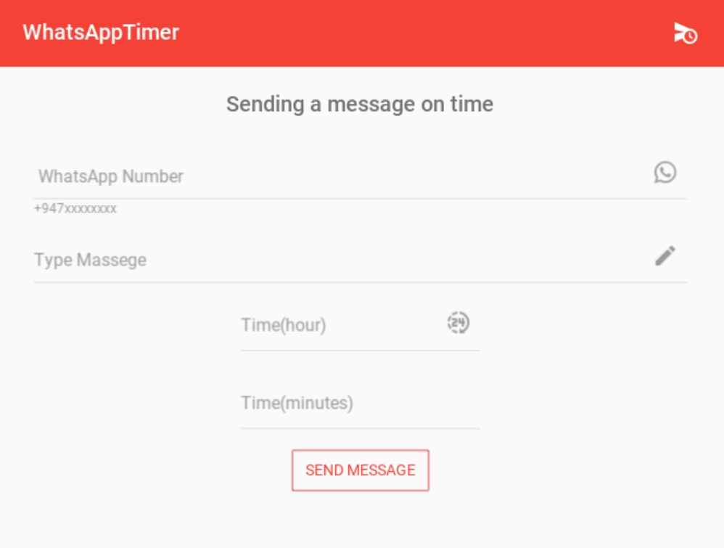
Write your massage and send on time

Slide 3
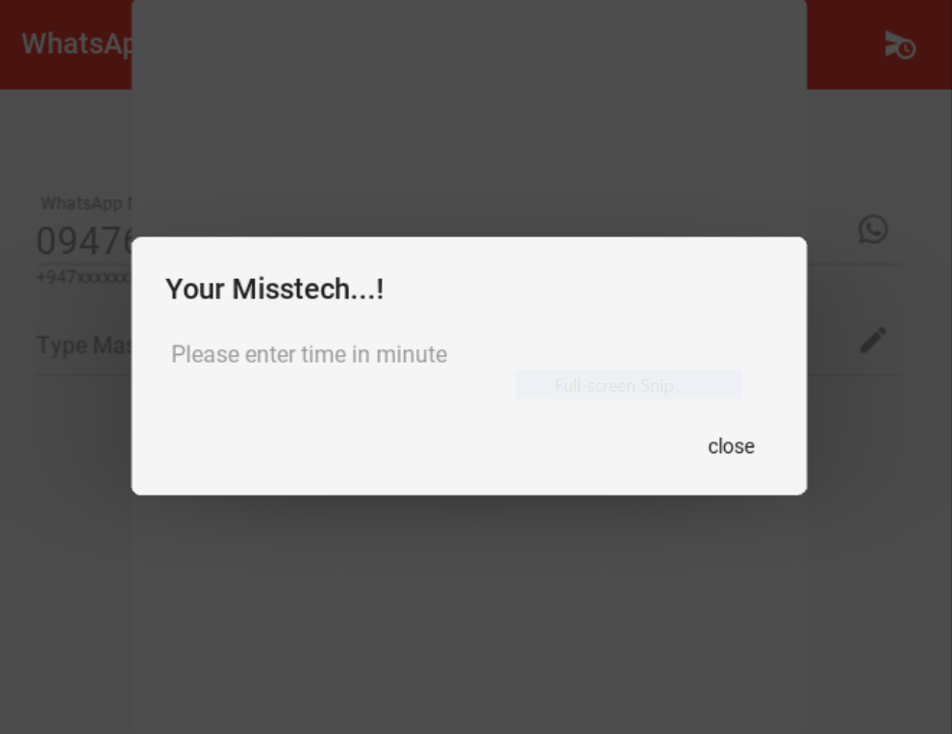
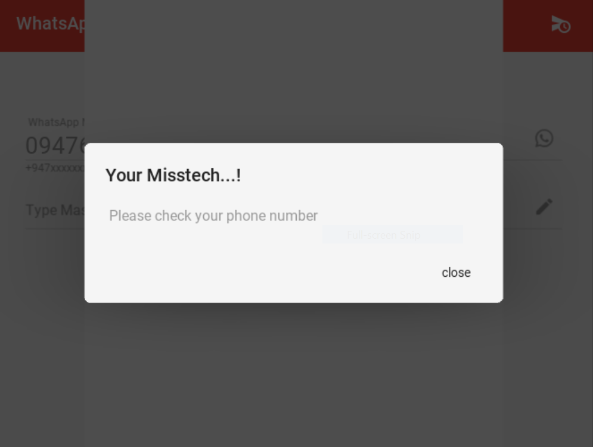
App Show Your Misteck

Slide 4
SENDYOUR FAVOURITE MASSEGE WITH WhatsAppTimmer
THANKYOU..!!!

