Slide 1

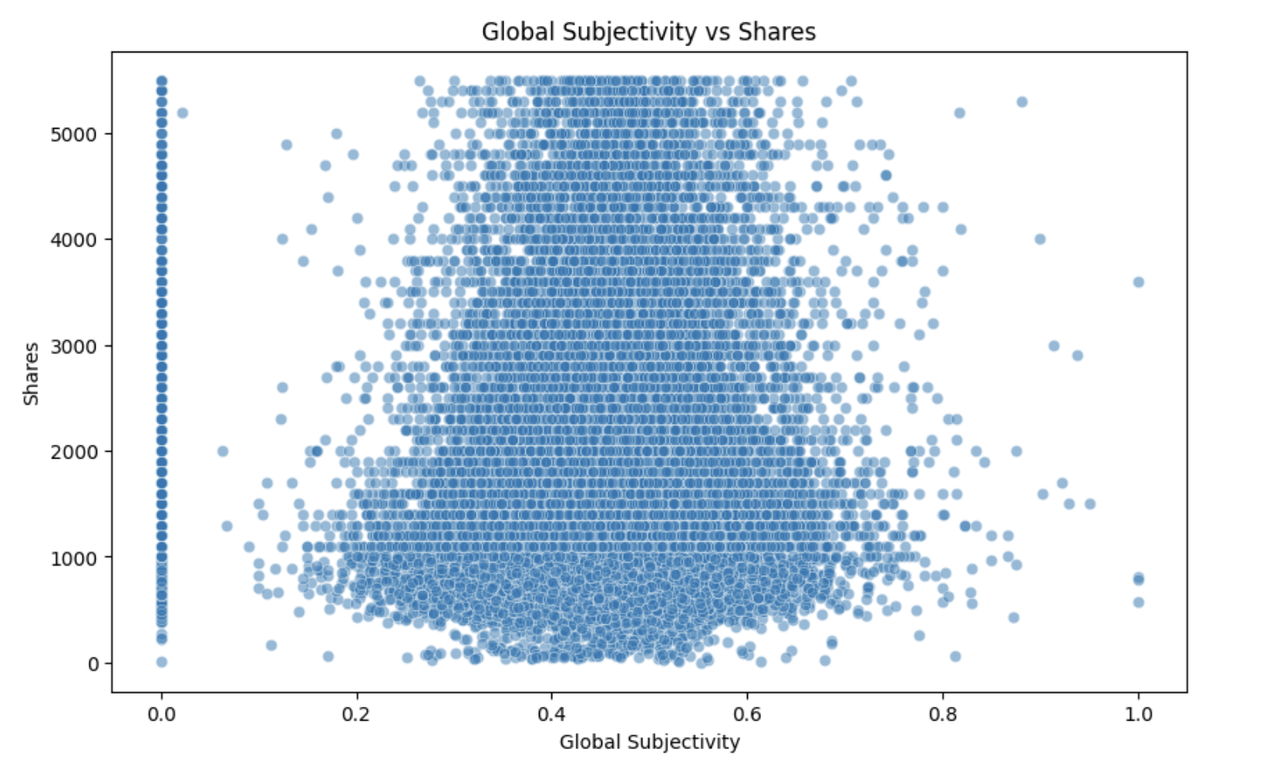
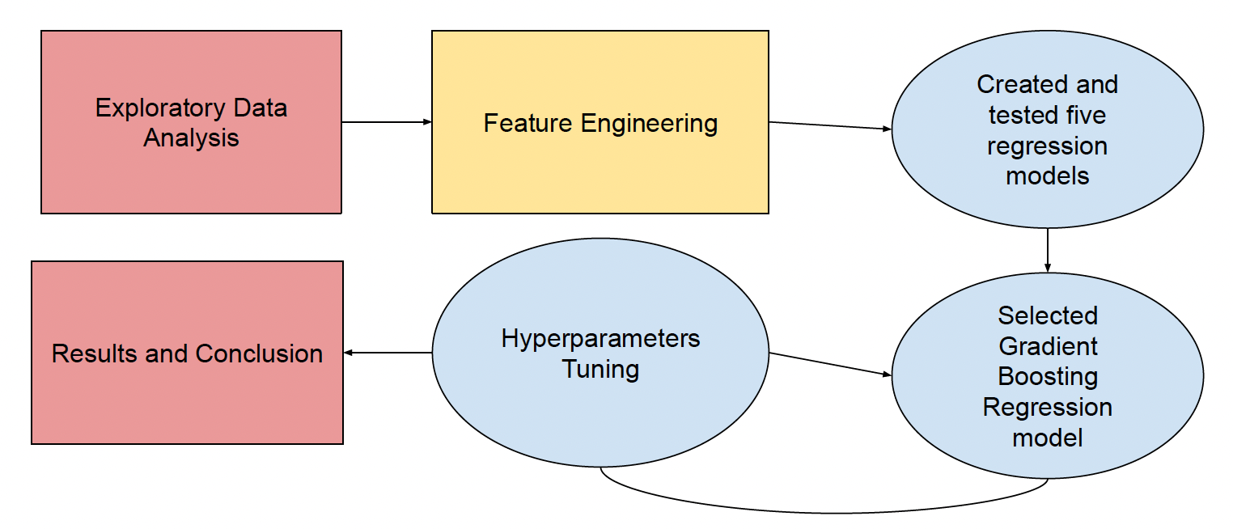
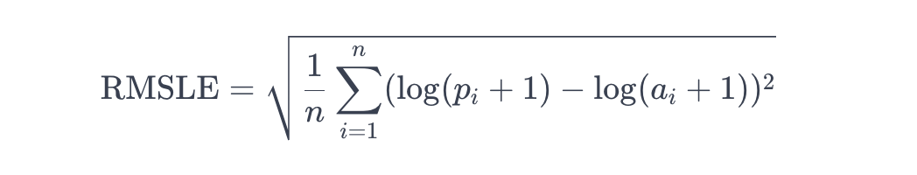
Online News Popularity: New articles Shares Prediction based on various Regression Algorithms and Study of Global Subjectivity impact on Engagement through Shares
Ruchit Patel
Pace University, Seidenberg School of CSIS
Abstract
Dataset
Figures
Social media is one of the main ways that Americans consume news. 48% of American people claim they "often" acquire their news from social media. Facebook is the most widely used social media platform, surpassing all others in usage, with about one-third of American adults frequently obtaining news from it. The aim of this research is to develop a model that can predict how many shares a new article will receive. In order to forecast results with great precision, this research suggests five effective strategies. Many techniques are employed in regression algorithms, including Random Forest Regression, Gradient Boosting Regression, Lasso Regression, Ridge Regression, and Linear Regression. There are two sections to the dataset. Testing and training are divided into 80% and 20%, respectively. The Gradient Boosting Regressor model with the lowest RMSLE score was selected after the initial run, and its hyperparameters were altered to improve it further. The next step toward comprehending shares will be sentiment analysis, which will look into how text analysis and natural language processing (NLP) can be used to extract subjective information from titles and find patterns in them. This will help us understand how titles contribute to the number of shares.
This dataset compiles a variety of characteristics from articles that Mashable published over a two-year period. Predicting the quantity of shares (popularity) in social networks is the aim. The dataset contains almost 40,000 instances of records with over 60 features.
Associated Tasks : Regression
Target Variable: Shares
 | First Run | After Feature Engineering | Hyperparameter Tuning
Linear Regression | 0.865 | 0.582 | -
Ridge Regression | 0.864 | 0.582 | 0.581
Lasso Regression | 0.926 | 0.626 | 0.581
Random Forest Regression | 0.846 | 0.562 | 0.56
Gradient Boosting Regression | 0.842 | 0.56 | 0.55
Methodology
Figure 2 – RMSLE scores for each regression model
Firstly, it is important to began with Exploratory Data Analysis to understand your data set and try to figure any important patterns. During this step I created new categorical columns names to create visualization. Next , I standardize the features and created 5 regression, Linear Regression, Ridge, Lasso, Random Forest and Gradient Boosting. I selected the regression model with the lowest RMSLE score. Next, I improve the model by using feature engineering by tuning hyperparameters and reducing noise by removing outliers. In order to better understand the relationship between Global Subjectivity, I created correlation matrix and graphed the visualization.(Figure 1).
Figure 3 – No solid correlation between Global Subjectivity and Number of Shares
Research Question
Conclusions and Future Work
How does Global Subjectivity impact the number of news Shares on social media? (News that are shared the most are subjective or objective?)
Can we build a machine learning model which can predict the number of shares an article is going to get based on the features on the articles?
Which machine learning model will be the best fit to predict number of shares regarding the dataset?
Remarkably, most features have a very weak correlation with the target variable, nonetheless, global subjectivity has a very weak correlation with the number of times an article is shared. The maximum correlation between the average keyword and shares was 0.110413. The gradient boosting model was used because it had the best RMSLE score compared to other models and generally performed well with tabular datasets.
It will be interesting to investigate whether the article's title affects how many shares it receives. Utilize sentiment analysis to investigate how text analysis and natural language processing (NLP) can be used to find and extract subjective information from titles in order to comprehend how titles affect the number of shares.
Results
Related Work
Each model were evaluated by using Root Mean Squared Logarithmic Error (RMSLE) scores. RMSLE is a metric used to evaluate machine learning the regression models.
The data set was Divided into a ratio of 80% training and 20% testing. Next, I trained 5 most common regression model recorded the RMSLE score.
To improve the RMSLE scores, I went back and eliminated more noise from the dataset. Which brought down the RMSLE score hence improve the model. I then did some hyperparameter tuning on the Gradient Boosting Regression model since it had the best score
Global Subjectivity does not play a significant role in accurately predicting the number of shares
Gradient Boosting Regression is the machine learning model which proved to be the best fit in predicting numbers of shares with RMSLE score of 0.55.
References
Existing research that deals with electricity price prediction introduces the idea of comparing different machine learning models and using hyper parameters to improve the model. [S. Orenc]. A study by [K. D. Garg] explained the use of RMSLE scores to evaluate the model which is something I have included into this project to evaluate my models. Most of the research paper experiments with multiple testes to determine the accuracy of there models but I wanted to have one Technique with multiple models
K. D. Garg, M. Gupta, B. Sharma and I. B. Dhaou, "A Comparison of Regression Techniques for Prediction of Air Quality in Smart Cities," 2023 1st International Conference on Advanced Innovations in Smart Cities (ICAISC), Jeddah, Saudi Arabia, 2023, pp. 1-6, doi: 10.1109/ICAISC56366.2023.10085369.
S. Orenc, E. Acar and M. S. Özerdem, "The Electricity Price Prediction of Victoria City Based on Various Regression Algorithms," 2022 Global Energy Conference (GEC), Batman, Turkey, 2022, pp. 164-167, doi: 10.1109/GEC55014.2022.9986605.
C. G. Raju, V. Amudha and S. G, "Comparison of Linear Regression and Logistic Regression Algorithms for Ground Water Level Detection with Improved Accuracy," 2023 Eighth International Conference on Science Technology Engineering and Mathematics (ICONSTEM), Chennai, India, 2023, pp. 1-6, doi: 10.1109/ICONSTEM56934.2023.10142495.

