Slide 1
JPA 2.0
Rajeev Gupta

Slide 2
JPA?
What is JPA?
JSR 220, JSR-317 ,Java Persistence 2.0
Specification implemented by : Hibernate , eclipseLink, topLink etc
JPA abstraction above JDBC
javax.persistence package
Component of JPA?
ORM
Entity manager API CRUD operations
JPQL
Transactions and locking mechanisms when accessing data concurrently provided by:
Java Transaction API (JTA)
Resource-local (non-JTA)
Callbacks and listeners to hook business logic into the life cycle of a persistent

Slide 3
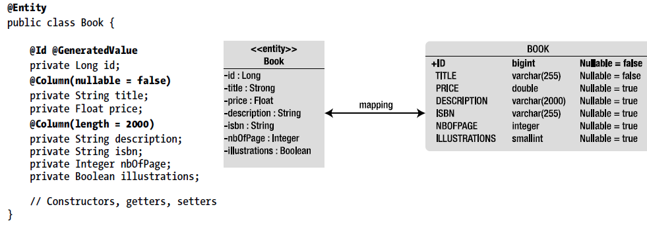
Entity

Slide 4
Rule to be Entity
Entity class must be:
Annotated with @javax.persistence.Entity
@javax.persistence.Id annotation must be used to denote primary key
Must have a no-arg constructor that has to be public or protected.
Must be a top-level class.
Entity class must not be final.
No methods or persistent instance variables of the entity class may be final
May implements Serializable interface

Slide 5
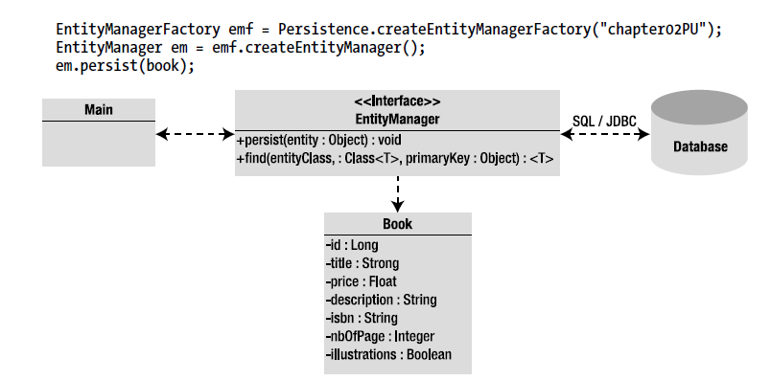
EntityManager interacts with Entity

Slide 6
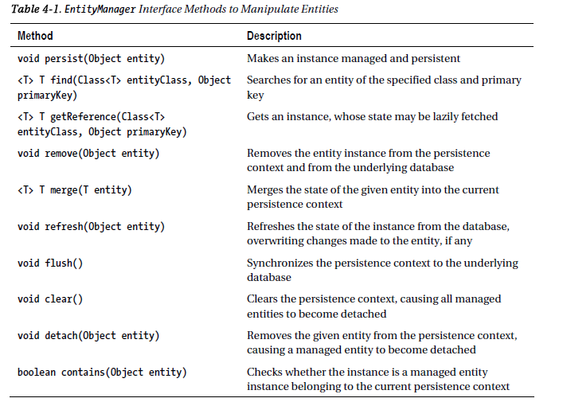
EntityManager Methods

Slide 7
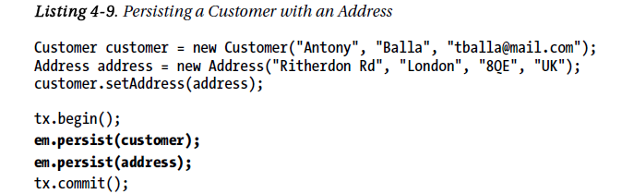
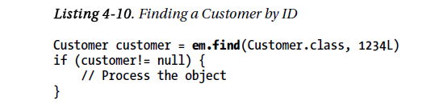
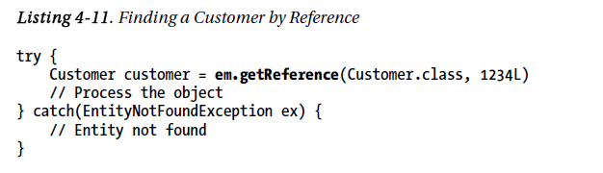
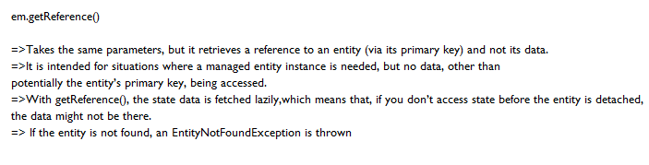
EntityManager Methods

Slide 8
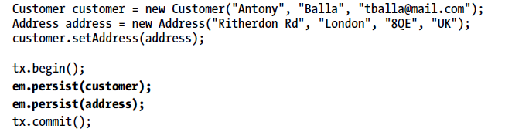

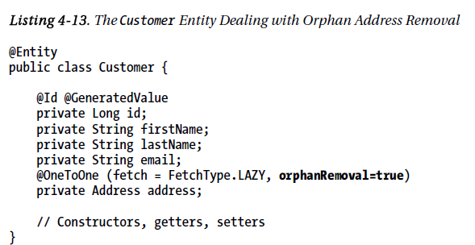
EntityManager Methods remove()

Slide 9
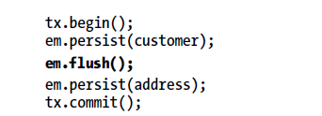
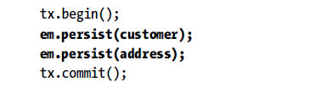
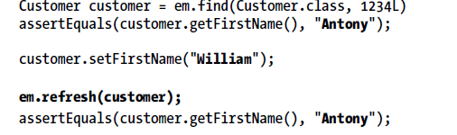
EntityManager Methods persist(), flush(), refresh()
Forcing persistence to flush the data, to synch with DB
The refresh() method is used for data synchronization in the opposite direction of the flush, meaning it
overwrites the current state of a managed entity with data as it is present in the database. A typical case
is where the EntityManager.refresh() method is used to undo changes that have been done to the entity
in memory only. The test class snippet in Listing 4-14 finds a Customer by ID, changes its first name, and
undoes this change using the refresh() method.

Slide 10
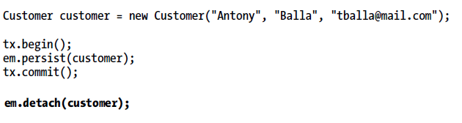
EntityManager Methods :Clear and Detach
The clear() method is straightforward: it empties the persistence context, causing all managed entities to become detached.
The detach(Object entity) method removes the given entity from the persistence context.
Changes made to the entity will not be synchronized to the database

Slide 11
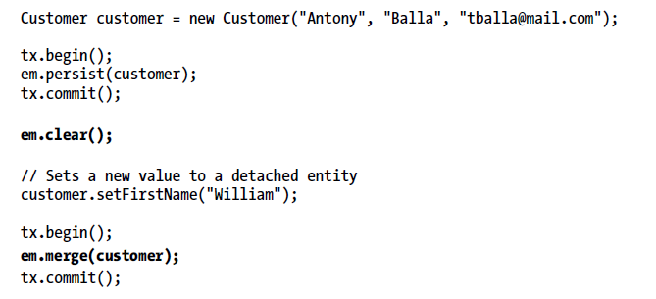
Merging an Entity
A detached entity is no longer associated with a persistence context. If you want to manage it, you need to merge it.
Let’s take the example of an entity that needs to be displayed in a JSF page. The entity is first loaded from the database in the persistent layer (it is managed), it is returned from an invocation of a local EJB (it is detached because the transaction context ends), the presentation layer displays it (it is still detached), and then it returns to be updated to the database.
However, at that moment, the entity is detached and needs to be attached again, or merged, to synchronize its state with the database.

Slide 12
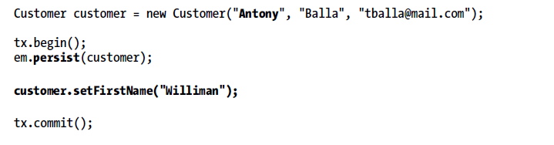
Updating an Entity

Slide 13
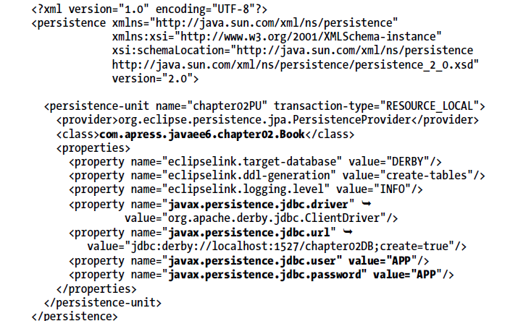
persistence.xml

Slide 14
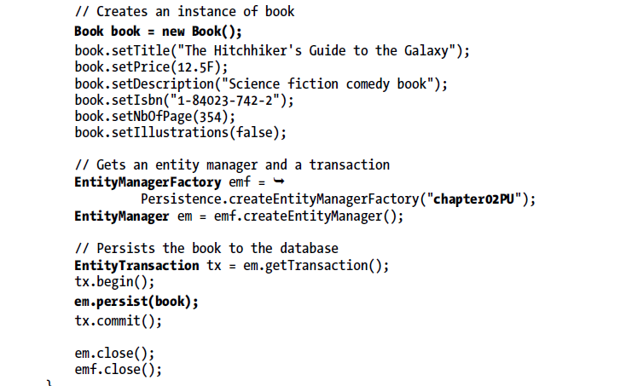

Inserting Record

Slide 15
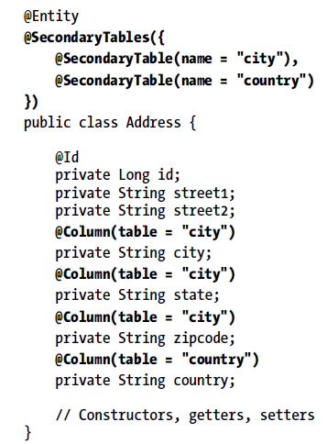
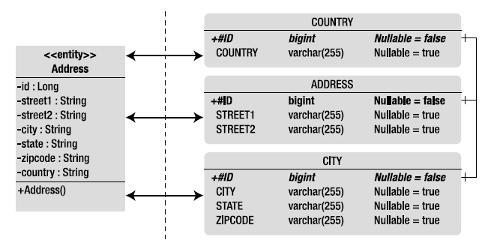
@SecondaryTable
Data need to spread across multiple tables called secondary tables
Use annotation @SecondaryTable to associate a secondary table to an entity or @SecondaryTables (with an “s”) for several secondary tables
Entity Address Mapped to 3 tables

Slide 16
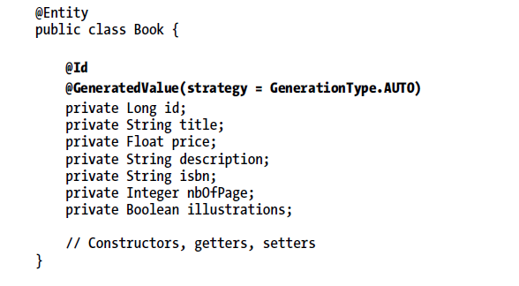
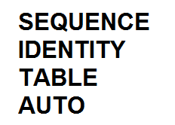
@Id and @GeneratedValue

Slide 17
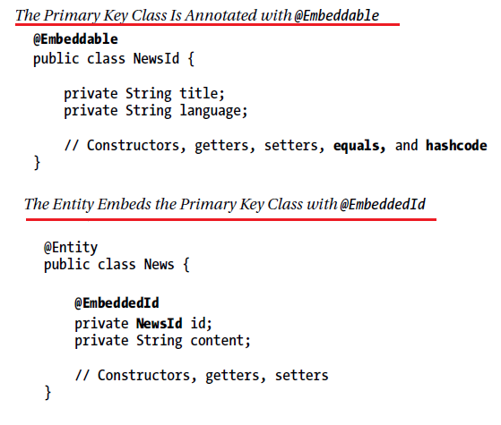

Composite Primary Keys

Slide 18
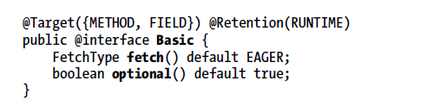
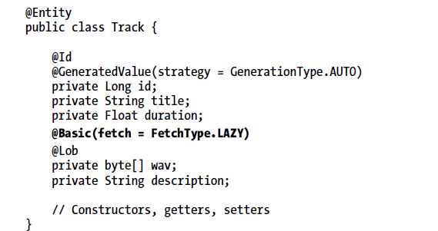
@Basic

Slide 19
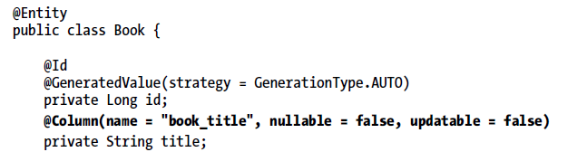
@Column
Define properties of an column

Slide 20
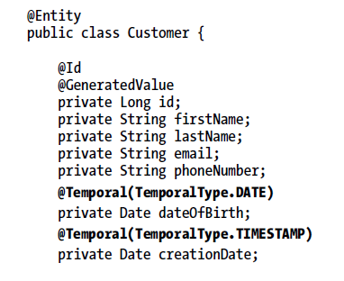
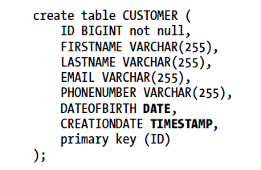
@Temporal

Slide 21
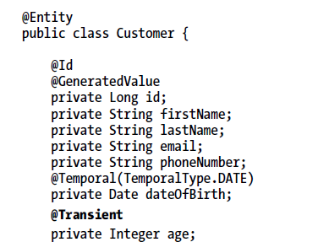
@Transient
Don’t get stored in DB

Slide 22
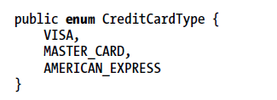
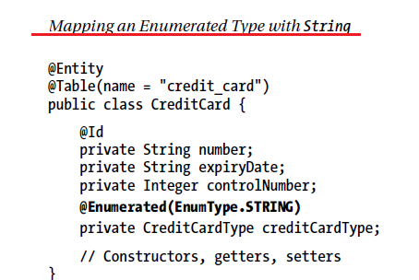
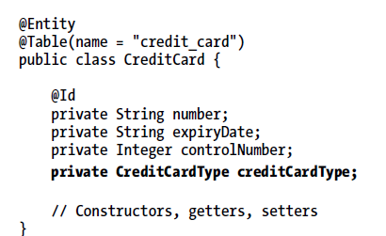
@Enumerated

Slide 23
Collection of Basic Types
@ElementCollection annotation is used to indicate that an attribute of type java.util.Collection contains a collection of instances of basic types (i.e., nonentities)
Attribute can be of the following types:
• java.util.Collection: Generic root interface in the collection hierarchy.
• java.util.Set: Collection that prevents the insertion of duplicate elements.
• java.util.List: Collection used when the elements need to be retrieved in some
user-defined order.

Slide 24
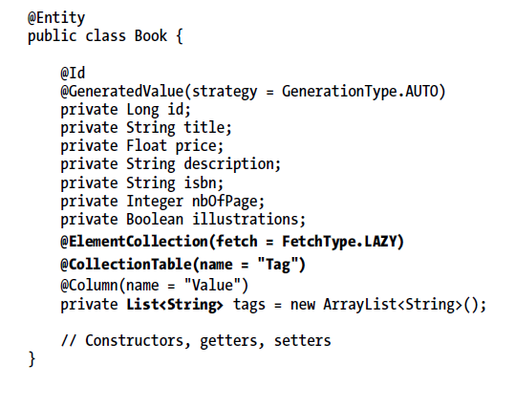
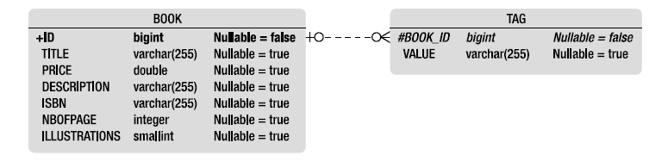
Collection of Basic Types
Book Entity with collection of Strings

Slide 25
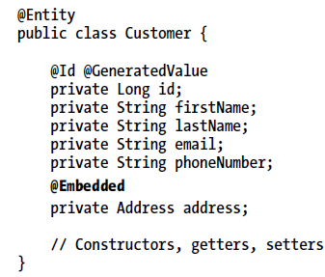
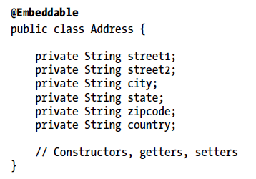
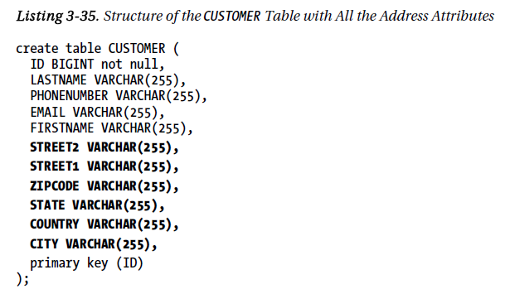
Embeddables

Slide 26
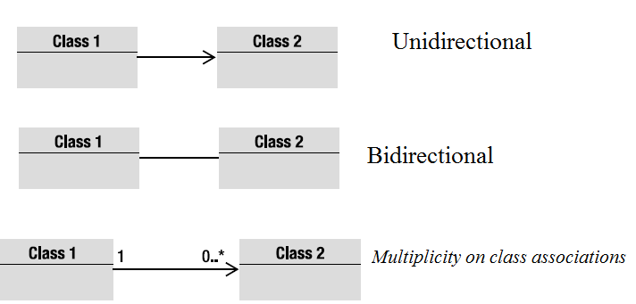
Relationship Mapping
OO relations
Association between the Objects
IS-A, HAS-A, USE-A
An association has a direction:
Unidirectional
Bidirectional

Slide 27
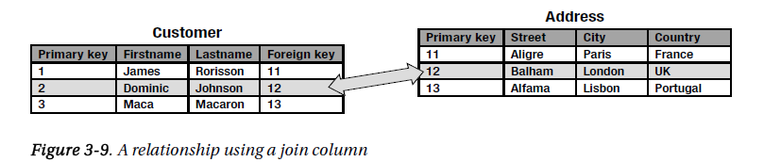
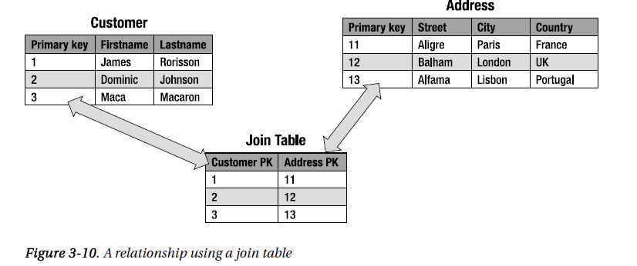
Relationships in Relational Databases

Slide 28
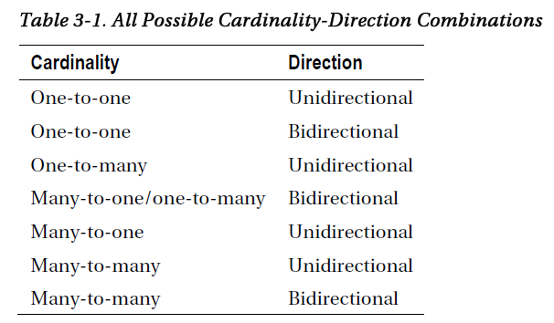
Entity Relationships

Slide 29
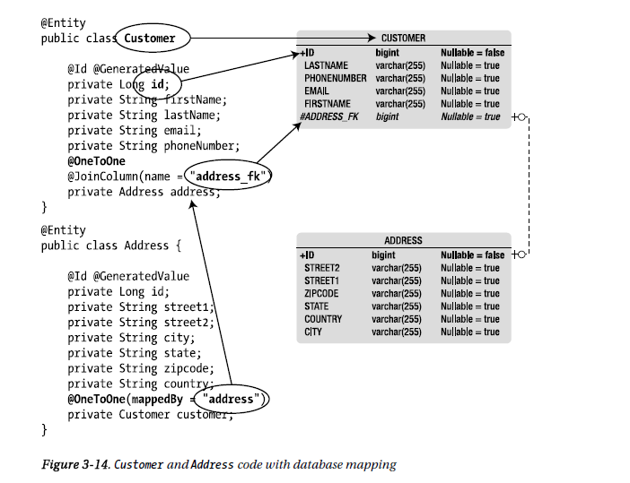
One to one Bidirectional

Slide 30
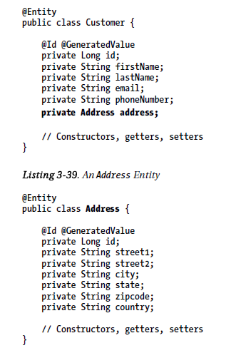
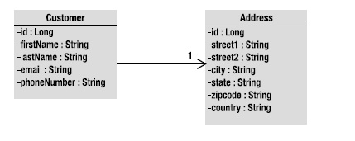
One to one Unidirectional

Slide 31
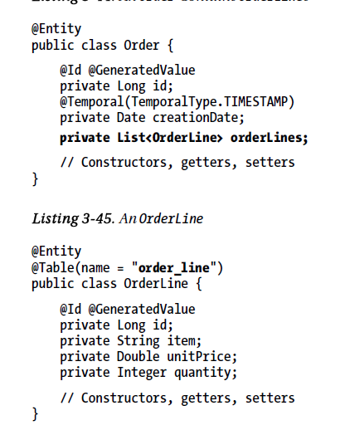
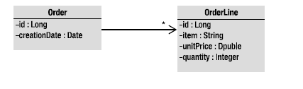
One to many unidirectional

Slide 32
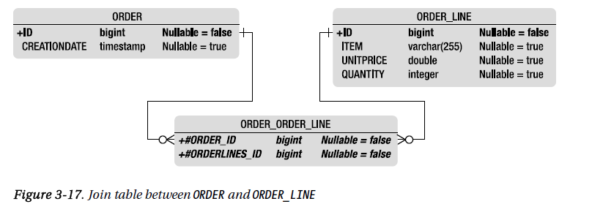
One to many unidirectional
Previous annotations leads to mapping that relies on the configuration-by exception paradigm.
By default relationships use a join table to keep the relationship information, with two foreign key columns. One foreign key column refers to the table ORDER and has the same type as its primary key, and the other refers to ORDER_LINE. The name of this joined table is the name of both entities, separated by the _ symbol.
The join table is named ORDER_ORDER_LINE and will result in the schema structure :-

Slide 33
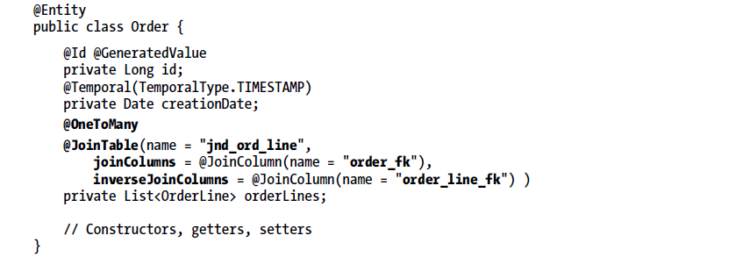
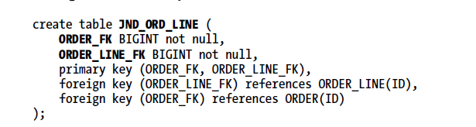
One to many unidirectional
Controlling join tables name, fields etc

Slide 34
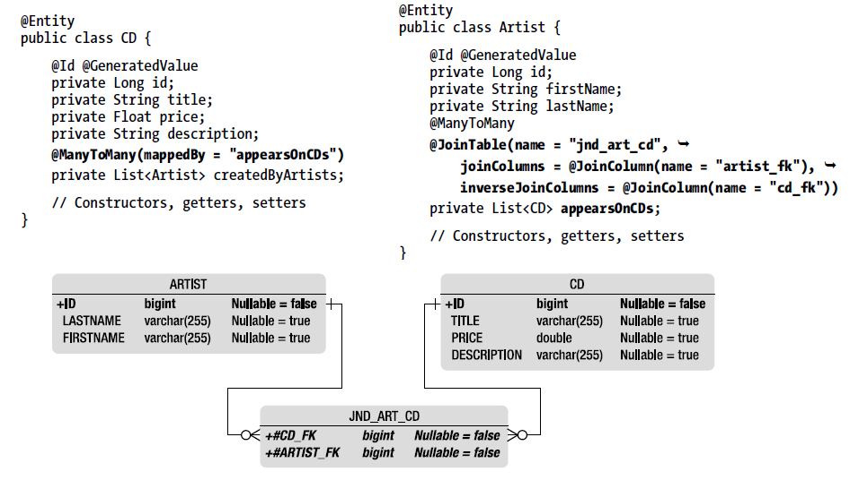
Many to Many Bi-directional

Slide 35
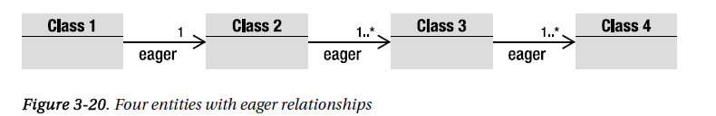

Fetching Relationships
Consider four entities related by eager strategy

Slide 36



Fetching Relationships

Slide 37


@OrderBy
Dynamic ordering can be done with the @OrderBy annotation. “Dynamically” means that the ordering of the elements of a collection is made when the association is retrieved

Slide 38
Inheritance Mapping
JPA has three different strategies to choose from:-
A single-table-per-class hierarchy strategy
The sum of the attributes of the entire entity hierarchy is flattened down to a single table
This is the default strategy
A joined-subclass strategy
In this approach, each entity in the hierarchy, concrete or abstract, is mapped to its own dedicated table.
A table-per-concrete-class strategy
This strategy maps each concrete entity hierarchy to its own separate table

Slide 39

Inheritance Mapping

Slide 40





Single-Table-per-Class Hierarchy Strategy

Slide 41
Single-Table-per-Class Hierarchy Strategy(II)
Discriminator column is called DTYPE by default, is of type String (mapped to a VARCHAR), and contains the name of the entity.
If the defaults don’t suit, the @DiscriminatorColumn annotation allows you to change the name and the data type.
By default, the value of this column is the entity name to which it refers, although an entity may override this value using the @DiscriminatorValue annotation.

Slide 42




Single-Table-per-Class Hierarchy Strategy(III)

Slide 43


Joined-Subclass Strategy

Slide 44


Table-per-Concrete-Class Strategy

Slide 45

JPQL
Under the hood, JPQL uses the mechanism of mapping to transform a JPQL query into language comprehensible by an SQL database.
The query is executed on the underlying database with SQL and JDBC calls, and then entity instances have their attributes set and are returned to the application—all in a very simple and powerful manner using a rich query syntax.

Slide 46

Binding Parameters

Slide 47

Hibernate vs JPA

Slide 48
Hibernate vs. JPA

Slide 49

Entity Life Cycle

Slide 50

Hibernate.cfg.xml

Slide 51


Adding record

