Slide 1
PREDICT THE SENTIMENT
Presented by:
Ankita Datta
Ruchita Patil
Heera Kesavan
Komal Bharadva

Slide 2
BUSINESS PROBLEM
Twitter has now become a useful way to build one's business as it helps in giving the brand a voice and a personality.
To identify the user’s sentiment about the product/brand based on the user’s tweets.
To discover customer trends and interests and launch a product accordingly

Slide 3
BUSINESS IMPACT
To design a marketing campaign based on user’s sentiment
To help business take better actions for a new product based on feedback received.
To gain the pulse of competing products and associated sentiment from social media

Slide 4
Dataset
The training dataset is a csv file of type tweet_id, sentiment, tweet where the tweet_id is a unique integer identifying the tweet, sentiment is either 1 (positive) or 0 (negative), and tweet. Similarly, the test dataset is a csv file of type tweet_id, tweet.

Slide 5
1
FIRST STEPS EDA
Let’s start with the first set of Visualizations

Slide 6
What is SXSW?
South by Southwest Interactive conference is an event known for giving tech trends the momentum to hit the masses.
The event takes place every year in mid-March in Austin, Texas, United States and is recognized as a testing ground for emerging social apps and technologies.
The show has developed a reputation as a tech launch pad, thanks to two spectacular case studies: Twitter and Foursquare.
Twitter had been around for nine months by the time SXSW 2007 opened, but its user base skyrocketed after the show
Two years later, location-based networking service Foursquare pulled off a similar trick, launching its check-in service at SXSW 2009

Slide 7
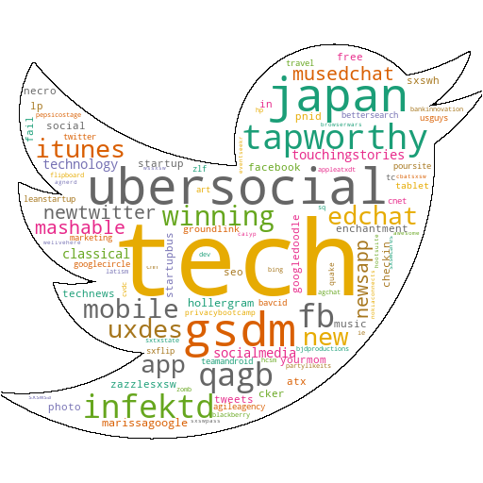
TOP HASHTAGS AT SXSW 2011
New UberSocial app was launched for iphone with UberGuide to #sxsw feature in partnership with mashable which included topic streams and also allowed people who couldn’t make it Austin a sense being a part of this amazing event.
qagb –Questions and answers session held by Google and Bing on Website Ranking and SEO
Gsdm -Advertising Agency in Austin held an industry party co-hosted with google

Slide 8
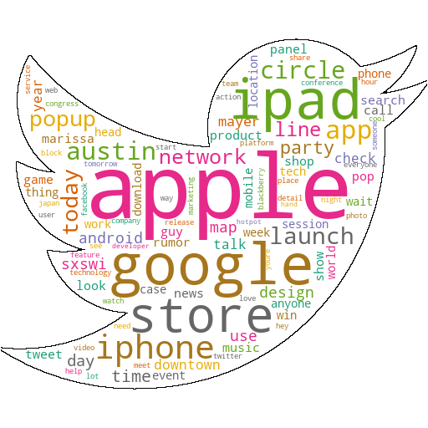
TWEETS AT SXSW 2011
Apple and Google were the most talked about brands at SXSWI 2011
Apple launched the Ipad 2 at the event and had set up a popup store to cater to the crowds.
There was a lot of anticipation around Google launching its social network app Google Circles to compete with Facebook.
Google's Marissa Mayer gave a talk on the future of location: augmented reality, contextual discovery, making smartphones smarter.

Slide 9
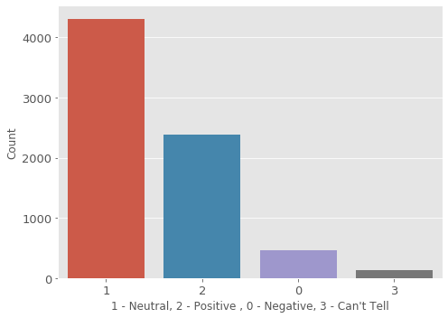
SENTIMENT DISTRIBUTION ACROSS TWEETS
Out of 7273 tweets for the SXSW event around 4311 were neutral which was around 60%.
Around 2382 tweets were positive around 32%.
456 tweets had been negative which were around 7%.
And for 125 tweets, the sentiment could not be predicted.

Slide 10
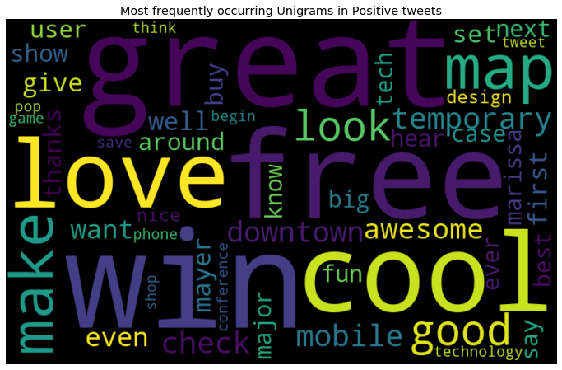
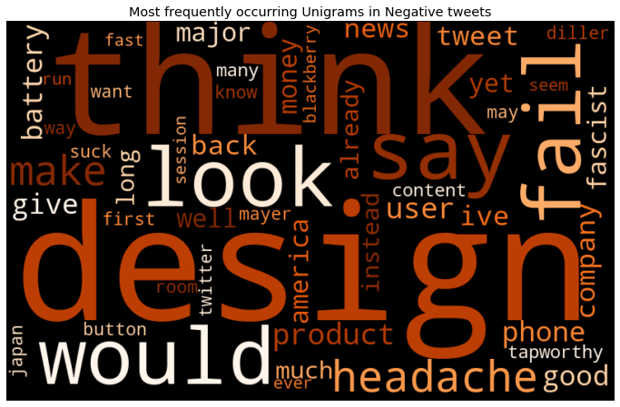
POSITIVE AND NEGATIVE WORDS
By the time of this event, 40% of google maps usage was through mobile phones.
People were mostly not happy with the design and battery.

Slide 11
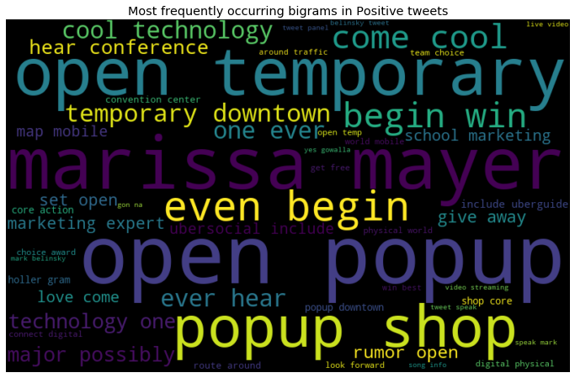
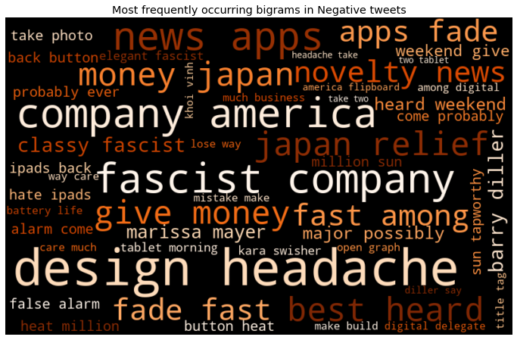
POSITIVE AND NEGATIVE BIGRAMS
Apple’s popup store to sell iPad2 generated a lot of positive buzz at the event.
Fascist Company - Apple seems to want to be able to control every aspect of how we engage with the virtual. This was disliked by a lot of users.

Slide 12
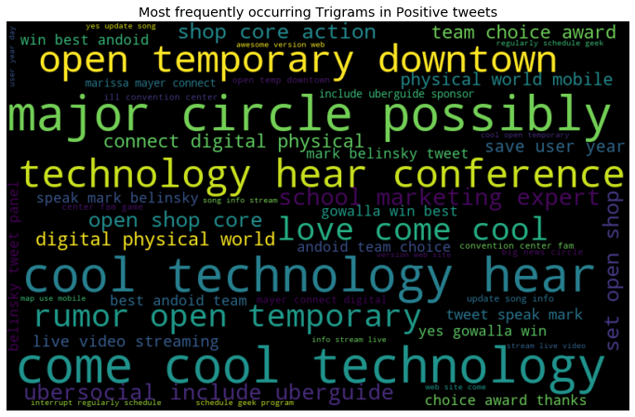
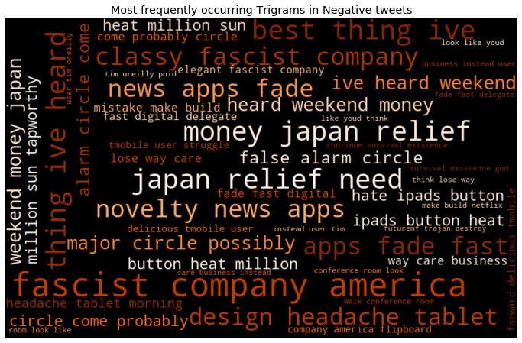
POSITIVE AND NEGATIVE TRIGRAMS
Gowalla- a Geosocial networking app won the best Android app at the Team Android Choice Awards
Many attendees were deeply affected by the Japan crisis and considered donating the money instead of buying an ipad2.

Slide 13
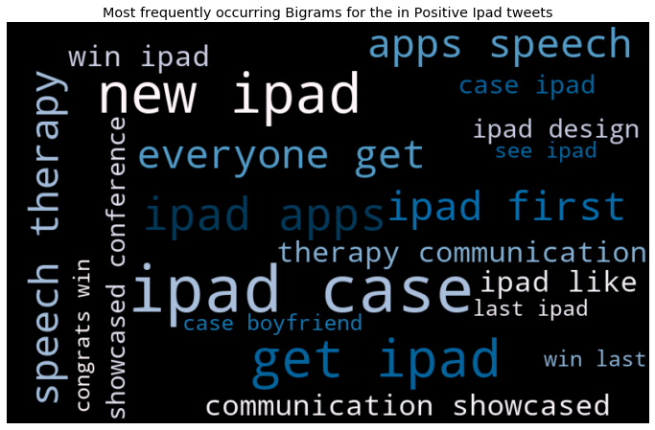
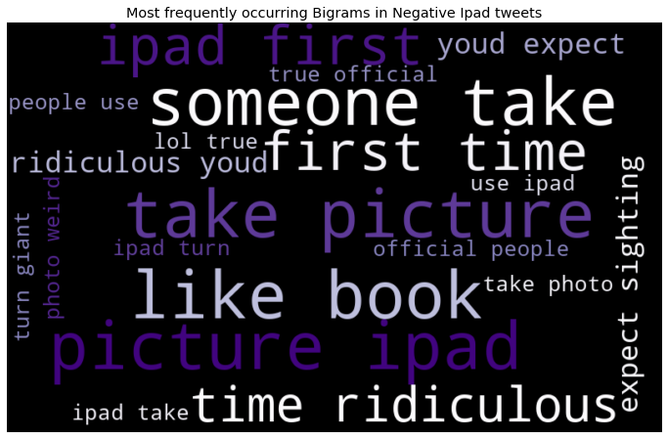
IPAD2 SENTIMENT ANALYSIS
New iPad apps were launched for speech therapy and was liked by the attendees.
Many attendees were unhappy with the iPad 2 camera.

Slide 14
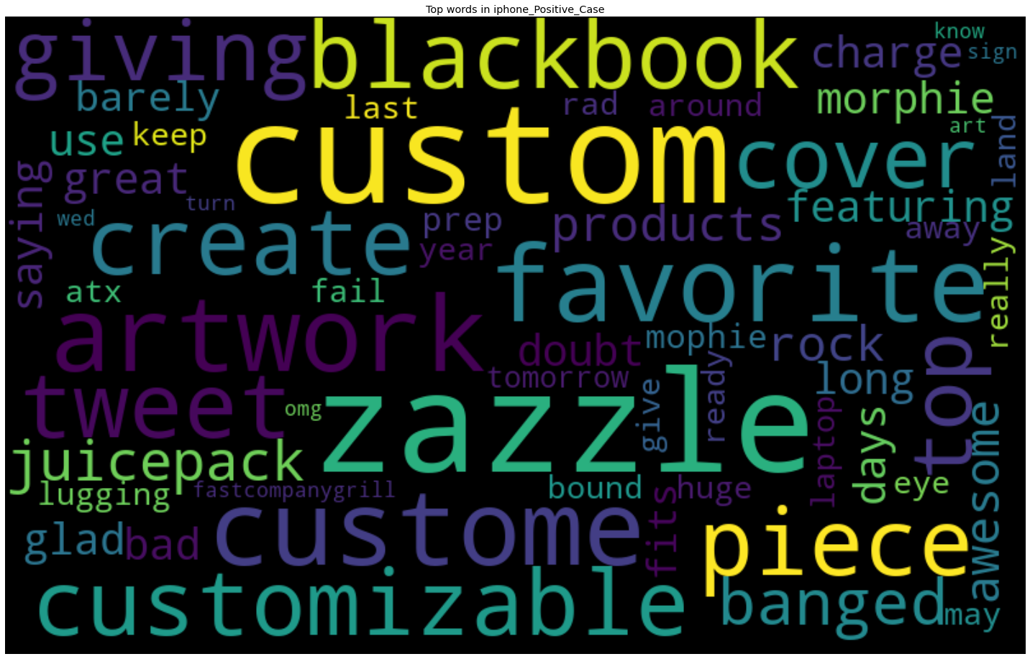
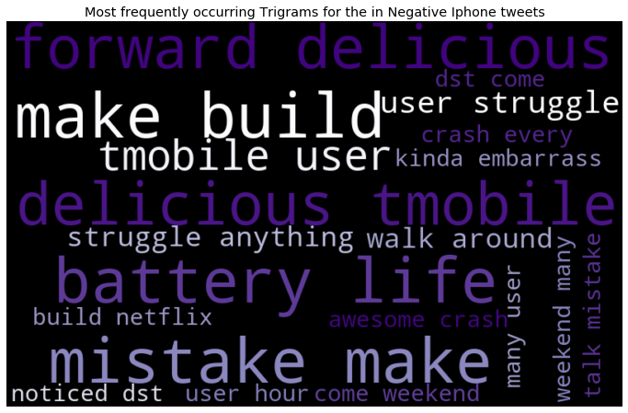
IPHONE SENTIMENT ANALYSIS
Customizable cases for iPhone
Battery Issues on iPhone

Slide 15
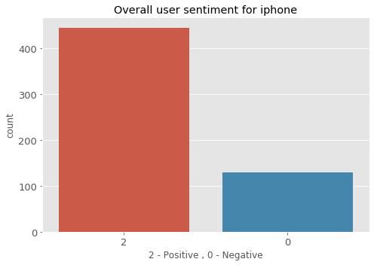
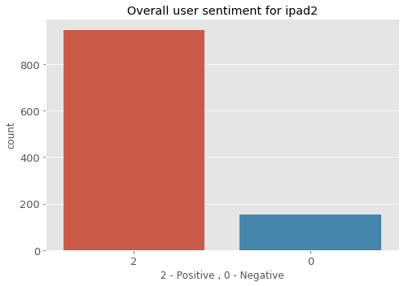
IPHONE & IPAD SENTIMENT AT THE EVENT
For iPad : 86% of the tweets were positive and 14% of them were negative.
For iPhone : 77% were positive and 23% of them were negative.

Slide 16

DATA PREPROCESSING STEPS
Dropped a blank Tweet
Converted entire tweets to lower case
Removed user handles and RT
Removed URLs
Removed Stop words, Punctuation and Digits.
Handled negative words(isn’t to is not)
Chat words conversion/slangs (fyi – for your information)
Replacing emoticons & emojis with words.
Lemmatization with POS tags.

Slide 17
MODELLING
Feature Extraction
Handle Imbalanced Data
Model Fitting and Prediction
- Count Vectorizer
- TFIDF Vectorizer
SMOTE was used to generates synthetic samples for treating the data imbalance issue
Logistic Regression, Linear SVC, Naive Bayes and Random Forest were the models applied on data

Slide 18
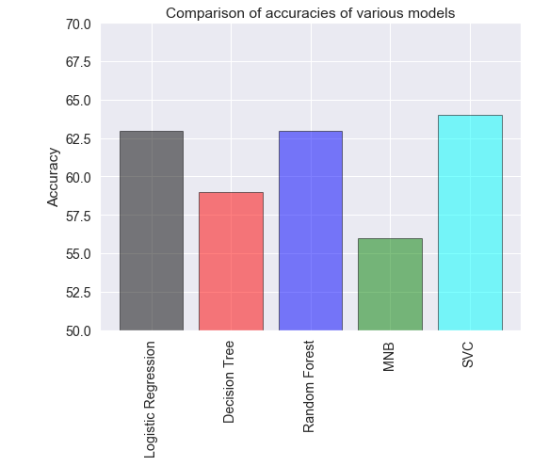
Baseline Model

Slide 19
Model Scores
Model | Weighted F1 Score
Logistic Reg with TF-IDF | 0.627
Logistic Reg with Count Vect. | 0.653
Logistic Reg with Hashing Vect. | 0.613
SVC with TF-IDF | 0.636

Slide 20
Model Tuning
Model | Weighted F1 Score | Best Parameters
LinearSVC with RandomizedSeacrhCV | 0.656 | {'penalty': 'l2', 'max_iter': 1000, 'C': 0.8}
LinearSVC with GridSearchCV | 0.603 | {'C': 1.2, 'max_iter': 150, 'penalty': 'l2'}
Random Forest Classifier | 0.606 | {'n_estimators': 10, 'max_features': 100, 'max_depth': 60, 'criterion': 'gini', 'bootstrap': 'False'}

Slide 21
ACTIONABLE INSIGHTS
SXSW is a tech launch pad. Participating in such events will help the company’s products and ideas to reach large number of people.
Similar to google, throw industry party at such events and conduct some tech sessions so that the company and to some extent the product will be in top trending list in tech world which would surely augment the global recognition of the product as well as the company.
Following the marketing strategies of tech giants like apple and Google, do social media marketing prior to such events which will definitely increase the anticipation among people about the product.
Learn from the negative reviews of other similar kind of products participated in such events to avoid such mistakes, since as startup one could not afford to make changes in their products again and again. This also will help in providing best impression at first, which is required to create faith in public about the product

Slide 22
Next Steps
Handling emotion ranges
Using symbols
Building a classifier for Hindi tweets
Improving Results using Semantics Analysis

Slide 23
THANKS!

