Slide 1



Sustainable Supply Chain Performance Dashboard : Power BI Project

Slide 2

Learning Objectives
Understand supply chain sustainability
Analyze data for decision-making
Develop interactive Power BI dashboards
GOAL
Source :
www.freepik.com/

Slide 3
Tools and Technology used
Power BI: For creating interactive dashboards and visualizations
Microsoft Excel: For data preprocessing and analysis
Data Visualization Techniques: For effectively representing sustainability KPIs

Slide 4
Methodology
Data Collection: Organized and structured the provided data for analysis
Data Cleaning & Transformation: Ensured data accuracy by handling inconsistencies and formatting issues
Dashboard Design: Built an interactive Power BI dashboard to visualize key sustainability metrics
Data Analysis & Insights: Interpreted trends and patterns to support data-driven decision-making

Slide 5
Problem Statement:
Organizations face challenges in monitoring and improving their supply chain sustainability due to a lack of real-time visibility, difficulty in tracking sustainability metrics, and fragmented data sources. This results in inefficient decision-making and an inability to achieve sustainability goals effectively.

Slide 6
Solution:
Designed and developed a Power BI dashboard to provide real-time visibility into supply chain performance.
Integrated key sustainability KPIs for tracking environmental impact.
Centralized data from multiple sources to eliminate data silos, enabling data-driven decision-making for optimizing supply chain sustainability.

Slide 7
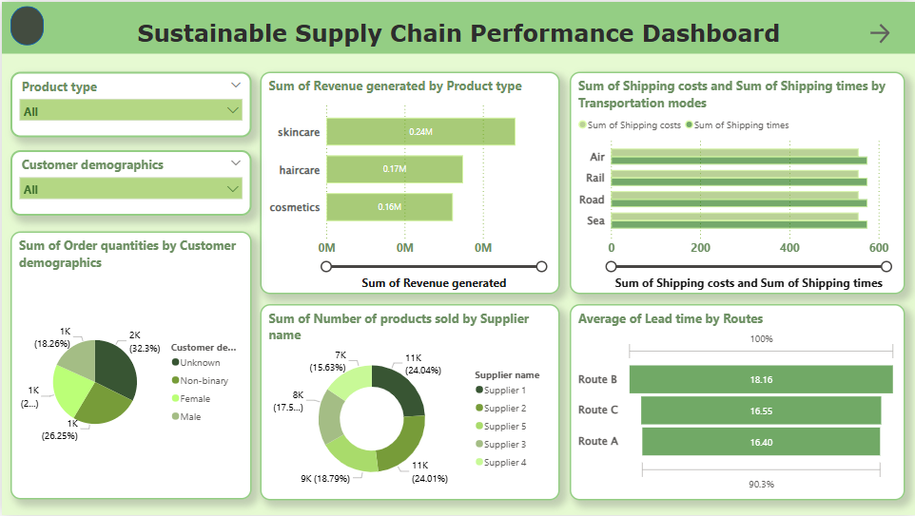
Screenshot of Output:

Slide 8
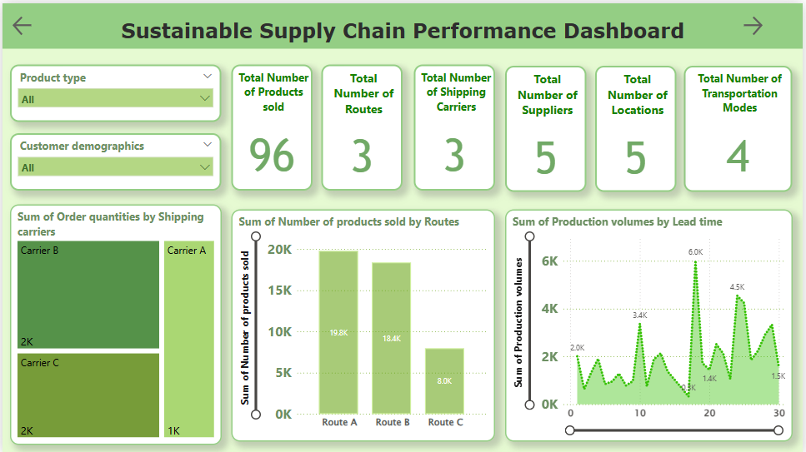
Screenshot of Output:

Slide 9
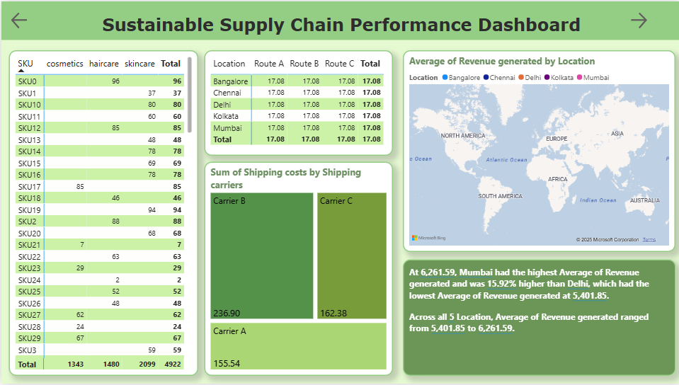
Screenshot of Output:

Slide 10
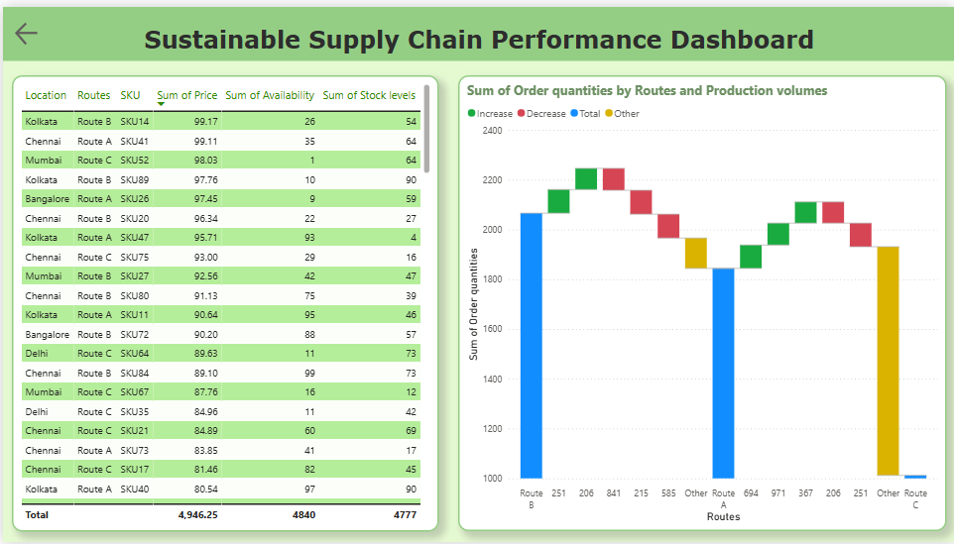
Screenshot of Output:

Slide 11
Conclusion:
Enhanced visibility into supply chain performance through real-time analytics
Improved sustainability tracking by integrating key performance indicators (KPIs).
Future scope: Implementing AI-based predictive analytics for proactive decision-making.

