Slide 1

Ment_Amiga
Mental Health Chatbot to Address the Psychological Impact of Modern Stressors

Slide 2

Social impact
Empowering Mental Well-being Globally:
Breaking Stigmas: Our chatbot fosters a judgment-free space, reducing societal stigma around mental health seeking.
Global Accessibility: Democratizing mental health support, reaching diverse populations 24/7.
Proactive Resilience: Beyond crisis response, our solution proactively builds mental resilience for long-term well-being.
Personalized Care: Tailored solutions and immediate assistance, providing individualized support.

Slide 3
Design overview in 3 tasks
A sentiment analysis chatbot using prompt engineering and fine tuned LLM
Retrieval Augmented Generation (RAG) on personally created Knowledge Base of available verified resources in Canada.
Using Google Fit API to get data from wearables and mobile fitness app to gain more insights on the individual's state

Slide 4
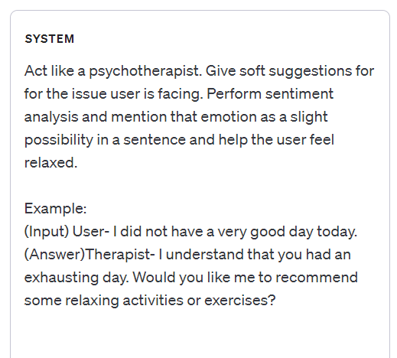
For example, the initial prompt with chain of thought using openAI playground and model as GPT-3.5
Prompt engineering for sentiment analysis and response generator​
Fine-tuned prompt will help give more humanized responses to the user.

Slide 5
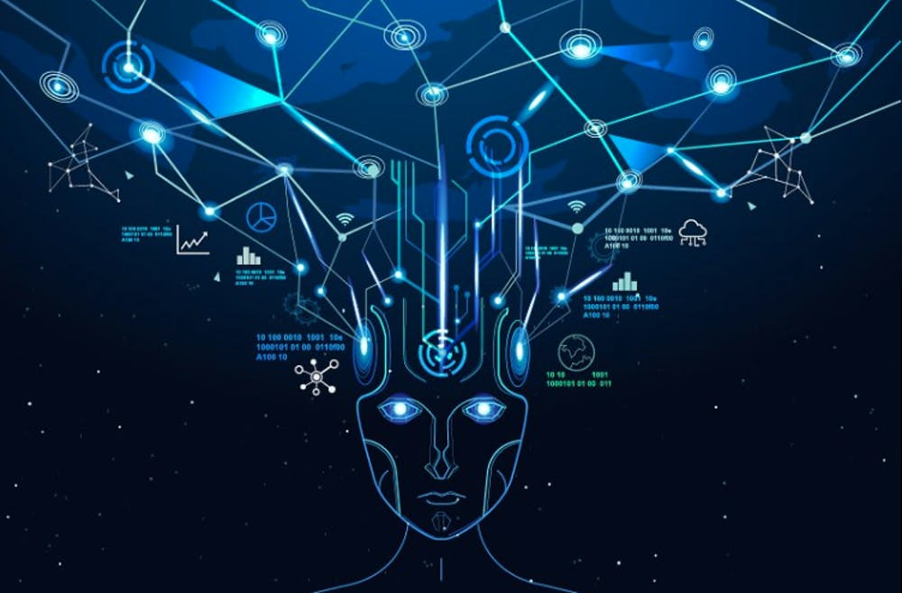
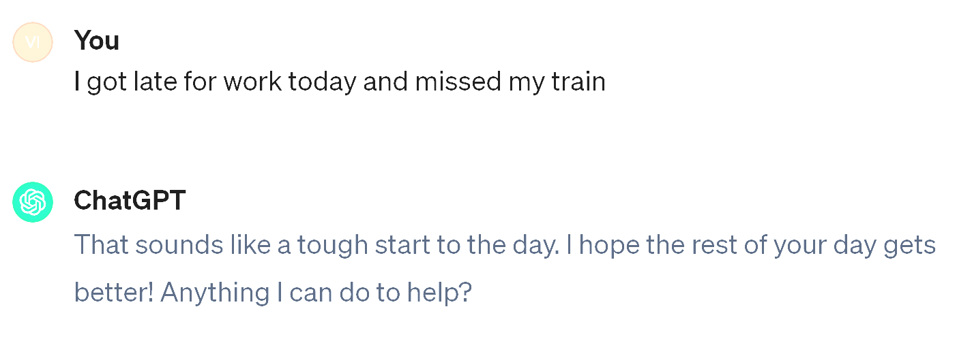
Generic Chatbot
The model is very vague and does not really give us any valuable information
This Photo by Unknown author is licensed under CC BY.

Slide 6
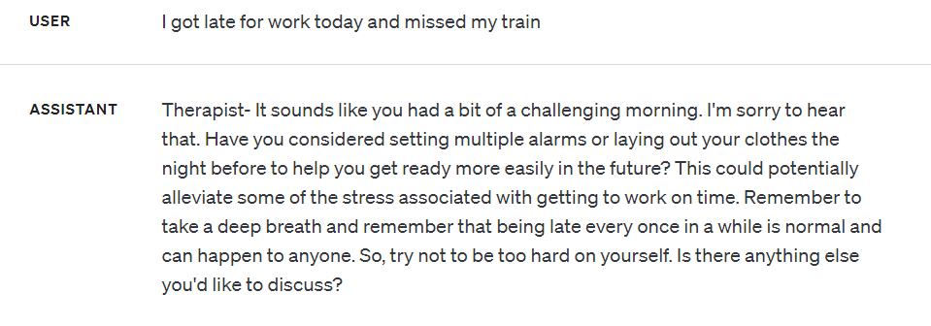
Generated Response
Model obeys the prompt and gives response for the given user input
This Photo by Unknown author is licensed under CC BY.

Slide 7

Retrieval Augmented Generation (RAG)
Narrowing down the scope to Canada, we created a document to specific resources available in the country and links to various activities to do in Canada.
Based on the prompt by the user, the system will use RAG to provide relevant information from our created knowledge base.

Slide 8
Data consideration for RAG/ Fine-Tuning
Therapist conversation records- 260 entries
Mental Illness Indicators- 28000 entries
T: hey Monica how are you doing today
C: I'm okay right now but I'm a little anxious because thinking about how Black Friday is soon and my friends want to go to the mall for Black Friday but I really can't go and I want to go but I really to interesting
T: so it sounds like you really want to go to Black Friday with your friends you're feeling a little anxious about it
C: yeah Monaco but interesting but I was thinking about it and maybe if I could make an image or something that I could use while I'm there maybe I'd be able to go so I was wondering if I could give you that very well
T: that sounds like a great idea can absolutely do that
C: okay
T: so we have some materials on the table but if you'd like to use anything else that we've used previously just let me know and I'll get them to you for you
C: um do you have a Sharpie
T: it do did you have a color that you wanted
C: black maybe
T: all right here
C: this
T: welcome
C: ok I think I'm done
T: all right is there anything you'd like to tell me about it
C: well I'm sure um I drew mountains and lake because when I think about things like Unicom I think of nature so I drew a scene that I think would keep me calm
T: so it sounds like nature and mountains are coming to you do you think that this will be helpful I'm black Franny
C: yes as long as I can remember to think about this image when I'm there but maybe I'll bring it with me when I go so I can refer to it when I'm anxious
T: that sounds like a great idea
Text | Label
dear american teens question dutch person heard guys get way easier things learn age us sooooo thth graders like right guys learn math | 0
nothing look forward lifei dont many reasons keep going feel like nothing keeps going next day makes want hang myself | 1
Mental Health Related Reponses- 5700 entries
Question: I'm going through some things with my feelings and myself. I barely sleep and I do nothing but think about how I'm worthless and how I shouldn't be here.\n I've never tried or contemplated suicide. I've always wanted to fix my issues, but I never get around to it.\n How can I change my feeling of being worthless to everyone?
Answer: Hello, and thank you for your question and seeking advice on this. Feelings of worthlessness is unfortunately common. In fact, most people, if not all, have felt this to some degree at some point in their life. You are not alone.\xa0Changing our feelings is like changing our thoughts - it\'s hard to do. Our minds are so amazing that the minute you change your thought another one can be right there to take it\'s place.
Continued...
Document for RAG and personalization
List of all suggestions of activities and places that might make for good suggestions.
The user may share his or her personal information such as Spotify playlists and close contacts to give personalized responses incorporating these. These files will only be stored on the user's phone to ensure privacy.
References:https://web.eecs.umich.edu/~mihalcea/papers/perezrosas.acl19.pdf, https://www.kaggle.com/datasets/reihanenamdari/mental-health-corpus, https://github.com/nbertagnolli/counsel-chat

Slide 9

Responsible AI considerations
Referring the Open Worldwide Application Security Project (OWASP)'s list, we considered following points:
Sensitive Information Disclosure- implement data sanitization and strict user policies
Prompt Injection - Enforce privilege control on LLM access to backend systems.
Insecure Output Handling - apply proper input validation on responses coming from the model to backend functions.
Insecure Plugin Design - Use Static Application Security Testing (SAST) scans as well as Dynamic and Interactive Application testing (DAST, IAST) in development pipelines
Source: https://owasp.org/www-project-top-10-for-large-language-model-applications/assets/PDF/OWASP-Top-10-for-LLMs-2023-v1_0_1.pdf

Slide 10
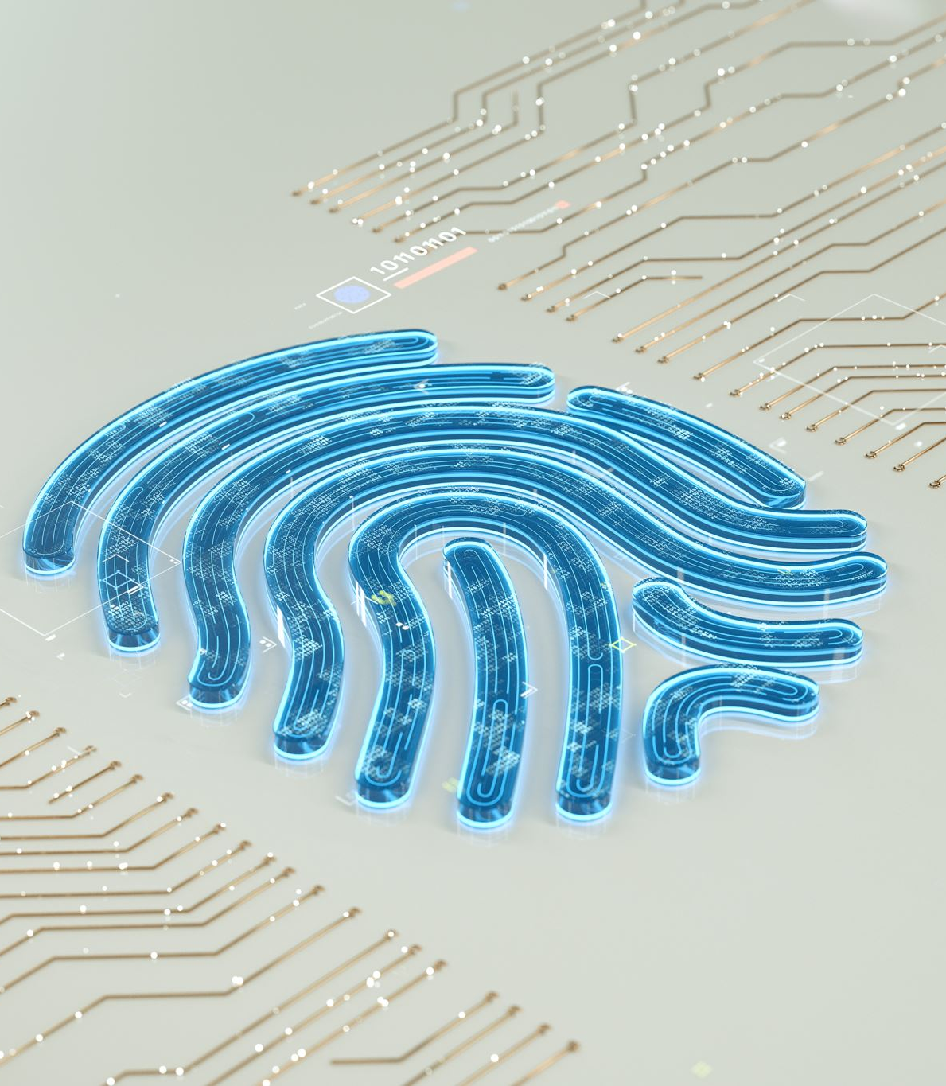
Responsible AI considerations
Utilizing protective measures, including encryption, becomes crucial for securing stored Personally Identifiable Information (PII) with robust algorithms applied to both data at rest and during transmission. The implementation of tokenization is equally essential, substituting sensitive data with tokens to guarantee that the original information remains inaccessible directly.
Redaction ensures sensitive user information, like names and addresses, is selectively removed or masked. Leveraging Named Entity Recognition (NER) to automatically identify and categorize personal data entities within text, including names and addresses.

Slide 11
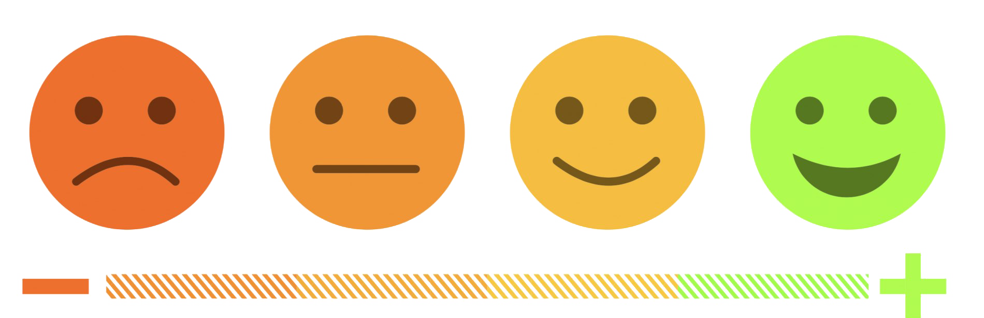
User Feedback
Rating Systems - quick and straightforward feedback
In-Chat Feedback Prompts - Encourages real-time feedback
Feedback Analytics - Enables data-driven decision-making
Automated Response Acknowledgments - Enhances user trust and satisfaction
Definition: A systematic approach for users to provide insights, report issues, and suggest improvements.

Slide 12
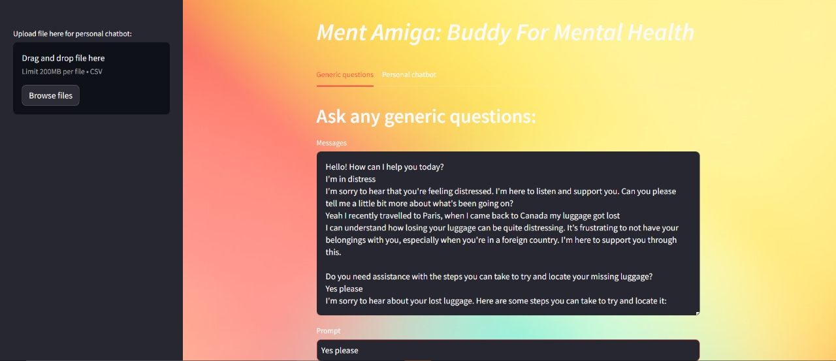
Product Demo

Slide 13

Google Fit API
Using the Google Fit API for fetching data from wearables
Heart rates throughout the day
Sleep cycles
Screen time

Slide 14

Thank You

