Slide 1

STUDENT FACE LOGIN PORTAL
Team Members
B.SAI ABHISHEK BL.EN.U4AIE21015
B.RUCHITH BALAJI BL.EN.U4AIE21017
CHILLAKURU HARI BL.EN.U4AIE21038
Date:01/12/23
Course :CSE
Divya Maam
AI 5th Sem –E Sec

Slide 2
Outline
INTRODUCTION
LITERATURE
SURVEY
SCHEMA
ER DIAGRAM
IMPLEMENTATION
REFERENCES
CONCLUSION
DATA BASE
METHODOLOGY

Slide 3
Introduction
Student Login Portal is a compulsary platform for Colleges.
There are some various types of Login variants :
1) Registration Number and Password
2) Fingerprints
3) Face Recognition
We see normal method i.e Registration and Password mostly.
We are adding face recognition feature.

Slide 4
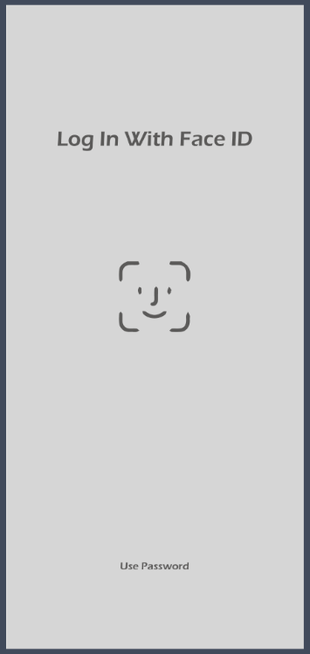
Introduction
In today's technologically advanced world, the education sector is embracing digital solutions to enhance efficiency and security.
This project focuses on the design and implementation of an Online Student Portal with Face ID authentication, utilizing DBMS

Slide 5
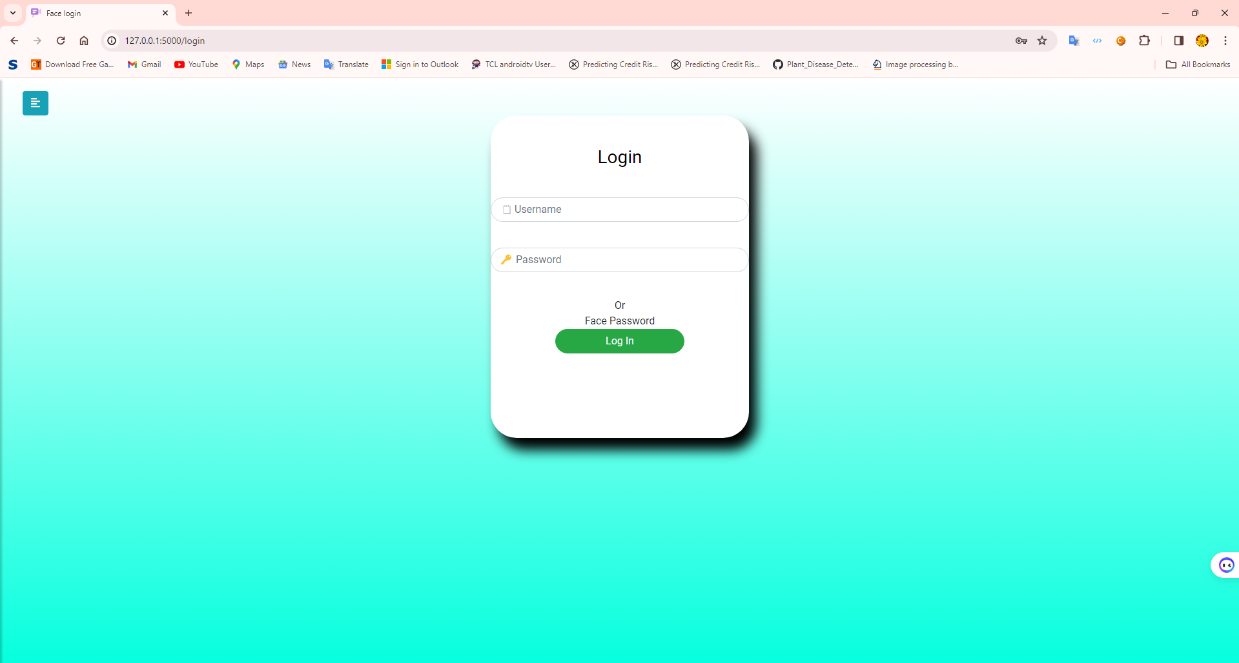
Introduction
We are creating student login portal with two options :
1) id and password 2) Face recognition
Most of the collages are using id and password method.
We are additionally using face recognition only for their security purpose.

Slide 6
Introduction
The Online Student Portal is a web-based platform designed to streamline various academic and administrative processes.
This portal provides students, faculty, and administrators with a centralized system to access and manage academic information, grades, schedules, and other relevant data.
The system architecture comprises three main components:
User Interface (UI): The front-end of the portal accessible through web browsers.
Authentication Module: Utilizes Face ID technology for secure user authentication.
Database Management System (DBMS): Stores and manages student information, grades, schedules, etc.

Slide 7
Literature Survey
Basarkar, S., Bedmutha, S., Hire, S. and Lad, P., STUDENT ATTENDANCE SYSTEM USING FACE RECOGNITION..
In this paper the proposed student attendance system is based on face recognition algorithms. In this system each student image will be captured and then face regions then of all students is extracted and the pre-processed for further processing.
After recognition of faces then it is passed for post-processing where the attendance of every student is generated into excel sheet.
A robust face detection algorithm has been implemented

Slide 8
Literature Survey
Pradyumna, J., Khan, T. and Kumar, K., Smart Attendance System using Face Recognition.
The goal of this paper is to outline the specifications for the "Face Track: Facial Recognition Attendance System" development.
This system uses facial recognition technology to automate the tracking of attendance in a company.
Uses Deep learning Techniques

Slide 9
Literature Survey
Bhanushali, R., Agarwal, C., Dongare, T. and Sharma, S., Student Management System.
The system starts with the college entering an excel sheet containing the registered email id of the student that shall go for form submission.
Only the students in this table who have a registered email id can fill out the form.
The waterfall model is a sequential design approach used in software development processes.

Slide 10
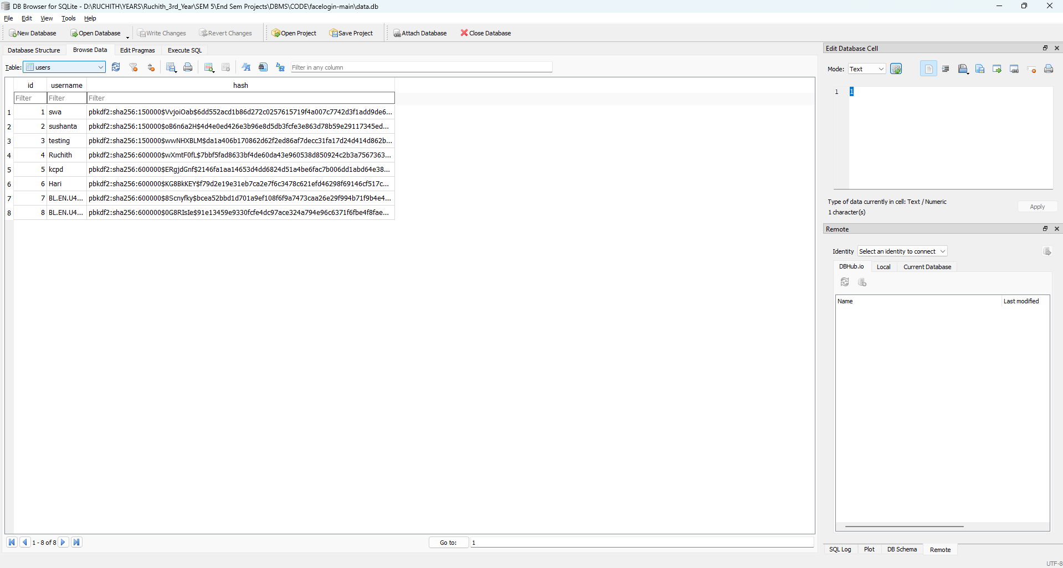
SQLite DB
SQLite is a server-less, embedded SQL database engine.
It's a library that software developers embed in their apps, and is the most widely used database engine

Slide 11
SQLite DB - Features
Embedded: SQLite doesn't have a separate server process and reads and writes directly to disk files.
In-memory: SQLite is an open-source library that doesn't require installation.
Small: SQLite is less than 500 KB in size, which is smaller than other database management systems.
Built-in: SQLite is built into all mobile phones and most computers.
Reliable: SQLite is a full-featured, high-reliability database engine.

Slide 12
SCHEMA
Entities:
Student
User Account
Face Recognition Data
Attributes:
Student:
StudentID (Primary Key) - Char
FirstName - VarChar
LastName - VarChar
Email – VarChar
Other relevant attributes
User Account:
Username : Varchar
Password (encrypted) : Varchar
Other relevant attributes
Face Recognition Data:
FaceID (Primary Key) : Int
FaceTemplate - Binary
Other relevant attributes

Slide 13
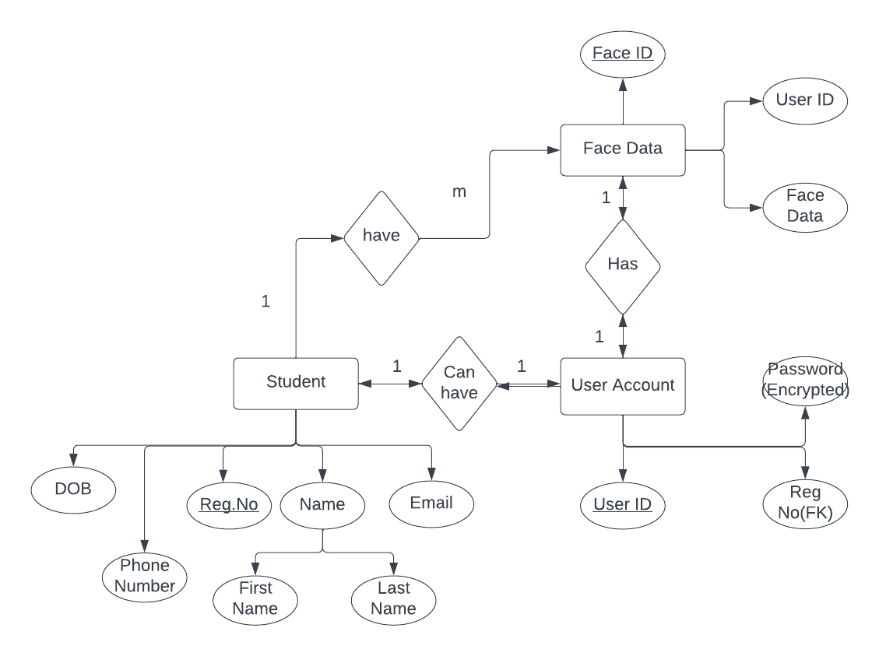
ER DIAGRAM

Slide 14
Methodology
The face_recognition module in Python is a simple user interface for face detection and recognition tasks.
It makes use of the deep learning-based face identification algorithm from Dlib.
The model has an accuracy of 99.38% on the Labeled Faces in the Wild benchmark.

Slide 15
IMPLEMENTATION
We are Going to divide the Implementation into 4 Steps:
File Structure Description
Frontend Code
Backend Code
Implementation - Main

Slide 16
IMPLEMENTATION-File Structure
Templates
Camera.html
Error.html
Face.html
Index.html
Login.html
Layout.html
Register.html
Zoom.html
Main App
Static
Templates
Application.py
Data.db
Helpers.py
Static
Face
Style1.css
Style2.css

Slide 17
IMPLEMENTATION – Frontend Code
Templates
Camera.html
Error.html
Face.html
Index.html
Login.html
Layout.html
Register.html
Zoom.html
Static
Style1.css
Style2.css

Slide 18
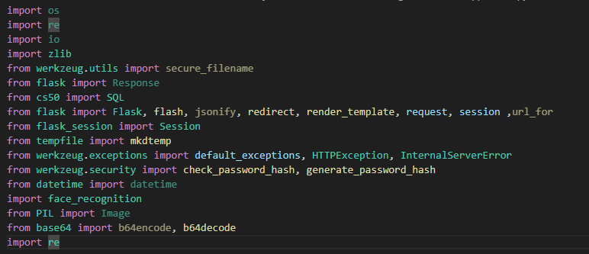
IMPLEMENTATION – Backend Code
Main App
Application.py
Data.db
Helpers.py

Slide 19
IMPLEMENTATION – Main
Run Application.py in the Terminal.
It creates a local flask server.
Routes to Login page.

Slide 20
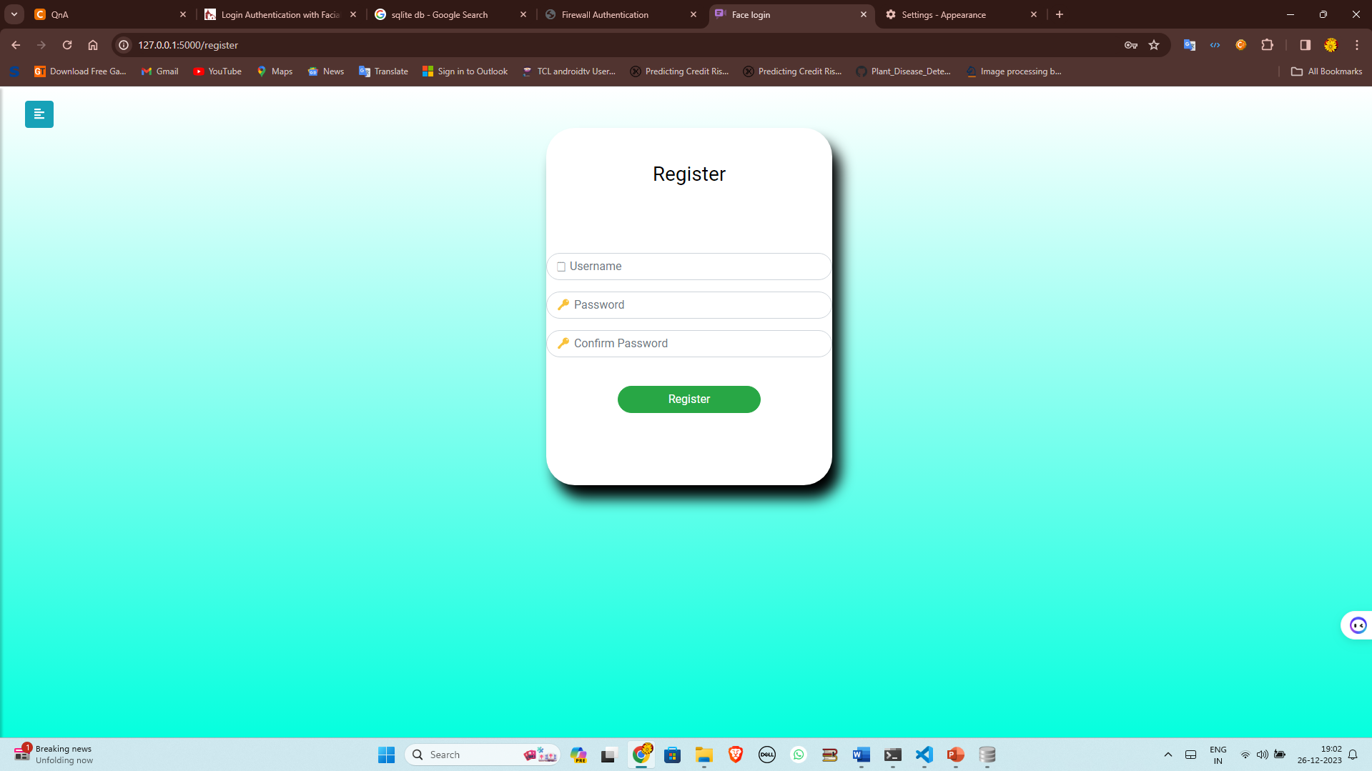
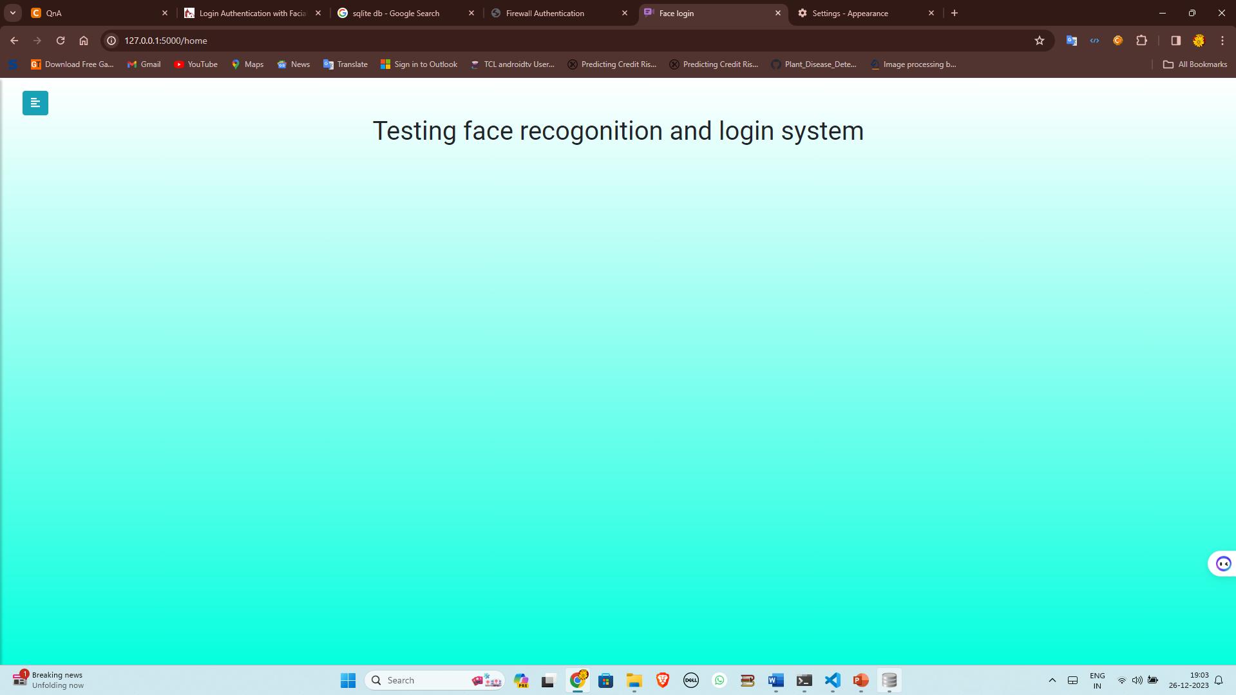
IMPLEMENTATION – Main

Slide 21
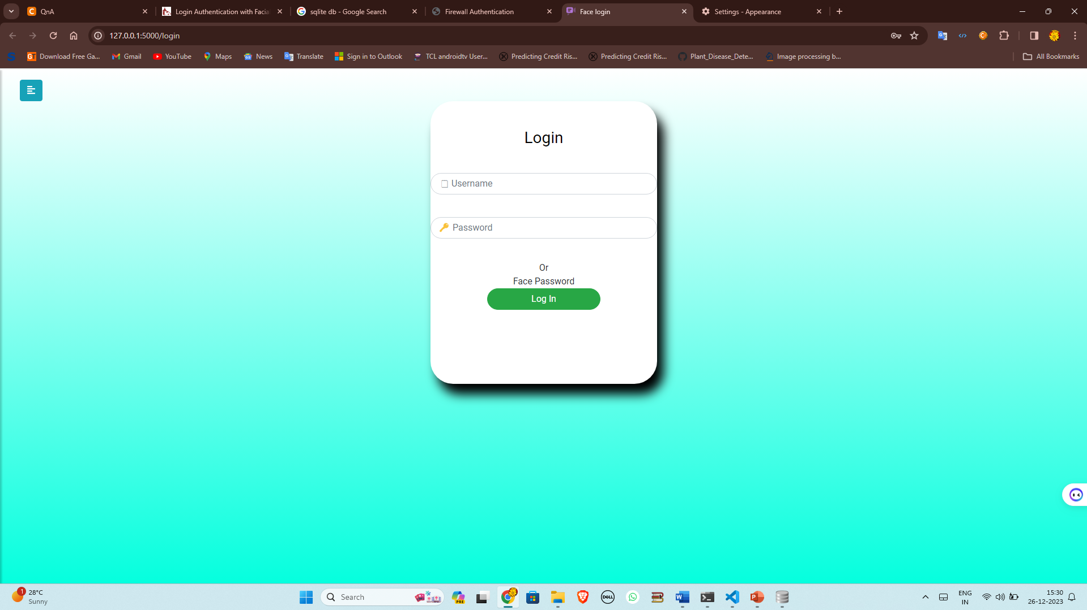
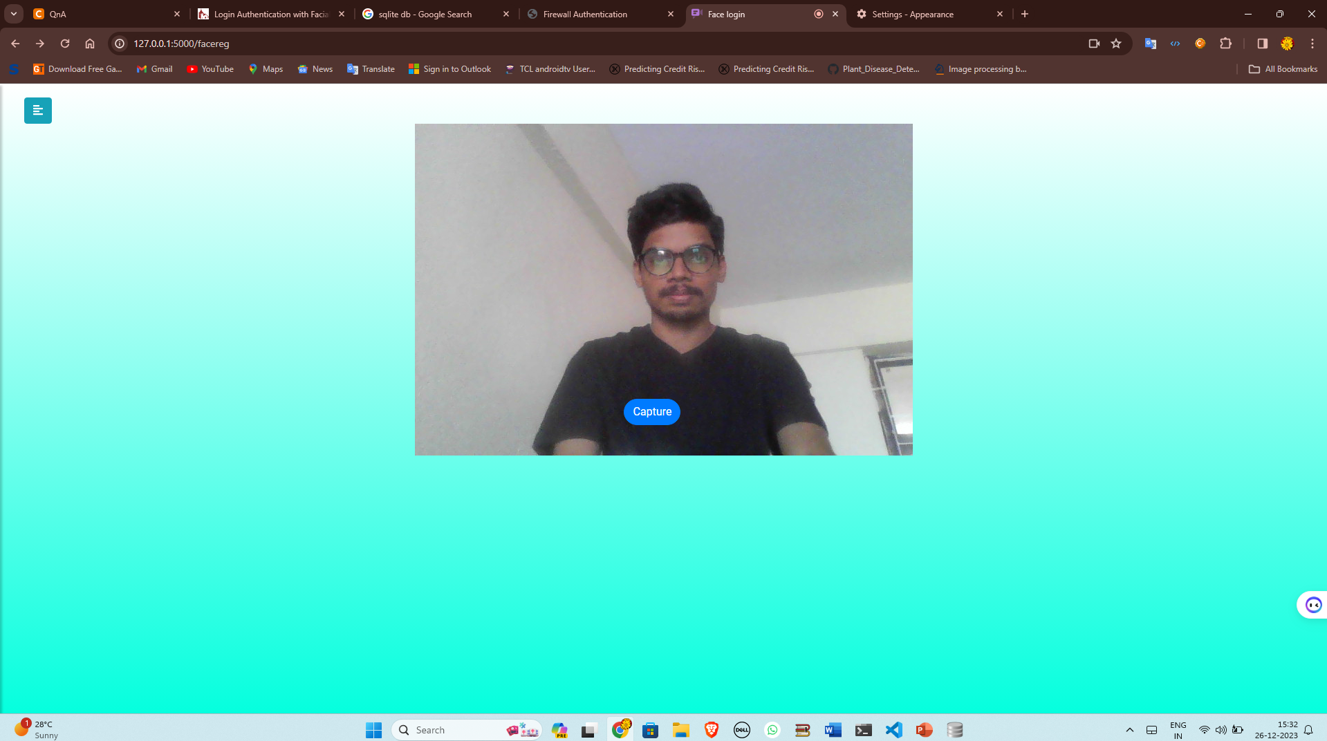
IMPLEMENTATION – Main

Slide 22
CONCLUSION
In conclusion, the implementation of a student login portal with face recognition technology offers a myriad of benefits for educational institutions.
The utilization of facial recognition adds an extra layer of authentication, reducing the risk of unauthorized access

Slide 23
References
[1] S.R.Bharamagoudar, Geeta R.B & S.G.Totad, “Web service api for student information and course management systems”. International Journal of Advanced Research in Computer and Communication Engineering Vol. June 2013.
[2] Almahdi Alshareef, Ahmed Alkilany, "Toward a Student Information System for Sebha University, Libya", Fifth international conference on Innovative Computing Technology (INTECH 2015)-p 34-39
[3] Prabhu T Kannan, Srividya K Bansal, "Unimate: A Student Information System", International Conference on Advances in Computing, Communications and Informatics (ICACCI 2013)-p-1251-1256

Slide 24

Thank You

