Slide 1

Final Project Presentation
on
LEISHMANIA DISEASE DETECTION
Team Members
B.SAI ABHISHEK BL.EN.U4AIE21015
B.RUCHITH BALAJI BL.EN.U4AIE21017
Chillakuru Hari BL.EN.U4AIE21038
Date:21/06/23
Course :Intelligence in Biological Systems-4
Dr. Siva Kumar
AI 4th Sem –E Sec

Slide 2
Outline
INTRODUCTION
Bio-Informatics Analysis
Machine Learning Techniques
KNN & SVN
EVALUATION METRICS
RESULTS
CONCLUSION
REFERENCES

Slide 3
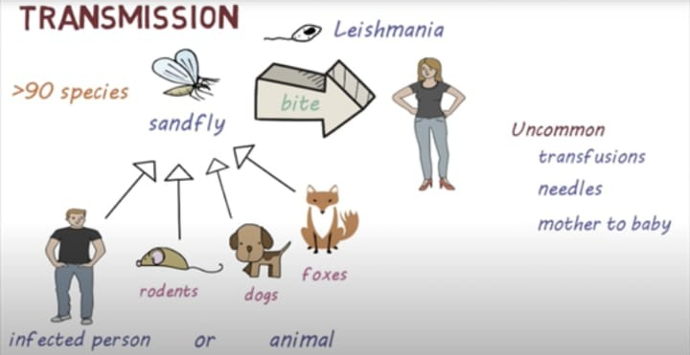
Introduction
Leishmaniasis is a parasitic disease.
Leishmaniasis is caused by infection with Leishmania parasites.
Parasites were spread through phlebotomine sand flies.

Slide 4
Introduction
Who will be affected by Leishmaniasis?
The one who live in rural areas with inadequate sanitation.
People with HIV and other conditions that weaken their immune
System are more likely become prey for Leishmania.

Slide 5
Introduction
Leishmaniasis is currently considered the third most important vector-borne parasitic disease after malaria and lymphatic filariasis.
Types of Leishmaniasis :
Visceral Leishmaniasis
Cutaneous
Mucocutaneous

Slide 6
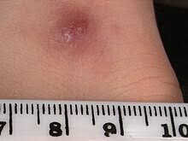
Introduction
Cutaneous Leishmaniasis :
=> It is a Infection in our skin .
=> We get a bump that turn into large ulcer.
2) Mucosal Leishmaniasis :
=> Complication of cutaneous leishmaniasis.
=> Ulcers develops in nose , mouth .

Slide 7
Introduction
Visceral Leishmaniasis (Kala-azar) :
* Serious form of the disease.
* Affects internal organs
Symptoms : Fever
Chills
Weight loss
Fatigue

Slide 8
Prevention
Avoid sand fly bites
Cover exposed skin with clothing
Kill sand flies by spraying insecticides

Slide 9
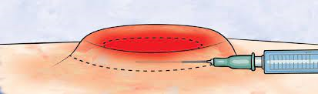
Diagnosis
Needle biopsy
Skin biopsy

Slide 10
Bio informatic analysis:
Retrieve DNA Sequence
Preprocessing
Genome Sequence
Species identification
Visualization

Slide 11
We use machine learning for Efficient processing , improving accuracy
K- Nearest Neighbor
Support Vector Machines
Machine Learning

Slide 12
Machine learning techniques :
KNN (K Nearest Neighbours)
SVM (Support Vector Machines)
Both are popular supervised machine learning algorithms used for classification and regression

Slide 13
K-Nearest-Neighbour
Classifies a data point by comparing it to K nearest neighbours in training dataset
To classify new point we calculate distance between new point and existing(Training point).
Will select K nearest points , data point will be updated to the majority number .

Slide 14
Design
KNN & SVM - Design
Creating a
Session
Data Loading
Data
Pre-processing
KNN ,SVN Model
Creation
Dividing data
To
Test , Train
Fitting the Data
Into Model
Predicting
Credit Risk
Final Results

Slide 15
Support vector machines
We will find optimal hyperplane to separate data points of different classes.
Tries to maximize the margin between data points.
Once hyperplane established , SVM can classify new data point by assigning to either classes , based on which side hyperplane they fall.
Effective for large dimension.

Slide 16
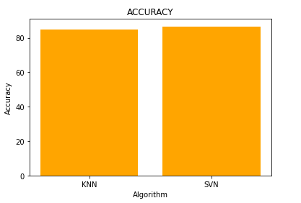
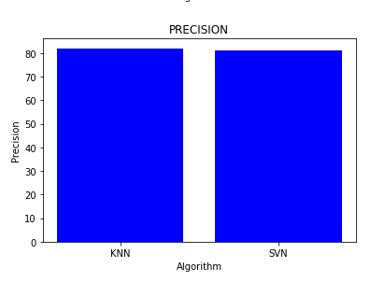
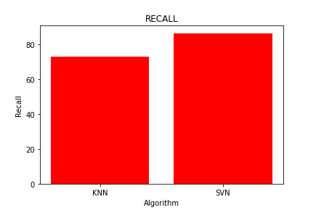
Evaluation Metrics(LR)

Slide 17
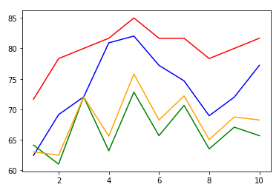
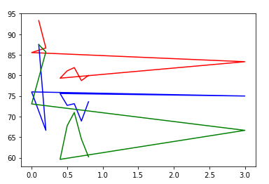
Results(LR)

Slide 18
Conclusion
We have done the Leishmania detection using Bio-Informatics Analytics,
KNN ,SVM in all of three SVM is efficient

Slide 19

Thank You

