Slide 1

END SEM PRESENTATION
on
SPAM MAIL DETECTION WITH
BAYESIAN NETWORKS
Team Members
B.SAI ABHISHEK BL.EN.U4AIE21015
B.RUCHITH BALAJI BL.EN.U4AIE21017
CHILLAKURU HARI BL.EN.U4AIE21038
Date:10/01/24
Course :Maths
Murali Sir
AI 5th Sem –E Sec

Slide 2
CONTENTS
Introduction
Problem Statement
Literature Survey
Dataset Description
Proposed Methodology
Results
Conclusion
References

Slide 3
INTRODUCTION
In an era where communication relies heavily on electronic mediums, the influx of unwanted and potentially harmful spam emails has become a ubiquitous issue.
In this presentation, we will explore the intricacies of Bayesian networks and their application in creating a robust spam mail detection system.
As we navigate through the fundamentals of Bayesian networks, we will unravel how these probabilistic graphical models can capture the complex relationships and dependencies between various features associated with emails.

Slide 4
INTRODUCTION
Traditional methods often fall short in adapting to the dynamic nature of spam, as spammers continuously refine their techniques to bypass conventional filters.
One of the key advantages of Bayesian networks lies in their ability to incorporate user feedback and adapt to individual preferences.
This personalized touch not only enhances the accuracy of spam detection but also minimizes the risk of false positives, ensuring that legitimate messages are not inadvertently flagged.

Slide 5
Problem Statement
The problem Statement is to predict from a given dataset which is SPAM or HAM
The goal is to build a scalable and efficient solution that incorporates advanced machine learning techniques to predict with High Accuracy
Challenges:
Data Collection.
Creating a Bayesian Model.
Training the model to get high Accuracy.
Comparing the trained models.

Slide 6
Literature Survey
Title:A comprehensive dual-layer architecture for phishing and spam email detection. Computers & Security
Authors: Doshi, J., Parmar, K., Sanghavi, R. and Shekokar, N.
Year: 2023
In the research paper the authors presents a novel approach that utilizes a dual-layer architecture for classifying emails into spam and phishing categories, achieving high-performance metrics.
The proposed dual-layer architecture solves the prevalent problem of data imbalance in email classification, resulting in high recall, precision, and f1-score for minority classes. The data set is CSV
The research demonstrates that considering features from both the email content and email body during model training resulted in high-performance metric values.
The proposed pipeline in this research enables the simultaneous and efficient classification of both phishing and spam emails.

Slide 7
Literature Survey
Title: Machine learning techniques for spam detection in email and IoT platforms
Authors: Ahmed, N., Amin, R., Aldabbas, H., Koundal, D., Alouffi, B. and Shah, T.
Year: 2022
In the research the authors discusses various machine learning-based spam filters, their architecture, along with their pros and cons. They also discussed the basic features of spam email.
The algorithms they have used are SVM, Navie bayes, Neural networks.
The research categorizes different spam detection methods according to machine learning techniques to better understand concepts jointly.
They have used CSV file as dataset.

Slide 8
Literature Survey
Title:Spam detection using bidirectional transformers and machine learning classifier algorithms. Journal Computational and Cognitive Engineering, 2(1), pp.5-9. Traditional Machine Learning Algorithms
Authors: Guo, Y., Mustafaoglu, Z. and Koundal, D.
Year: 2023
Author has discussed about a spam detection model based on a pretrained BERT is constructed and trained on two different datasets.
This study used two publicly available datasets. The Enron dataset has 33,716emails, including 17,171 spam mails and 16,545 ham mails. In which all are stored in CSV format.
The performance of four classifier algorithms, SVM, KNNclassifiers, RF, and logistic regression, is compared.
The second dataset, the spam or not spam dataset. This dataset consists of 2,999 valid samples: 499 spam and 2,500 ham.

Slide 9
Literature Survey
Title:A review of spam email detection: analysis of spammer strategies and the dataset shift problem. Artificial Intelligence Review
Authors: Jáñez-Martino, F., Alaiz-Rodríguez, R., González-Castro, V., Fidalgo, E. and Alegre, E.
Year: 2023
In this paper authors presents a review on spam email detection, focusing on the analysis of spammer strategies and the changing nature of the data in this field.
The algorithms like Navie bayes, SVM, Random forest, Decision Tree are used.
They also evaluated the impact on the performance when there is a mismatch between training and operational data distributions.

Slide 10
Literature Survey
Title:Enhanced Text Classification Methods to Improve the Performance of the Various Text Mining Processes using Rapid Miner
Authors: Shitanshu Jain, S.C.Jain, Santosh Vishwakarma
Year: 2022
The authors they have used approaches in text mining procedures will be discussed in this study. This study offered a new similarity measure method that outperformed the K-NN and Naive-Bayes approaches.
The proposed approach improves the accuracy of text classification methods while also implementing an effective term weighting strategy that gives the maximum accuracy when compared to other text classification methods.
They evaluated the performance of the different TF-IDF models and proposed TFIDF to perform text classification

Slide 11
Literature Survey – Metrics Comparison
Papers | Accuracy they Got | Accuracy we got
Paper - I | 97.6 | 99.63
Paper - II | 98.46
Paper - III | 97.05 +/- 0.0024
Paper - IV | 98.81

Slide 12
Literature Survey
What they had did | What we are going to do
Mainly Focused on CSV data | We are handing with TEXT data
Mainly used ML algorithms | We are going to use Bayesian networks and Improve Accuracy
Text processing has not done | We are going to do Text processing
Motivation
To classify the SPAM and HAM emails Fastly and accurately
Protecting User Privacy

Slide 13
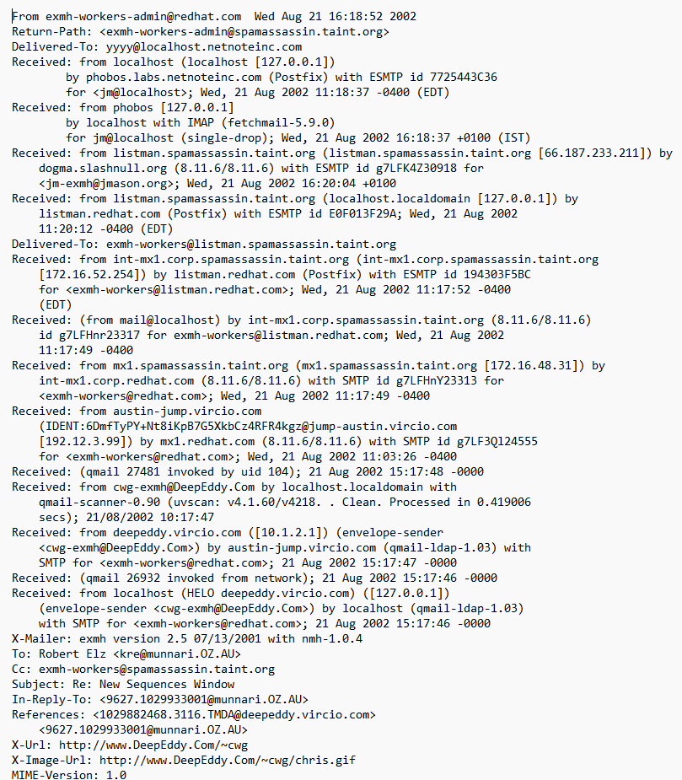
Data Set Description
Data set format : TEXT
Data set Composition:
Train – 2000 text emails
Test- 800 text email
Each mail has receiver's Information and Senders information.
And also it has time, date information also.

Slide 14


Methodology- Bayesian Networks
A Bayesian network is a graphical model that represents probabilistic relationships among a set of variables. The relationships are depicted as a directed acyclic graph (DAG), where nodes represent variables, and edges represent probabilistic dependencies between the variables.
Components:
Nodes (Vertices): Represent random variables.
Edges (Directed Arrows): Indicate probabilistic dependencies between variables.
Conditional Probability Tables (CPTs): Assign probabilities to each variable given the values of its parents.
Bayesian Networks Formula:
The joint probability distribution of a Bayesian network can be factorized using the chain rule of probability:

Slide 15
Methodology – Flow diagram
Data
Collection
Data and Text Preprocessing
Feature Extraction
Bayesian Network Construction
Parameter Learning
Classification of Emails

Slide 16
Methodology- BN in project
Input Data:
The input data is a text data which consists of 2000 ham and spam emails which is in the text format. It contains all the details like date, time, sender, receiver.
Data Preprocessing:
The collected data is processed by going under through text processing methods like removing unwanted words, phrases.
Feature Extraction:
The features are extracted so that it decides how the word is depends on the previous word. Mainly like the conditional probabilities.
Bayesian Network Construction:
The model is constructed based on the features extracted from the feature extraction that is from the previous step.
Parametric Learning:
The model is trained again and again so that accuracy should be so much high, and it should predict the email correctly.
Classification of E-mails:
Now the model is able to predict the email belongs to spam or ham. All the test data is loaded in to the model and predicted. After the prediction the metrics were calculated.

Slide 17
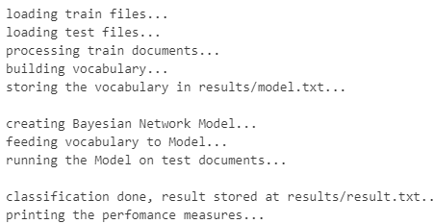
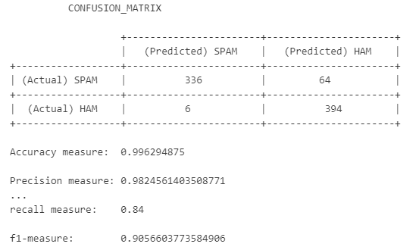
Results
Preprocessing
Confusion Matrix

Slide 18
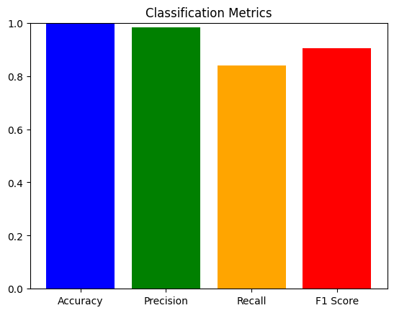
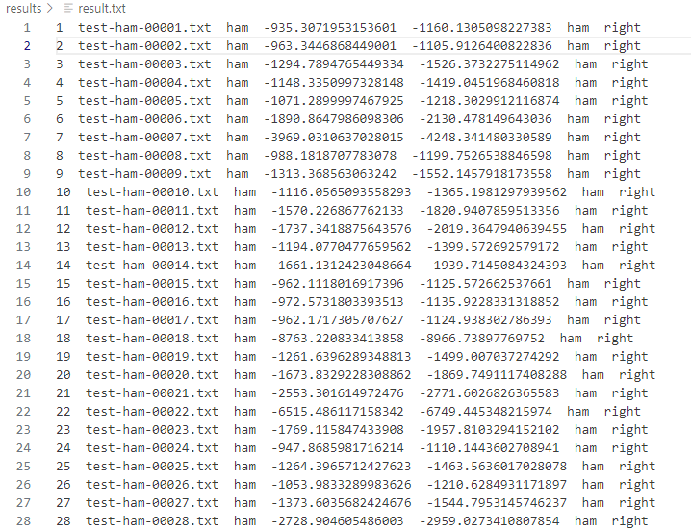
Results
Metrics
Results.txt

Slide 19
Conclusion
In conclusion the scalability of Bayesian networks positions them as a formidable solution in the face of the escalating volume of global email traffic. As our digital communication channels continue to expand, the need for a robust and efficient spam detection system has never been more critical.
Bayesian networks rise to this challenge, offering a scalable architecture capable of handling vast amounts of data without compromising on accuracy.
The integration of Bayesian networks into our email security infrastructure represents a paradigm shift, a technological advancement that promises to redefine the way we safeguard our digital communications.

Slide 20
References
Ahmed, N., Amin, R., Aldabbas, H., Koundal, D., Alouffi, B., & Shah, T. (2022). Machine learning techniques for spam detection in email and IOT platforms: Analysis and research challenges. Security and Communication Networks, 2022, 1–19. https://doi.org/10.1155/2022/1862888
Tida, V. S., & Hsu, S. H. (2022). Universal spam detection using transfer learning of Bert model. In Proceedings of the Annual Hawaii International Conference on System Sciences. https://doi.org/10.24251/hicss.2022.921
Al Nabki W, Fidalgo E, Alegre E, Alaiz R (2020) File name classifcation approach to identify child sexualabuse. In: Conference: 9th international conference on pattern recognition applications and methods, pp 228–234. https://doi.org/10.5220/0009154802280234
Annadatha A, Stamp M (2016) Image spam analysis and detection. J Comput Virol Hacking Tech 14(1):39–52. https://doi.org/10.1007/s11416-016-0287-x

