Slide 1

CASE STUDY
on
DIABETES PREDICTION
Team Members
B.SAI ABHISHEK BL.EN.U4AIE21015
B.RUCHITH BALAJI BL.EN.U4AIE21017
CHILLAKURU HARI BL.EN.U4AIE21038
Date:16/11/23
Course :Big Data & DBMS
Manju Ma’am
AI 5th Sem –E Sec

Slide 2
Outline
INTRODUCTION
PROBLEM STATEMENT
DATASET
PROPOSED FRAMEWORK
LITERATURE SURVEY
CONCLUSION

Slide 3

Introduction
Diabetes is a chronic condition characterized by elevated blood glucose levels.
Diabetes prediction involves using various data-driven techniques and models.

Slide 4
Introduction
Predicting diabetes using PySpark MLlib involves using machine learning techniques to build a model that can predict whether a person is likely to have diabetes based on certain features.
Common Pyspark Mllib models used for diabetes prediction include:
1) LOGISTIC REGRESSION
2) RANDOM FOREST
3) NAVIE BAYES

Slide 5
Problem Statement
The problem Statement is to predict whether a person has Diabetes or Not based on Given Features
The goal is to build a scalable and efficient solution that incorporates advanced machine learning techniques to predict with High Accuracy
Final project Presentation, 21AIE214

Slide 6
Motivation
Early Intervention and Prevention, Learning and Skill Development
Resource Optimization

Slide 7
Dataset
We Have taken the data Set with Following Attributes:
Gender
Age
HyperTension
Smoking
BMI
HbA1c_Level
Heart Disease
Blood Glucose level
Diabetes

Slide 8
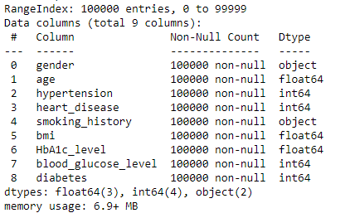
Dataset
Data Set has a shape (100000,9)

Slide 9
Proposed Framework
We are going to use framework for Efficient processing , improving accuracy
Logistic Regression
Random Forest
Py-Spark

Slide 10
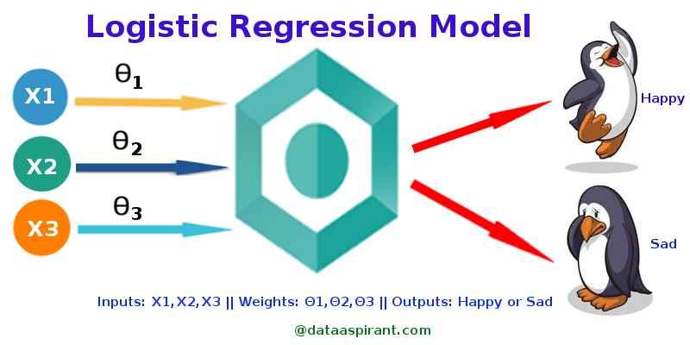
Proposed Framework
Logistic Regression (Py-spark)
Logistic regression is an example of supervised learning. It is used to calculate or predict the probability of a binary (yes/no) event occurring.
Binary Classification.
Model Evaluation.
Real-Time Analysis

Slide 11
Proposed Framework
Logistic Regression (Py-spark) - Design
Creating a
Spark Session
Dividing data
To
Test , Train
Data Loading
Pipe Lining
Fitting the Data
Into Model
Data
Pre-processing
Logistic Model
Creation
Predicting
Diabetes
Final Results

Slide 12
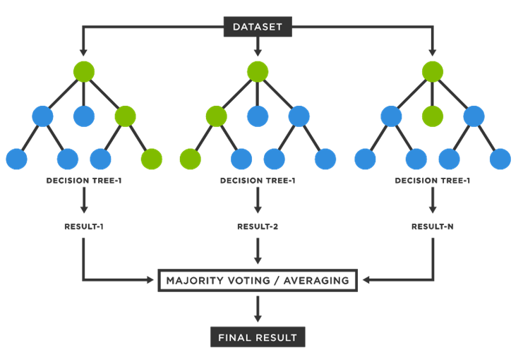
Proposed Framework
Random Forest (Py-Spark)
Random Forest is an ensemble learning method that combines multiple decision trees to improve predictive accuracy and reduce overfitting.
Voting Mechanism
Handling Missing Data and Outliers

Slide 13
Proposed Framework
Logistic Regression (Py-spark) - Design
Creating a
Spark Session
Data Loading
Data
Pre-processing
Assembling Data
Random Model
Creation
Dividing data
To
Test , Train
Fitting the Data
Into Model
Predicting
Diabetes
Final Results

Slide 14
Literature Survey
1) An Efficient Diabetes Prediction Model using Machine Learning.
Dataset: Parameters : pregnancies , glucose , blood pressure , skin thickness , insulin measurement , age , outcome.
It is a binary classification.
We have 800 instances
We have 9 columns
Methods: Machine learning techniques: KNN,SVM,CART(classification and regression tree),RF(Random Forest).
Proposed Method: LightGBM has accuracy of 90.2

Slide 15
Literature Survey
2) Diabetes Data Prediction Using Spark and Analysis in Hue Over Big Data.
Dataset: Pima Indian Dataset
Methods: Predictive analysis algorithm is used
Based on the dataset and the graphs obtained, they analysed that the 72 patients have diabetes mellitus at the age 22. 63 patients have diabetes mellitus at the age 21. 48 patients have diabetes mellitus at the age 25. 29 patients have diabetes mellitus at the age 29.

Slide 16
Literature Survey
3) Diabetes Mellitus Prediction using Supervised Machine Learning Techniques
Dataset: Parameters : pregnancies , glucose , blood pressure , skin thickness , insulin measurement , age , outcome.
It is a binary classification.
We have 1000 instances
We have 16 columns
Methods: Machine learning techniques: LR,DNN,SVM,RF (classification and regression tree),RF(Random Forest).
RF has accuracy of 98%,.KNN SVM have 70% nearly, DNN is 90%.

Slide 17
Literature Survey
4) Diabetes Prediction and Classification using Machine Learning Algorithms
Three differentdatasets are used to evaluate the ML model. First is from N.K.P. Salve Institute of Medical Science & Research Centreand Lata Mangeshkar Hospital, Nagpur;
Second is from Shalinitai Meghe Hospital & Research Center, Nagpur; and,
Third is from Mendeley Data
Methods: LR,Naive Bayes,SVM,RF.
RF has high precision ,Recall, Accuracy with 99%.Kappa index max was RF with 97%.

Slide 18
Literature Survey
5) Diabetes Prediction in Healthcare at Early StageUsing Machine Learning Approach
rows 289,columns 13,(13 Instances)
Methods: Logistic Regression, XGBoost, RandomForest, Decision Tree.
RF has high precision ,Recall, Accuracy with 98%.

Slide 19
Literature Survey
6) Machine Learning-based Diabetes Prediction
Cross-Country Perspective rows 15000 columns 25
Glucose level, Insulin, BMI, Creatinine, Cholesterol,and Glycohemoglobin
Third is from Mendeley Data
Methods: Desicion tree,Navie bayes,Support vector machine(svm),Random forest,Artificial Neural Network
Accuracy 99%

Slide 20
Conclusion

Slide 21

Thank You

