Slide 1

END SEM PRESENTATION
on
DIABETES PREDICTION
Team Members
B.SAI ABHISHEK BL.EN.U4AIE21015
B.RUCHITH BALAJI BL.EN.U4AIE21017
CHILLAKURU HARI BL.EN.U4AIE21038
Date:05/01/24
Course :BDMS
Manju Venugopalan maam
AI 5th Sem –E Sec

Slide 2
CONTENTS
Introduction
Problem Statement
Dataset Description
Proposed Methodology
Results and Analysis
Conclusion
Future Work
References

Slide 3
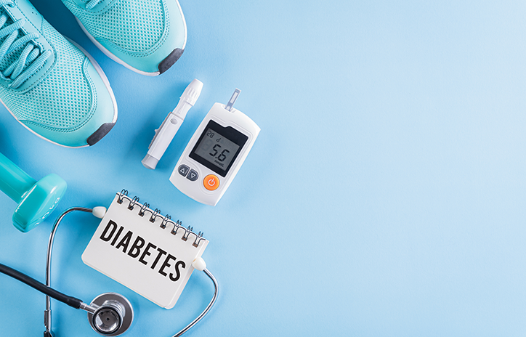
INTRODUCTION
Diabetes is a chronic condition characterized by elevated blood glucose levels.
Diabetes prediction involves using various data-driven techniques and models.
Early detection and proactive management of diabetes are crucial for preventing complications and improving the overall quality of life for individuals affected by the condition.

Slide 4
INTRODUCTION
The integration of predictive analytics in diabetes management holds the potential to transform the current reactive healthcare model into a more proactive and preventive one.
Machine learning algorithms have gained prominence in the field of healthcare for their ability to analyze complex datasets and make predictions based on patterns and relationships within the data.
The integration of machine learning algorithms in diabetes prediction empowers healthcare professionals to leverage advanced analytics for early detection and intervention.
By utilizing these algorithms, it is possible to analyze patient data comprehensively, identify patterns, and make informed predictions regarding the likelihood of diabetes,

Slide 5
Problem Statement
The problem Statement is to predict whether a person has Diabetes or Not based on Given Features
The goal is to build a scalable and efficient solution that incorporates advanced machine learning techniques to predict with High Accuracy
Challenges:
Data Collection.
Choosing appropriate ML Algorithms.
Training the model to get high Accuracy.
Comparing the trained models.

Slide 6
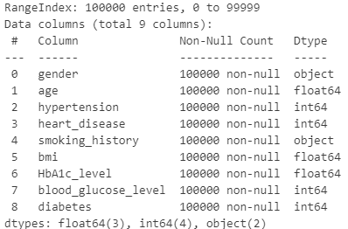
Data Set Description
The dataset used for this project is Diabetes_Prediction.csv
The data is Obtained from the Kaggle database.
The dataset is meticulously organized, with 9 columns includes which are in Figure.
The data set has 1,00,000 Instances.
The dataset is slightly imbalanced which means the ratio of People having diabetes to not having diabetes is 4:6

Slide 7
Methodology
We are Going to use 5 Machine learning models using Pyspark.
Logistic Regression (LR)
Random Forest (RF)
Naïve Bayes (NB)
SVM(Support Vector Machines)
Decision Trees (DT)
Data Collection
Data
PreProcessing
Model
Creation
Machine learning
Techniques
Training the Model
Testing
Metric
Calculation

Slide 8
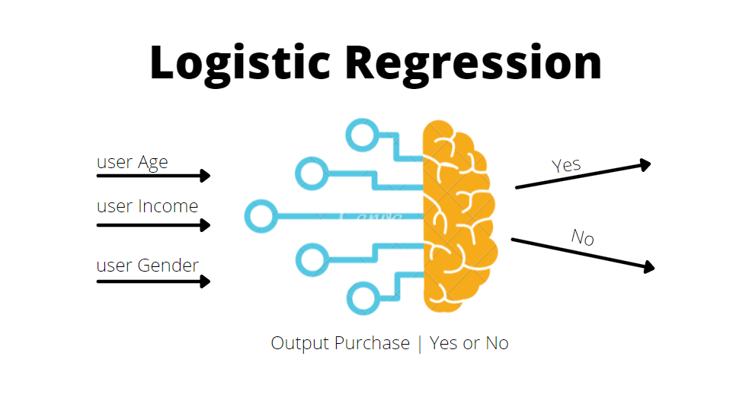
Methodology-LR
Logistic Regression is a widely used statistical method for binary classification problems, making it suitable for predicting the likelihood of diabetes onset..
By modeling the relationship between the independent variables (features) and the probability of diabetes, logistic regression produces probability scores that can be translated into class predictions.
Its simplicity and interpretability make logistic regression an attractive choice for healthcare applications.

Slide 9
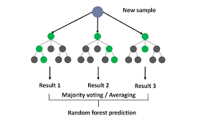
Methodology-RF
Random Forest is an ensemble learning algorithm that combines multiple decision trees to enhance predictive accuracy and reduce overfitting.
In the context of diabetes prediction, Random Forest can handle a large number of features, capture complex relationships, and provide insights into feature importance.
The ensemble nature of Random Forest improves generalization, making it effective for robust diabetes prediction models.

Slide 10
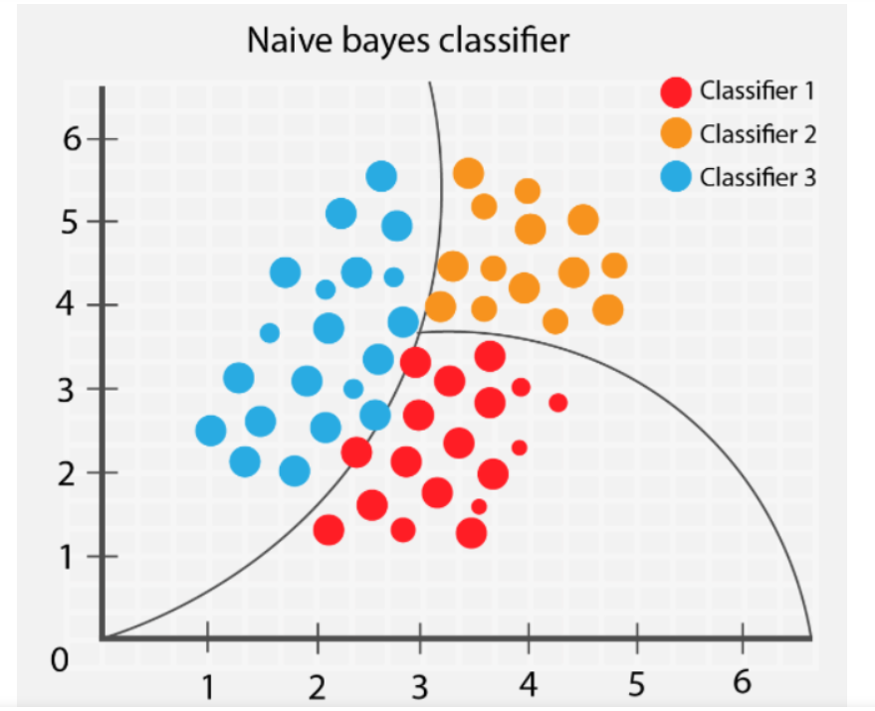
Methodology-NB
Naive Bayes is a probabilistic classifier based on Bayes' theorem, assuming independence between features. Despite its simplistic assumptions.
Naive Bayes has proven effective in various classification tasks, including diabetes prediction. It is particularly well-suited for datasets with high dimensionality and can provide rapid predictions.
Naive Bayes models are interpretable and computationally efficient, making them practical for healthcare applications

Slide 11

Methodology-SVM
SVM is a powerful supervised learning algorithm used for classification and regression tasks.
In the context of diabetes prediction, SVM can be employed to create a decision boundary that effectively separates the data into different classes, distinguishing between individuals with and without diabetes.
SVM aims to maximize the margin between classes, providing robust predictions and adaptability to non-linear relationships in the data.

Slide 12

Methodology-DT
Decision Trees are a fundamental machine learning model that recursively splits the data based on features, creating a tree-like structure.
In the context of diabetes prediction, Decision Trees can uncover complex decision paths and interactions between different patient characteristics.
Decision Trees are interpretable and provide a visual representation of the decision-making process.

Slide 13
Implementation
Heading to VS Code….

Slide 14
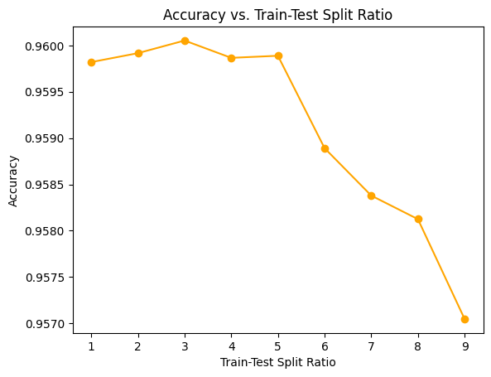
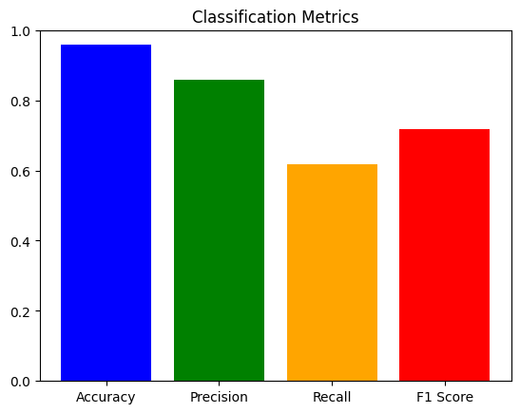

Results - LR
Accuracy Graph Result Classification Report

Slide 15
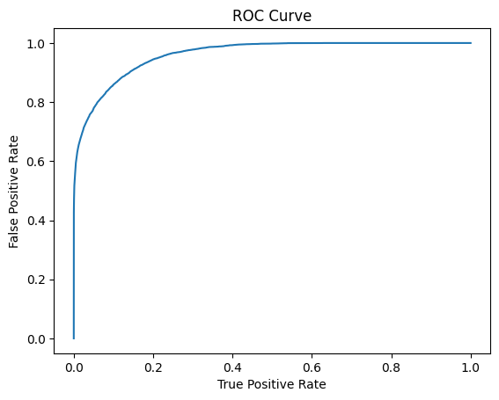
Results - LR
ROC Curve

Slide 16
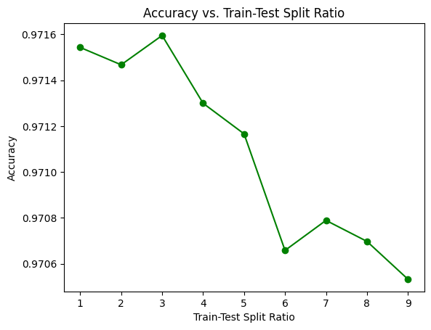
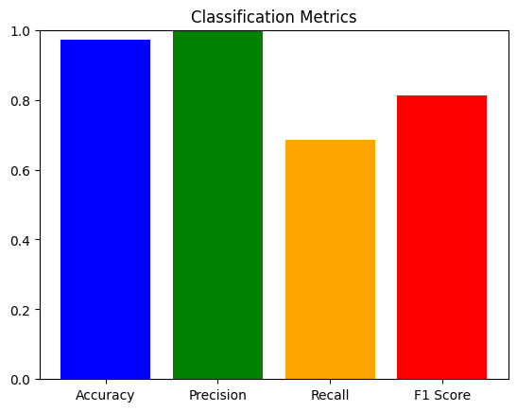

Results– RF
Accuracy Graph Result Classification Report

Slide 17
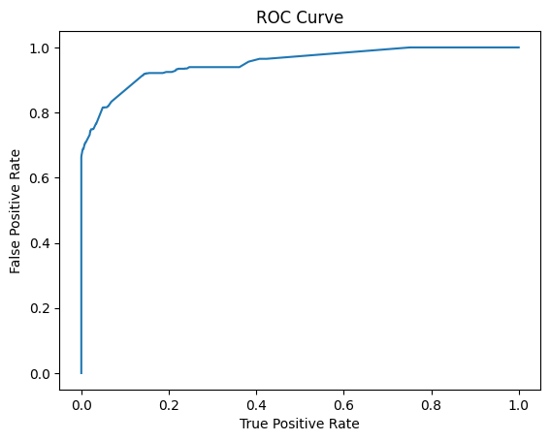
Results - RF
ROC Curve

Slide 18
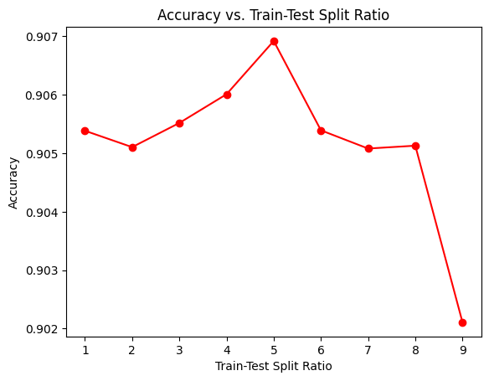
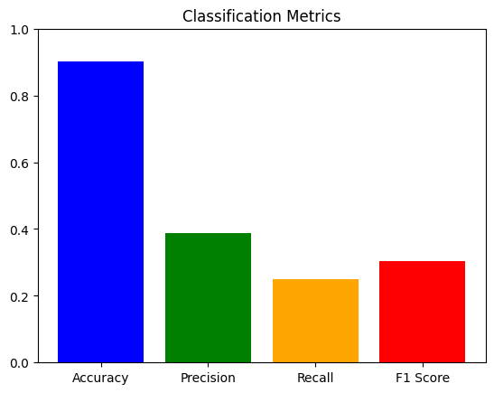

Results– NB
Accuracy Graph Result Classification Report

Slide 19
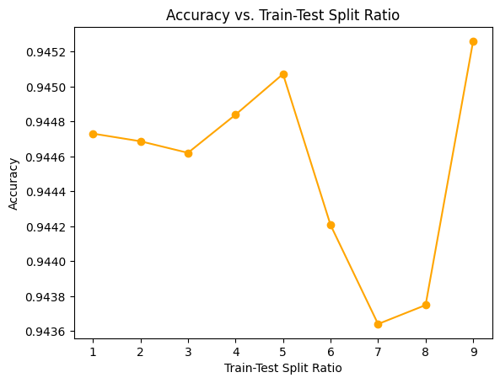
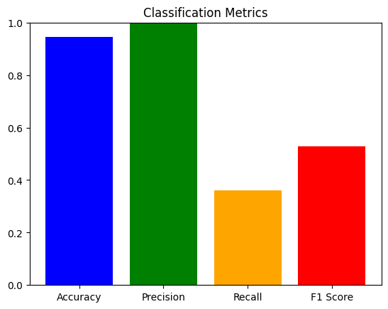

Results - SVM
Accuracy Graph Result Classification Report

Slide 20
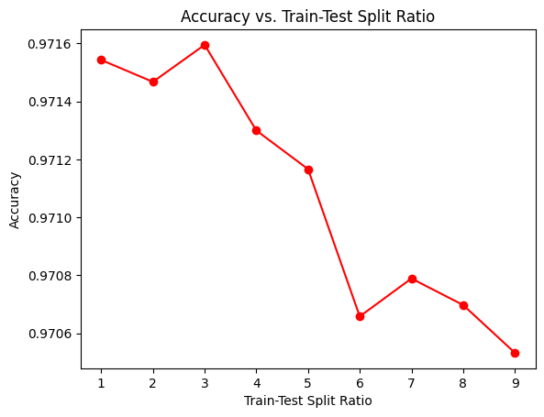


Results– DT
Accuracy Graph Result Classification Report

Slide 21
Analysis
Analyzing the performance of different Machine learning algorithms (SVM, LR, NB, DT, RF) in Diabetes disease detection involves considering several aspects such as accuracy, precision, recall, F1 score. Based on following things….
Accuracy Comparison
Precision, Recall and F-1Score
Model | Accuracy | Precision | Recall | F1-Score
Logistic Regression | 95.18 | 85.63 | 61.82 | 71.88
SVM | 94.52 | 99.67 | 36.02 | 52.92
Decision Tree | 97.05 | 100 | 65.49 | 79.15
Random Forest | 97.28 | 100 | 68.44 | 81.26
Naïve Bayes | 90.21 | 38.65 | 24.91 | 30.29

Slide 22
Conclusion
In conclusion, machine learning algorithms such as SVM, Logistic Regression, Random Forest Decision Trees, Naive Bayes, and Decision Trees offer diverse and valuable tools for diabetes prediction
Each bringing unique strengths such as non-linear pattern recognition, interpretability, ensemble-based accuracy, efficiency in high-dimensional data, and visual decision representation, collectively empowering healthcare professionals in early detection and personalized intervention.

Slide 23
Future Scope
Future advancements in diabetes prediction models will likely involve sophisticated feature engineering techniques, incorporating genetic, lifestyle, and environmental data to enhance the accuracy and personalization of predictions.
The integration of ensemble learning techniques and model stacking could further improve the robustness and generalization of diabetes prediction models, combining the strengths of various algorithms to achieve superior performance.
Future developments may focus on real-time monitoring through wearable devices, allowing continuous data collection and updating of prediction models, thereby enabling more dynamic and personalized healthcare interventions for individuals at risk of diabetes.

Slide 24
References
Han Wu, Shengqi Yang, Zhangqin Huang, Jian He, Xiaoyi Wang“Type 2 diabetes mellitus prediction model based on data mining”
Mayo Clinic Q and A: Childhood diabetes, March 31, 2021,06:00 p.m. CDT
Science Saturday: Could regenerative medicine provide a newapproach to diabetes care?, Nov. 28, 2020, 12:00 p.m. CDT
Iancu, I., Mota, M., and Iancu, E. (2008). “Method for the analysing of blood glucose dynamics in diabetes mellitus patients,” in Proceedings of the 2008 IEEE International Conference on Automation, Quality and Testing, Robotics, Cluj-Napoca. doi: 10.1109/AQTR.2008.4588883
Cox, M. E., and Edelman, D. (2009). Tests for screening and diagnosis of type 2 diabetes. Clin. Diabetes 27, 132–138. doi: 10.2337/diaclin.27.4.132

Slide 25
References
American Diabetes Association (2012). Diagnosis and classification of diabetes mellitus. Diabetes Care 35(Suppl. 1), S64–S71. doi: 10.2337/dc12-s064
Lee, B. J., and Kim, J. Y. (2016). Identification of type 2 diabetes risk factors using phenotypes consisting of anthropometry and triglycerides based on machine learning. IEEE J. Biomed. Health Inform. 20, 39–46. doi:10.1109/JBHI.2015.2396520
Alghamdi, M., Al-Mallah, M., Keteyian, S., Brawner, C.,Ehrman, J., and Sakr, S. (2017). Predicting diabetes mellitus using SMOTE and ensemble machine learning approach: the henry ford exercise testing (FIT) project. PLoS One 12:e0179805. doi: 10.1371/journal.pone.0179805
Kavakiotis, I., Tsave, O., Salifoglou, A., Maglaveras, N., Vlahavas, I., and Chouvarda, I. (2017). Machine learning and data mining methods in diabetes research. Comput. Struct. Biotechnol. J.

