Slide 1

END SEM PRESENTATION
on
Tomato Plant Disease Detection using
Various Deep learning Techniques.
Team Members
B.SAI ABHISHEK BL.EN.U4AIE21015
B.RUCHITH BALAJI BL.EN.U4AIE21017
CHILLAKURU HARI BL.EN.U4AIE21038
Date:03/01/24
Course :SIP
Dr.Nidhin Prabhakar T V
AI 5th Sem –E Sec

Slide 2
CONTENTS
Introduction
Problem Statement
Dataset Description
Proposed Methodology
Results and Analysis
Conclusion
Future Work
References

Slide 3
INTRODUCTION
Tomato plants, scientifically known as Solanum lycopersicum, are popular and economically significant crops cultivated worldwide.
Tomato plants are susceptible to various diseases that can affect their growth, yield, and overall health. These diseases can be caused by fungi, bacteria, viruses, and other pathogens.
Proper identification and management of these diseases are crucial for maintaining a healthy tomato crop.
Understanding the common tomato plant diseases is essential for farmers, gardeners, and researchers to implement effective prevention and management strategies.

Slide 4
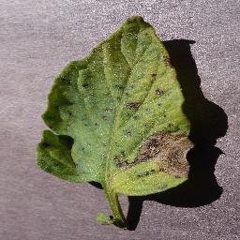
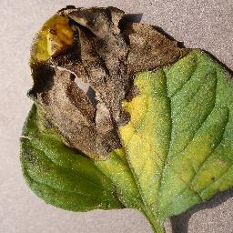
INTRODUCTION
TYPES OF DISEASES:
Early Blight (Alternaria solani):
Symptoms: Circular lesions with concentric rings on lower leaves, leading to yellowing and wilting.
Management: Crop rotation, fungicides, pruning, and proper spacing.
Late Blight (Phytophthora infestans):
Symptoms: Brown lesions on leaves, stems, and fruit, often accompanied by white mold.
Management: Fungicides, proper ventilation, and removal of infected plant parts.

Slide 5
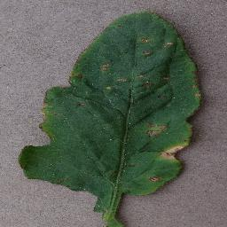
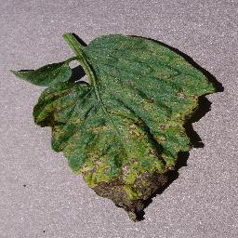
INTRODUCTION
TYPES OF DISEASES:
Bacterial Spot (Xanthomonas campestris pv. vesicatoria):
Symptoms: Dark, water-soaked spots on leaves with a yellow halo.
Management: Copper-based sprays, avoiding overhead watering, and crop rotation.
Septoria Leaf Spot (Septoria lycopersici):
Symptoms: Small, dark spots with a light center on leaves, leading to defoliation.
Management: Fungicides, proper spacing, and removal of infected leaves.

Slide 6
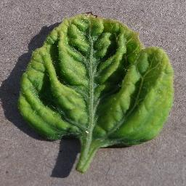
INTRODUCTION
TYPES OF DISEASES:
Tomato Yellow Leaf Curl Virus (TYLCV):
Symptoms: Yellowing, curling, and stunting of leaves, along with distorted fruit.
Management: Resistant varieties, controlling whiteflies (vectors), and removing infected plants..
By familiarizing themselves with the symptoms and management techniques for these diseases, growers can take proactive measures to protect their tomato crops, ensuring a healthier and more productive harvest.

Slide 7
Problem Statement
The Problem statement is to develop a robust and reliable deep learning-based system capable of accurately identifying and classifying common tomato plant diseases.
The system should leverage the capabilities of five distinct deep learning models to enhance detection accuracy and robustness.
Challenges:
Data Variability: Tomato plant diseases manifest in various forms, and capturing this variability in training data is essential for model generalization.
Model Selection: Choosing the most suitable deep learning models for the task, such as Convolutional Neural Networks (CNNs), Recurrent Neural Networks (RNNs), or hybrid architectures, to ensure comprehensive disease detection.

Slide 8
Data Set Description
The dataset used for training and validation in this study comprises a diverse collection of tomato plant images categorized into six distinct classes with 13883 images
The dataset is meticulously organized, with each class representing a specific type of plant health condition. The classes include:
Bacterial Spot
Early Blight
Healthy
Late Blight
Septoria Leaf Spot
Yellow Leaf Curl Virus

Slide 9
Data Set Description
Training Set:
The training set consists of 11,108 tomato plant images distributed across the six afore mentioned classes. Each class is represented by a dedicated folder.
Validation Set:
The validation set complements the training set and is designed for evaluating the performance and generalization capabilities of the trained models. It consists of 2,495 tomato plant images, with each class mirroring the classes present in the training set.
Test Set:
The test set complements the training set and validation set is designed for testing the performance and generalization capabilities of the trained models. It consists of 280 tomato plant images, with each class mirroring the classes present in the training set.

Slide 10
Literature Survey
Image processing based system for the detection, identification and treatment of tomato leaf diseases. Sami Ur Rahman 1 & Fakhre Alam 1 & Niaz Ahmad 1 & Shakil Arshad 1
The Paper describes a proposed image processing-based system for the detection, identification, and treatment of tomato leaf diseases. The traditional manual methods of disease detection and treatment are based on naked eye observation, which is not accurate or timely. The proposed method uses image processing techniques, including Gray Level Co-Occurrence Matrix (GLCM) algorithm and Support Vector Machine (SVM) classification,
Deep Learning-Based Leaf Disease Detection in Crops Using Images for Agricultural Applications Andrew J. 1 , Jennifer Eunice 2 , Daniela Elena Popescu 3 ,M. Kalpana Chowdary 4,* and Jude Hemanth 2
The paper discusses the use of deep learningbased leaf disease detection in crops using images for agricultural applications. The authors utilized pretrained convolutional neural network (CNN) models, such as DenseNet-121, ResNet-50, VGG-16, and Inception V4, to identify plant diseases.

Slide 11
Literature Survey
Plant disease detection using machine learning approaches Imtiaz Ahmed | Pramod Kumar Yadav
The Paper discusses the use of machine learning approaches for plant disease detection. The author highlights the importance of early detection of plant diseases to reduce plant mortality rates. Machine learning, specifically techniques such as random forest, linear regression, Naive Bayes, neural networks, and support vector machine, are used to develop plant disease prediction models.
Performance of Machine Learning and Image Processing in Plant Leaf Disease Detection Abu Sarwar Zamani 1L. Anand ,2Kantilal Pitambar Rane ,3P. Prabhu
The paper discusses the significance of automated disease detection in agriculture and the application of machine learning and image processing in identifying leaf diseases. The study uses a dataset of 120 images, consisting of three disease categories, for training and testing machine learning algorithms. The performance of the algorithms is evaluated based on accuracy, sensitivity, and specificity.

Slide 12
Methodology
We are Going to use 5 deep learning models:
Convolutional Neural Network (CNN)
CNN with Generative Adversarial Network (CNN-GAN)
ResNet (Residual Neural Network)
DenseNet (Densely Connected Convolutional Network)
VGG16 (Visual Geometry Group Network)
Data Collection
Data
PreProcessing
Model
Creation
Deep learning
Techniques
Training the Model
Testing and
Validating
Metric
Calculation

Slide 13
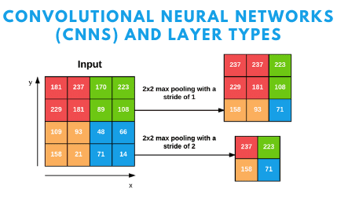
Methodology-CNN
A Convolutional Neural Network (CNN) is a type of Deep Learning neural network architecture commonly used in Computer Vision.
CNNs are a class of deep neural networks designed specifically for image analysis.
They consist of convolutional layers that apply filters to input images, enabling the network to automatically learn hierarchical features.
CNNs excel at image classification tasks, making them suitable for identifying patterns and features.

Slide 14
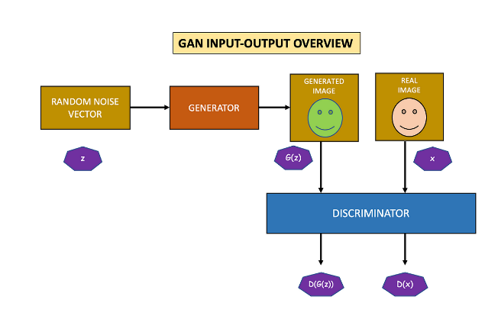
Methodology-CNN with GAN
CNN-GAN combines the architecture of CNNs with Generative Adversarial Networks.
GANs consist of a generator and a discriminator in a competitive training setup
The CNN-GAN model leverages the generative power of GANs to augment the dataset, enhancing the model's ability to generalize by exposing it to a more diverse set of images..

Slide 15
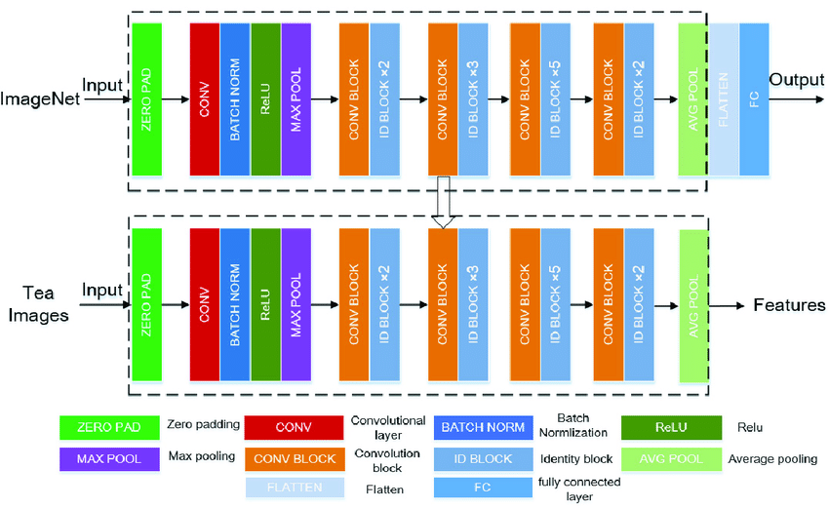
Methodology-ResNet50
ResNet is a deep learning architecture that addresses the vanishing gradient problem by introducing residual connections
ResNet introduces residual connections, allowing the model to skip one or more layers during training.
This architecture addresses the vanishing gradient problem, enabling the training of very deep networks. ResNet is known for its performance in capturing intricate features

Slide 16
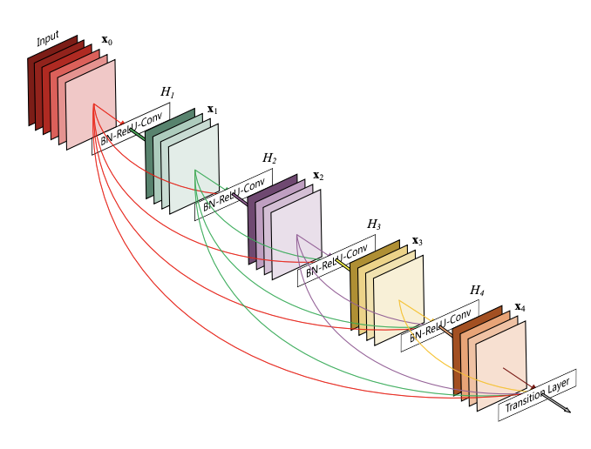
Methodology-DenseNet
DenseNet optimizes the information flow between layers by connecting each layer to every other layer in a feed-forward fashion.
This densely connected structure encourages feature reuse, parameter efficiency, and alleviates the vanishing gradient issue.
DenseNet is included to investigate its ability to capture and leverage feature interactions in the context of plant disease detection

Slide 17
Methodology-VGG16
VGG16 is a classic deep learning architecture known for its simplicity and effectiveness.
It consists of 16 weight layers, including convolutional and fully connected layers.
VGG16 is selected to assess the performance of a model with a moderate depth and explore its suitability for tomato plant disease classification.

Slide 18
Implementation
Heading to Kaggle GPU….

Slide 19
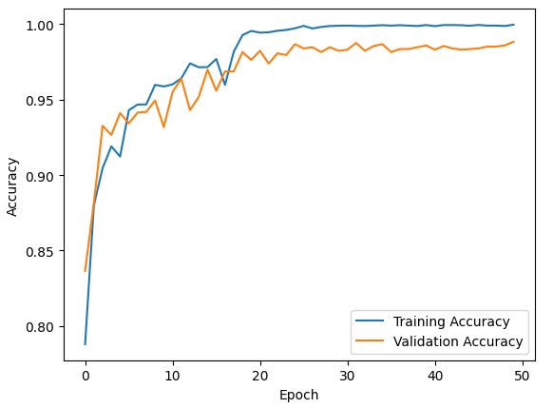
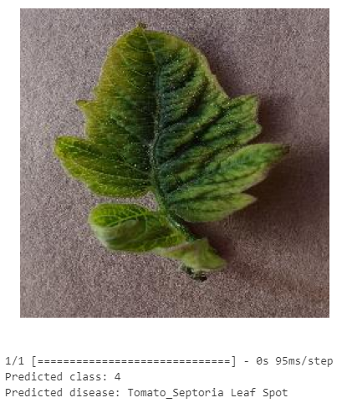
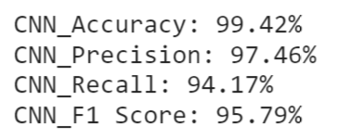
Results - CNN
Accuracy Graph Result Classification Report

Slide 20
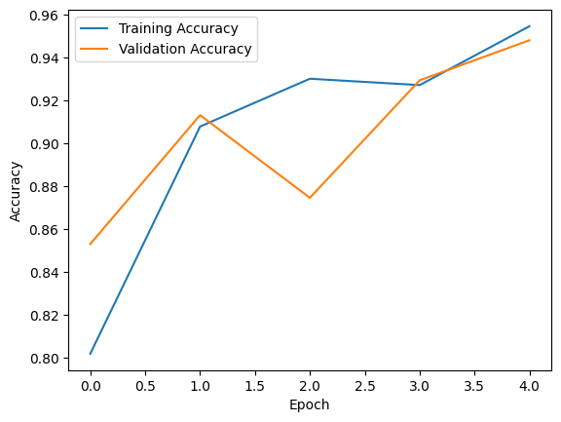
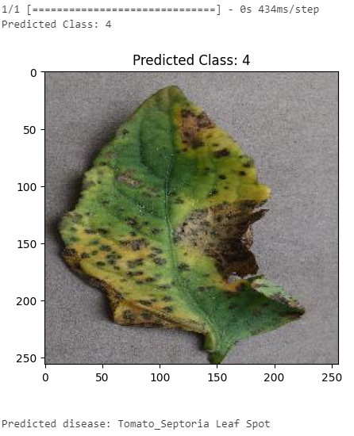

Results– CNN-GAN
Accuracy Graph Result Classification Report

Slide 21
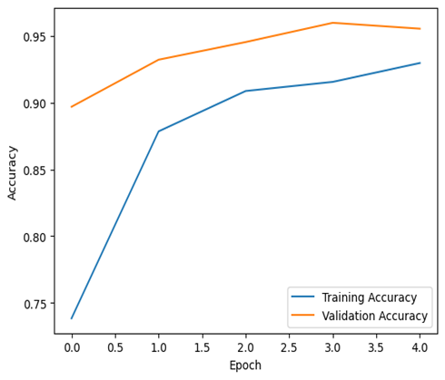
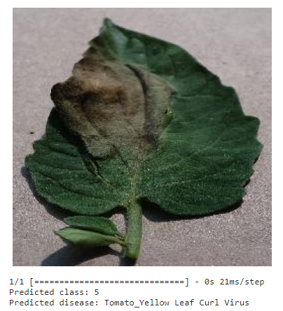
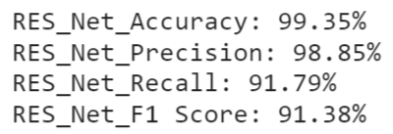
Results– ResNet50
Accuracy Graph Result Classification Report

Slide 22
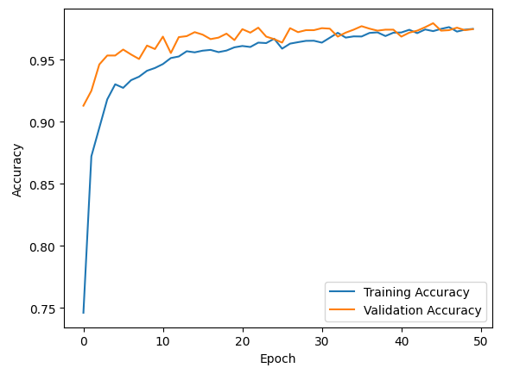
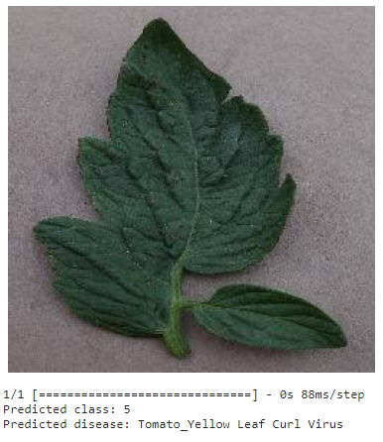
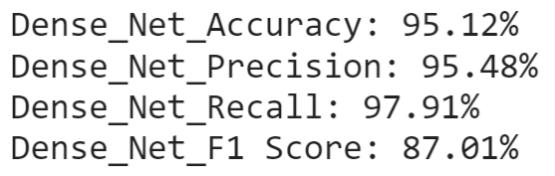
Results - DenseNet
Accuracy Graph Result Classification Report

Slide 23
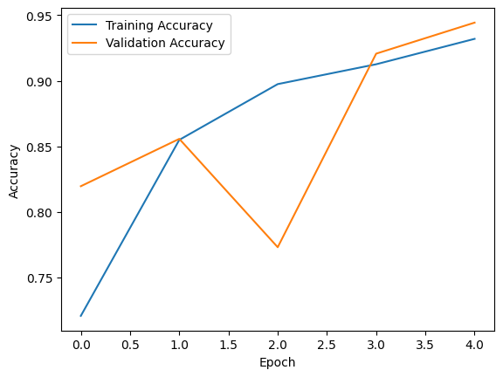
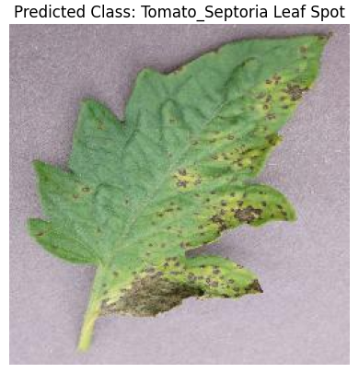

Results– VGG16
Accuracy Graph Result Classification Report

Slide 24
Analysis
Analyzing the performance of different deep learning algorithms (CNN, GAN, ResNet, DenseNet, VGG16) in plant disease detection involves considering several aspects such as accuracy, precision, recall, F1 score, training time, and model complexity. Based on following things….
Accuracy Comparison
Precision, Recall and F-1Score
Training Time
Model Complexity
Algorithm | Accuracy | Precision | Recall | F1-Score | Training Time | Complexity
CNN | 99.42 | 97.46 | 94.17 | 95.79 | 3-4 hours | Moderate
CNN-GAN | 96.51 | 91.54 | 91.57 | 87.89 | >4 hours | Complex
RESNET | 99.35 | 99.85 | 91.79 | 91.38 | 6 hours | Very High
DENSENET | 95.12 | 95.48 | 97.91 | 87.01 | 1 hour | Low
VGG16 | 98.35 | 97.34 | 98.34 | 93.93 | 2-3 hours | High

Slide 25
Conclusion
In conclusion, the application of deep learning algorithms for tomato plant detection has proven to be a highly effective and efficient approach.
The use of convolutional neural networks (CNNs) and other deep learning architectures has allowed for accurate and reliable identification of tomato plants in various settings.
This technology holds great promise for revolutionizing agricultural practices by automating the monitoring and management of tomato crops.

Slide 26
Future Scope
Develop models that are more robust to variations in environmental conditions, lighting, and plant growth stages.
This could involve incorporating techniques such as domain adaptation to ensure the model performs well across different settings.
Focus on reducing inference time to enable real-time monitoring of tomato crops.
This improvement is crucial for providing timely insights to farmers, allowing them to take prompt actions in response to changing conditions.

Slide 27
References
Li, L.; Zhang, S.; Wang, B. Plant Disease Detection and Classification by Deep Learning—A Review. IEEE Access 2021, 9,56683–56698. [CrossRef]
Panigrahi, K.P.; Sahoo, A.K.; Das, H. A CNN Approach for Corn Leaves Disease Detection to support Digital Agricultural System.In Proceedings of the 4th International Conference on Trends in Electronics and Information, Tirunelveli, India, 15–17 June 2020;pp. 678–683.
Singh V, Misra A (2017) Detection of plant leaf diseases using image segmentation and soft computing techniques. Inf Process Agric 4(1):41–49
Noonari S, Memon MIN, Solangi SU, Laghari MA,Wagan SA, Sethar AA, ... Panhwar GM(2015)Economic implications of tomato production in naushahroferoze district of Sindh Pakistan. ResHumanit Soc Sci 5(7): 158–70.
Haralick RM, Shanmugam K (1973) Textural features for image classification. IEEE Trans Syst Man Cybern 6:610–621
Bhowmik D, Kumar KS, Paswan S, Srivastava S (2012) Tomato-a natural medicine and its health benefits. J Pharmacogn Phytochem 1(1):33–43

Slide 28
References
Walker R, Jackway P, Longstaff I (1997) Recent developments in the use of the co-occurrence matrix for texture recognition. In: Digital Signal Processing Proceedings, DSP 97, 1997 13th International Conference on. IEEE.
Mokhtar U, Ali MA, Hassenian AE, Hefny H (2015) Tomato leaves diseases detection approach based on support vector machines. In: Computer Engineering Conference (ICENCO), 2015 11th International (pp.246–250). IEEE
Hitimana E, Gwun O (2014) Automatic estimation of live coffee leaf infection based on image processing techniques. arXiv preprint arXiv:1402.5805
Din MZ, Adnan SM, Ahmad W, Aziz S, Rashid J, Ismail W, Iqbal MJ (2018) Classification ofdisease in tomato plants’ leaf using image segmentation and SVM Technical Journal, University of Engineering and Technology (UET) Taxila, Pakistan Vol. 23 No. 2–2018.

