Slide 1


HANDWRITING LETTER PREDICTION
Presenting by
B Sai Abhishek BL.EN.U4AIE21015
B Ruchith Balaji BL.EN.U4AIE21017
Chillakuru Hari BL.EN.U4AIE21038
21AIE205- Python for Machine Learning

Slide 2
Contents:
Main Objective.
Introduction.
Data Set
System Model
Algorithms used
Code
Classification Report
Conclusion

Slide 3
Main Objective:
Performing Algorithms to predict the most accurate Outcome.
To Perform KNN, SVN, Decision Tree.
Knowing the Accuracy, Precision, Recall, F1-Score.

Slide 4
Introduction:
What is Hand Writing letter Recognition?
What are the Different ways to Approach?
Is there any application or advantages with this?

Slide 5
Introduction:
What is Hand Writing letter Recognition?
Recognising Letters.
Converts Images to textual Formats.
What are the different ways to Approach?
K nearest neighbor.
Support vector machine.
decision trees.
Is there any application or advantages with this?

Slide 6
Data Set:
Hand Writing letter Recognition
Source Kaggle.
Data Set contains
17 Columns.
1-Dependent
16-Independent
20000 Rows

Slide 7
Data Set:
17 Columns are :

Slide 8
System Model:
Input Data
KNN
Training Data
Training for ML Algorithm
Model Input
ML Algorithm
SVM
Decision Tree
Prediction
K-Nearest Neighbour.
Support Vector Machine.
Decision Tree
Successful Model

Slide 9
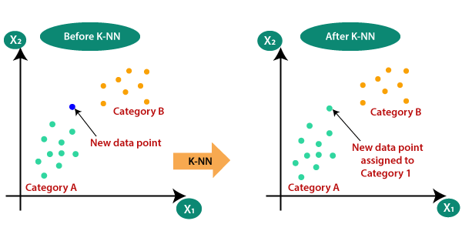
Algorithms Used:
K-Nearest Neighbour:
Super vised learning Algorithm.
Data Set is divided into Test and Train data sets
Working is based on 4 distance function:
Euclidean distance.
Cosine Similarity Measure.
Correlation.
Chi-Square.
KNN Classifier is used to execute.

Slide 10
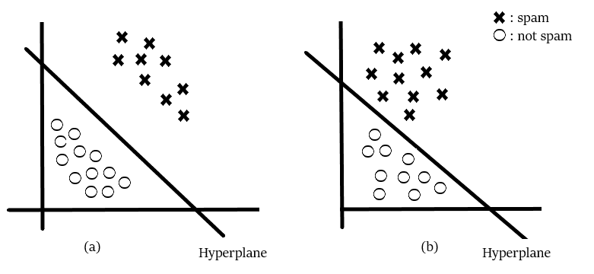
Algorithms Used:
Support Vector Machines:
Super vised learning Algorithm.
Data Set is divided into Test and Train data sets
Working is based on different Kernels:
Polynomial.
Linear.
Gaussian.
Radial Basis Function.
Laplace kernel.
SVC Classifier is used to execute.

Slide 11
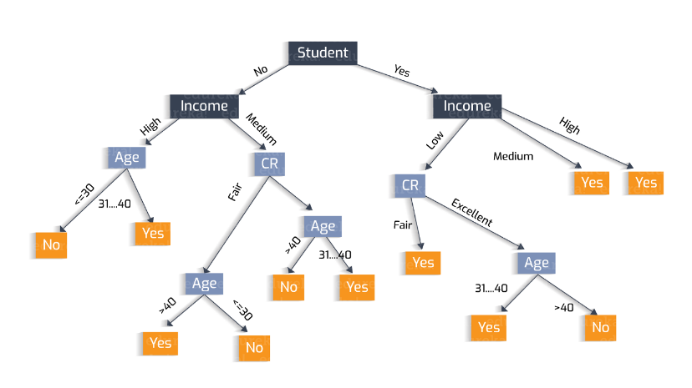
Algorithms Used:
Decision Tree:
Super vised learning Algorithm.
Data Set is divided into Test and Train data sets
Working is based function:
Entropy.
Gine.
Decision classifier is Used to execute.

Slide 12
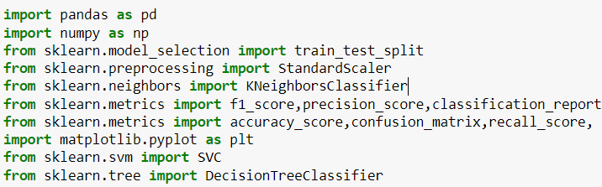
Code:
Importing Libraries:

Slide 13
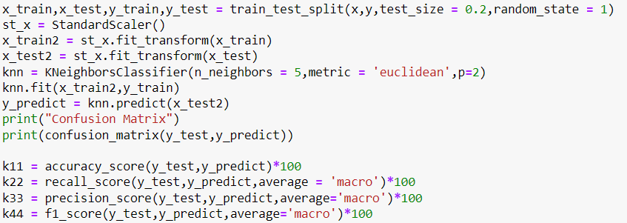
Code:
KNN:

Slide 14
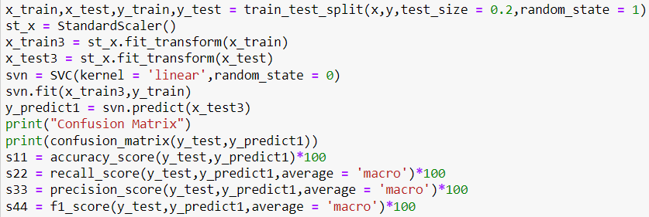
Code:
Support Vector Machines:

Slide 15
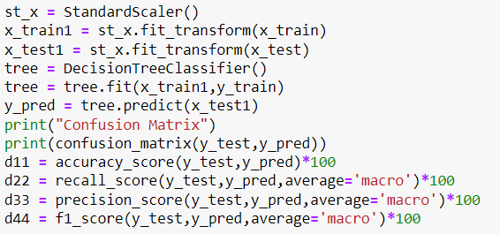
Code:
Decision Tree:

Slide 16
Classification Report:
Classification Report Consists of
Accuracy.
Precision.
Recall Score.
F1 Score.

Slide 17
Conclusion:
Performed KNN, SVM, Decision tree
Obtained Accuracy, precision, Recall, F1-Score from each Algorithm.
KNN is preferred as it has high accuracy when compared to both.

Slide 18
References:
[1] Ayush Kumar Agrawal, A.K. Shrivas, Vineet kumar Awasthi, Department of IT & CS,
Dr. C.V. Raman University, Bilaspur, (C.G.), India, A Robust Model for Handwritten
Digit Recognition using Machine and Deep Learning Technique, 2021 2nd International
Conference for Emerging Technology (INCET).
[2] Anupama Sahu;S. N. Mishra 2020 IEEE International Symposium on Sustainable Energy, Signal Processing and Cyber Security (iSSSC)
[3] Najoua Rahal, Maroua Tounsi, Tarek M Hamdani, Adel M Alimi, Handwritten Words and Digits Recognition using Deep Learning Based Bag of Features Framework, 2019 International Conference on Document Analysis and Recognition (ICDAR)

