Slide 1

Final Project Presentation
on
Credit Risk Analysis Using Py-Spark
Team Members
B.SAI ABHISHEK BL.EN.U4AIE21015
B.RUCHITH BALAJI BL.EN.U4AIE21017
Chillakuru Hari BL.EN.U4AIE21038
Date:21/06/23
Course :Big Data Analytics 21AIE214
Niharika Ma’am
AI 4th Sem –E Sec

Slide 2
Outline
INTRODUCTION
PROBLEM STATEMENT
DATASET
PROPOSED FRAMEWORK
EVALUATION METRICS
RESULTS
CONCLUSION AND SCOPE FOR IMPROVEMENTS
REFERENCES

Slide 3
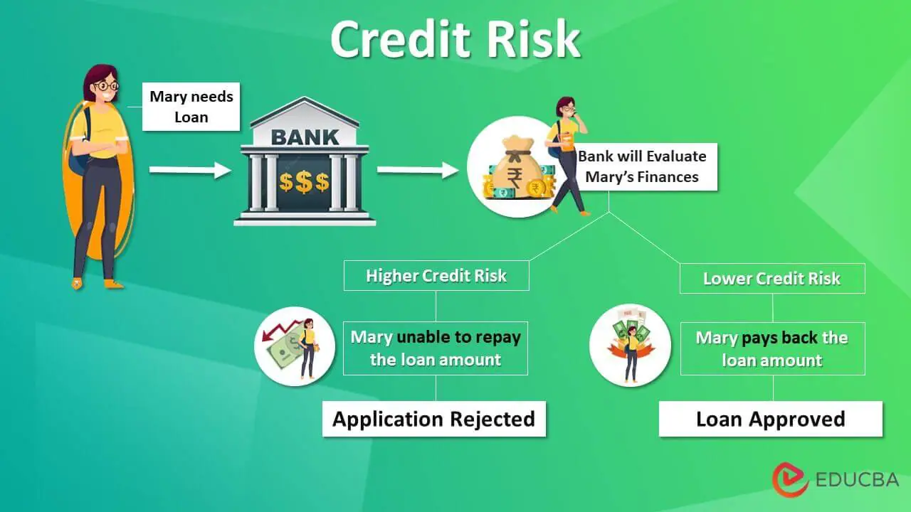
Introduction
Credit analysis involves in estimating of another party being able to pay or not.
Credit risk is the probability of a financial loss resulting from a borrower failure to replay a loan.

Slide 4
Introduction
Salesforce is a popular customer relationship management (CRM) platform.
It can also be utilized in credit risk analysis to enhance decision-making and streamline processes:
1) Centralized Customer Data : Financial statements , Payment histories
2) Automated Workflows : Document verification , reduces manual effort
3) Security : a) Two-Factor Authentication (2FA)
b) Backup and restore data

Slide 5
Problem Statement
The problem is to develop a credit risk analysis system using PySpark that accurately assesses the creditworthiness of borrowers and helps financial institutions make informed lending decisions.
The goal is to build a scalable and efficient solution that incorporates advanced machine learning techniques to predict and manage credit risk effectively.
Final project Presentation, 21AIE214

Slide 6
Dataset
We Have taken the data Set with Following Attributes:
Loan ID
Gender
Married
Dependents
Education
Self_Employes
Applicant Home
Loan Amount
Credit History
Property Area
Loan_status

Slide 7
Proposed Framework
We use framework for Efficient processing , improving accuracy
Logistic Regression
Random Forest
Py-Spark

Slide 8
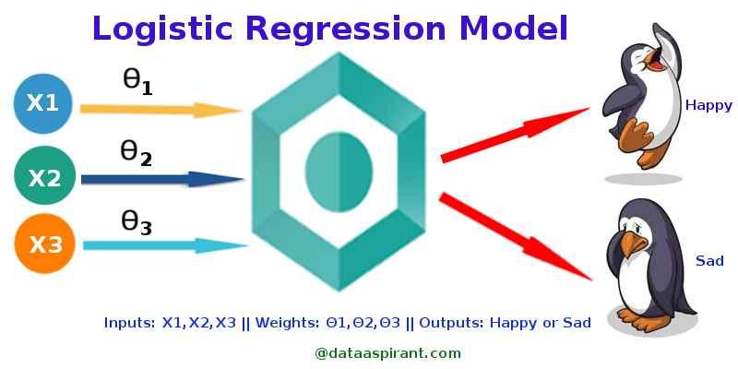
Proposed Framework
Logistic Regression (Py-spark)
Logistic regression is an example of supervised learning. It is used to calculate or predict the probability of a binary (yes/no) event occurring.
Binary Classification.
Model Evaluation.
Real-Time Analysis:

Slide 9
Proposed Framework
Logistic Regression (Py-spark) - Design
Creating a
Spark Session
Dividing data
To
Test , Train
Data Loading
Pipe Lining
Fitting the Data
Into Model
Data
Pre-processing
Logistic Model
Creation
Predicting
Credit Risk
Final Results

Slide 10
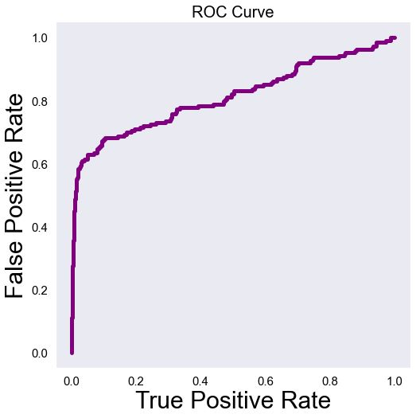
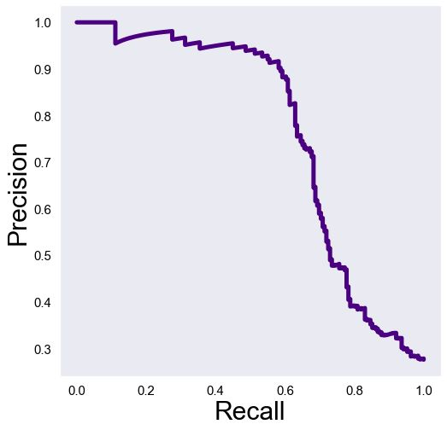
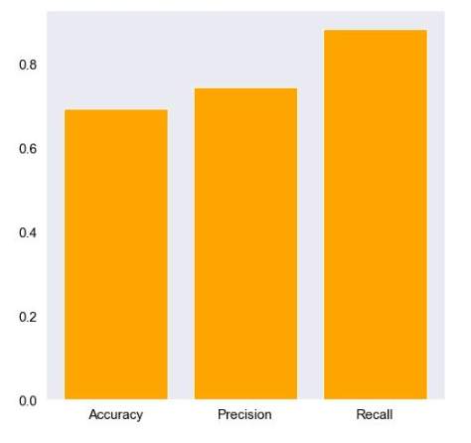
Evaluation Metrics(LR)

Slide 11
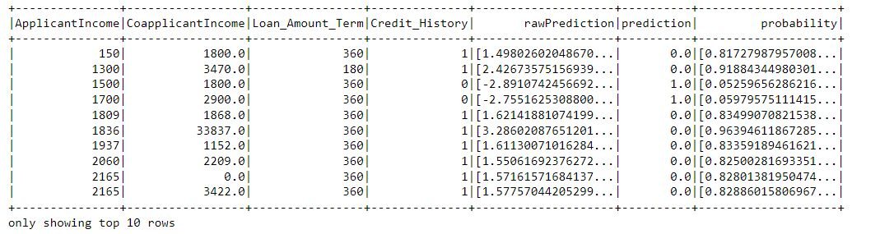
Results(LR)

Slide 12
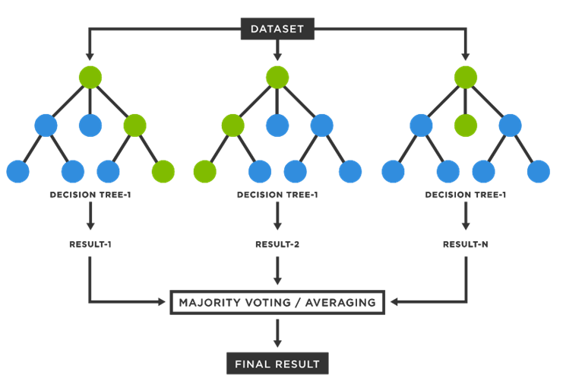
Proposed Framework
Random Forest (Py-Spark)
Random Forest is an ensemble learning method that combines multiple decision trees to improve predictive accuracy and reduce overfitting.
Voting Mechanism
Handling Missing Data and Outliers

Slide 13
Proposed Framework
Logistic Regression (Py-spark) - Design
Creating a
Spark Session
Data Loading
Data
Pre-processing
Assembling Data
Random Model
Creation
Dividing data
To
Test , Train
Fitting the Data
Into Model
Predicting
Credit Risk
Final Results

Slide 14
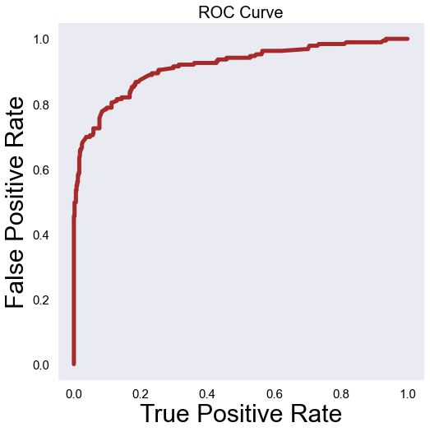
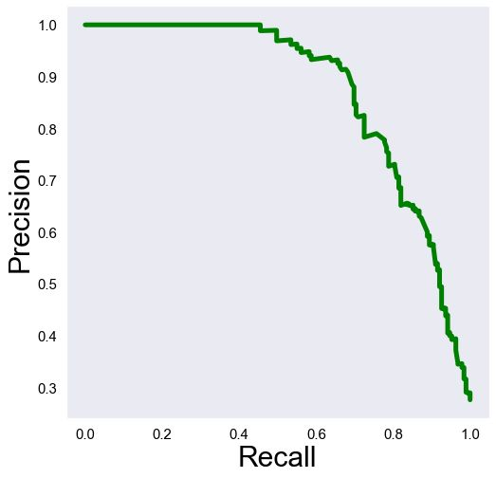
Evaluation Metrics(RF)

Slide 15
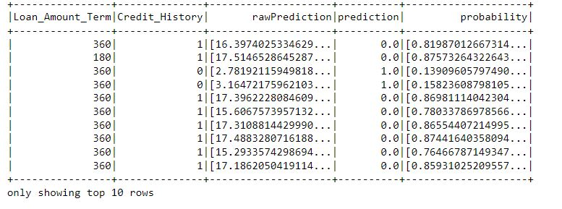
Results(LR)

Slide 16
Conclusion & Future Scope
Created a efficient Credit Risk Analysis Model to predict Credit Risk.
Advanced Machine Learning Techniques.
Real-time Credit Risk Analytics.
Continuous Model Improvement

Slide 17
References

Slide 18

Thank You

