Slide 1
Anomaly detection using One-class SVM
Team 12
Sahithi Akunoor
Yasasvi Nalla
Ruchith Reddy Parnem
Temitayo Okeowo
2447497
2444910
2403667
1532068

Slide 2
Agenda
What is anomaly detection?
One-class SVM overview
Dataset description
Methodology
Implementation
Analysis & Results
Conclusion

Slide 3
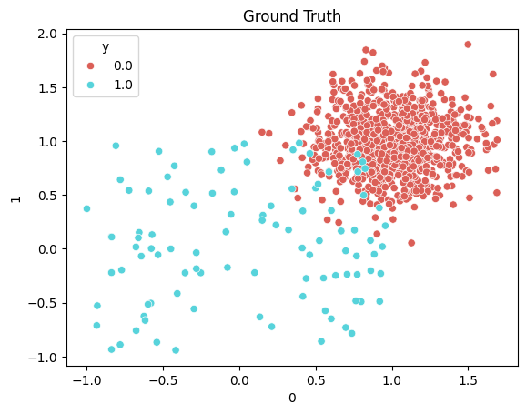
What is Anomaly Detection?
Anomaly detection identifies data deviating from expected behavior.
Types by Learning Approach:
Supervised: Uses labeled data (normal/anomalous) to train a classification model (e.g., decision trees, neural networks).
Unsupervised: Detects anomalies in unlabeled data by identifying points significantly deviating from established patterns.
Semi-supervised: Models normal behavior using labeled data, then identifies anomalies in new, unlabeled data.

Slide 4
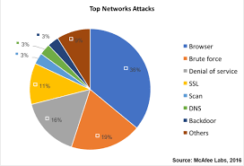
Problem Statement
1. Growing Cybersecurity Threats
2,200 daily attacks, $10.5T annual cost by 2025
DoS, port scanning, data exfiltration, malware
2. Traditional Detection Fails
Signature-based: Only detects KNOWN attacks
Fails to detect zero-day or novel attacks
3. Unsupervised Learning Solution
Learns "normal" behavior, flags deviations
Requires no labeled attack data
4. Zero-Day Attack Challenge
Unknown exploits lack existing signatures
Requires behavioral detection, not pattern matching
5. Our Goal
Detect anomalous network traffic using One-Class SVM
Automatically identify both known and unknown attacks

Slide 5
Why One-class svm?
Trains only on normal data
No labelled anomalies required
Works well on high dimensional, mixed-type, network features
Can detect unseen attacks
One-Class SVM is better at capturing complex, high-dimensional relationships present compared with isolation forest.

Slide 6
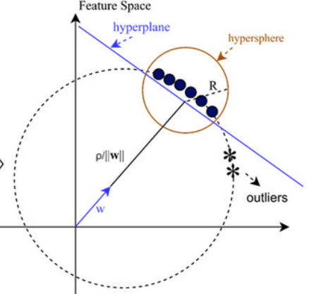
How One-Class SVM works
Maps data to high-dimensional space
Finds hyperplane separating normal vs outliers
Nu- controls expected fraction of anomalies
Gamma- controls boundary flexibility
Kernel: RBF Kernel, non linear patterns very well.
Decision boundary illustration

Slide 7
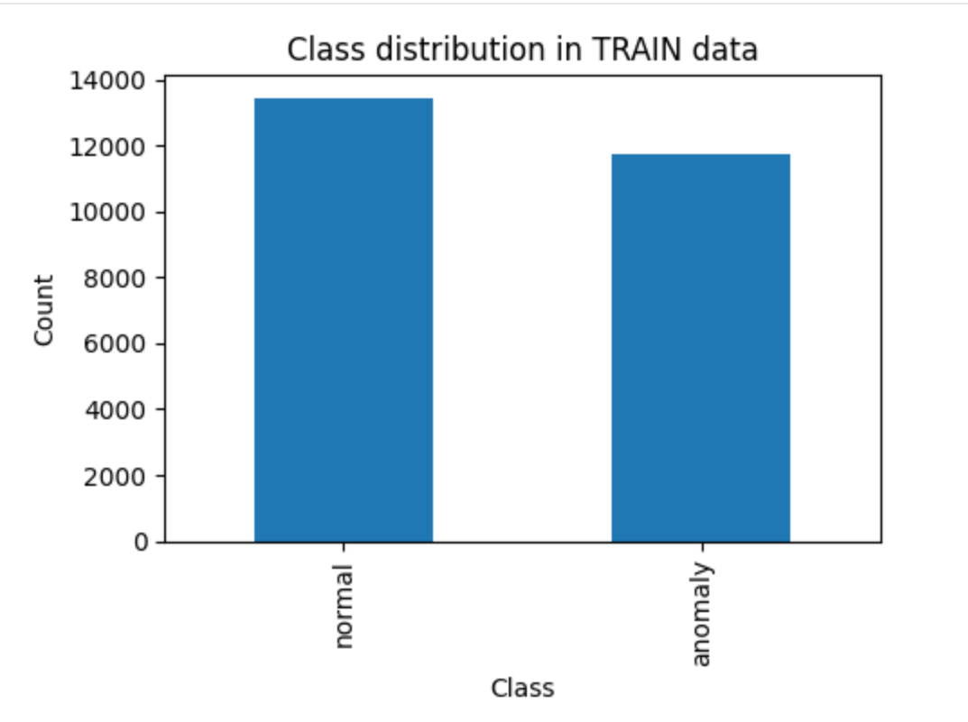
Dataset Description
Network intrusion dataset from kaggle
Training set: 25192 connections
Test set: 22544 connections
It has 41 features: duration, protocol, flag, sourced_bytes
Classes: Normal, Anomaly

Slide 8
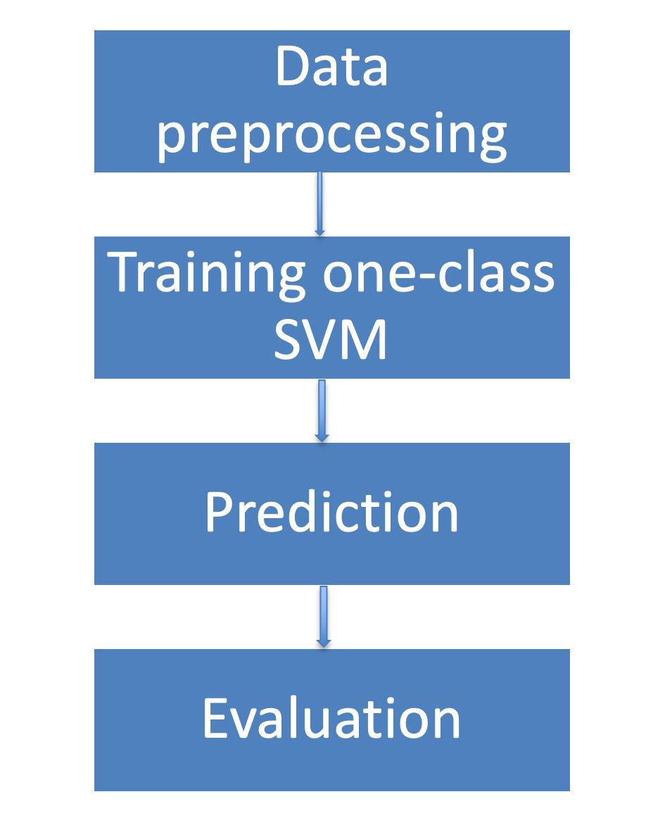
Methodology
Data preprocessing
Label encode categorical Features
Standardize all Features
Training one-class SVM
Use only normal samples
Prediction
Generate Prediction and anomaly scores, which tells us how far points lie from decision boundary.
Evaluation & Conclusion

Slide 9
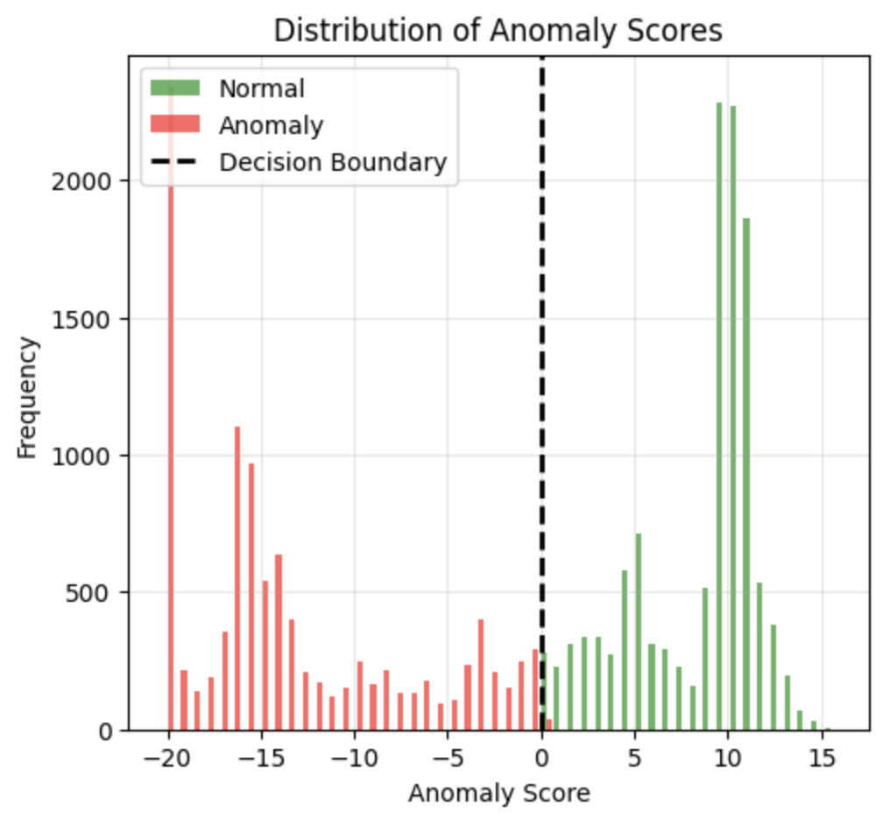
Hyperparameter Tuning
Tested multiple nu values: 0.01, 0.03, 0.05, 0.1
nu controls expected outliers (sensitivity of model)
Higher nu → more anomalies detected
Selected nu = 0.05 (best balance)
Gives stable anomaly detection around 46%
Gamma- scale, 0.01,0.1,1
gamma='scale' automatically calculates a gamma based on the dataset's variance

Slide 10
code

Slide 11
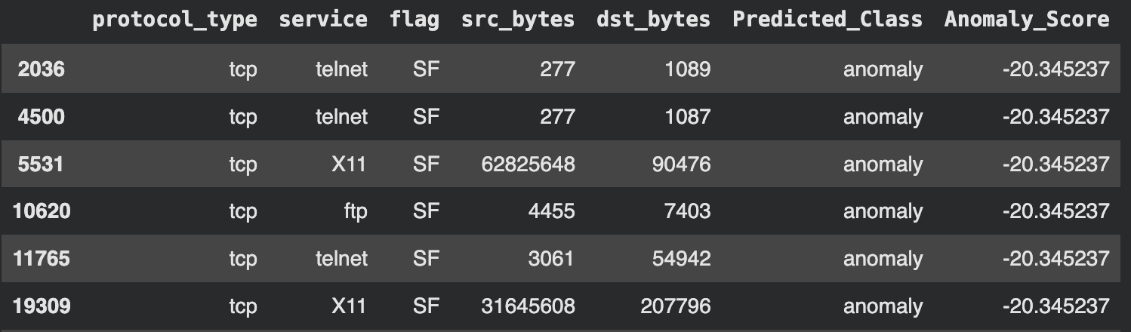
Overall Performance
Normal connections: 12,174 (54%)
Anomaly connections: 10,370 (46%)
High anomaly rate suggests mixed attack patterns
Anomaly score distribution clearly separates normal vs abnormal

Slide 12
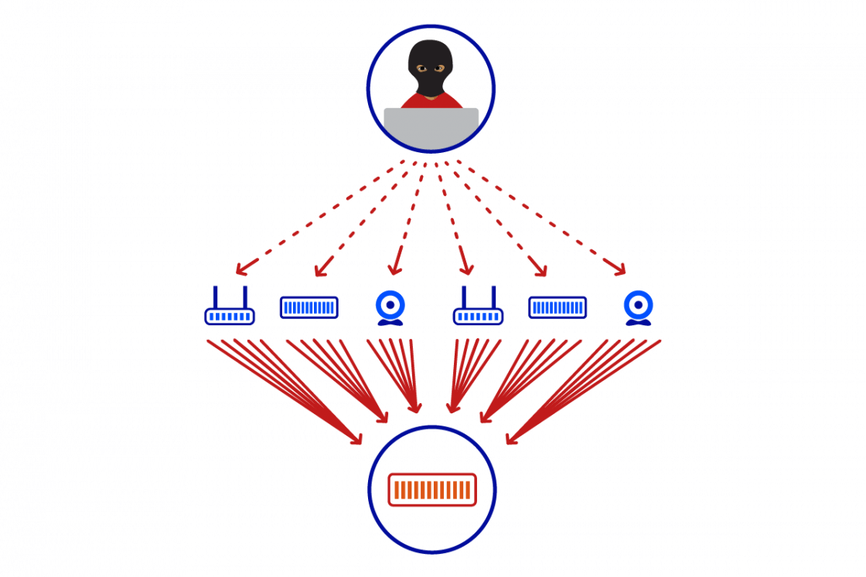

Applications
One Class SVM models have been successful at identifying attack types such as :
DoS / DDoS Attacks
Malware attacks
Credit Card Fraud
Insurance Fraud

Slide 13
Advantages of One Class SVM
Limitations of One Class SVM
This algorithm works well with normal data
It’s effective for high dimensional and non linear data
Strong performance on clear outliers
Poor scalability to Large Datasets
Sensitive to Hyperparameters

Slide 14
Conclusion
It is effective for network intrusion detection because it successfully identifies multiple attack patterns
Algorithm is efficient and interpretable for real time use
Future Work
Combine with other supervised ensemble methods to improve robustness

Slide 15


