Slide 1
Group 5 Data Science Mid-Term Project
Title: Insightful Trends in Loan Data Analysis
Group member Names
- Ruchith Reddy parnem
- YasaSvi Nalla
- Shehnaz Nijumudheen
- Temitayo okeowo
- Shreyashree Mondal

Slide 2
Problem Statement and Objective
The analysis aims to explore loan dataset patterns, focusing on customer demographics, financial behaviors, and loan metrics to derive insights through exploratory data analysis (EDA).
Objective:
The primary goals of this analysis are:
Understand the dataset structure (columns, data types, and missing values).
Clean and preprocess the data.
Detect and treat outliers.
Analyze key financial attributes such as Loan Amount, Debt, Expenditure, and Overdue Payments.
Compare financial patterns.
Visualize the data to gain better insights.

Slide 3
Basic Data Exploration
Missing Value Analysis
Identify and handle missing data using imputation strategies(replace with median).
Example: Income and Loan data are missing for 32 customers; expenditure data is missing for 19 customers.
Tools: Python (Pandas, Matplotlib).
Data Cleaning
Converting 'Debt' from string to numeric by removing commas.
Summary Statistics
Calculating the statistical values for the data.
Example: Mean of age, debt, loan, etc.
Outlier Detection
Find unusual data points to identify errors or fraud.
Example: Replacing outliers in 'Income' and 'Loan' with the mean using IQR method.

Slide 4

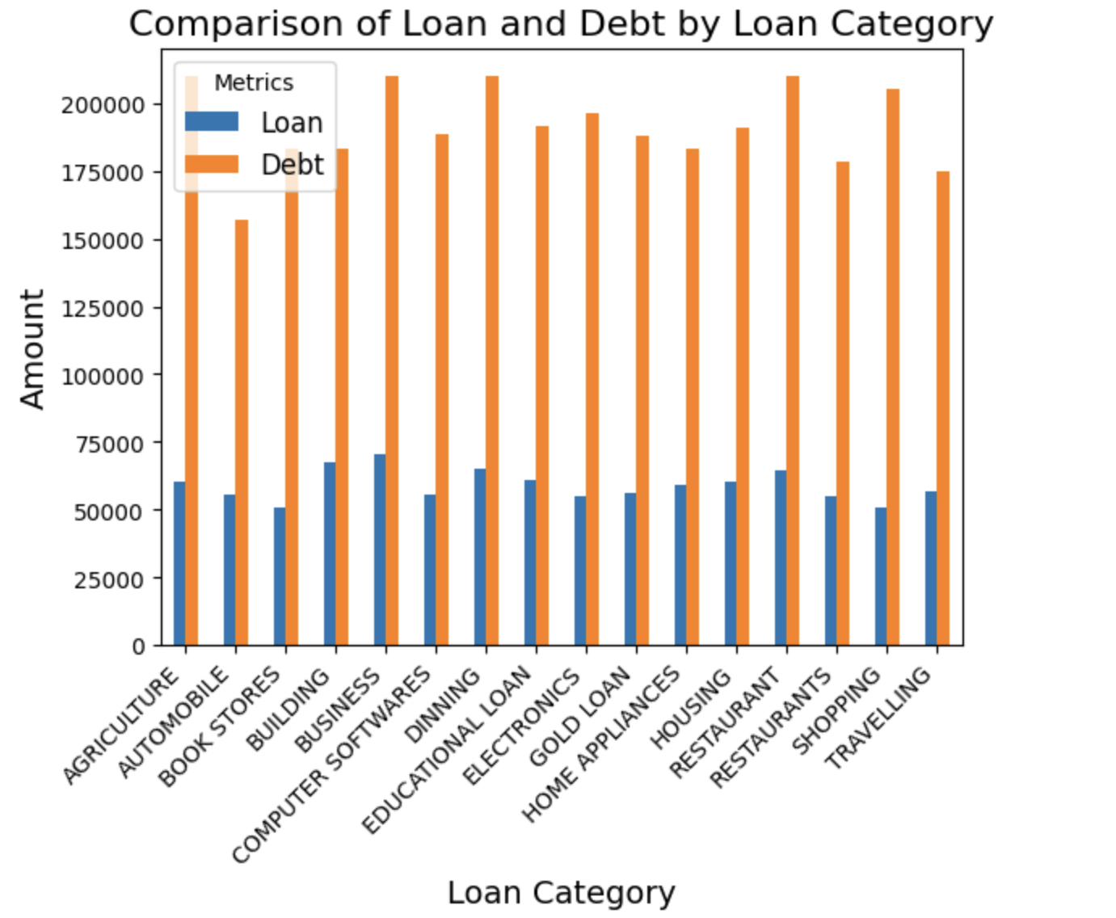
Comparison of Loan and Debt by Loan Category
Debt is higher than Loan in all categories.
Business and Dining have the highest debt.
Even small loans, like in Book Stores, lead to high debt.

Slide 5
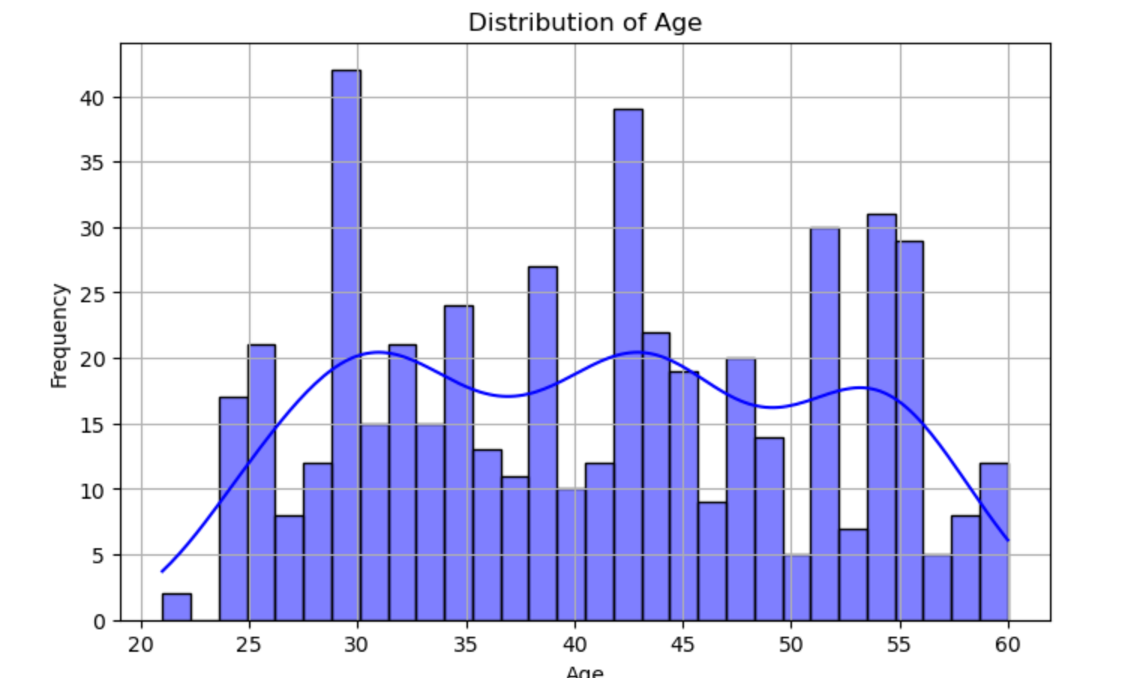
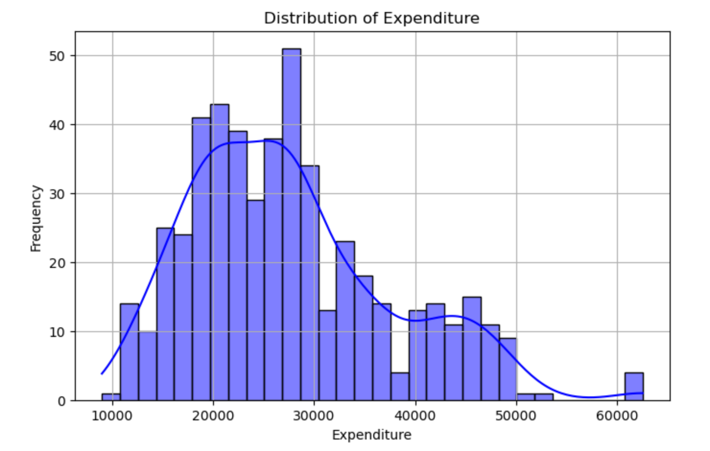
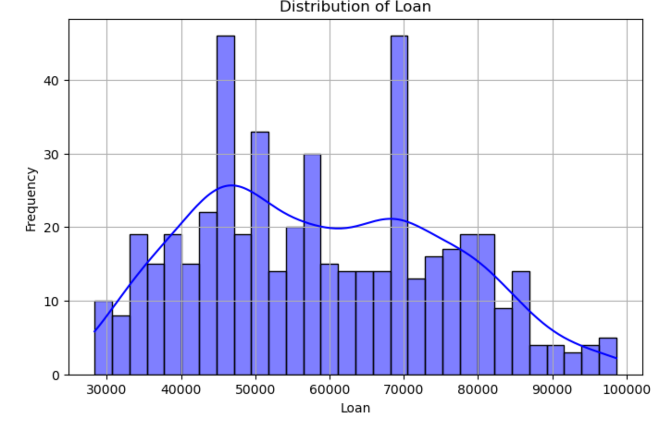
Univariate Analysis
Distribution of Age: The data shows a multimodal distribution of age, peaking in the 30s to early 40s and gradually tapering off with age.
Distribution of Expenditure: It is spread widely with concentration on lower range. A gradual decrease is observed as expenditure increases.
Distribution of Loan: It is bimodal distribution with two peaks. It is right skewed and there is a gradual decrease in frequency as loan amounts increase.

Slide 6
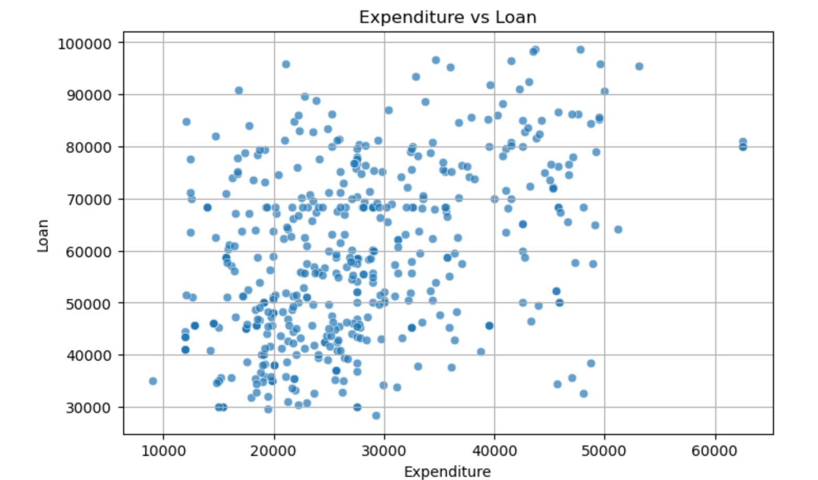
Bivariate Analysis
Graph : Scatterplot between Expenditure vs Loan
The scatterplot between Expenditure and Loan shows a moderate positive relationship.
The calculated correlation coefficient is 0.44, indicating that as expenditure increases, there is a tendency for the loan amount to also increase.

Slide 7
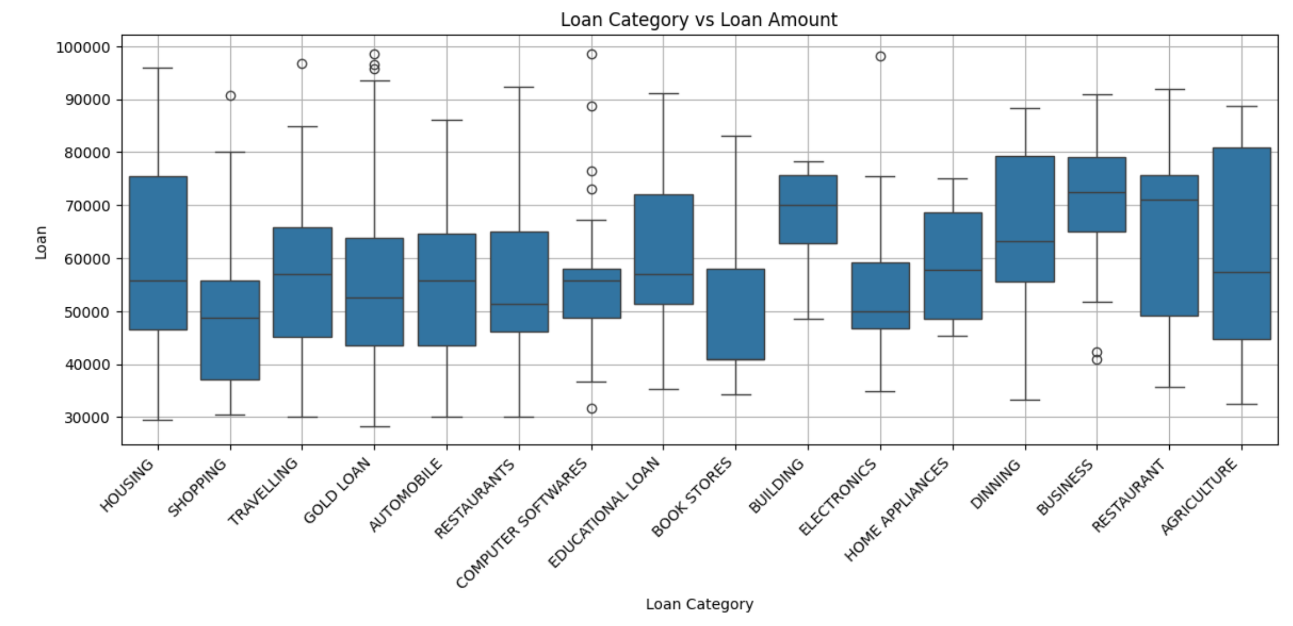
Data Visualization: Boxplot
Loan amount varies significantly by category, with business-related and essential sectors like agriculture, dining, and housing receiving larger loans.
Consumer-focused categories like shopping and restaurants see lower, more consistent loan sizes.

Slide 8
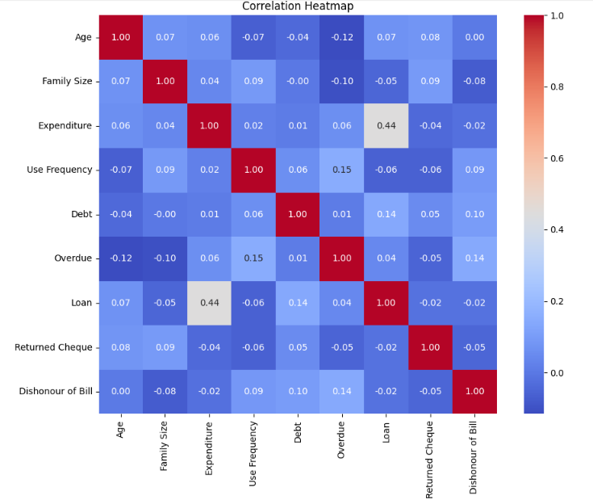
Heatmap is a visual representation of the correlation matrix.
HEATMAP

Slide 9
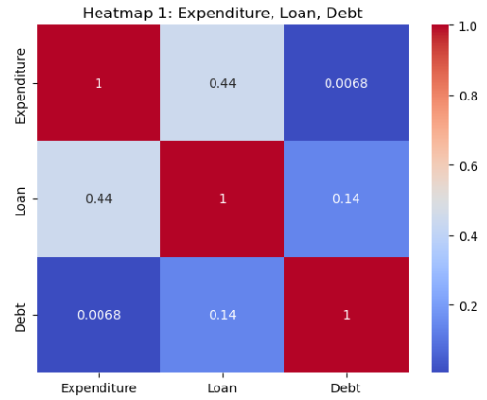
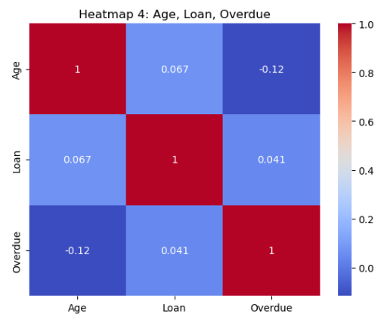
Multivariate Analysis
Heatmap 1 - Financial Behavior
Title: "Spending & Borrowing Patterns"
Heatmap 2 - Demographic Influence
Title: "Age and Overdue Behavior"

Slide 10
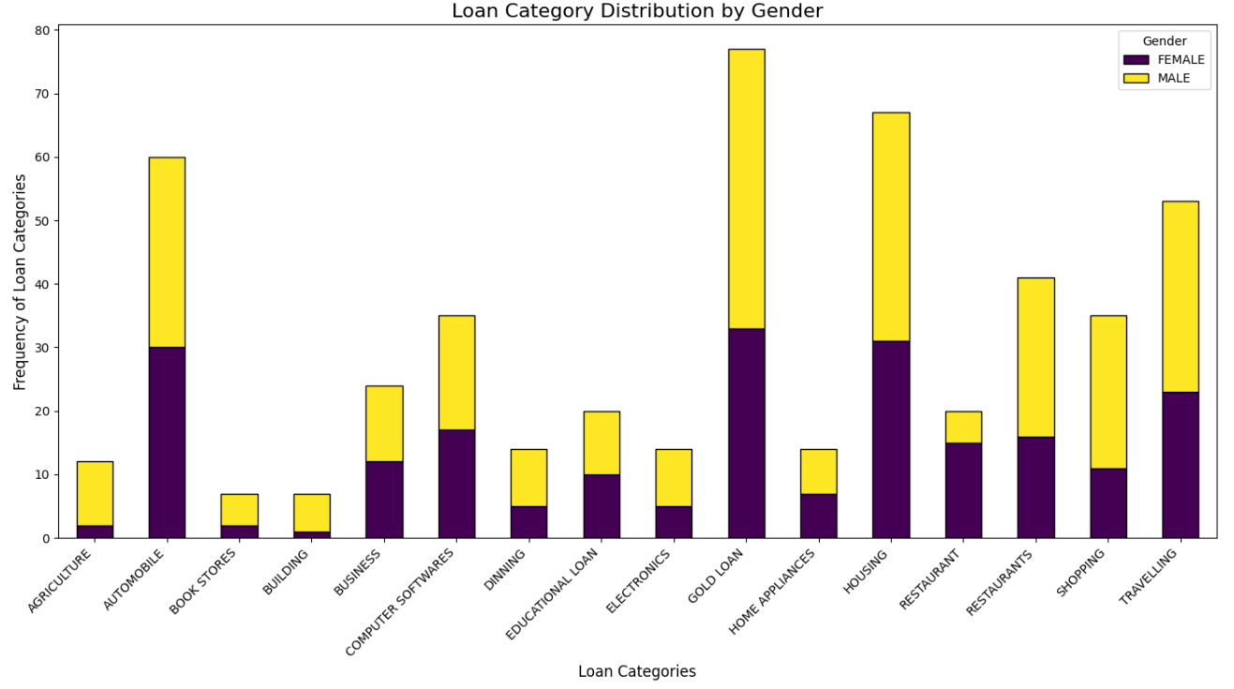
Data Mining Questions
Question: 1
Is there a pattern in gender distribution across loan types, loan frequency?
Answer: Males are inclined toward Gold loans, Automobiles, and Housing loans, with some overlap in preferences like Gold loans and Automobile, while females predominantly prefer Gold loans, Housing and Educational loans.

Slide 11
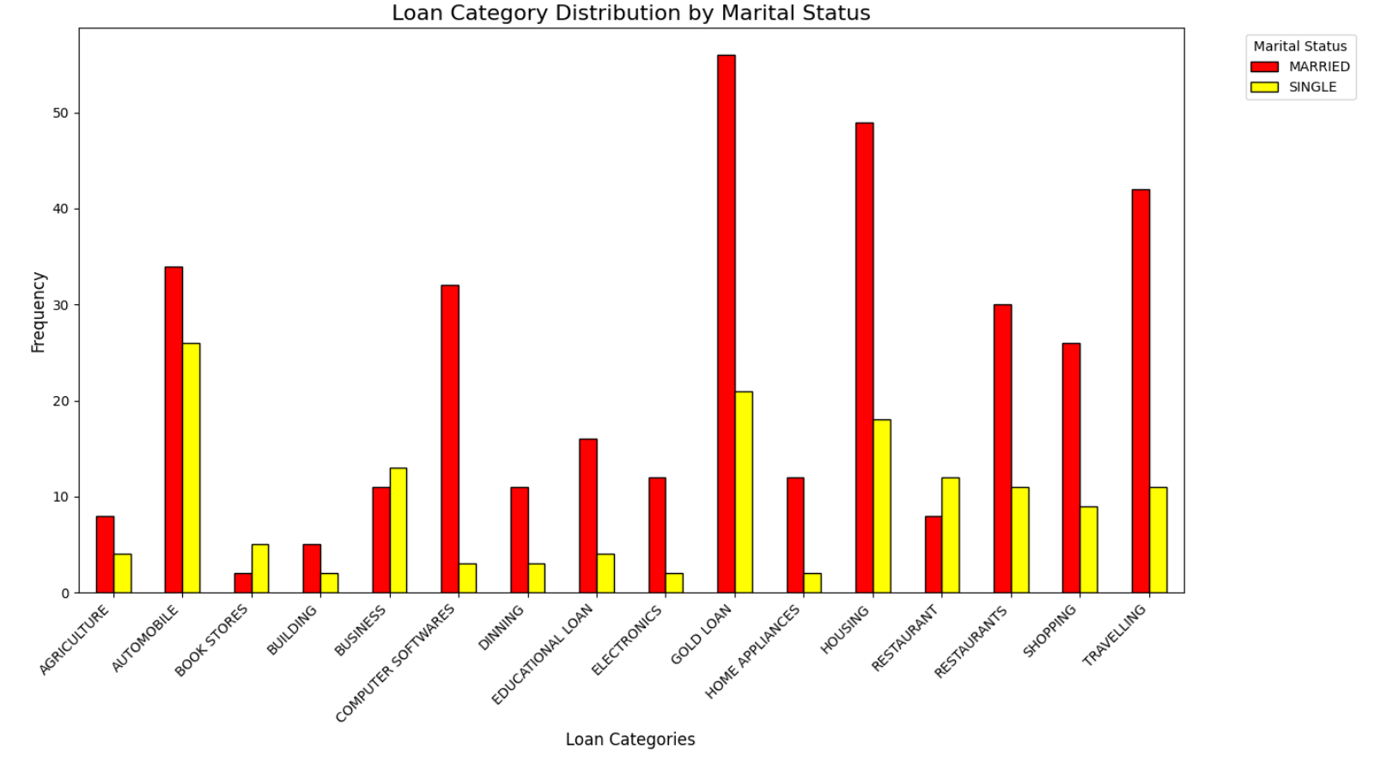
Question 2: Is there a relation between marital status and loan category?
Answer: Yes, there is a clear relationship between marital status and loan category preferences. Married individuals favor family or home-related loans such as Gold loans, Housing loans, Computer Software's, and Travelling loans. Meanwhile, single individuals lean towards more personal or career-oriented loans such as Business loans, Automobile loans, and Gold loans.

Slide 12
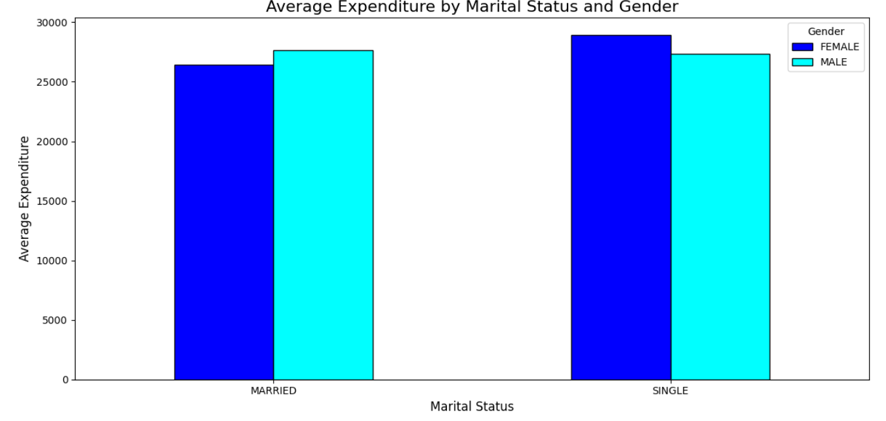
Question 3: What is the relationship between marital status, gender, and spending patterns in this dataset?
Answer: Females have the highest average expenditure, followed by single males. Married males and females have slightly lower expenditures, showcasing family-oriented or shared financial dynamics. Single individuals generally spend more on average than their married counterparts. This could indicate fewer shared expenses or higher personal financial commitments.

Slide 13
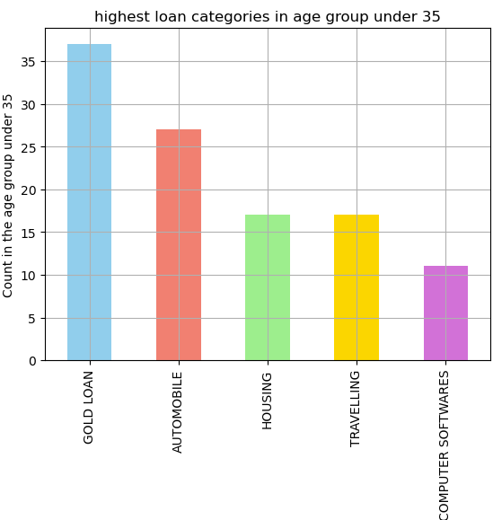
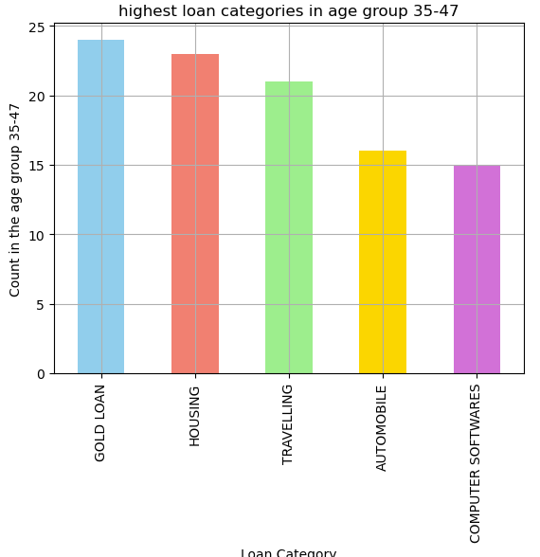
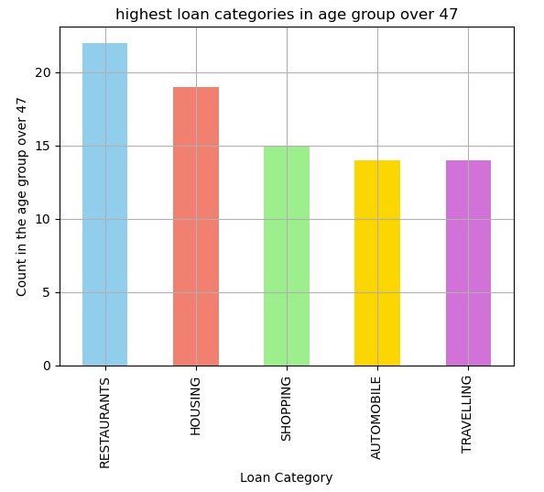
Data Mining Questions
Comparing age with indicators : loan category

Slide 14
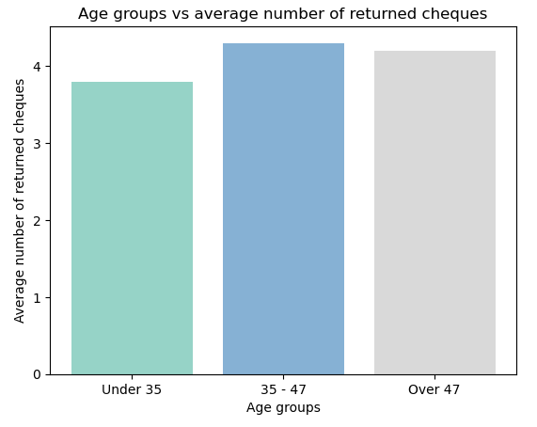
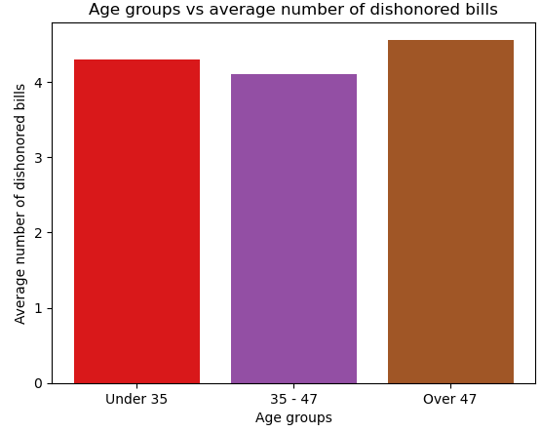
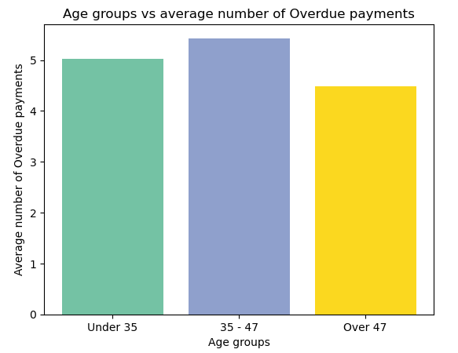
Data Mining Questions
Age groups vs loan success indicators : returned checks, dishonored bills and overdue payments

Slide 15
CONCLUSIONS:
Data cleaning improved dataset quality for accurate analysis.
Strong links exist between expenditure, loan, and debt patterns.
Demographic factors significantly influence loan behavior.
The most popular loan category is Gold and least one is Book Store.
Loan category preferences, frequency, and spending behavior vary significantly across gender and marital status, suggesting a strong influence of demographic factors.
Age plays a significant role in financial reliability, with trends showing variance in returned cheques, dishonored bills, and overdue payments across different age groups.
Certain occupations exhibit higher financial risk indicators such as dishonored bills, overdue payments, making occupation a strong predictor in risk modeling.
Larger family sizes correlate with increased loan frequency and a higher number of returned cheques, indicating potential financial strain in bigger households.
These findings offer deeper insights into financial behavior across various demographics, occupations, and categories, helping shape strategies for risk management and borrower assistance.

Slide 16


