Slide 1

MENTAL HEALTH TEXT CLASSIFICATION
USING NLP
INSTRUCTOR:
Dr. Nima Ekhtari
Team 13:
Saketh Desini
Ruchith Reddy Parnem
Lekha Kancharla

Slide 2
Overview
Motivation & Objectives
Dataset Description
Models Used
  RoBERTa-base
  DeBERTa-v3-large
  BiLSTM + FastText
Results & Comparisons
Conclusion & Future Work

Slide 3
Motivation and Objectives
Lot of people talk about mental health via text on social media.
Manually monitoring content is slow and not scalable.
Automatic text classification helps in early detection of at-risk users.
Compare performance using: Accuracy, Precision, Recall, F1-Score.
Analyze common misclassifications and challenges.

Slide 4
Dataset
Source : https://www.kaggle.com/datasets/suchintikasarkar/sentiment-analysis-for-mental-health/code
Features: 3 (id, Statement, Status), Size : 53,043
Classes : 7 (Normal, Depression, Suicidal, Anxiety, Stress, Bi-polar, Personality Disorder)
Text preprocessing: Removing extra spaces, line break, basic URL cleanup
Train/Val/Test Splits : 80/10/10
Class Imbalance:
  Weighted categorical cross entropy loss
  Stratified Split for training and testing

Slide 5
RoBERTa_Base
Robustly Optimized BERT Pretraining Approach(RoBERTa)
12 transformer layers, 768-dim hidden size, ~125M parameters
Removes NSP and trains with MLM.
Dynamic Masked Language Modeling.
Expanded training corpus (160GB of text).
Finetuned values: LR: 2e-5, Batch size: 16, weight decay: 0.01, context length: 384

Slide 6
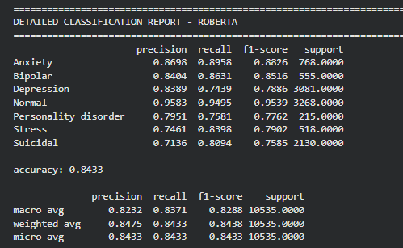
Results
Normal has the best performance (F1 ≈ 0.95, precision 0.96, recall 0.95).
Anxiety and Bipolar are also strong, with F1 scores around 0.88 and 0.85
For stress and suicidal the recall is more.
Macro-average F1 0.83 and weighted-average F1 0.84, indicating that not dominated only by the majority Normal class.

Slide 7
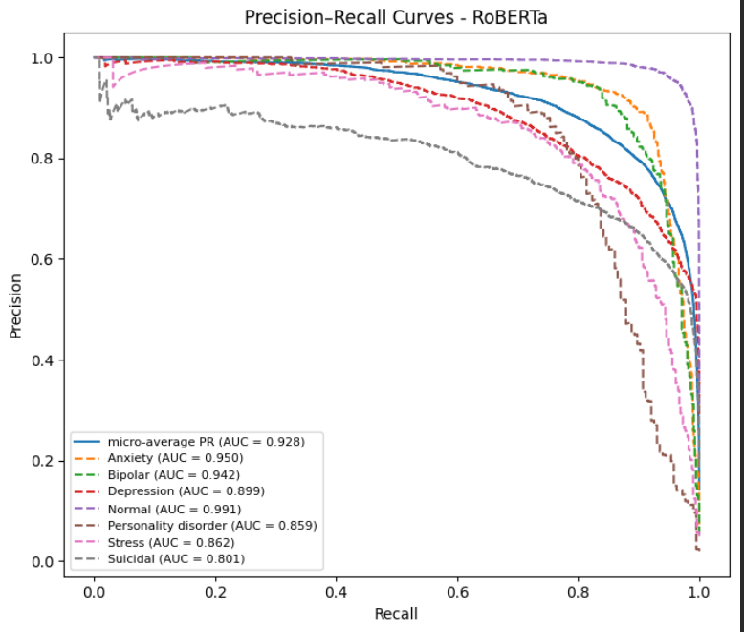
Results
More difficult categories like Personality disorder (AUC = 0.859) and Suicidal (AUC = 0.801) have slightly lower AUC.

Slide 8
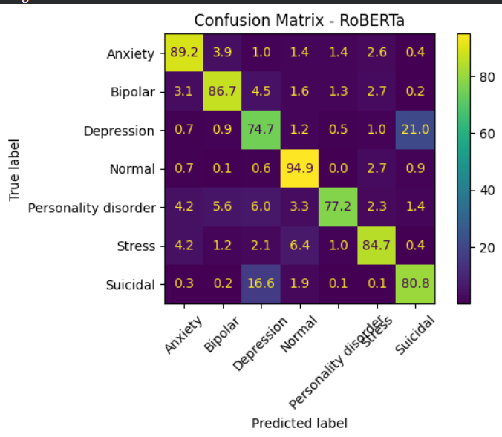
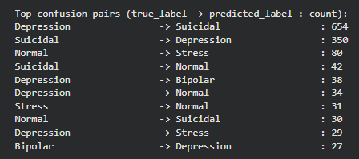
Results
Most frequent misclassifications are Depression -> Suicidal (654 cases) and Suicidal -> Depression (350 cases)

Slide 9
DeBERTa_v3_Large
Decoding Enhanced BERT with Disentangled Attention (DeBERTa)
24 layers , 1024 hidden size , ~ 304M parameters.
Trained same as RoBERTa with 160GB text
Separates content & positional embeddings
Fine tuned parameters: LR: 1e-5, batch size: 16, weight decay= 0.01, context length: 384

Slide 10
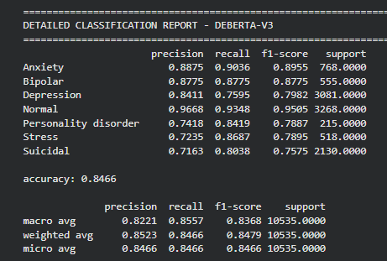
Results
Normal has the best performance (F1 ≈ 0.95, precision 0.97, recall 0.93)
Anxiety and Bipolar are also strong, with F1 0.90 and 0.88
For depression and suicidal the F1 are lower at 0.79 and 0.76.

Slide 11
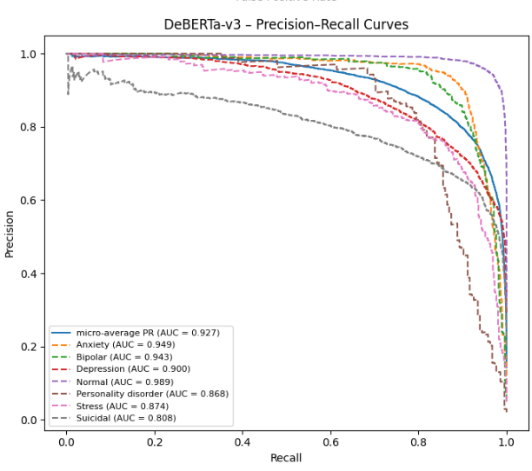
Results
All classes achieve AUC > 0.80
Normal has with AUC = 0.989
Anxiety (0.949) and Bipolar ( 0.943)
Personality disorder (0.868) and Suicidal (0.808) have slightly lower AUC.

Slide 12
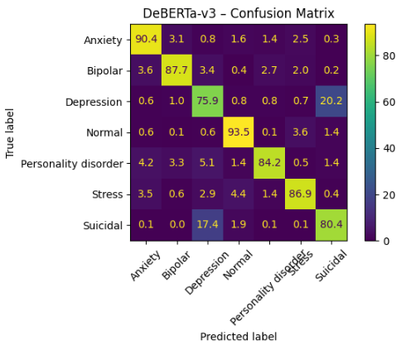
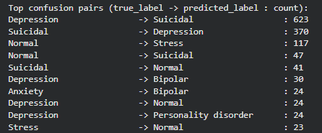
Results
Personality disorder achieves 84.2% (only 2.3% of data)
Mental health conditions rarely misclassified as Normal (< 2%)

Slide 13
BiLSTM
Bidirectional LSTM captures forward + backward context.
Word level tokenization
Pretrained FastText embeddings (non-trainable).
Bidirectional LSTM (64 units) -> LSTM (32 units) -> Dropout -> Dense softmax output (7 classes) with L2 regularization.
Weighted Categorical cross-entropy used for imbalance
Adam optimizer , Batch size =32, Epochs=20 with early stopping (patience = 3)

Slide 14
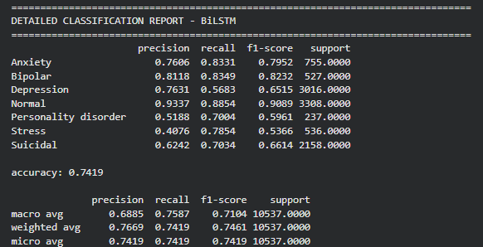
Results
Overall accuracy ≈ 74% on test set
Normal, Bipolar, Anxiety have the highest F1-scores
Stress and Personality disorder are the hardest minority classes
Macro F1 ≈ 0.71, Weighted F1 ≈ 0.75

Slide 15
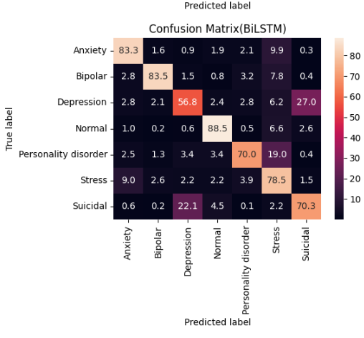
Results
Diagonal cells = correct predictions
Normal, Anxiety, Bipolar have strong diagonals (good recall)
Depression vs Suicidal and Personality disorder vs Stress show heavy confusion
understands that a post is about mental distress, but often gets the exact category wrong

Slide 16
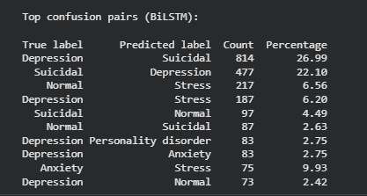
Biggest confusion: Depression → Suicidal (814 cases, ~27%)
Second biggest: Suicidal → Depression (477 cases, ~22%)
Normal is sometimes misclassified as Stress or Suicidal
sensitive to high-risk text but struggles to cleanly separate depression from suicidal ideation.
Results

Slide 17
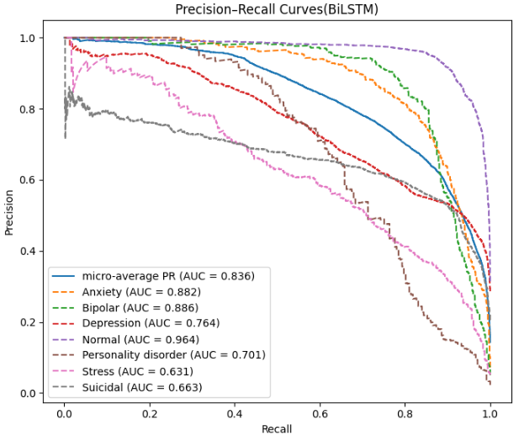
Results
Micro-average PR AUC ≈ 0.84
Normal, Anxiety, Bipolar have highest AUC (≈ 0.88–0.96)
Stress, Suicidal, Personality disorder have lower AUC (≈ 0.63–0.70)
Shows performance across different decision thresholds
careful in choosing thresholds, especially for the Suicidal class

Slide 18
Comparison
MODEL | ACCURACY | MACRO F1 | WEIGHTED F1 | PARAMETERS
DeBERTa | 0.84 | 0.83 | 0. 85 | 304M
RoBERTa | 0.84 | 0.82 | 0.84 | 125M
BiLSTM | 0.74 | 0.71 | 0.75 | 3M
BiLSTM -> Transformer: big improvement
RoBERTa -> DeBERTa: only slight improvement, not a dramatic jump

Slide 19
CONCLUSION
Best-performing model -DeBERTa-v3-large.
Weighted loss helped reduce imbalance effects but not fully.
Class imbalance remains the biggest challenge.
Misclassification mainly occurs between semantically overlapping labels.

