Slide 1
AI-Powered Collections Strategy
Leveraging Agentic AI for Scalable, Fair, and Effective Debt Management at Geldium

Slide 2
How the System Works
Title: "AI Collections System: From Data to Action"
Inputs:Customer payment history, credit utilization, transaction frequency, demographics (anonymized), External data (e.g., economic trends, seasonal patterns).
Decision Logic: Predictive model flags high-risk segments (e.g., 2+ missed payments, >80% credit utilization).
Actions:Tiered interventions:
Low Risk: Automated payment reminders (SMS/email).
High Risk: Human agent review → offer payment plans/counseling
Notes:
Prompts to try:
Generate a simple outline for an AI collections system workflow, including inputs, decision logic, action triggers, and learning loop.
List 3–5 key customer attributes that would be most predictive for collections decision-making, and explain why each one matters.
Suggest examples of business rules and AI-driven actions the system could use at different risk levels (e.g., low, medium, high risk).
Create a rough sketch or step-by-step description of how customer data flows through the system from intake to action.

Slide 3
How the System Works
Learning:Monitors response rates, adjusts strategies (e.g., optimizes reminder timing/messaging).
Visual: Flowchart showing data → model → action → feedback → model update.

Slide 4
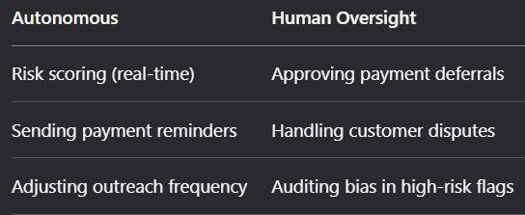
Role of Agentic AI
Title: "Balancing Autonomy & Human Oversight”
"Agentic AI handles 80% of routine tasks, freeing humans for complex cases."
Notes:
Prompts to try:
Explain how agentic AI could automate financial collections while keeping humans in critical decision points.
List 3–5 examples of collection actions, and classify each as best suited for full automation or requiring human oversight, with a brief reason why.

Slide 5
Responsible AI Guardrails
Title: "Ethical & Compliant by Design"
Bias Mitigation:
Monthly audits for demographic disparities (e.g., race, age).
Example: "Adjust risk thresholds for ‘thin-file’ customers."
Explainability:
SHAP values show top risk factors (e.g., "Missed payments contributed 60% to your score").
Plain-language customer notices.
Notes:
Prompts to try:
List key fairness, transparency, and compliance practices to build into an AI-powered credit collections system.
Suggest specific ways to monitor and audit the system over time to ensure it stays fair, compliant, and effective.

Slide 6
Responsible AI Guardrails
Compliance:
Human review for high-impact actions (loan denials).
GDPR/FCRA-compliant data handling.
Transparency Dashboard:
Real-time monitoring of system decisions for regulators.

Slide 7
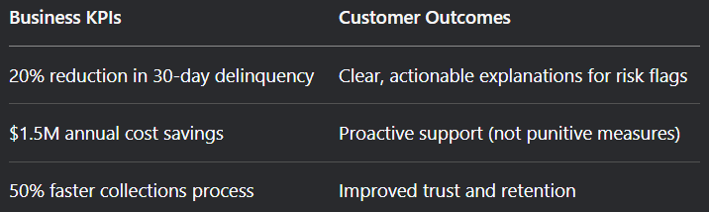
Expected Business Impact
Title: "Delivering Value for Geldium & Customers“
Callout Box:
"Ethical AI = 30% higher customer satisfaction scores (Industry benchmark)."
Notes:
Prompts to try:
Suggest KPIs for an AI-powered collections strategy that balances business outcomes with customer fairness.
Describe 2–3 ways an AI collections system could improve both operational efficiency and customer experience.

Slide 8
Roadmap
Title: "Implementation Roadmap“
1. Pilot Phase (Months 1–3)
Target: 5,000 high-risk customers (e.g., subprime borrowers with >80% credit utilization).
Actions:
Deploy AI-driven SMS reminders + credit counseling offers.
Human review for 100% of high-risk interventions.
Success Metrics:
≥10% reduction in pilot group delinquency vs. control group.
Customer feedback scores (e.g., ≥4/5 on communication clarity).

Slide 9
Roadmap
2. Scale Phase (Months 4–6)
Expand: To 50,000 customers (all high-risk segments).
Enhancements:
Automate 80% of low-risk outreach (e.g., payment nudges).
Integrate alternative data (e.g., rent payments) for fairness.
Metrics:
Cost-per-collection reduced by 30%.
Bias audits quarterly (disparity thresholds: <5% across demographics).

Slide 10
Roadmap
Optimize Phase (Ongoing)
AI Learning Loop:
Dynamic adjustment of risk thresholds (e.g., seasonal economic shifts).
A/B test intervention types (e.g., email vs. SMS).
Long-Term Goals:
$2M+ annual savings from reduced delinquencies.
Industry leadership in ethical AI collections.

