Slide 1

Analysis on Rental Properties in Hyderabad
By :
K. Ruchitha Vardhani
K . Teena

Slide 2
AGENDA
Introduction
Problem Statement
Tools used(Libraries)
Data Collection
Raw Data Vs Cleaned Data
Univariate Analysis
Bivariate Analysis
Multivariate Analysis
Conclusion

Slide 3
PROBLEM STATEMENT
To analyze the variation in rental prices across different locations in Hyderabad. We provide valuable insights for real estate investors, property managers, and renters to make decisions regarding property investments, pricing strategies, and market positioning.

Slide 4
INTRODUCTION
Analyzing how Rental prices are varying in different locations of Hyderabad.
The dataset includes 780 properties
1. Apartments,
2. Independent Houses,
3. Independent Floors ,
4. Studio Apartments and
5. Villas
Each property varies in Rent, Area, Rooms, Bathrooms, Furnishing Status.
Helping real estate stakeholders to make decisions about property investments, pricing strategies, and market position.

Slide 5
LIBRARIES USED
Request
Beautiful Soup
Numpy
Pandas
Matplotlib
Seaborn

Slide 6

WEB SCRAPING
Web Scrapping is an automatic way to retrieve unstructured data from a website and store them in a structured format.
PROCESS
Taking the website that we want to work.
Access the URL of website using code and download all the HTML contents on the page.
Find out the request-response that gives us the data that we want.
Depending on the type of request(post or get)simulate the request in our code and retrieve the data from API.
Extract out useful info that we need.

Slide 7
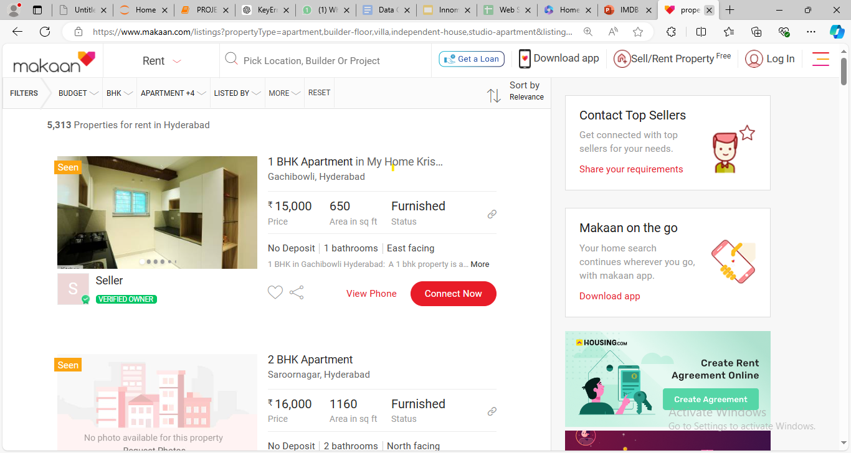
DATA COLLECTION

Slide 8
DATA CLEANING STEPS
Removing special characters in Rent column.
Searching for nan values and filling them using Subgroups and Mode.
Type Conversion.
Removed Duplicate Values.

Slide 9
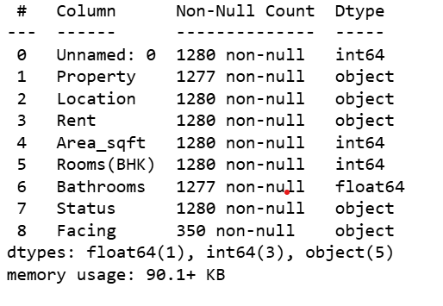
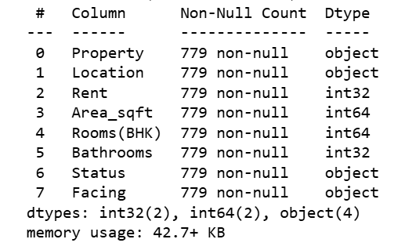
RAW DATA VS CLEANED DATA

Slide 10
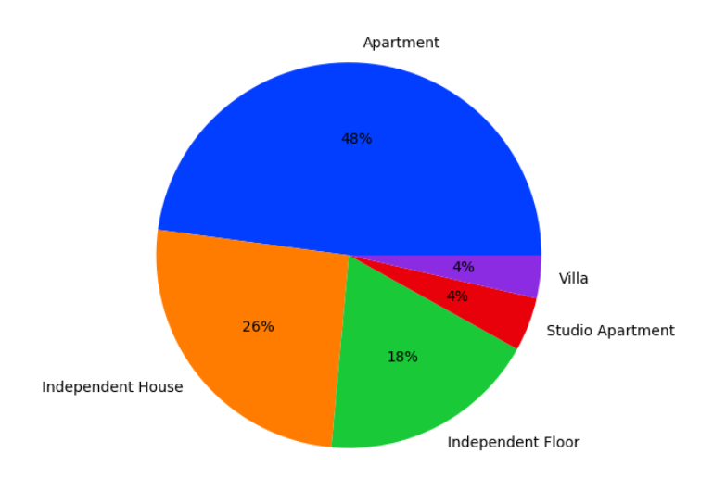
PROPERTY
In Hyderabad the most of the Apartments are given for rent
Most of the people would like to live in Apartments

Slide 11
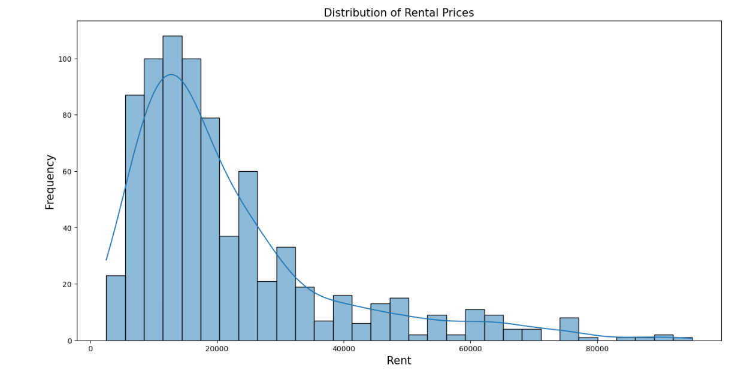
RENT
The most of the rent prices in Hyderabad are in between range 15000 – 20000
Most of the people are willing to spend15000-2000 to rent a property.

Slide 12
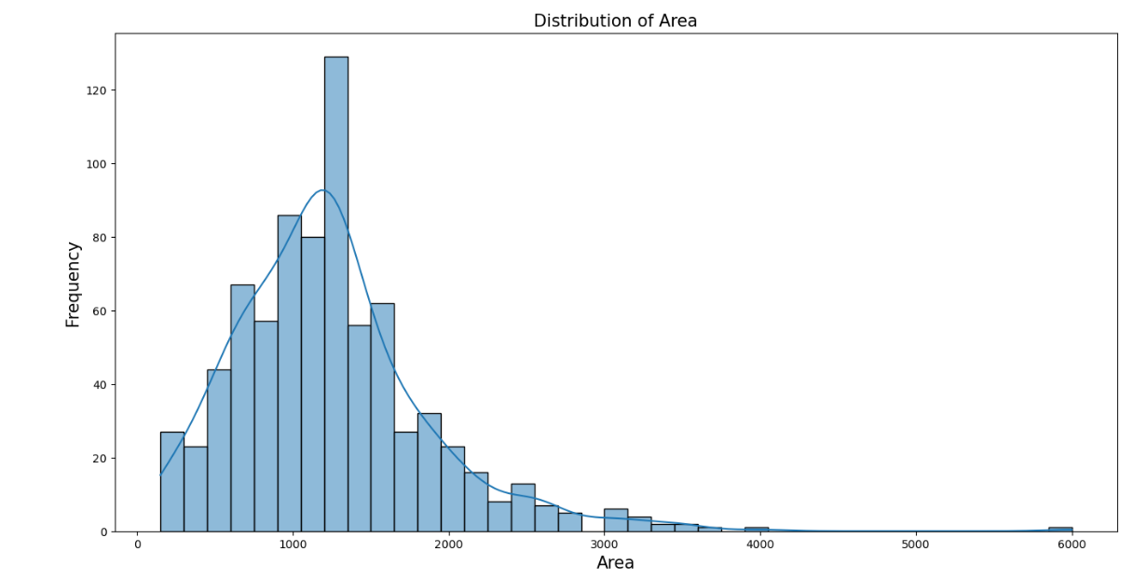
AREA
The most of the properties are having the area between 1000 sqft – 1500 sqft

Slide 13
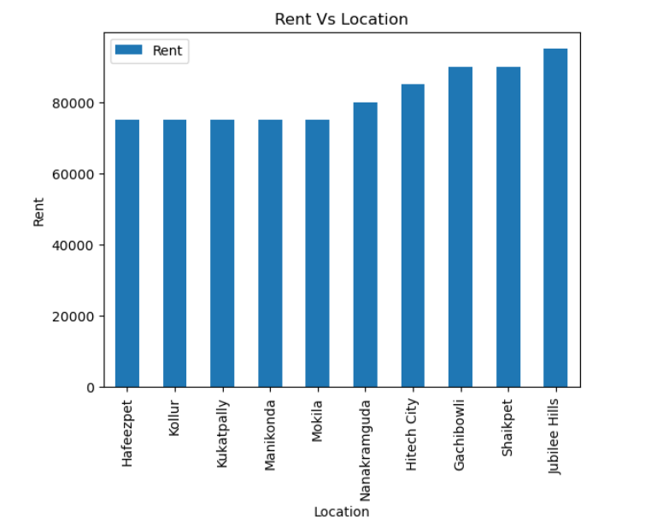
LOCATION VS HIGHRENT
The highest rental prices are in Jubilee Hills.
If an real estate invest over these areas they get more profits .

Slide 14
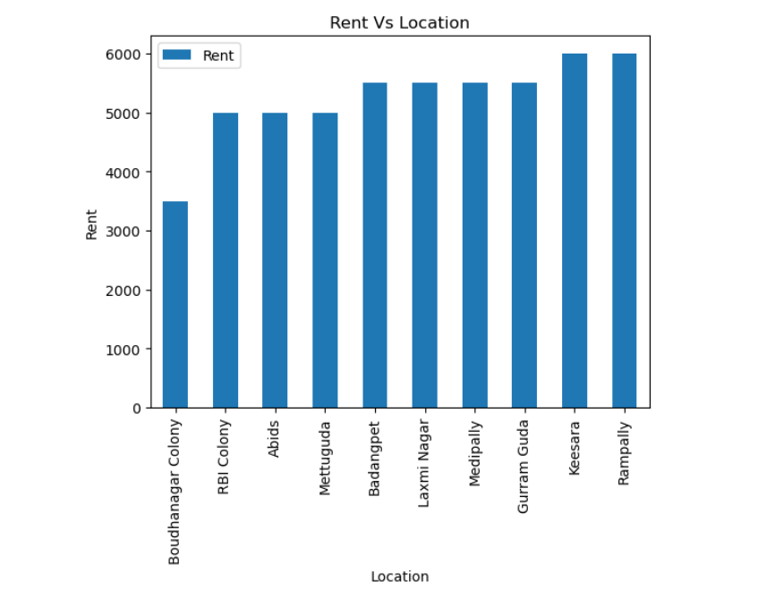
LOCATION VS LOWRENT
The lowest rental prices are in Boudhanagar Colony.
If an real estate invest over these areas they may not get more profits .

Slide 15
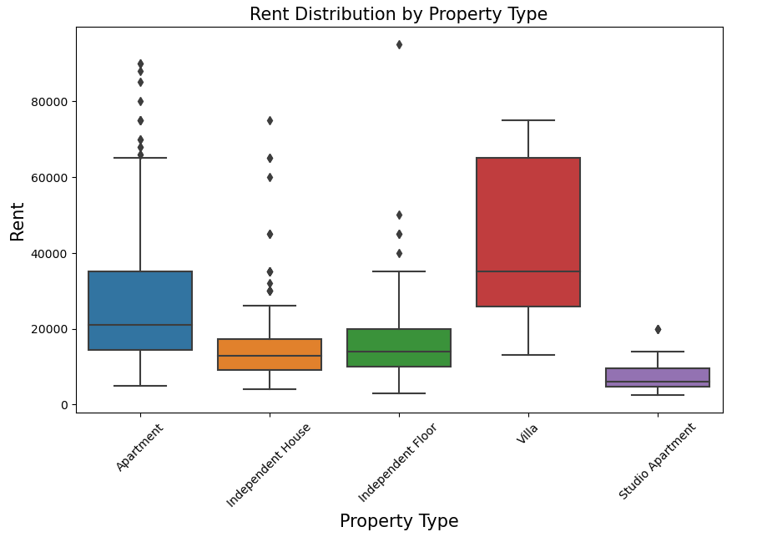
RENT VS PROPERTY
Here Villas are having more rental price .
The starting rental price of a Villa is more.

Slide 16
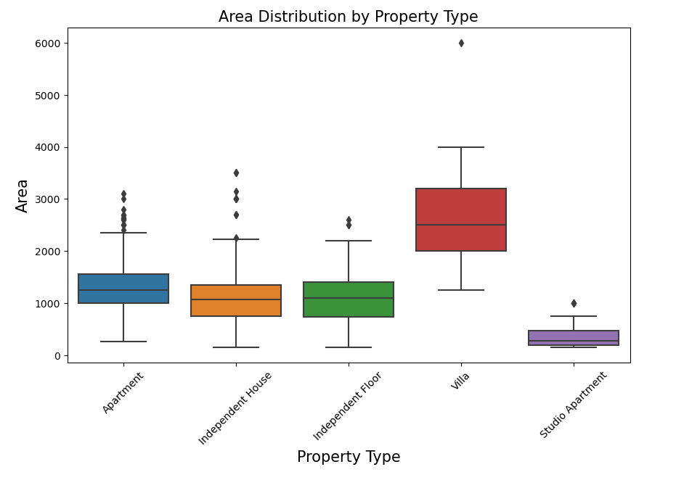
AREA VS PROPERTY
Here Villas occupy more area .
Help Real Estate people to construct a Villa if they own a land of area in between 2000 to 3000 sqft.

Slide 17
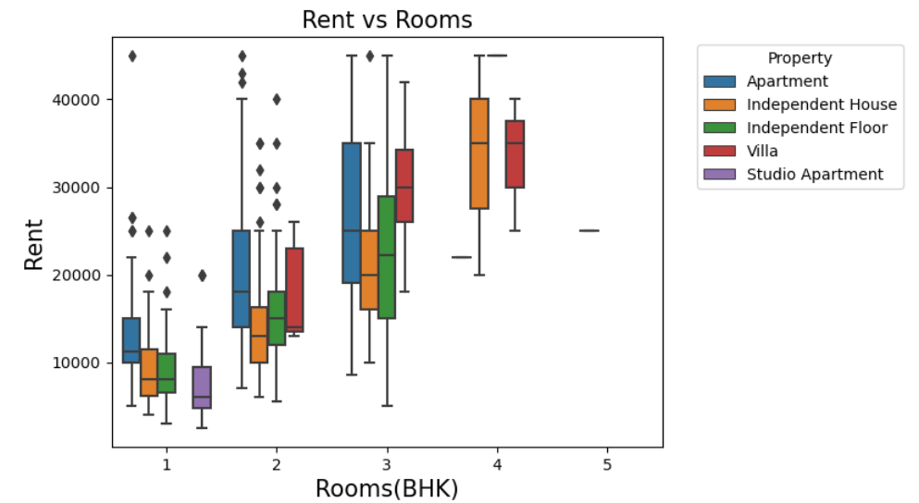
RENT VS ROOMS
As the Rooms increasing Rent price increasing.
Apartment – max 3
Independent House – max 4
Independent Floor – max 3
Villa – max 4
Studio Apartment – max 1
To get more rental price on these properties there should be more number of rooms.

Slide 18
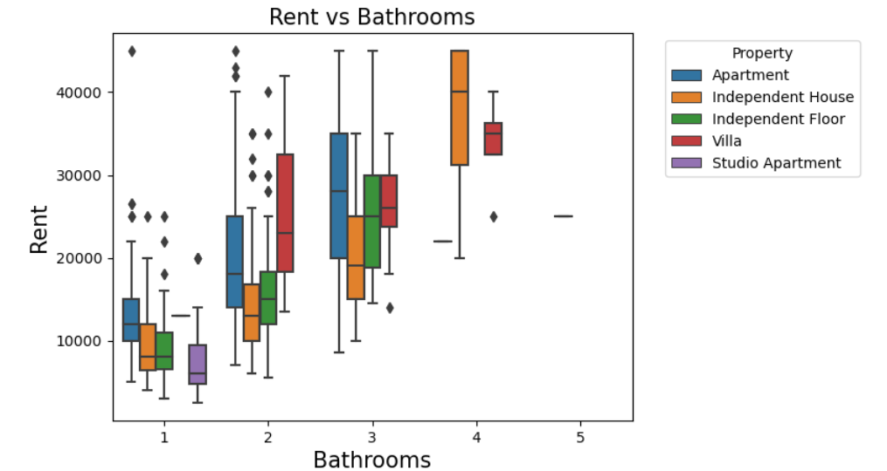
RENT VS BATHROOMS
Count of Bathrooms are affecting the Rent price.
Apartment – max 3
Independent House – max 4
Independent Floor – max 3
Villa – max 4
Studio Apartment – max 1
Better to have more number of bathrooms in order to get more rental price.

Slide 19
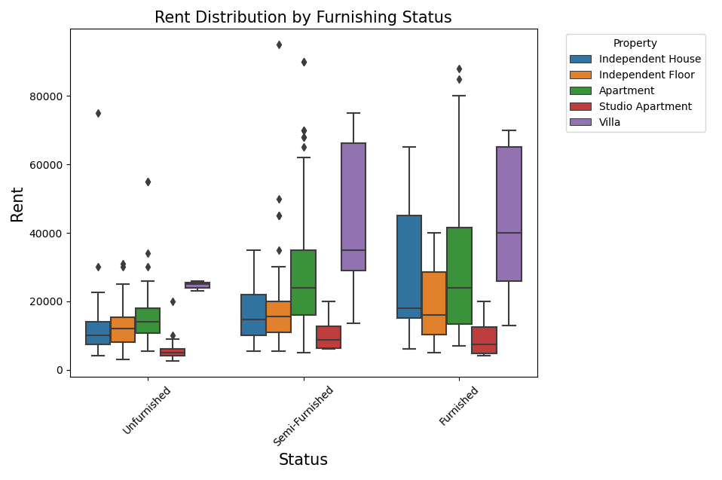
RENT VS FURNISHING STATUS
For a Furnished properties the Rental price is High.
To get more rent the property should be furnished.

Slide 20
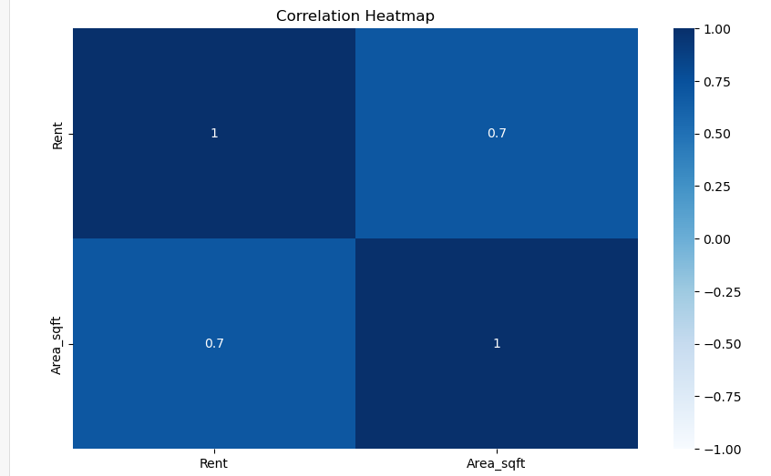
HEATMAP

Slide 21
CHALLENGES FACED
Finding the website for data collection.
We faced more Challenge while Collecting the data from Website.
Cleaning of data.

Slide 22
CONCLUSION
We can conclude that the Real Estate investors, stakeholders, renters can invest money on buy a land or constructing a property in Jubilee Hills,Shaikpet, Gachibowli, Hitech City, Nanakramguda, Kukatpally to get more profits.

Slide 23

THANK YOU

