Slide 1

CLAIM MANAGEMENT SYSTEM
TEAM:
Ruchitha P N
Ranya G P
Yashaswini S M

Slide 2
Introduction
Technology and Tools Used
Microservices
Architecture
Project Flow
Conclusion
Objective
CONTENT

Slide 3
INTRODUCTION
Every hospitals has their own policies, that offers specified benefits which people can claim based on their eligibility.
In this project, we have only focused on few of those hospitals where the eligible users can submit their claims and view their claim status.

Slide 4
Technology and Tools Used
Spring Boot
Angular
Postman
Visual Studio Code
MySQL Workbench

Slide 5
OBJECTIVE
A leading HealthCare Management Organization wants to strengthen its Middleware by exposing the core logic related to Claims Management as Microservices.
There will also be a Member Portal to be developed part of this scope that consumes these Microservices and responses back to members who are in need of Claim related information.

Slide 6
MICROSERVICES
The core modules of the Project are :
Claims Microservice - Claims Module is a Middleware Microservice that performs the following operations:
Get Claim Status
Validate Eligibility of Claim and Action Settlement

Slide 7
MICROSERVICES
Policy Microservice - Policy Module is a Middleware Microservice that performs the following operations:
Get Chain of Permissible Providers (Hospitals)
Get Benefits permissible under a policy
Get Acceptable Claim Amount per benefit, per policy

Slide 8
MICROSERVICES
Member Microservice - Member Module is a Middleware Microservice that performs the following operations:
View Bills
Submit Claim
View Claim Status

Slide 9
MICROSERVICES
Member Portal - A Web Portal that allows a member to Login and allows to do following operations:
Login
View Bill Status
Verify Claim Status
Submit a Claim

Slide 10
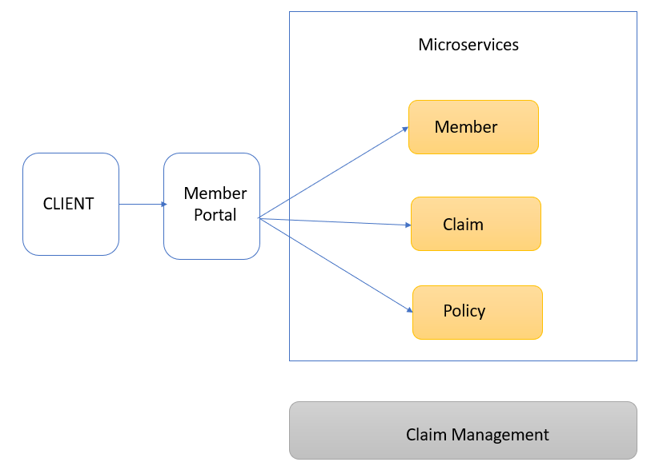
ARCHITECTURE

Slide 11
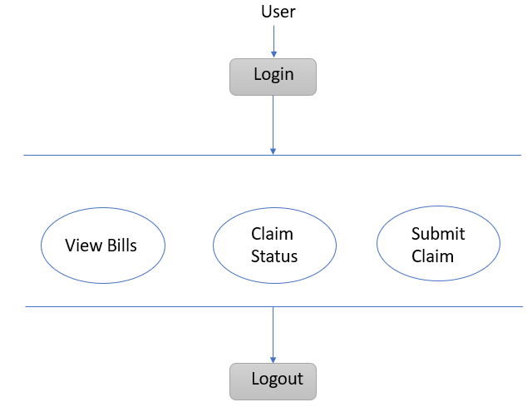
PROJECT FLOW

Slide 12
SNAPSHOTS

Slide 13
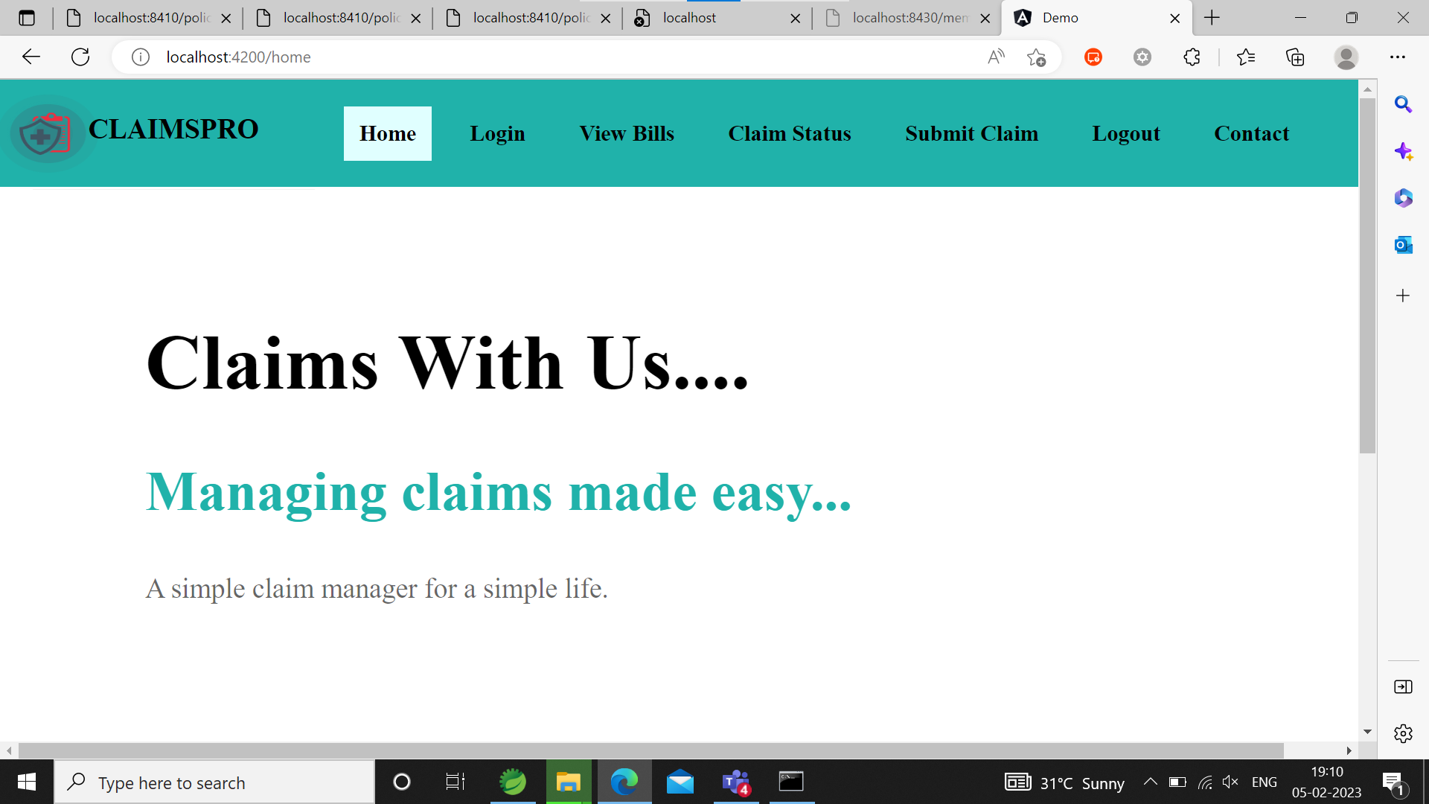
HOME PAGE

Slide 14
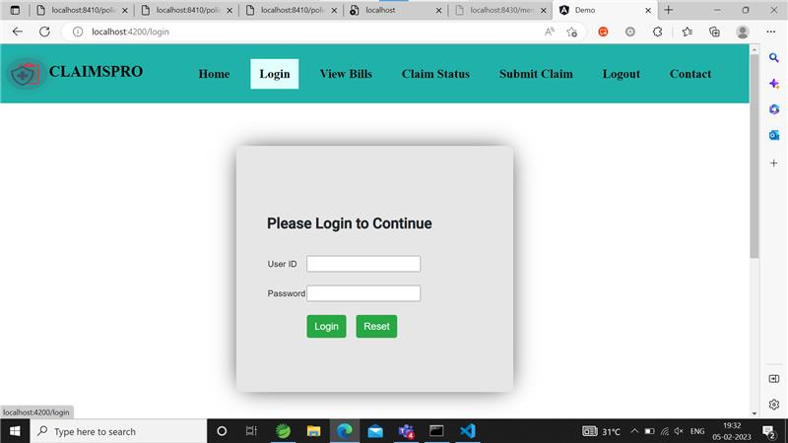
LOGIN

Slide 15
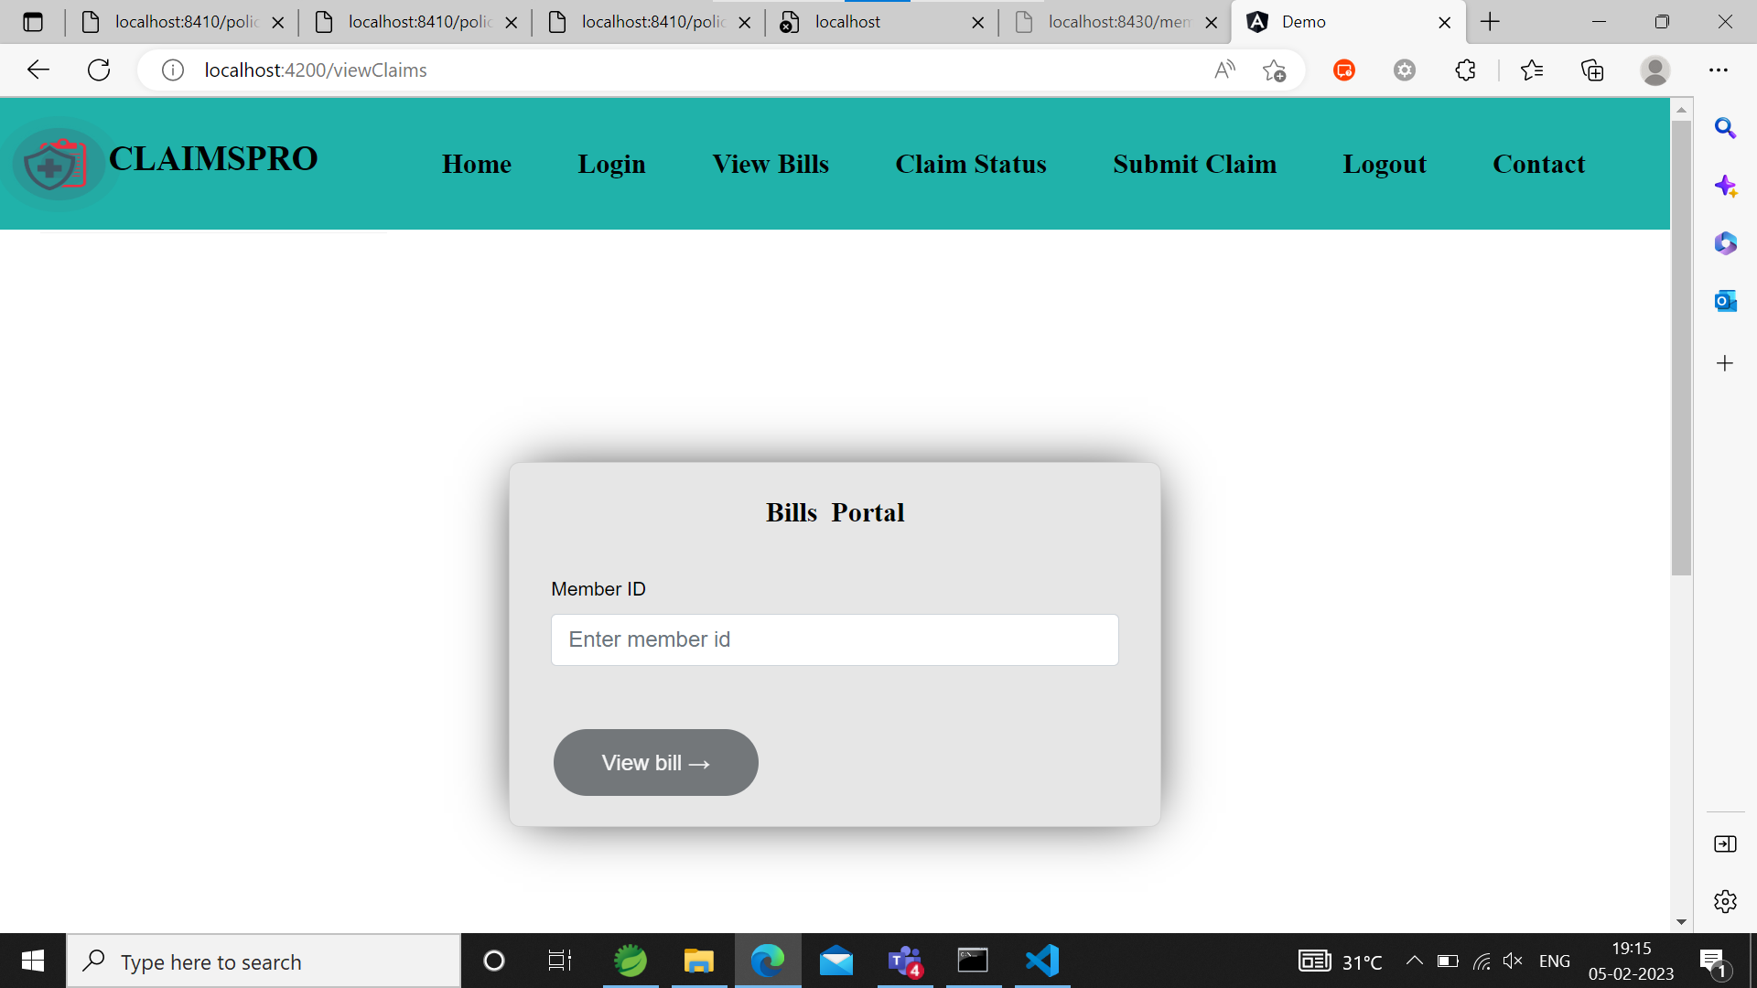
VIEW BILLS

Slide 16
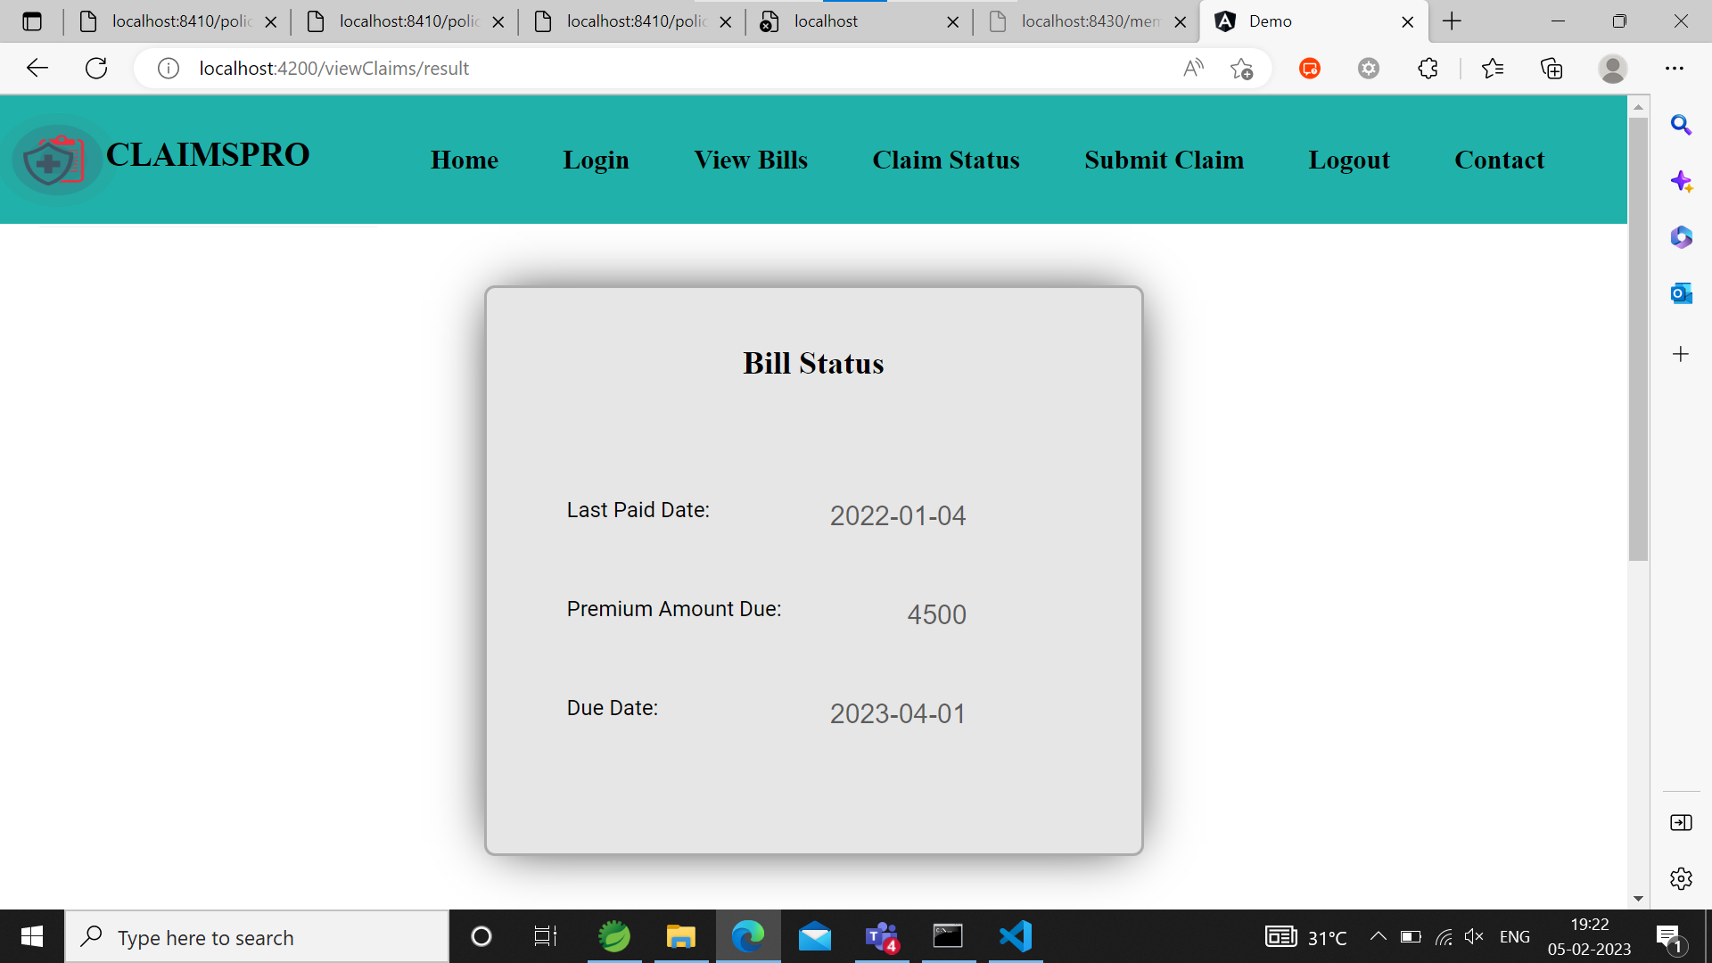
BILL STATUS

Slide 17
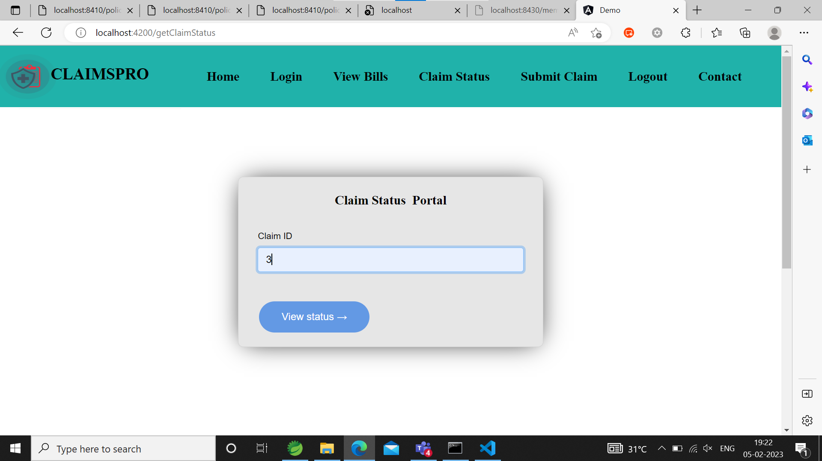
CLAIM STATUS

Slide 18

CLAIM STATUS

Slide 19
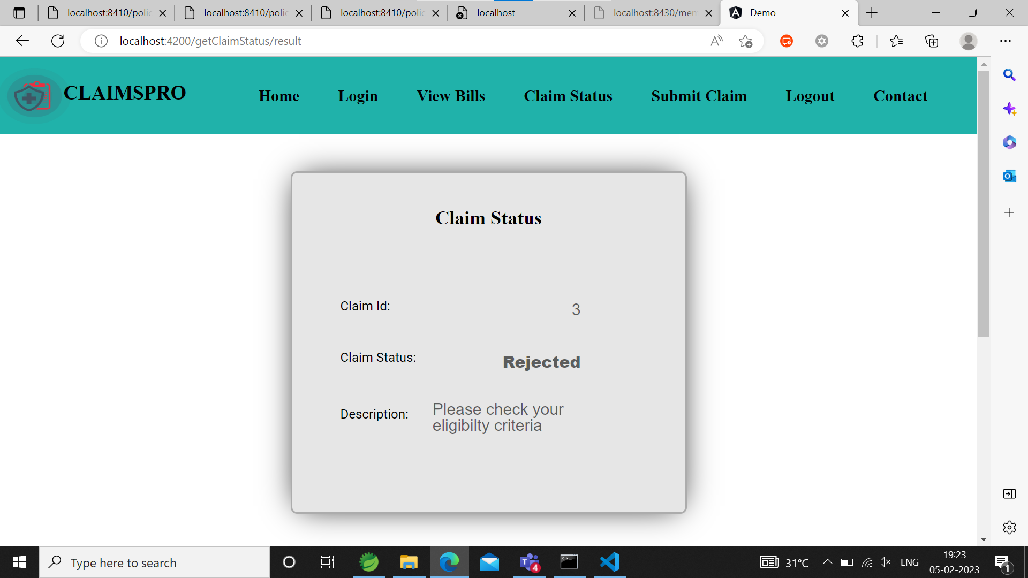
CLAIM STATUS

Slide 20
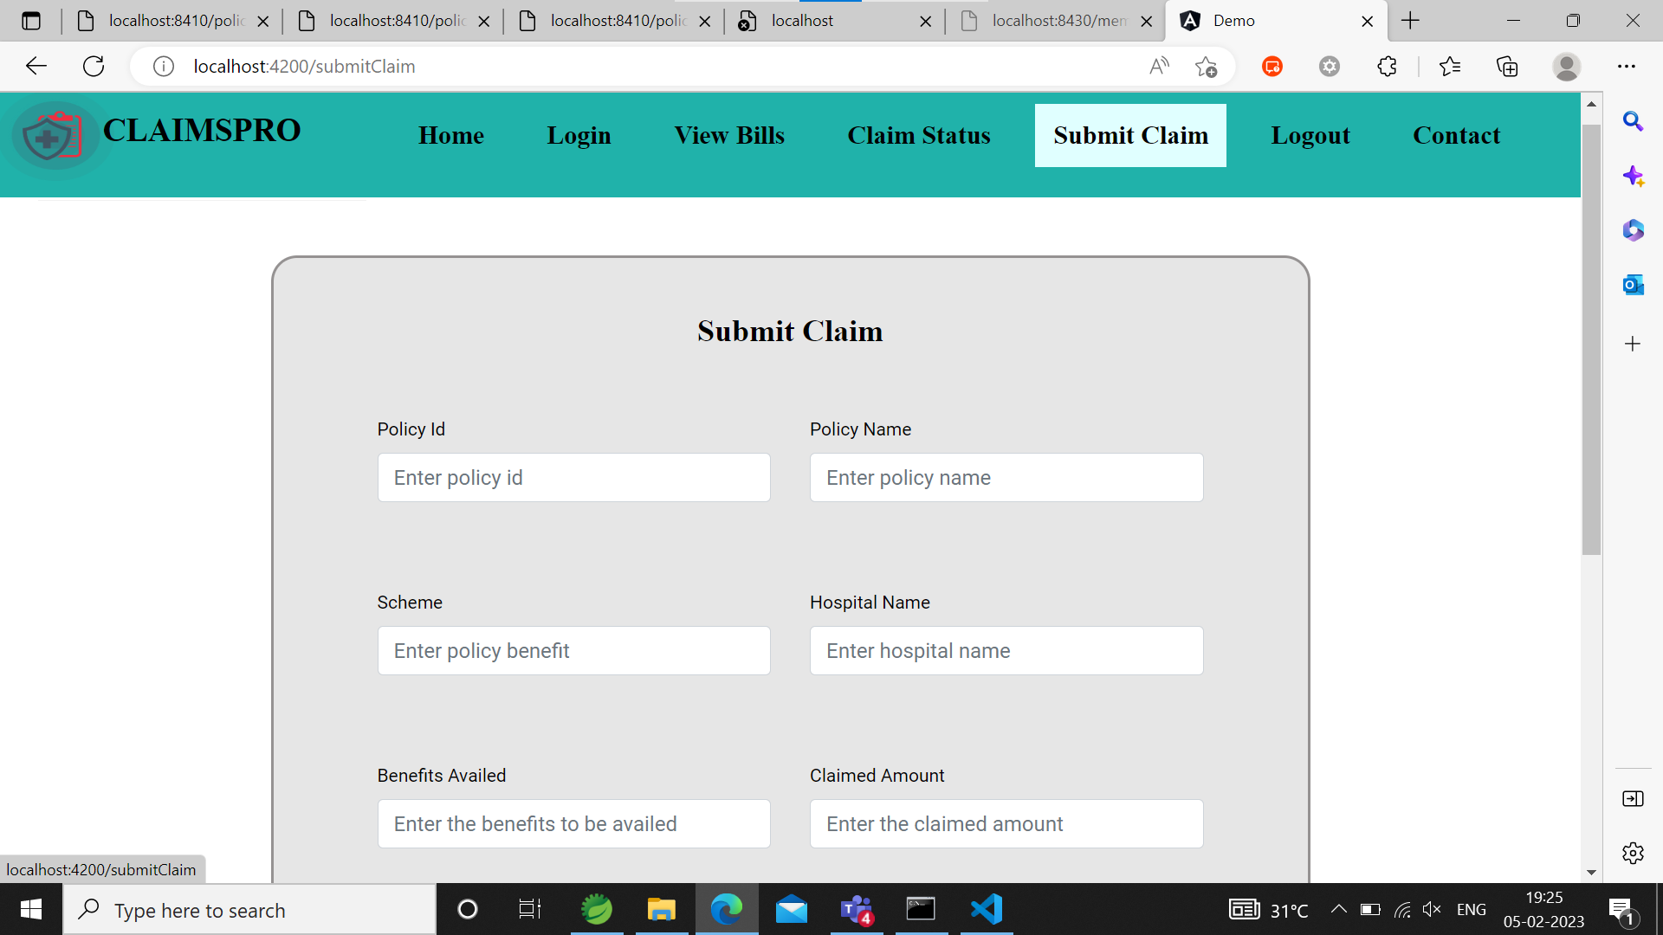
SUBMIT CLAIM

Slide 21
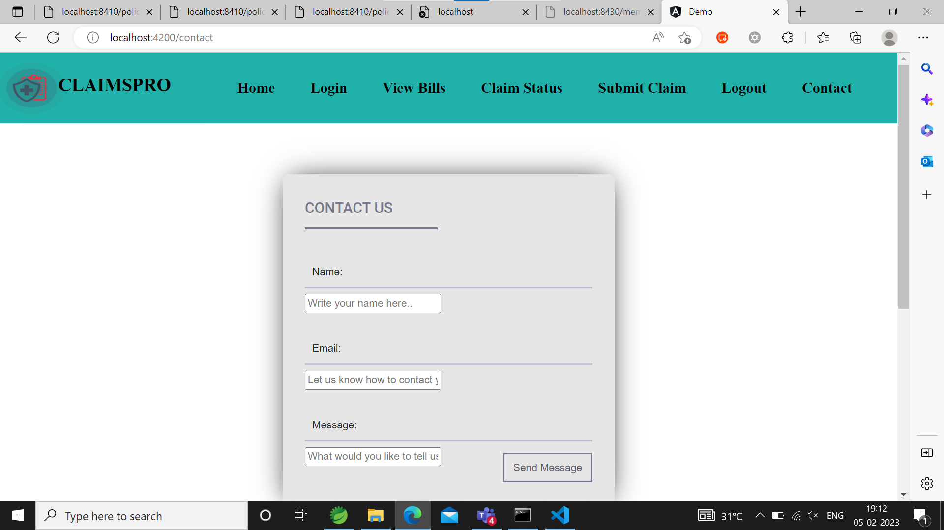
CONTACT US

Slide 22
CONCLUSION
From this project, we learnt how to work as a team.
We constantly shared the same code base among all the members simultaneously.
The microservice communication is handled using feign client.
The web portal is built using Angular 15.

Slide 23
THANK YOU

