Slide 1


SOAP API v/s REST API

Slide 2

What is a Web Service
A web service is a software system designed to support interoperable machine-to-machine interaction over a network.
Web Services can be implemented in either of the two ways-
1) SOAP
2) REST

Slide 3
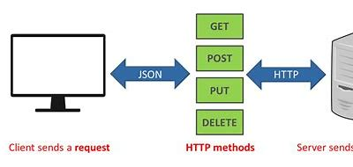
What is REST API
R - REpresentational
S - State
T - Transfer
REST API is a way of accessing web services in a simple and flexible way without having any processing.

Slide 4
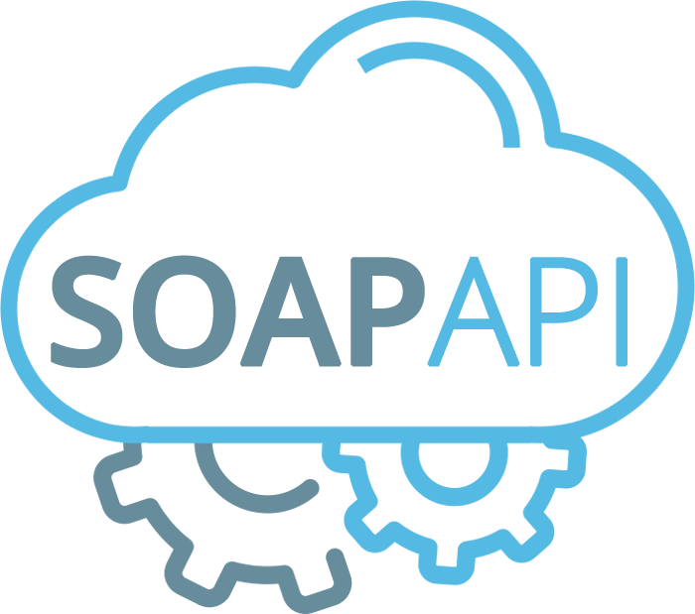
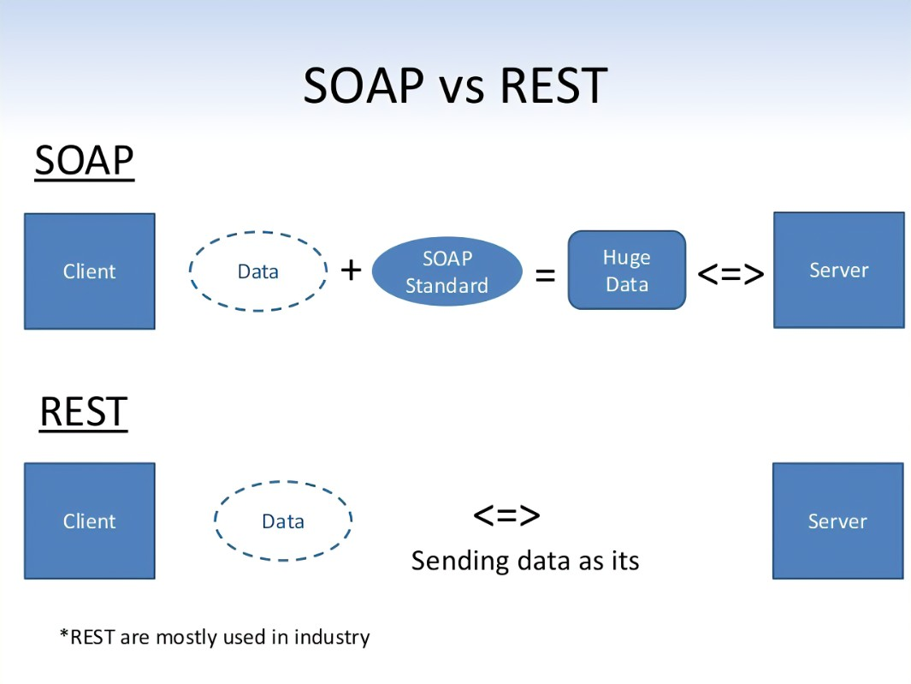
What is SOAP API
SOAP — Simple Object Access Protocol — is an API that uses Extensible Markup Language (XML) data to send requests and responses.
SOAP APIs communicate using Hypertext Transfer Protocol (HTTP) and allow applications and various types of software to communicate with each other.

Slide 5
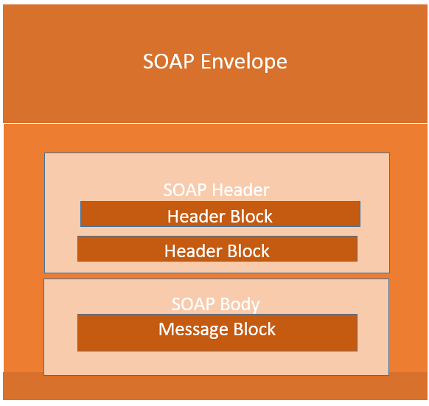
How SOAP API works
SOAP allows you to receive responses from a variety of XML document platforms. XML documents include coding consisting of the following tags:
Message
Header
Envelope
Body
Fault

Slide 6
Challenges in SOAP
WSDL file
Document Size

Slide 7
Difference between REST and SOAP API
Message Format:
SOAP:
Uses XML for message formatting.
REST:
Supports various formats like XML, JSON, HTML, etc.
Communication:
SOAP:
Requires a strict contract (WSDL - Web Services Description Language).
REST:
Communication is stateless, and no contract is needed.
Protocol:
SOAP:
Can use various protocols such as HTTP, SMTP, TCP, etc.
REST:
Primarily relies on HTTP, but can also use other protocols if needed.

Slide 8
Statefulness:
SOAP:
Can be stateful or stateless.
REST:
Stateless, each request from a client contains all the information needed to understand and fulfill the request.
Performance:
SOAP:
Can be slower due to XML overhead.
REST:
Generally faster and consumes less bandwidth, especially with JSON.
Error Handling:
SOAP:
Has built-in error handling using standardized fault elements.
REST:
Relies on HTTP status codes for error handling.
Examples:
SOAP:
Used in web services for financial transactions, reservation systems, etc.
REST:
Used in social media APIs (Twitter, Facebook), cloud services (AWS, Google Cloud), and many public APIs.

Slide 9
Why Rest API
Simplicity and Ease of Use
Lightweight Communication
Flexibility and Scalability
Statelessness
No Strict Contract Require:
Industry Adoption
Easier Integration with Other Web Technologies

Slide 10
Conclusion:
Choose SOAP if you need a strict contract, ACID transactions, and built-in security.
Choose REST for simplicity, scalability, and when working with limited resources or in web and mobile applications.

