Slide 1


Slide 2

What is GraphQL
GraphQL is a query programming language we can use to ask for data from a server. It allows clients to ask exactly for the data they need in one request, making it possible to get all the requested information in a single response. We can get information about anything the server knows about, like a list of all the users on a website or all the posts on a blog.

Slide 3
When should you use GraphQL
GraphQL is ideal when we need finer control over the data we request from the server. GraphQL also requires fewer requests than a REST API since all the requested data can be returned in a single response. It also allows for greater flexibility in data manipulation, as GraphQL easily lets us query complex relationships between different data types

Slide 4
What is REST API
REST (Representational State Transfer) is an architectural style for building web services. A REST API is a way of accessing data from a remote web server. It allows clients to retrieve, add, delete, or modify data on the server with requests made over HTTP/HTTPS.

Slide 5
When should you use REST API
REST API is best when we need to access a large amount of data quickly. It's also better for working with multiple data types since each request can be tailored to return only the specific data needed. Additionally, because REST APIs are more standardized and widely used, they tend to be easier and faster to set up than GraphQL APIs.

Slide 6
GraphQL vs. Rest API
Data Control
Speed & Efficiency
Set-up and Maintenance
Bandwidth Concerns
Rapid Prototyping
Error Handling

Slide 7
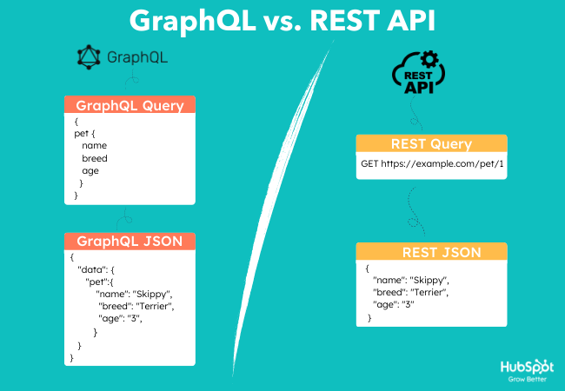

Slide 8
What REST limitations does GraphQL attempt to overcome?
Fixed-structure data exchange
Overfetching and underfetching

Slide 9
Wrapping Up GraphQL vs. REST APIs
GraphQL is great for data control since it allows us to request exactly what we need in one query.
On the other hand, REST APIs are well-suited for large amounts of data, web caching, and error monitoring.

Slide 10
Thank you

