Slide 1
Contents
What is Semaphores
Working of Semaphores
Types of Semaphores
Common Uses of Semaphores in Multithreading

Slide 2

What is Semaphores
Semaphores are a synchronization mechanism used in multi-threaded programming to control access to shared resources.
The use of the semaphore ensures that only a limited number of threads can concurrently execute the critical section.
It ensures that the shared resource (seats) is accessed in a controlled manner.

Slide 3
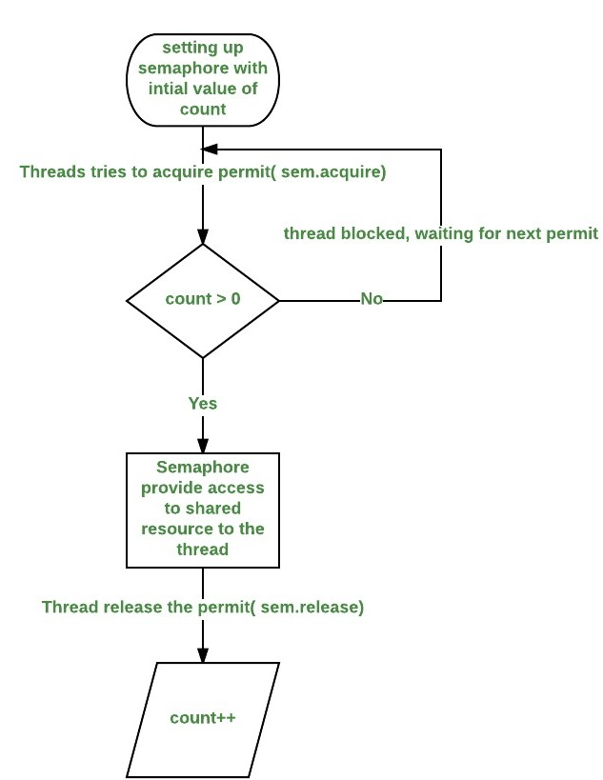
Working of semaphores

Slide 4
Types of Semaphores
Binary Semaphore
Counting Semaphore

Slide 5
Use Cases
Resource Allocation
Synchronization

Slide 6
Any queries ??

