Slide 1

OTP (One-Time Password) Authentication

Slide 2
Introduction
OTP authentication is a secure method for verifying user identity by sending a unique code that can be used only once, typically through email, SMS, or a dedicated OTP generator
This concept plays an important role if we want to give an extra security in our application.
The person can see the important credentials only after a successful validation of OTP
There are two ways to send the OTP for Authentication.
To Email Address.
On Mobile Device as an SMS.

Slide 3
Technologies Used
Angular Framework 15
Springboot
4.17

Slide 4
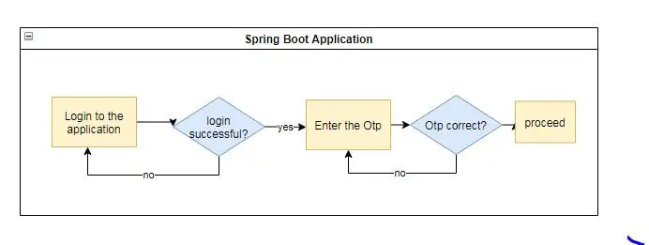
Flow Diagram

Slide 5
Implementation
1. Delivering OTP via Mobile Device (SMS):
One common method of delivering OTPs to users is through SMS (Short Message Service). This method requires integrating our web application with an SMS gateway service.
a. Choose an SMS Gateway Service:
Select an SMS gateway service that suits your needs. Some popular choices include Twilio, Nexmo, or Plivo. We can sign up for an account and obtain API credentials.
b. Integrate the SMS Gateway:
Integrate the SMS gateway service into your Spring Boot application.

Slide 6

2. Delivering OTP via Email:
Another common method for delivering OTPs is via email. This method requires integrating our application with an email service provider.
Using Java Mail sender to cache the OTP number to validate and set the timer to the cached OTP expiry.

Slide 7
Examples
The OTP authentication system can be applied in various use cases:
User Registration: During the registration process, a user provides their mobile number or email address. An OTP is sent to the provided contact information for verification.
Login: After successful registration, users can log in to their accounts using OTP authentication in addition to the standard username/password login.
Password Reset: Users who forget their passwords can initiate a password reset process. An OTP is sent to the user's registered email or mobile number to verify their identity before setting a new password.
Two-Factor Authentication (2FA): OTP can be used as one of the factors in two-factor authentication, adding an extra layer of security to the login process.
Secure Transactions: In financial applications, OTP authentication can be used to authorize secure transactions, such as money transfers.
Access Control: In enterprise applications, OTP can be used to secure access to sensitive systems or data.

Slide 8
Thank You

