Slide 1
Used Car Price Prediction
Team No : 5
Presented by : 1. Mohammed Harrish Musthafa
2. Mohamed Fadhil
3. Sneha Wandhare
4. Arihant Kumar Jain
5. Ruchithra Gundlapalli

Slide 2
Introduction
According to Statista.com, the automotive industry across India became the fourth largest in the world in the year of 2017. Adding on to the list, almost 30 Lakhs of new car registrations have been made in the year of 2019. At the same time, sources also reported that the used car market had a size of over 40 Lakhs units in the same year. Everyday a new model car is getting launched around the world with upgraded specifications of the present car to enhance the end user’s comfort. The market for the automobile industry, mainly for cars, is keep on increasing over the period of years.
Mostly when one sells his car, he/she was unable to get the right price for their car though they have not used the car that much. As there is arrival of new models in the market, the price of the pre-owned car is determined only by considering some factors like Brand, Make, Kilometres and the Year. This leads to the huge drop in the price of the car. To Overcome the huge drop in the price, the price should not be only determined by certain factors and some other factors have to be considered as well. In this Model, we are applying our data science skills and knowledge on a used cars data set and predict a right price of a used car by considering various factors as well.

Slide 3
Problem Statement
The market of the pre-owned cars in India has been increasing over the past few years and according to statistics, it has been reported that its size has crossed 40 Lakh units in the year of 2019. Though there is a huge market for the pre-owned cars, the price of them is not based on the true potential of the car and it is mainly based on only certain factors of them. This leads to huge loss for one who sells his car for lower price though he did not use it much.
The current trends on the make and type of the cars also make a huge impact on the used car prices. The main aim of this model is to predict a suitable price of the used car by applying the data science skills and knowledge that has been learned throughout the course.
The price of a used car is determined only on some factors like Brand, Model and Year. We strongly believe that there are much more factors which must be considered like the current market trends on the make of the car, car Engine capacity, mileage, transmission etc., In this model, we are going to predict the price by implementing some machine learning techniques such as Multiple Linear Regression, K-nearest neighbors, Naives Bayes and Decision Tree Method into this price prediction.
As Mentioned above, the price of a used car is based on certain factors. At the end, we will be able to predict a price based on various other factors which may have impact on the price. This will lead to obtain a suitable price for one who wishes to sell his car.

Slide 4
Data sets considered
We have considered a dataset which has all the details of used cars and the data is scraped from cardheko.com.
The total number of rows are 19974 and total number of columns are 13.
Numeric Variables : 8
year – The year of the car which it was made. E.g., 2010
age_of_car – current age of the car from the year of manufacturing.
km_driven – Total kilometers driven from the date of purchasing.
mileage – kilometers that can be driven per unit of fuel.
engine – The cooling capacity (CC) of the engine.
max_power – The power of the car (torque).
seats – The total number of seats in the car.
price_in_lakhs – The current selling price of the used car in lakhs.
Categoric Variables – 5
brand – Contains the brand of the car e.g Honda, Maruti, Toyota, BMW.
car_model – Model of the car e.g City, swift, Fortuner.
seller_type – Info of the type of seller. E.g. Individual, dealer.
fuel_type – Type of fuel used. E.g Petrol, Diesel, CNG.
transmission_type – transmission type of the car. E.g. Automatic, Manual.

Slide 5
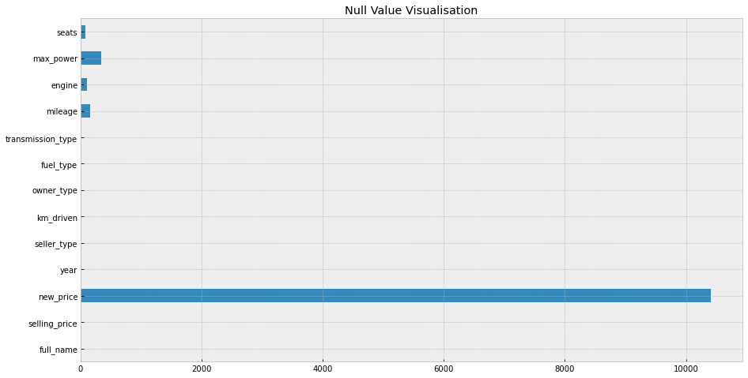
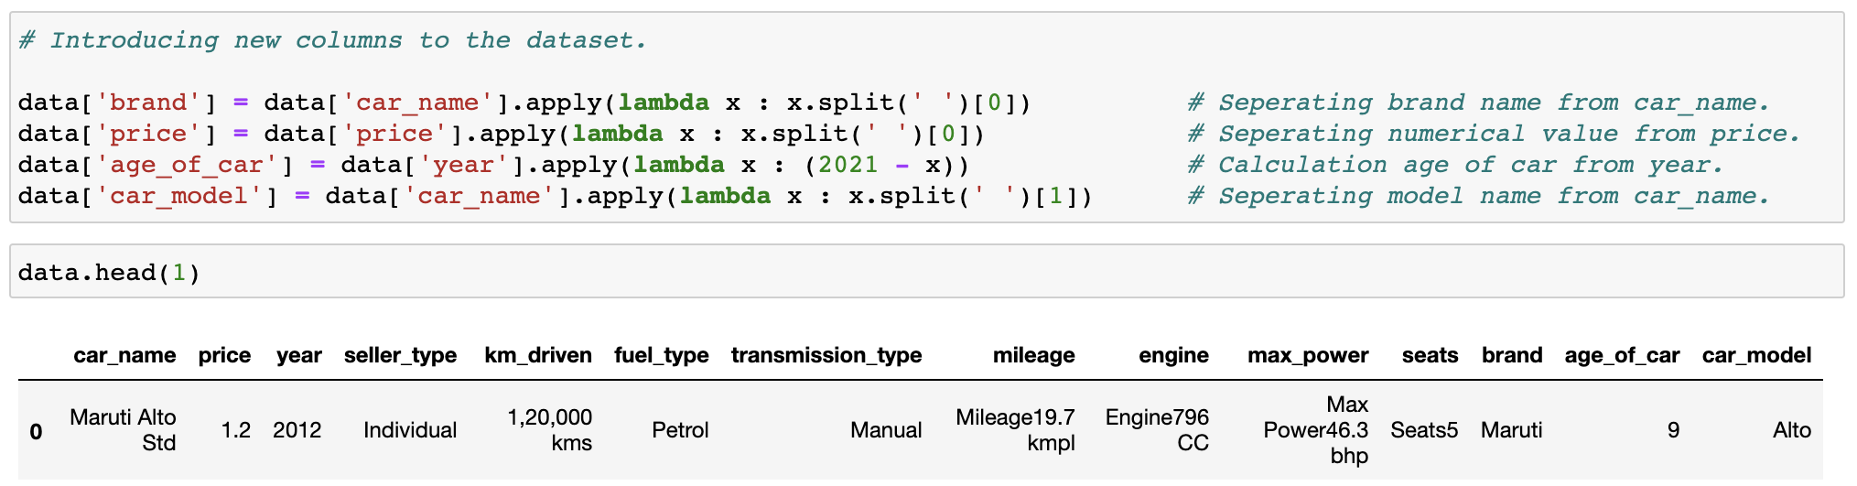
Exploratory data analytics done
First we started cleaning the dataset by
dropping the features with large number of
null/missing values.
Then we treated the features with less
null values by getting not null value rows
The shape of dataset after treating
null/missing values : (19542, 12)
Since the owner_type feature has only
one unique value, we dropped that column.
We introduced new columns.

Slide 6
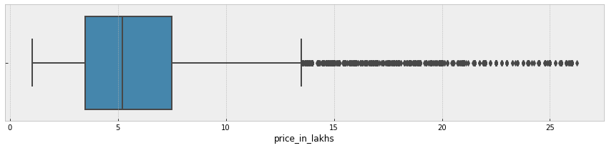
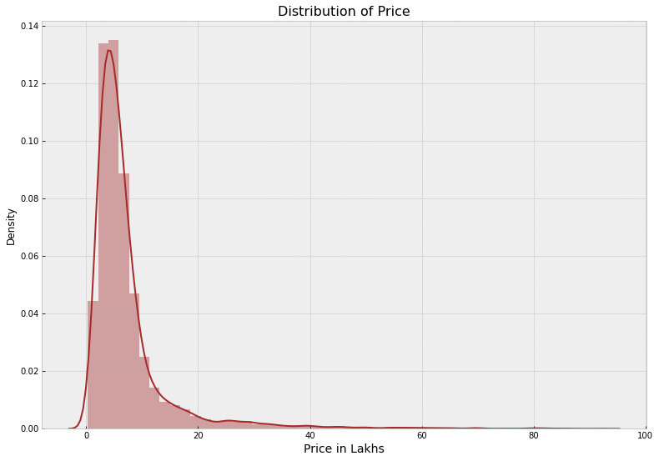
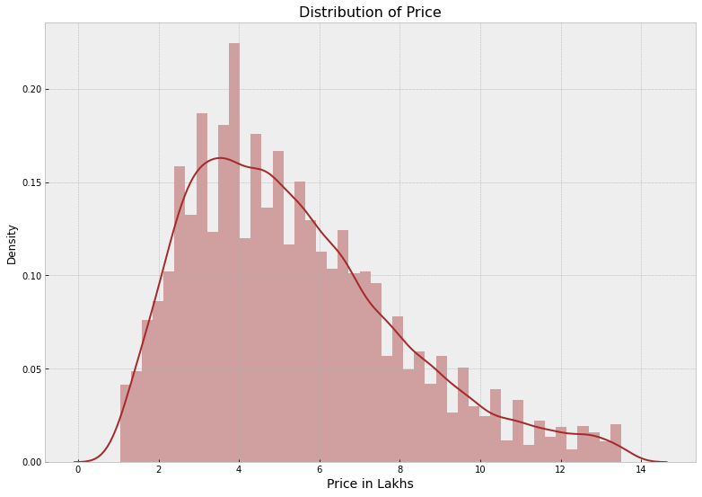
Any challenges expected/addressed
Outliers in the ‘Price’ feature.
Before Outlier Treatment
After Outlier Treatment

Slide 7
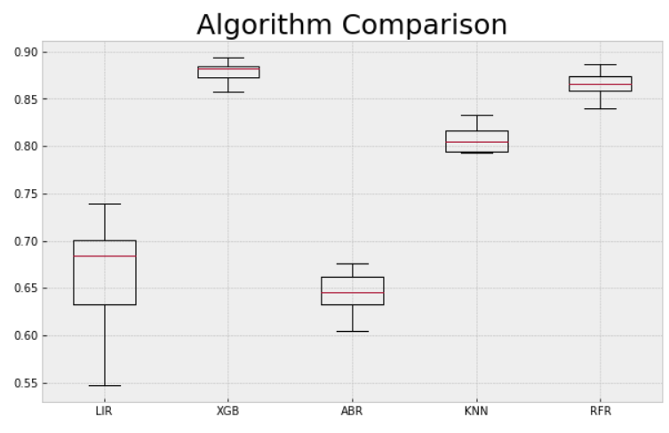
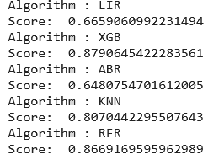
Algorithms, Solution and Conclusions
Performance of different regressor models based on R2 score

Slide 8
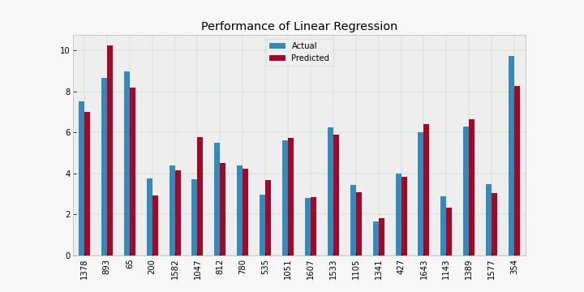
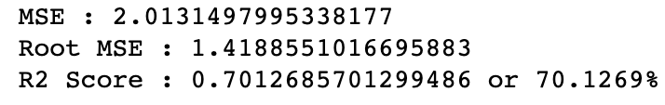
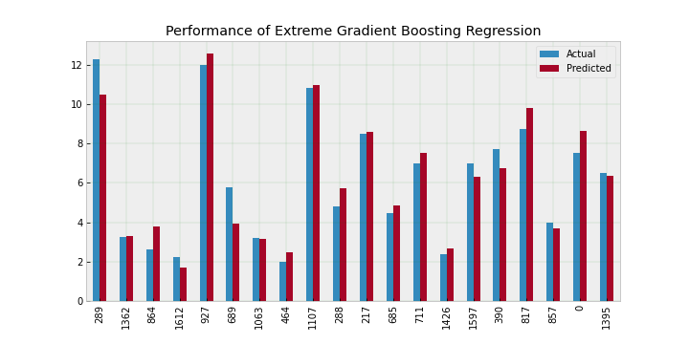
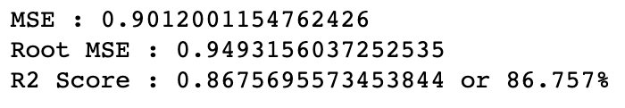
Algorithm Performance

Slide 9
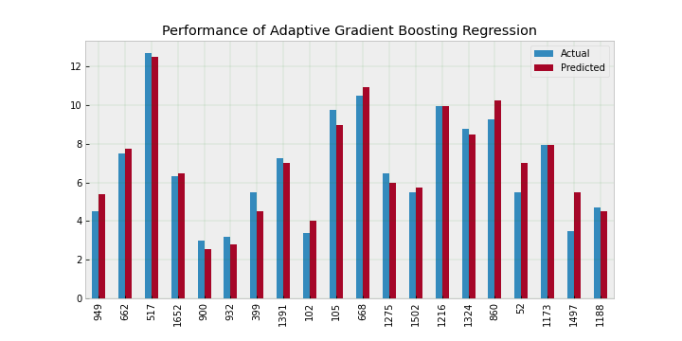
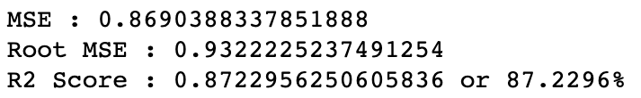
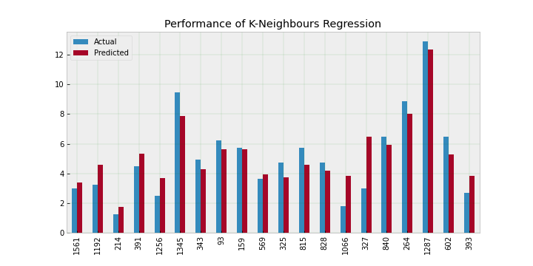
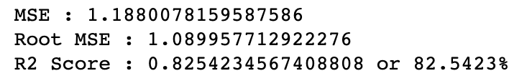
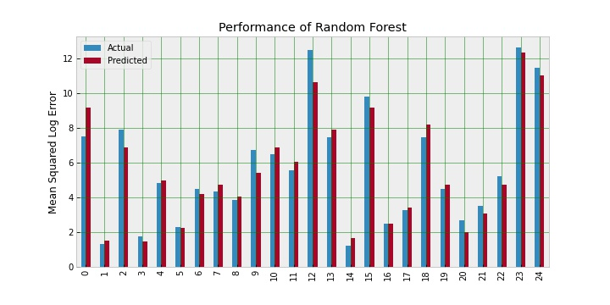
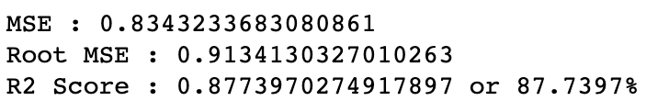
Algorithm Performance

Slide 10
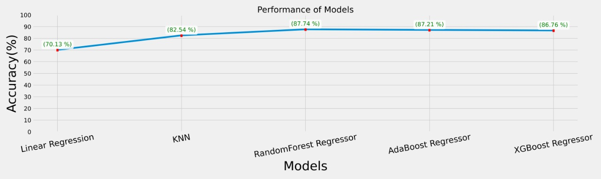
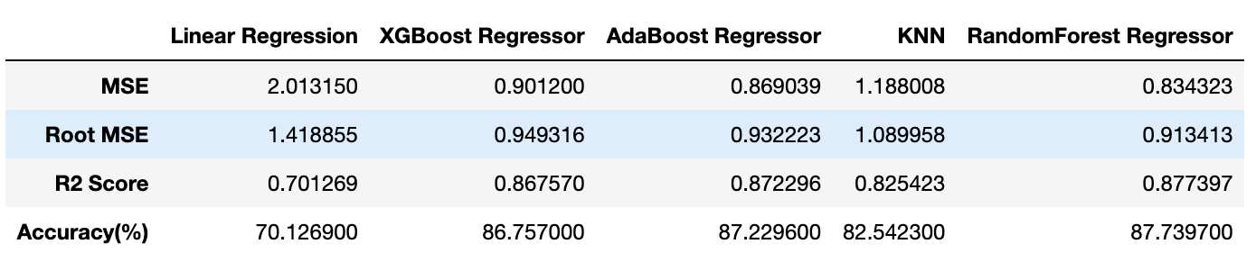
Results

Slide 11
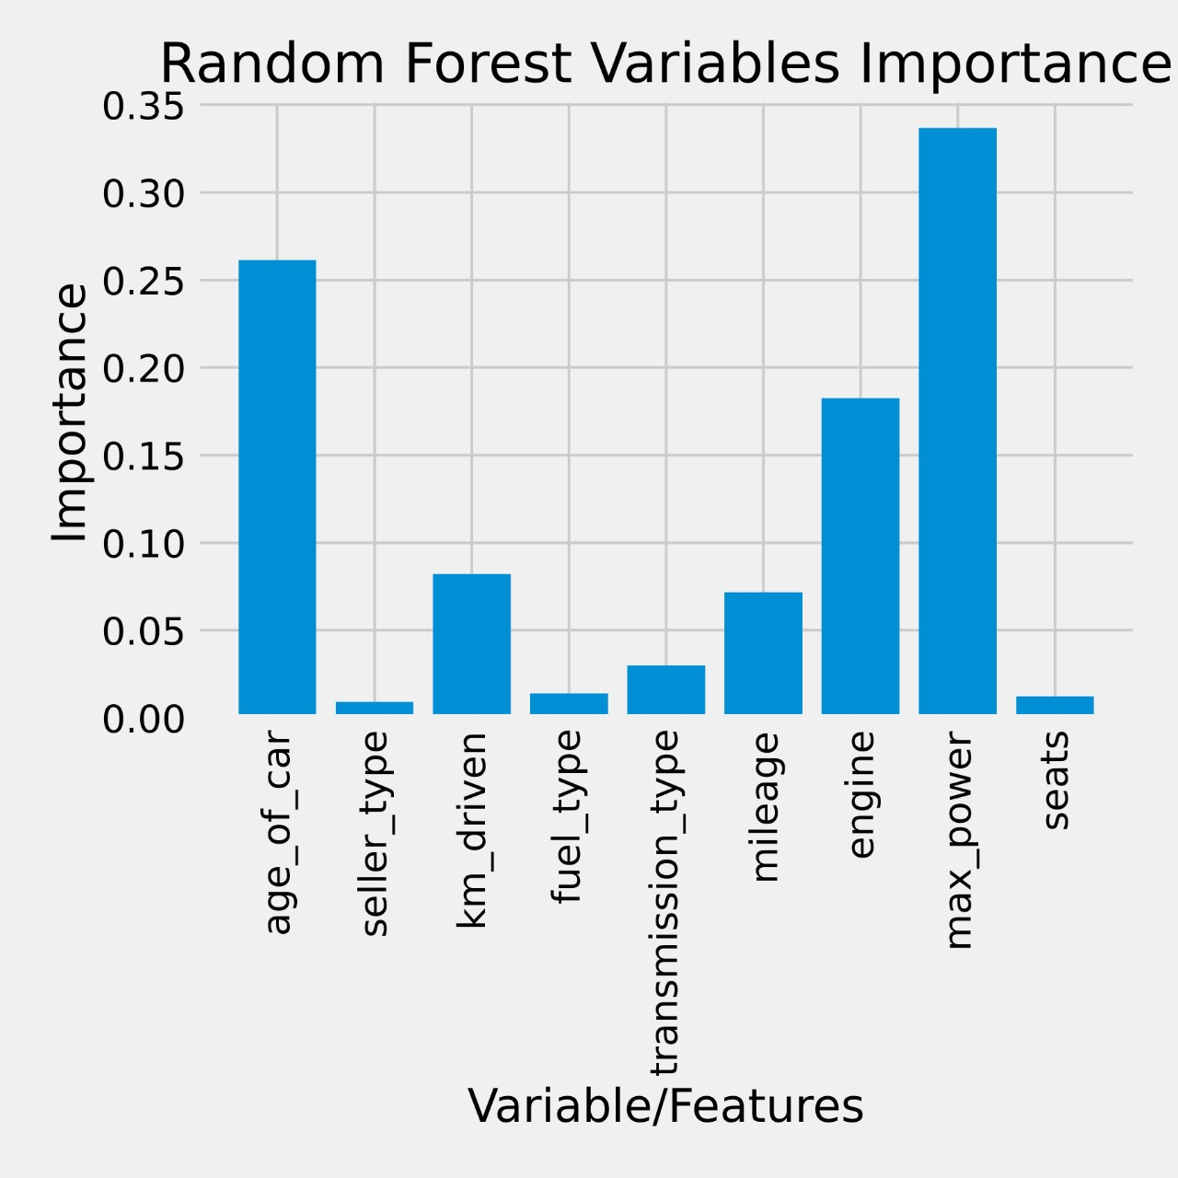
Feature importance based on Radom Forest Regressor:
max_power impacted the price most followed by age of the car and engine displacement.
No. of seats of the car is amongst the least desired variable.

Slide 12
Conclusion
Our aim was to predict the price of the cars with least error and maximum accuracy (87.7%).
We used different ML models and evaluated them based on the score, accuracy, MSE.
We conclude that the Random Forest Regressor is the best model for the prediction for used car prices amongst the other.
Random Forest Boost as a regression model gave the best MSE and RMSE values.
We also observed some new features that adds to predicting price of used car such as max_power, age_of_car and engine displacement.

Slide 13
Thanks!

