Slide 1


Search
Nethra Viswanathan
Ruchithra Sathyanarayanan
Alankrutha Reddy Purumandla
Ridham Sujitbhai Mangukia

Slide 2
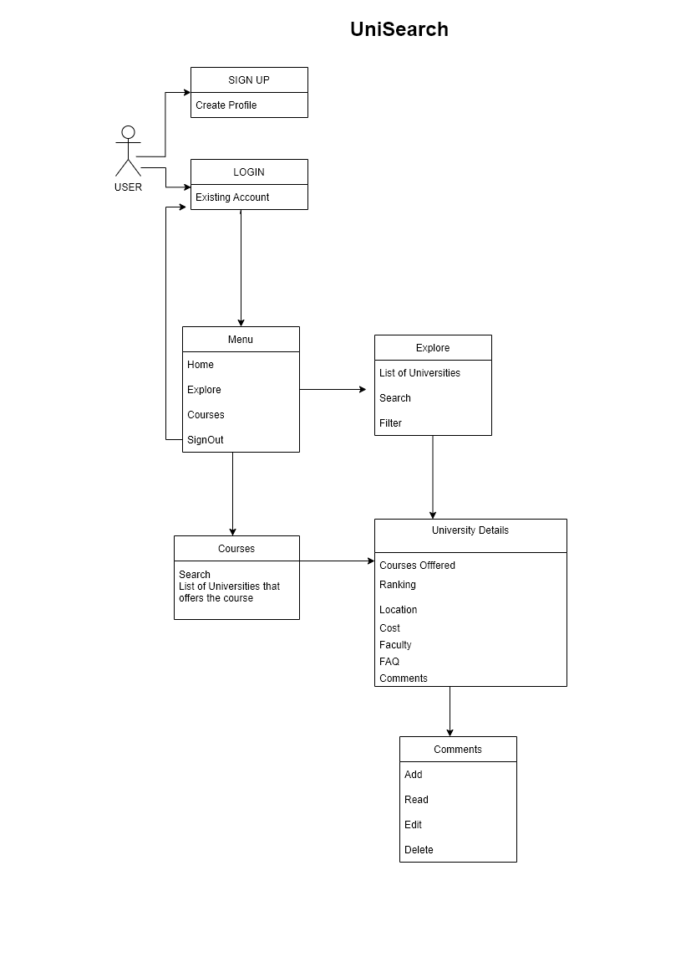

Slide 3
PURPOSE:
Making choices for a Bachelor’s or Master’s degree has always been rather complicated, especially when there are too many options to consider.
Using UNIsearch, you can locate Universities that meet your needs and are a good fit for you.
The sheer explosion of opportunities is overwhelming, but you need to start somewhere soon. Using UNIsearch ,you can identify affordable universities,Best ranked institutions in your dream countries.
UNIsearch allows applicants to learn about the university, its ranking, the faculty, and what Alumni have to say about it.

Slide 4
FEATURES:
Login and Register Functionalities
Email verification to Users
Search and sort functionality for universities.
Authentication
User friendly Application

Slide 5
API’s Implemented
Universities List
Courses
Faculty
Comments
University Majors

Slide 6

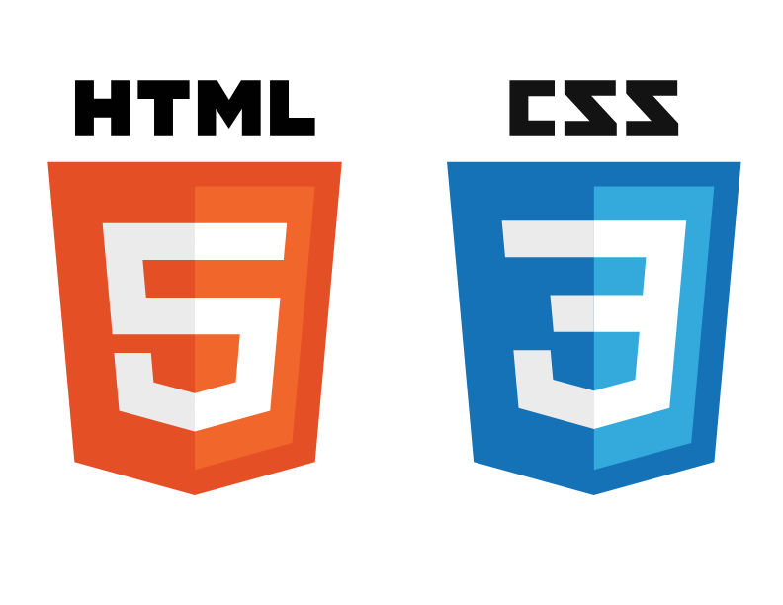






TECH STACK

Slide 7
CONTRIBUTIONS:
Nethra Viswanathan :Created figma designs,Design and API integration for explore screen, courses screen,University About, University FAQs ,CRUD operation in Alumni comments,Used Redux to store states.
Ridham Sujitbhai Mangukia:Designing and Implementing CRUD APIs for University, Major, Course, Faculty and Comment.
Implemented filtering by Courses offered, Ranking, Location, SortBy and Search by University logic for the frontend UI.
Used NodeJs, MongoDB, ReactJs for development.
Alankrutha Reddy Purumandla:- Testing Frontend,Testing Backend,Documentation,Presentation.
Ruchithra Sathyanarayanan :- Sign in, sign up, authentication, mongodb, email verification.

Slide 8
REFERENCES
https://developer.mozilla.org/en-US/docs/Web/JavaScript/Guide
https://nodejs.org/en/docs/
https://www.mongodb.com/docs
https://reactjs.org/docs/getting-started.html

Slide 9
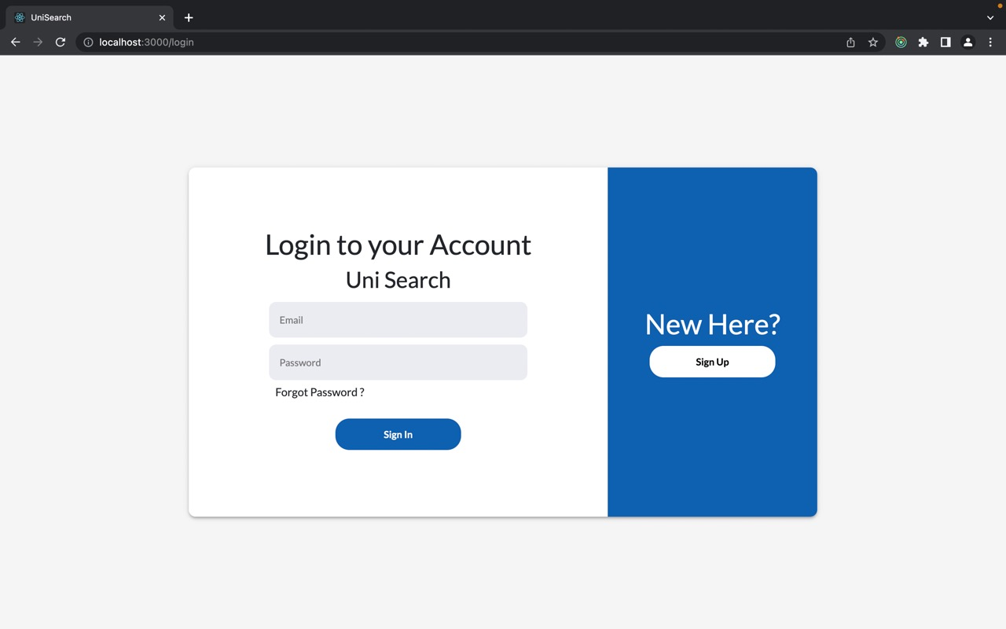

Slide 10
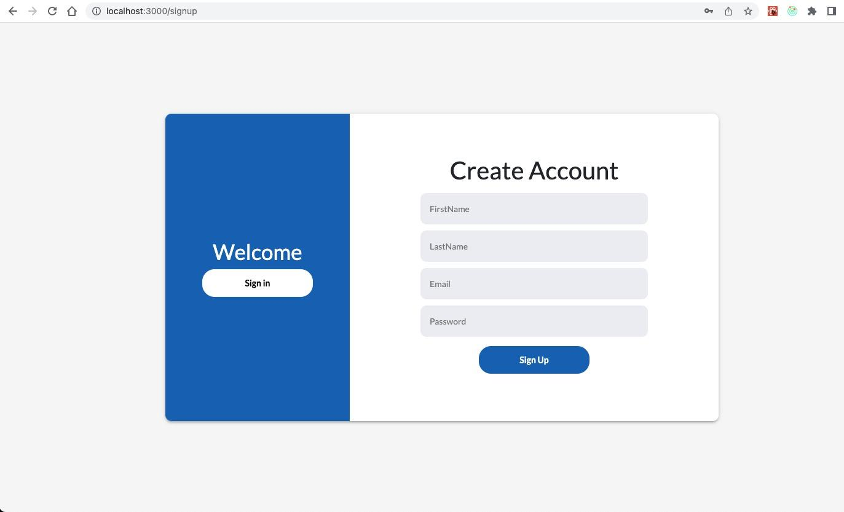

Slide 11
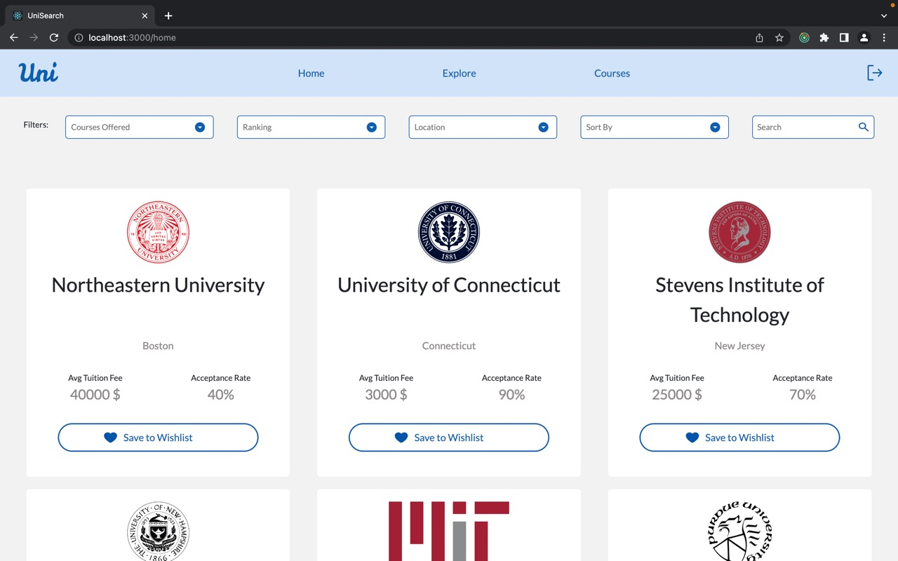

Slide 12
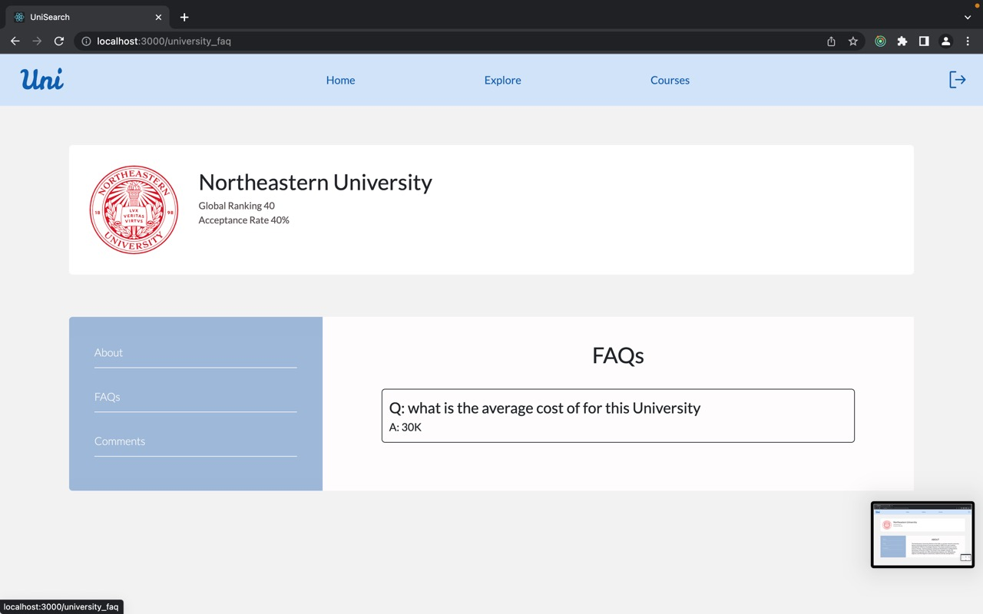

Slide 13
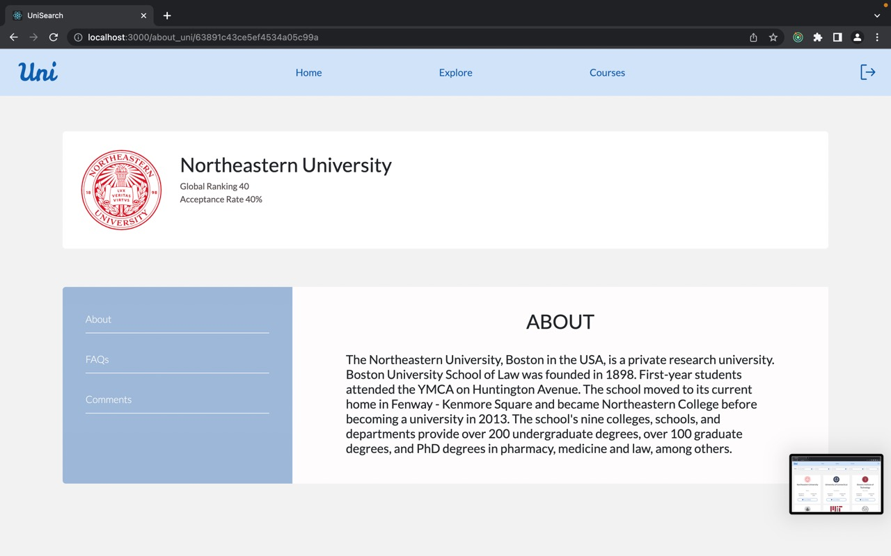

Slide 14
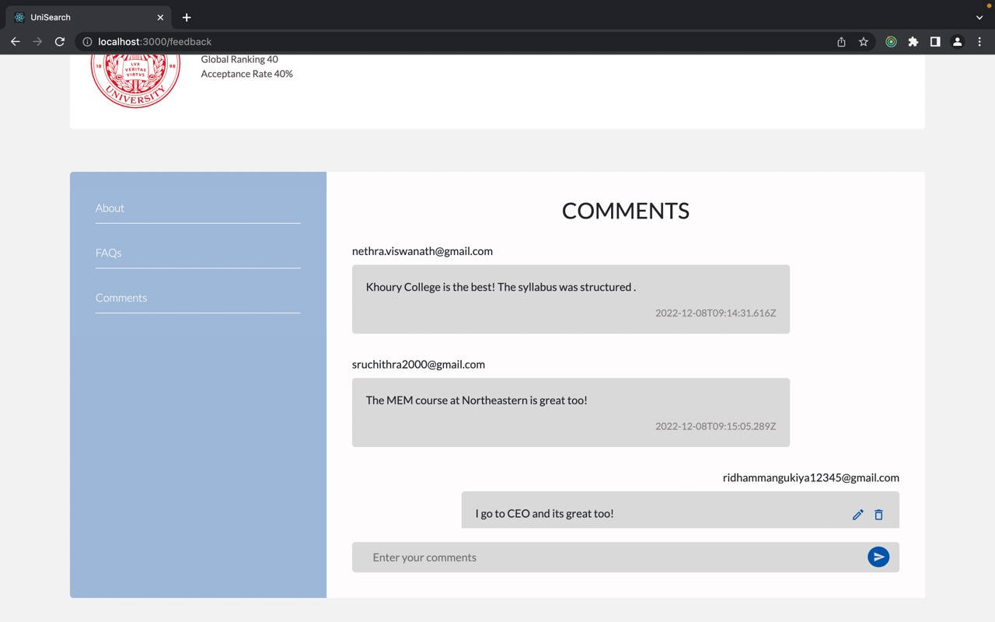

Slide 15
