Slide 1
自然语言处理实验项目 聊天机器人（Chatbot）
万韦涛 2018202111

Slide 2
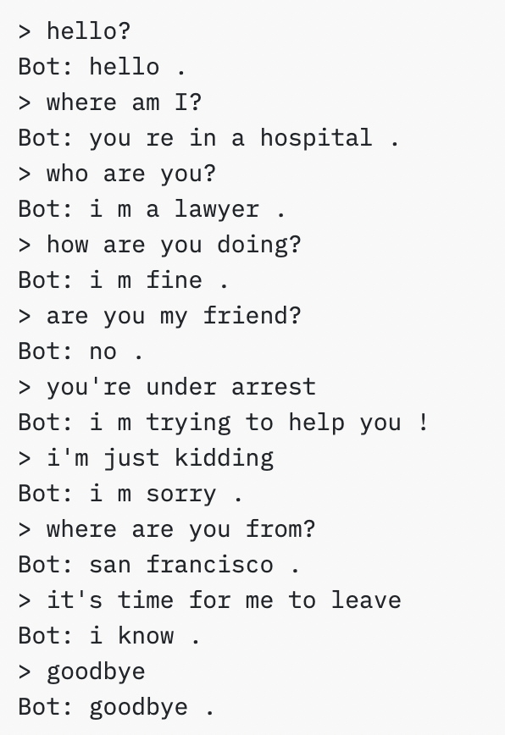
1. Description
Build a chatbot support English.
Build a chatbot support Chinese.

Slide 3
2. Datasets
Cornell Movie-Dialogs Corpus
"Can we make this quick? Roxanne Korrine and Andrew Barrett are having an incredibly horrendous public break- up on the quad. Again."
"Well, I thought we'd start with pronunciation, if that's okay with you."
LCCC（Large-scale Cleaned Chinese Conversation）数据集
…

Slide 4
3. Problems
How to understand the input sentence rather than just discrete words?
use Recurrent Neural Networks ✅
How to represent a sentence?
use a vector of word index ✅
How to measure the quality of generated responses?
compare it with the original response
Further optimization of the chatbot?
use more dataset to train ✅
use better representation of sentence (word index -> word embedding) ✅
use attention mechanisms to improve performance on long sequence ✅

Slide 5
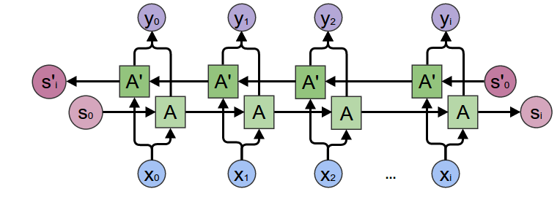
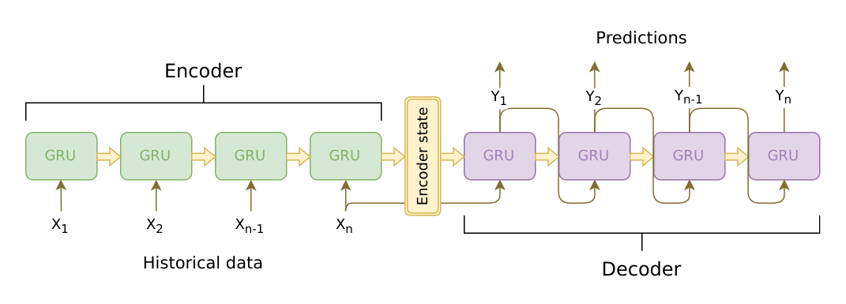
4. Model
Recurrent Neural Networks (GRU and LSTM)
Example: Bidirectional GRU
Seq2Seq Model (a network with Encoder and Decoder)
Loss function: cross entropy loss function

Slide 6
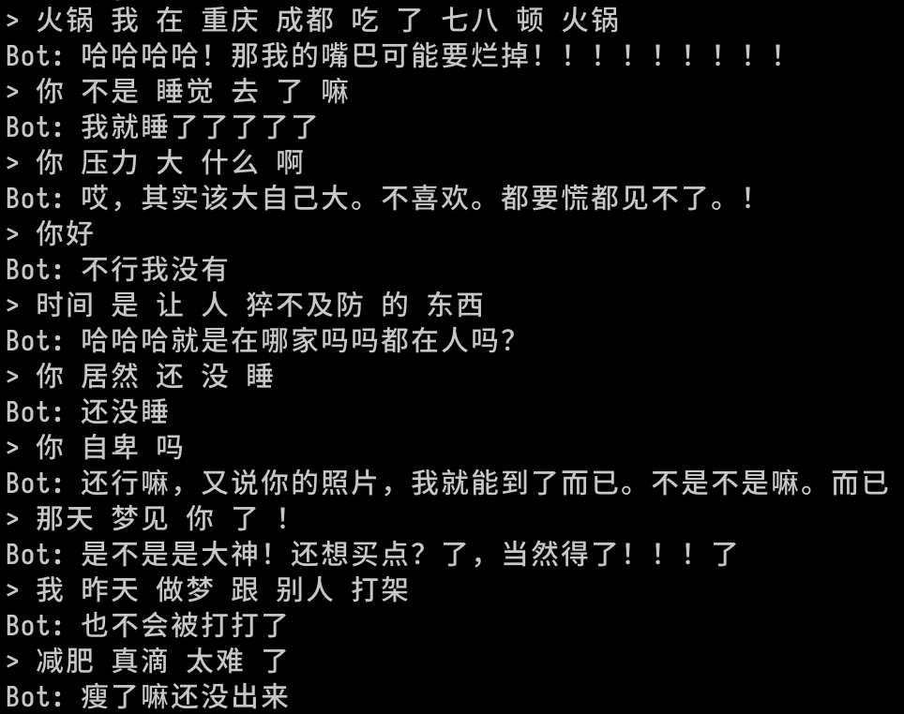
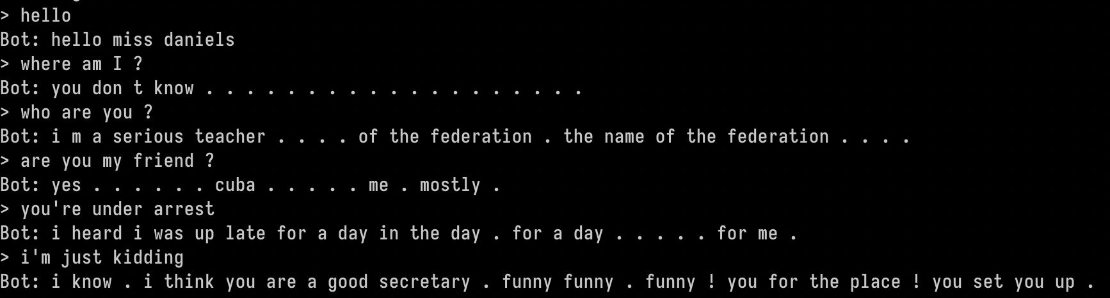
5. Progress
Support English Chatting ✅
Support Chinese Chatting ✅

Slide 7
6. References
[1] Cho, K., Van Merriënboer, B., Gulcehre, C., Bahdanau, D., Bougares, F., Schwenk, H., & Bengio, Y. (2014). Learning phrase representations using RNN encoder-decoder for statistical machine translation. arXiv preprint arXiv:1406.1078.
[2] Sutskever, I., Vinyals, O., & Le, Q. V. (2014). Sequence to sequence learning with neural networks. In Advances in neural information processing systems (pp. 3104-3112).
[3] Luong, M. T., Pham, H., & Manning, C. D. (2015). Effective approaches to attention-based neural machine translation. arXiv preprint arXiv:1508.04025.

