Slide 1
Course Overview
Module | Topic | Rechnology/Framework Learn
1 | Introduction | Core Java
2 | Web app Development | Servlet,JSP,MVC
3 | Java Persistence using JPA and Hibernate | Hibernate,ORM,HQL,HPQL,JPA
4 | Spring core | Spring,Spring Boot,Spring REST,Spring MVC,Spring AOP
5 | Automation Tools | Junit,Maven,Selinium

Slide 2
Module 1
Introduction

Slide 3
Module1 - Content
Review of Java
Advanced concepts of Java
Java generics
Java IO
New Features of Java
Unit Testing

Slide 4
Module 1 Overview
Sl. No | Topic | Sub Topics
1 | Review of Java | File
2 | Java IO | Serialization
3 | Advanced concepts of Java | Collection Framework
4 | Java generics
5 | New Features of Java | Annotation, Lambda Expression
6 | JDBC
7 | Unit Testing tools | JUnit

Slide 5
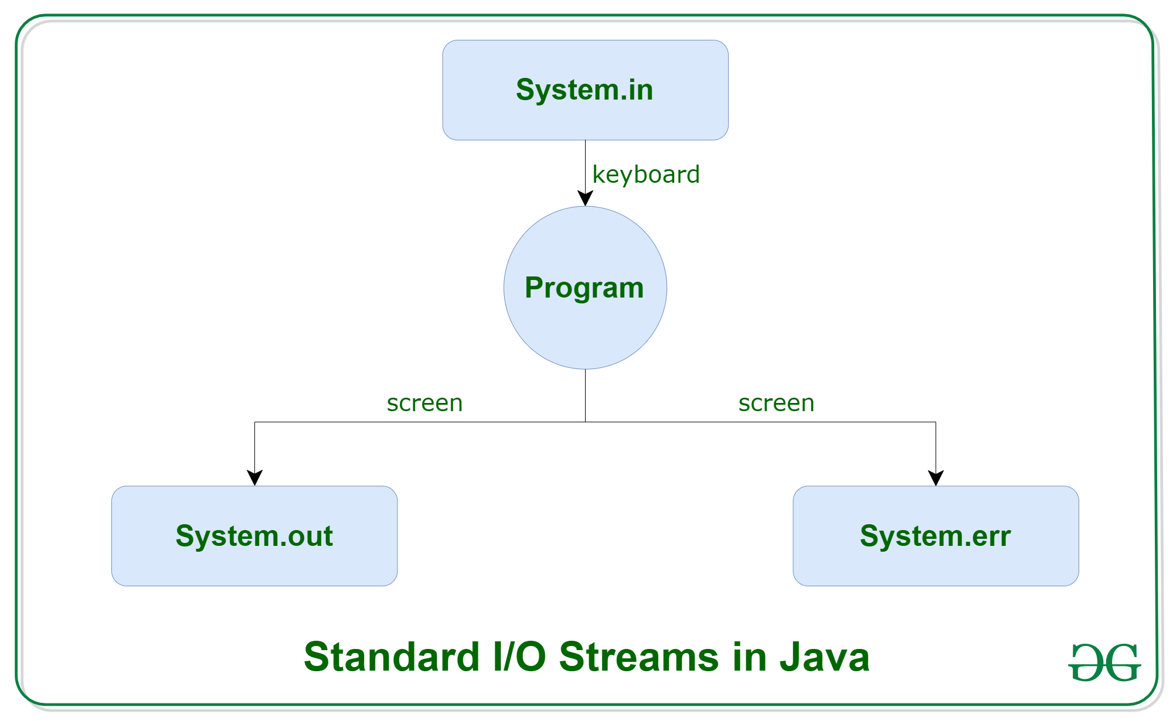
Java I/O
Java I/O (Input and Output) is used to process the input and produce the output.
Java uses the concept of a stream to make I/O operation fast. The java.io package contains all the classes required for input and output operations.
Perform file handling in Java by Java I/O API.
Stream
stream is a sequence of data. In Java, a stream is composed of bytes. It's called a stream because it is like a stream of water that continues to flow
In Java, 3 streams are created for us automatically. All these streams are attached with the console.
1) System.out: standard output stream
2) System.in: standard input stream
3) System.err: standard error stream
the code to print output and an error message to the console.

Slide 6

Stream
A stream can be defined as a sequence of data. There are two kinds of Streams −
InPutStream − The InputStream is used to read data from a source.
OutPutStream − The OutputStream is used for writing data to a destination.
Byte Streams
Java byte streams are used to perform input and output of 8-bit bytes. Though there are many classes related to byte streams but the most frequently used classes are, FileInputStream and FileOutputStream.
Character Streams
Java Byte streams are used to perform input and output of 8-bit bytes, whereas Java Character streams are used to perform input and output for 16-bit unicode. Though there are many classes related to character streams but the most frequently used classes are, FileReader and FileWriter. Though internally FileReader uses FileInputStream and FileWriter uses FileOutputStream but here the major difference is that FileReader reads two bytes at a time and FileWriter writes two bytes at a time

Slide 7
OutputStream vs InputStream
OutputStream
Java application uses an output stream to write data to a destination; it may be a file, an array, peripheral device or socket.
InputStream
Java application uses an input stream to read data from a source; it may be a file, an array, peripheral device or socket.

Slide 8
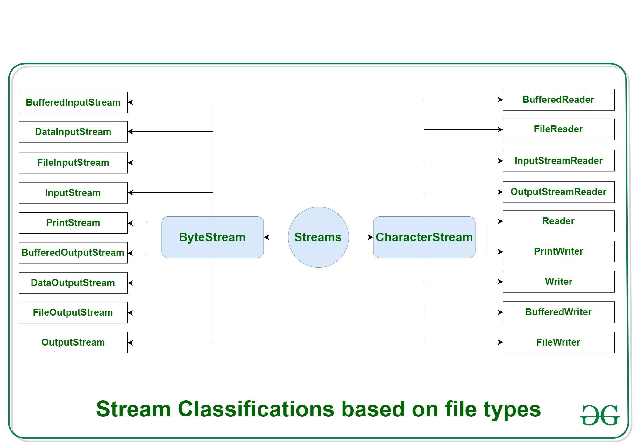
Byte Stream and Character Stream

Slide 9
OutputStream class
OutputStream class is an abstract class. It is the superclass of all classes representing an output stream of bytes. An output stream accepts output bytes and sends them to some sink.
Method | Description
1) public void write(int)throws IOException | is used to write a byte to the current output stream.
2) public void write(byte[])throws IOException | is used to write an array of byte to the current output stream.
3) public void flush()throws IOException | flushes the current output stream.
4) public void close()throws IOException | is used to close the current output stream.

Slide 10
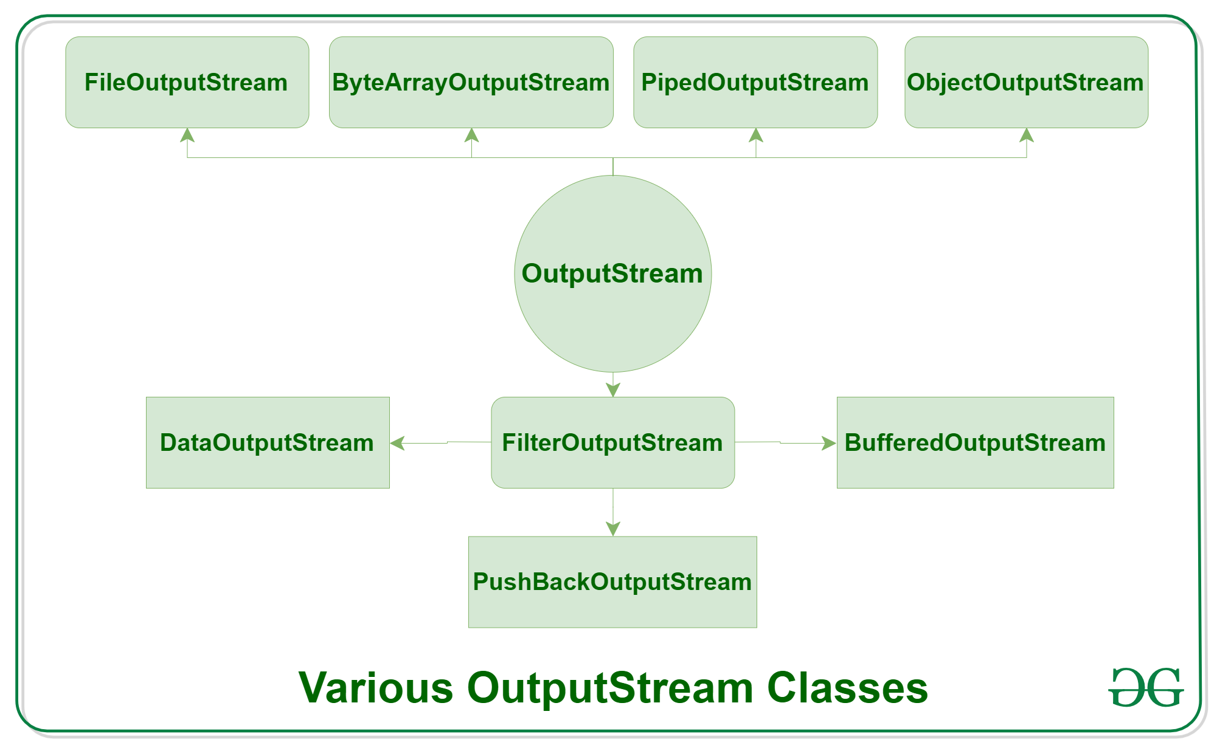
OutputStream Hierarchy

Slide 11
InputStream class
InputStream class is an abstract class. It is the superclass of all classes representing an input stream of bytes.
Method | Description
1) public abstract int read()throws IOException | reads the next byte of data from the input stream. It returns -1 at the end of the file.
2) public int available()throws IOException | returns an estimate of the number of bytes that can be read from the current input stream.
3) public void close()throws IOException | is used to close the current input stream.

Slide 12
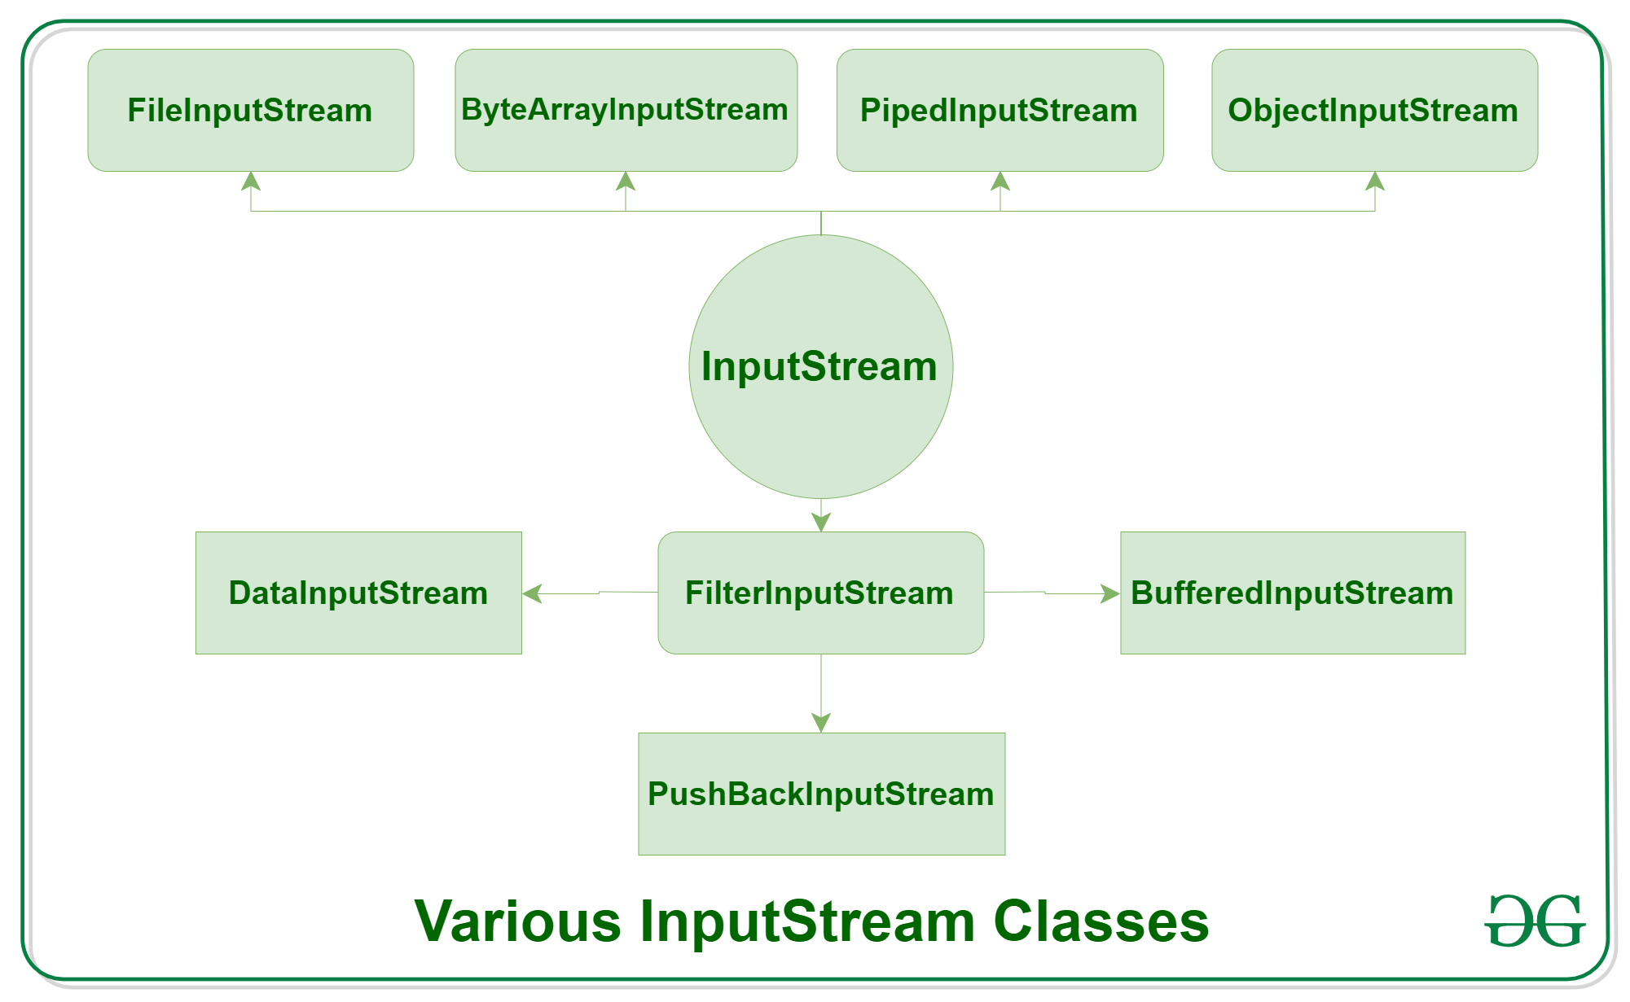
InputStream Hierarchy

Slide 13
FileOutputStream
Java FileOutputStream is an output stream used for writing data to a file.
If you have to write primitive values into a file, use FileOutputStream class. You can write byte-oriented as well as character-oriented data through FileOutputStream class.

Slide 14
Methods in FileOutputStream
Method | Description
protected void finalize() | It is used to clean up the connection with the file output stream.
void write(byte[] ary) | It is used to write ary.length bytes from the byte array to the file output stream.
void write(byte[] ary, int off, int len) | It is used to write len bytes from the byte array starting at offset off to the file output stream.
void write(int b) | It is used to write the specified byte to the file output stream.
FileChannel getChannel() | It is used to return the file channel object associated with the file output stream.
FileDescriptor getFD() | It is used to return the file descriptor associated with the stream.
void close() | It is used to closes the file output stream.

Slide 15
Java FileOutputStream Example 1: write byte
import java.io.FileOutputStream;
public class FileOutputStreamExample {
public static void main(String args[]){
try{
FileOutputStream fout=new FileOutputStream("D:\\testout.txt");
fout.write(65);
fout.close();
System.out.println("success...");
}catch(Exception e){System.out.println(e);}
}
}

Slide 16
Java FileOutputStream example 2: write string
import java.io.FileOutputStream;
public class FileOutputStreamExample {
public static void main(String args[]){
try{
FileOutputStream fout=new FileOutputStream("D:\\testout.txt");
String s="Welcome to javaTpoint.";
byte b[]=s.getBytes();//converting string into byte array
fout.write(b);
fout.close();
System.out.println("success...");
}catch(Exception e){System.out.println(e);}
}
}

Slide 17
FileInputStream Class
Java FileInputStream class obtains input bytes from a file. It is used for reading byte-oriented data (streams of raw bytes) such as image data, audio, video etc. You can also read character-stream data.
Method | Description
int available() | It is used to return the estimated number of bytes that can be read from the input stream.
int read() | It is used to read the byte of data from the input stream.
int read(byte[] b) | It is used to read up to b.length bytes of data from the input stream.
int read(byte[] b, int off, int len) | It is used to read up to len bytes of data from the input stream.
long skip(long x) | It is used to skip over and discards x bytes of data from the input stream.
FileChannel getChannel() | It is used to return the unique FileChannel object associated with the file input stream.
FileDescriptor getFD() | It is used to return the FileDescriptor object.
protected void finalize() | It is used to ensure that the close method is call when there is no more reference to the file input stream.
void close() | It is used to closes the stream.

Slide 18
Java FileInputStream example 1: read single character
import java.io.FileInputStream;
public class DataStreamExample {
public static void main(String args[]){
try{
FileInputStream fin=new FileInputStream("D:\\testout.txt");
int i=fin.read();
System.out.print((char)i);
fin.close();
}catch(Exception e){System.out.println(e);}
}
}

Slide 19
Java FileInputStream example 2: read all characters
import java.io.FileInputStream;
public class DataStreamExample {
public static void main(String args[]){
try{
FileInputStream fin=new FileInputStream("D:\\testout.txt");
int i=0;
while((i=fin.read())!=-1){
System.out.print((char)i);
}
fin.close();
}catch(Exception e){System.out.println(e);}
}
}

Slide 20
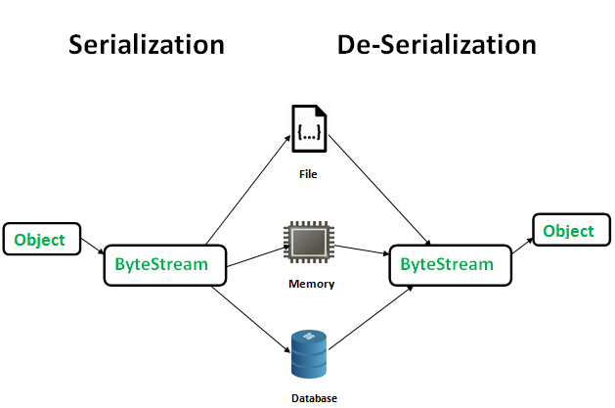
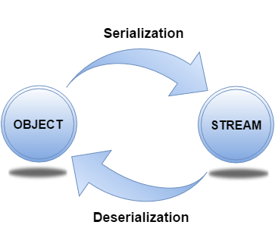
Serialization and Deserialization
Serialization in Java is a mechanism of writing the state of an object into a byte-stream. It is mainly used in Hibernate, RMI, JPA, EJB and JMS technologies.
The reverse operation of serialization is called deserialization where byte-stream is converted into an object. The serialization and deserialization process is platform-independent, it means you can serialize an object on one platform and deserialize it on a different platform.
.

Slide 21
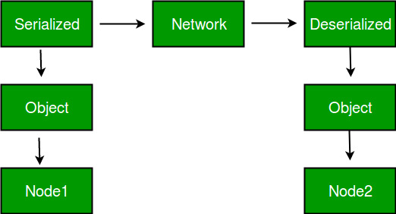
Advantages of Java Serialization
It is mainly used to travel object's state on the network (that is known as marshalling).
To save/persist state of an object.
To travel an object across a network.

Slide 22
Methods used for Serialization and Deserialization
For serializing the object, call the writeObject() method of ObjectOutputStream class
for deserialization call the readObject() method of ObjectInputStream class.
To implement the Serializable interface for serializing the object

Slide 23
Example - Serialization
Import java.io.Serializable;
public class Student implements Serializable{
int id;
String name;
public Student(int id, String name) {
this.id = id;
this.name = name;
}
}
import java.io.*;
class Persist{
public static void main(String args[]){
try{
//Creating the object
Student s1 =new Student(211,"ravi");
//Creating stream and writing the object
FileOutputStream fout=new FileOutputStream("f.txt");
ObjectOutputStream out=new ObjectOutputStream(fout);
out.writeObject(s1);
out.flush();
//closing the stream
out.close();
System.out.println("success");
}catch(Exception e){System.out.println(e);}
}
}

Slide 24
Example - Deserialization
import java.io.*;
class Depersist{
public static void main(String args[]){
try{
//Creating stream to read the object
ObjectInputStream in=new ObjectInputStream(new FileInputStream("f.txt"));
Student s=(Student)in.readObject();
//printing the data of the serialized object
System.out.println(s.id+" "+s.name);
//closing the stream
in.close();
}catch(Exception e){System.out.println(e);}
}
}

Slide 25
Collection Framework
provides an architecture to store and manipulate the group of objects.
achieve all the operations that you perform on a data such as searching, sorting, insertion, manipulation, and deletion.
Java Collection means a single unit of objects. Java Collection framework provides many interfaces (Set, List, Queue, Deque) and classes (ArrayList, Vector, LinkedList, PriorityQueue, HashSet, LinkedHashSet, TreeSet).

Slide 26
Terms used
Collection represents a single unit of objects, i.e., a group.
framework - provides readymade architecture.represents a set of classes and interfaces.
The Collection framework represents a unified architecture for storing and manipulating a group of objects.
It has:
Interfaces and its implementations, i.e., classes
Algorithm

Slide 27
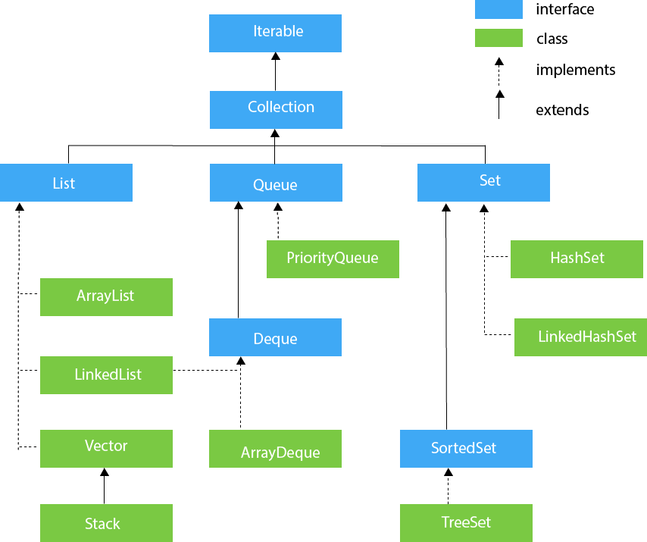
Hierarchy of Collection Framework
The java.util package contains all the classes and interfaces for the Collection framework.

Slide 28
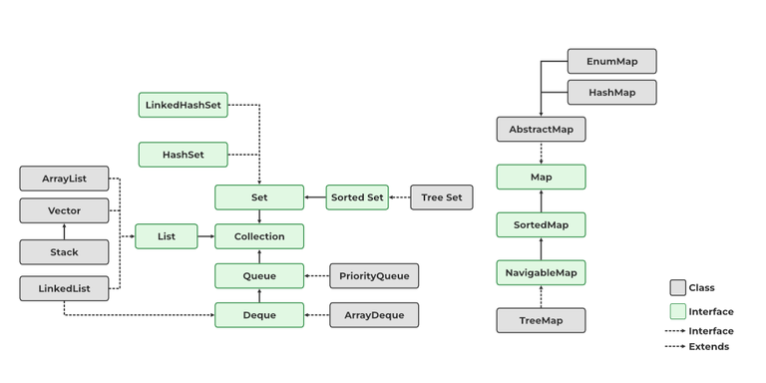
Contd..

Slide 29
Iterable Interface
The Iterable interface is the root interface for all the collection classes. The Collection interface extends the Iterable interface and therefore all the subclasses of Collection interface also implement the Iterable interface.
It contains only one abstract method. i.e.,
Iterator<T> iterator()
It returns the iterator over the elements of type T.

Slide 30
Collection Interface
The Collection interface is the interface which is implemented by all the classes in the collection framework. It declares the methods that every collection will have. In other words, we can say that the Collection interface builds the foundation on which the collection framework depends.
Some of the methods of Collection interface are Boolean add ( Object obj), Boolean addAll ( Collection c), void clear(), etc. which are implemented by all the subclasses of Collection interface.

Slide 31
Methods of Collection interface
No. | Method | Description
1 | public boolean add(E e) | It is used to insert an element in this collection.
2 | public boolean addAll(Collection<? extends E> c) | It is used to insert the specified collection elements in the invoking collection.
3 | public boolean remove(Object element) | It is used to delete an element from the collection.
4 | public boolean removeAll(Collection<?> c) | It is used to delete all the elements of the specified collection from the invoking collection.
5 | default boolean removeIf(Predicate<? super E> filter) | It is used to delete all the elements of the collection that satisfy the specified predicate.
6 | public boolean retainAll(Collection<?> c) | It is used to delete all the elements of invoking collection except the specified collection.
7 | public int size() | It returns the total number of elements in the collection.
8 | public void clear() | It removes the total number of elements from the collection.
9 | public boolean contains(Object element) | It is used to search an element.
10 | public boolean containsAll(Collection<?> c) | It is used to search the specified collection in the collection.
11 | public Iterator iterator() | It returns an iterator.
12 | public Object[] toArray() | It converts collection into array.
13 | public <T> T[] toArray(T[] a) | It converts collection into array. Here, the runtime type of the returned array is that of the specified array.
14 | public boolean isEmpty() | It checks if collection is empty.
15 | default Stream<E> parallelStream() | It returns a possibly parallel Stream with the collection as its source.
16 | default Stream<E> stream() | It returns a sequential Stream with the collection as its source.
17 | default Spliterator<E> spliterator() | It generates a Spliterator over the specified elements in the collection.
18 | public boolean equals(Object element) | It matches two collections.
19 | public int hashCode() | It returns the hash code number of the collection.

Slide 32
Iterator interface
Iterator interface provides the facility of iterating the elements in a forward direction only.
No. | Method | Description
1 | public boolean hasNext() | It returns true if the iterator has more elements otherwise it returns false.
2 | public Object next() | It returns the element and moves the cursor pointer to the next element.
3 | public void remove() | It removes the last elements returned by the iterator. It is less used.

Slide 33
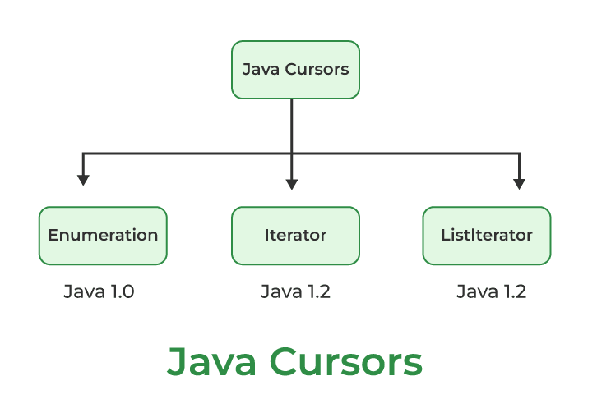
used to iterate or traverse or retrieve a Collection or Stream object’s elements one by one.

Slide 34
Access collection by
Using iterator() Method
Using forEach() Method
Using listIterator() Method

Slide 35
Enumerator
It is an interface used to get elements of legacy collections(Vector, Hashtable). Enumeration is the first iterator present from JDK 1.0, rests are included in JDK 1.2 with more functionality.
There are two methods in the Enumeration interface namely :
1. public boolean hasMoreElements(): This method tests if this enumeration contains more elements or not.
2. public Object nextElement(): This method returns the next element of this enumeration. It throws NoSuchElementException if no more element is present

Slide 36
Example
import java.util.Enumeration;
import java.util.Vector;
public class Test {
public static void main(String[] args)
{
Vector v = new Vector();
for (int i = 0; i < 10; i++)
v.addElement(i);
// Printing elements in vector object
System.out.println(v);
Enumeration e = v.elements();
while (e.hasMoreElements()) {
int i = (Integer)e.nextElement();
System.out.print(i + " ");
}
}
}

Slide 37
Distinguish between Iterator and Enumeration.
Sr. No. | Key | Iterator | Enumeration
1 | Basic | In Iterator, we can read and remove element while traversing element in the collections. | Using Enumeration, we can only read element during traversing element in the collections.
2. | Access | It can be used with any class of the collection framework. | It can be used only with legacy class of the collection framework such as a Vector and HashTable.
3. | Fail-Fast and Fail -Safe | Any changes in the collection, such as removing element from the collection during a thread is iterating collection then it throw concurrent modification exception. | Enumeration is Fail safe in nature. It doesn’t throw concurrent modification exception
4. | Limitation | Only forward direction iterating is possible | Remove operations can not be performed using Enumeration.
5. | Methods | It has following methods − *hasNext() *next() *remove() | It has following methods − *hasMoreElements() *nextElement()

Slide 38
List Interface
List interface is the child interface of Collection interface.
store the ordered collection of objects.
It can have duplicate values.
can be used to insert, delete, and access the elements from the list.
List interface is implemented by the classes ArrayList, LinkedList, Vector, and Stack.
To instantiate the List interface, we must use :
List <data-type> list1= new ArrayList();
List <data-type> list2 = new LinkedList();
List <data-type> list3 = new Vector();
List <data-type> list4 = new Stack();

Slide 39
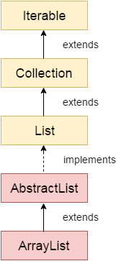
ArrayList
The ArrayList class implements the List interface.
It uses a dynamic array to store the duplicate element of different data types.
Java ArrayList class uses a dynamic array for storing the elements. It is like an array, but there is no size limit .The ArrayList class maintains the insertion order and is non-synchronized. The elements stored in the ArrayList class can be randomly accessed.
. We can add or remove elements anytime. So, it is much more flexible than the traditional array

Slide 40
Example1
import java.util.*;
public class ArrayListExample2{
public static void main(String args[]){
ArrayList<String> list=new ArrayList<String>();
list.add("Mango");//Adding object in arraylist
list.add("Apple");
list.add("Banana");
list.add("Grapes");
//Traversing list through Iterator
Iterator itr=list.iterator();//getting the Iterator
while(itr.hasNext()){//check if iterator has the elements
System.out.println(itr.next());//printing the element and move to next
}
}
}

Slide 41
Example2
import java.util.*;
class SortArrayList{
public static void main(String args[]){
//Creating a list of fruits
List<String> list1=new ArrayList<String>();
list1.add("Mango");
list1.add("Apple");
list1.add("Banana");
list1.add("Grapes");
//Sorting the list
Collections.sort(list1);
//Traversing list through the for-each loop
for(String fruit:list1)
System.out.println(fruit);
System.out.println("Sorting numbers...");
//Creating a list of numbers
List<Integer> list2=new ArrayList<Integer>();
list2.add(21);
list2.add(11);
list2.add(51);
list2.add(1);
//Sorting the list
Collections.sort(list2);
//Traversing list through the for-each loop
for(Integer number:list2)
System.out.println(number);
}
}

Slide 42
User-defined class objects in Java ArrayList
class Student{
int rollno;
String name;
int age;
Student(int rollno,String name,int age){
this.rollno=rollno;
this.name=name;
this.age=age;
}
}
import java.util.*;
class ArrayList5{
public static void main(String args[]){
//Creating user-defined class objects
Student s1=new Student(101,"Sonoo",23);
Student s2=new Student(102,"Ravi",21);
Student s2=new Student(103,"Hanumat",25);
//creating arraylist
ArrayList<Student> al=new ArrayList<Student>();
al.add(s1);//adding Student class object
al.add(s2);
al.add(s3);
//Getting Iterator
Iterator itr=al.iterator();
//traversing elements of ArrayList object
while(itr.hasNext()){
Student st=(Student)itr.next();
System.out.println(st.rollno+" "+st.name+" "+st.age);
}
}
}

Slide 43
Vector
Vector is like the dynamic array which can grow or shrink its size. Unlike array, we can store n-number of elements in it as there is no size limit.
It is similar to the ArrayList, but with two differences-
Vector is synchronized.
Java Vector contains many legacy methods that are not the part of a collections framework.

Slide 44
Example
import java.util.*;
public class VectorExample1 {
public static void main(String args[]) {
//Create an empty vector with initial capacity 4
Vector<String> vec = new Vector<String>(4);
//Adding elements to a vector
vec.add("Tiger");
vec.add("Lion");
vec.add("Dog");
vec.add("Elephant");
//Check size and capacity
System.out.println("Size is: "+vec.size());
System.out.println("Default capacity is: "+vec.capacity());
//Display Vector elements
System.out.println("Vector element is: "+vec);
vec.addElement("Rat");
vec.addElement("Cat");
vec.addElement("Deer");
//Again check size and capacity after two insertions
System.out.println("Size after addition: "+vec.size());
System.out.println("Capacity after addition is: "+vec.capacity());
//Display Vector elements again
System.out.println("Elements are: "+vec);
//Checking if Tiger is present or not in this vector
if(vec.contains("Tiger"))
{
System.out.println("Tiger is present at the index " +vec.indexOf("Tiger"));
}
else
{
System.out.println("Tiger is not present in the list.");
}
//Get the first element
System.out.println("The first animal of the vector is = "+vec.firstElement());
//Get the last element
System.out.println("The last animal of the vector is = "+vec.lastElement());
}
}

Slide 45
Difference between ArrayList and Vector
ArrayList | Vector
1) ArrayList is not synchronized. | Vector is synchronized.
2) ArrayList increments 50% of current array size if the number of elements exceeds from its capacity. | Vector increments 100% means doubles the array size if the total number of elements exceeds than its capacity.
3) ArrayList is not a legacy class. It is introduced in JDK 1.2. | Vector is a legacy class.
4) ArrayList is fast because it is non-synchronized. | Vector is slow because it is synchronized, i.e., in a multithreading environment, it holds the other threads in runnable or non-runnable state until current thread releases the lock of the object.
5) ArrayList uses the Iterator interface to traverse the elements. | A Vector can use the Iterator interface

Slide 46
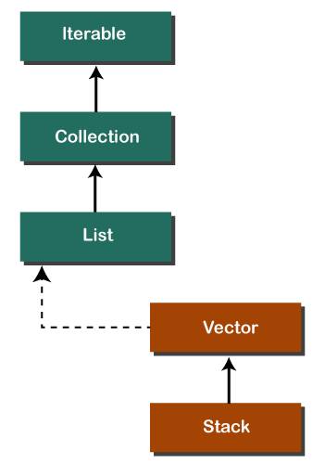
Stack
In Java, Stack is a class that falls under the Collection framework that extends the Vector class. It also implements interfaces List, Collection, Iterable, Cloneable, Serializable. It represents the LIFO stack of objects. Before using the Stack class, we must import the java.util package.

Slide 47
Example
import java.util.Stack;
class Main { public static void main(String[] args) {
Stack<String> animals= new Stack<>();
animals.push("Dog");
animals.push("Horse");
animals.push("Cat");
System.out.println("Initial Stack: " + animals);
String element = animals.pop();
System.out.println("Removed Element: " + element); } }

Slide 48
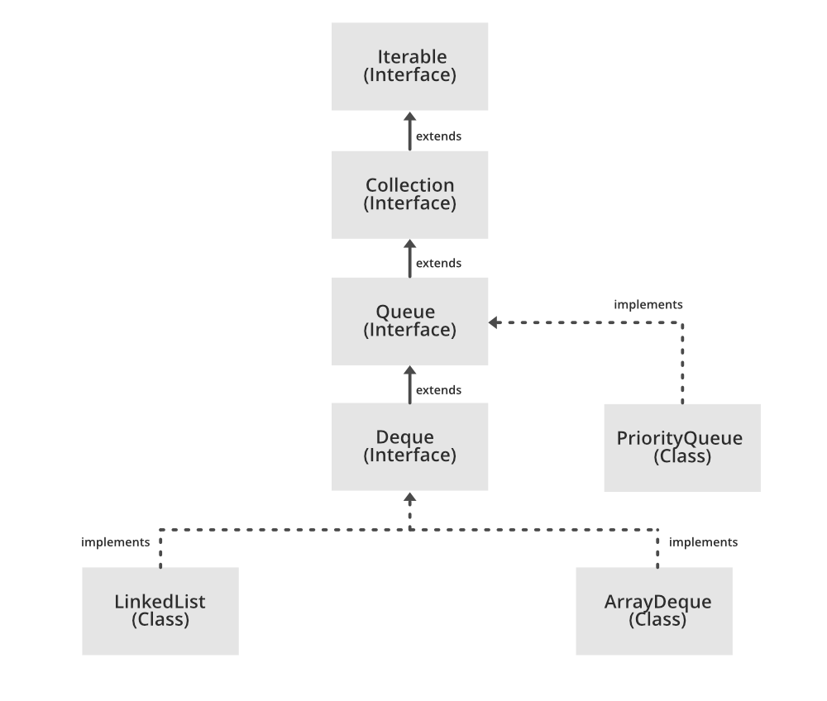
Queue
is used to hold the elements about to be processed in FIFO(First In First Out) order. It is an ordered list of objects with its use limited to inserting elements at the end of the list and deleting elements from the start of the list, (i.e.), it follows the FIFO or the First-In-First-Out principle.

Slide 49
Example
import java.util.LinkedList;
import java.util.Queue;
public class QueueExample {
public static void main(String[] args) {
Queue<String> queue = new LinkedList<>();
// add elements to the queue
queue.add("apple");
queue.add("banana");
queue.add("cherry");
// print the queue
System.out.println("Queue: " + queue);
// remove the element at the front of the queue
String front = queue.remove();
System.out.println("Removed element: " + front);
// print the updated queue
System.out.println("Queue after removal: " + queue);
// add another element to the queue
queue.add("date");
// peek at the element at the front of the queue
String peeked = queue.peek();
System.out.println("Peeked element: " + peeked);
// print the updated queue
System.out.println("Queue after peek: " + queue);
}
}

Slide 50
Java Deque Interface
The interface called Deque is present in java.util package. It is the subtype of the interface queue. The Deque supports the addition as well as the removal of elements from both ends of the data structure. Therefore, a deque can be used as a stack or a queue. We know that the stack supports the Last In First Out (LIFO) operation, and the operation First In First Out is supported by a queue. As a deque supports both, either of the mentioned operations can be performed on it. Deque is an acronym for "double ended queue".

Slide 51
Example
import java.util.*;
public class ArrayDequeExample {
public static void main(String[] args) {
//Creating Deque and adding elements
Deque<String> deque = new ArrayDeque<String>();
deque.add("Ravi");
deque.add("Vijay");
deque.add("Ajay");
//Traversing elements
for (String str : deque) {
System.out.println(str);
}
}
}

Slide 52
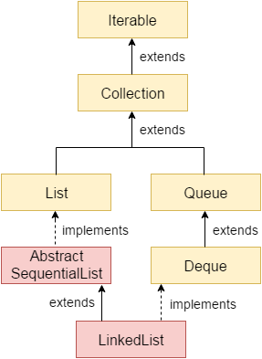
LinkedList class
Java LinkedList class uses a doubly linked list to store the elements. It provides a linked-list data structure. It inherits the AbstractList class and implements List and Deque interfaces.
The important points about Java LinkedList are:
Java LinkedList class can contain duplicate elements.
Java LinkedList class maintains insertion order.
Java LinkedList class is non synchronized.
In Java LinkedList class, manipulation is fast because no shifting needs to occur.
Java LinkedList class can be used as a list, stack or queue.

Slide 53
Example
import java.util.*;
public class LinkedList2{
public static void main(String args[]){
LinkedList<String> ll=new LinkedList<String>();
System.out.println("Initial list of elements: "+ll);
ll.add("Ravi");
ll.add("Vijay");
ll.add("Ajay");
System.out.println("After invoking add(E e) method: "+ll);
//Adding an element at the specific position
ll.add(1, "Gaurav");
System.out.println("After invoking add(int index, E element) method: "+ll);
LinkedList<String> ll2=new LinkedList<String>();
ll2.add("Sonoo");
ll2.add("Hanumat");
//Adding second list elements to the first list
ll.addAll(ll2);
System.out.println("After invoking addAll(Collection<? extends E> c) method: "+ll);
LinkedList<String> ll3=new LinkedList<String>();
ll3.add("John");
ll3.add("Rahul");
//Adding second list elements to the first list at specific position
ll.addAll(1, ll3);
System.out.println("After invoking addAll(int index, Collection<? extends E> c) method: "+ll);
//Adding an element at the first position
ll.addFirst("Lokesh");
System.out.println("After invoking addFirst(E e) method: "+ll);
//Adding an element at the last position
ll.addLast("Harsh");
System.out.println("After invoking addLast(E e) method: "+ll);
ll.remove("Vijay");
System.out.println("After invoking remove(object) method: "+ll);
//Removing element on the basis of specific position
ll.remove(0);
System.out.println("After invoking remove(index) method: "+ll);
LinkedList<String> ll2=new LinkedList<String>();
ll2.add("Ravi");
ll2.add("Hanumat");
// Adding new elements to arraylist
ll.addAll(ll2);
System.out.println("Updated list : "+ll);
//Removing all the new elements from arraylist
ll.removeAll(ll2);
System.out.println("After invoking removeAll() method: "+ll);
//Removing first element from the list
ll.removeFirst();
System.out.println("After invoking removeFirst() method: "+ll);
//Removing first element from the list
ll.removeLast();
System.out.println("After invoking removeLast() method: "+ll);
//Removing first occurrence of element from the list
ll.removeFirstOccurrence("Gaurav");
System.out.println("After invoking removeFirstOccurrence() method: "+ll);
//Removing last occurrence of element from the list
ll.removeLastOccurrence("Harsh");
System.out.println("After invoking removeLastOccurrence() method: "+ll);
//Removing all the elements available in the list
ll.clear();
System.out.println("After invoking clear() method: "+ll);
}
}

Slide 54
Example
import java.util.*;
public class LinkedList4{
public static void main(String args[]){
LinkedList<String> ll=new LinkedList<String>();
ll.add("Ravi");
ll.add("Vijay");
ll.add("Ajay");
//Traversing the list of elements in reverse order
Iterator i=ll.descendingIterator();
while(i.hasNext())
{
System.out.println(i.next());
}
}
}

Slide 55
Set
The set is an interface available in the java.util package. The set interface extends the Collection interface. An unordered collection or list in which duplicates are not allowed is referred to as a collection interface.
The set interface is used to create the mathematical set. The set interface use collection interface's methods to avoid the insertion of the same elements.
SortedSet and NavigableSet are two interfaces that extend the set implementation.

Slide 56
Difference between List and Set
A list can contain duplicate elements whereas Set contains unique elements only.
import java.util.*;
public class SetOperations
{
public static void main(String args[])
{
Integer[] A = {22, 45,33, 66, 55, 34, 77};
Integer[] B = {33, 2, 83, 45, 3, 12, 55};
Set<Integer> set1 = new HashSet<Integer>();
set1.addAll(Arrays.asList(A));
Set<Integer> set2 = new HashSet<Integer>();
set2.addAll(Arrays.asList(B));
// Finding Union of set1 and set2
Set<Integer> set3= new HashSet<Integer>(set1);
set3.addAll(set2);
System.out.print("Union of set1 and set2 is:");
System.out.println(set3);
// Finding Intersection of set1 and set2
Set<Integer> set4 = new HashSet<Integer>(set1);
set4.retainAll(set2);
System.out.print("Intersection of set1 and set2 is:");
System.out.println(set4);
// Finding Difference of set1 and set2
Set<Integer> set5= new HashSet<Integer>(set1);
set5.removeAll(set2);
System.out.print("Difference of set1 and set2 is:");
System.out.println(set5);
}
}

Slide 57
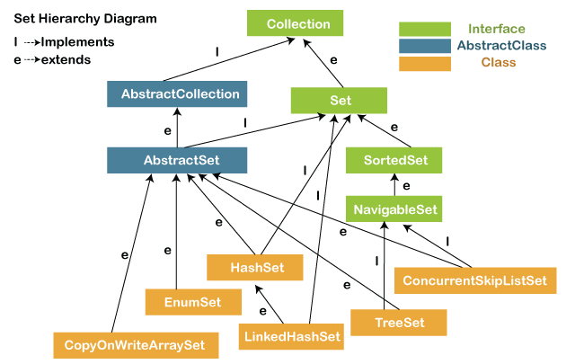

Slide 58
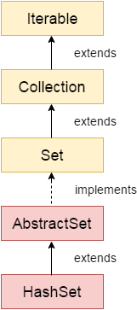
HashSet
Java HashSet class is used to create a collection that uses a hash table for storage. It inherits the AbstractSet class and implements Set interface.
The important points about Java HashSet class are:
HashSet stores the elements by using a mechanism called hashing.
HashSet contains unique elements only.
HashSet allows null value.
HashSet class is non synchronized.
HashSet doesn't maintain the insertion order. Here, elements are inserted on the basis of their hashcode.
HashSet is the best approach for search operations.
The initial default capacity of HashSet is 16, and the load factor is 0.75.

Slide 59
Java HashSet example to remove elements
import java.util.*;
class HashSet3{
public static void main(String args[]){
HashSet<String> set=new HashSet<String>();
set.add("Ravi");
set.add("Vijay");
set.add("Arun");
set.add("Sumit");
System.out.println("An initial list of elements: "+set);
//Removing specific element from HashSet
set.remove("Ravi");
System.out.println("After invoking remove(object) method: "+set);
HashSet<String> set1=new HashSet<String>();
set1.add("Ajay");
set1.add("Gaurav");
set.addAll(set1);
System.out.println("Updated List: "+set);
//Removing all the new elements from HashSet
set.removeAll(set1);
System.out.println("After invoking removeAll() method: "+set);
//Removing elements on the basis of specified condition
set.removeIf(str->str.contains("Vijay"));
System.out.println("After invoking removeIf() method: "+set);
//Removing all the elements available in the set
set.clear();
System.out.println("After invoking clear() method: "+set);
}
}

Slide 60
Java HashSet from another Collection
import java.util.*;
class HashSet4{
public static void main(String args[]){
ArrayList<String> list=new ArrayList<String>();
list.add("Ravi");
list.add("Vijay");
list.add("Ajay");
HashSet<String> set=new HashSet(list);
set.add("Gaurav");
Iterator<String> i=set.iterator();
while(i.hasNext())
{
System.out.println(i.next());
}
}
}

Slide 61
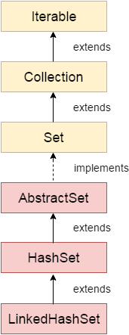
LinkedHashSet
Java LinkedHashSet class is a Hashtable and Linked list implementation of the Set interface. It inherits the HashSet class and implements the Set interface.
The important points about the Java LinkedHashSet class are:
Java LinkedHashSet class contains unique elements only like HashSet.
Java LinkedHashSet class provides all optional set operations and permits null elements.
Java LinkedHashSet class is non-synchronized.
Java LinkedHashSet class maintains insertion order.

Slide 62
Example
import java.util.*;
class LinkedHashSet1{
public static void main(String args[]){
//Creating HashSet and adding elements
LinkedHashSet<String> set=new LinkedHashSet();
set.add("One");
set.add("Two");
set.add("Three");
set.add("Four");
set.add("Five");
Iterator<String> i=set.iterator();
while(i.hasNext())
{
System.out.println(i.next());
}
}
}

Slide 63
import java.util.*;
class LinkedHashSet2{
public static void main(String args[]){
LinkedHashSet<String> al=new LinkedHashSet<String>();
al.add("Ravi");
al.add("Vijay");
al.add("Ravi");
al.add("Ajay");
Iterator<String> itr=al.iterator();
while(itr.hasNext()){
System.out.println(itr.next());
}
}
}

Slide 64
Example3
import java.util.*;
public class LinkedHashSet3
{
// main method
public static void main(String argvs[])
{
// Creating an empty LinekdhashSet of string type
LinkedHashSet<String> lhs = new LinkedHashSet<String>();
// Adding elements to the above Set
// by invoking the add() method
lhs.add("Java");
lhs.add("T");
lhs.add("Point");
lhs.add("Good");
lhs.add("Website");
// displaying all the elements on the console
System.out.println("The hash set is: " + lhs);
// Removing an element from the above linked Set
// since the element "Good" is present, therefore, the method remove()
// returns true
System.out.println(lhs.remove("Good"));
// After removing the element
System.out.println("After removing the element, the hash set is: " + lhs);
// since the element "For" is not present, therefore, the method remove()
// returns false
System.out.println(lhs.remove("For"));
}
}

Slide 65
import java.util.*;
class Book {
int id;
String name,author,publisher;
int quantity;
public Book(int id, String name, String author, String publisher, int quantity) {
this.id = id;
this.name = name;
this.author = author;
this.publisher = publisher;
this.quantity = quantity;
}
}
public class LinkedHashSetExample {
public static void main(String[] args) {
LinkedHashSet<Book> hs=new LinkedHashSet<Book>();
//Creating Books
Book b1=new Book(101,"Let us C","Yashwant Kanetkar","BPB",8);
Book b2=new Book(102,"Data Communications & Networking","Forouzan","Mc Graw Hill",4);
Book b3=new Book(103,"Operating System","Galvin","Wiley",6);
//Adding Books to hash table
hs.add(b1);
hs.add(b2);
hs.add(b3);
//Traversing hash table
for(Book b:hs){
System.out.println(b.id+" "+b.name+" "+b.author+" "+b.publisher+" "+b.quantity);
}
}
}

Slide 66
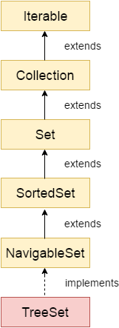
TreeSet
Java TreeSet class implements the Set interface that uses a tree for storage. It inherits AbstractSet class and implements the NavigableSet interface. The objects of the TreeSet class are stored in ascending order.
The important points about the Java TreeSet class are:
Java TreeSet class contains unique elements only like HashSet.
Java TreeSet class access and retrieval times are quiet fast.
Java TreeSet class doesn't allow null element.
Java TreeSet class is non synchronized.
Java TreeSet class maintains ascending order.
Java TreeSet class contains unique elements only like HashSet.
Java TreeSet class access and retrieval times are quite fast.
Java TreeSet class doesn't allow null elements.
Java TreeSet class is non-synchronized.
Java TreeSet class maintains ascending order.
The TreeSet can only allow those generic types that are comparable. For example The Comparable interface is being implemented by the StringBuffer class.
Internal Working of The TreeSet Class

Slide 67
Example
import java.util.*;
class TreeSet1{
public static void main(String args[]){
//Creating and adding elements
TreeSet<String> al=new TreeSet<String>();
al.add("Ravi");
al.add("Vijay");
al.add("Ravi");
al.add("Ajay");
//Traversing elements
Iterator<String> itr=al.iterator();
while(itr.hasNext()){
System.out.println(itr.next());
}
}
}

Slide 68
import java.util.*;
class TreeSet4{
public static void main(String args[]){
TreeSet<String> set=new TreeSet<String>();
set.add("A");
set.add("B");
set.add("C");
set.add("D");
set.add("E");
System.out.println("Initial Set: "+set);
System.out.println("Reverse Set: "+set.descendingSet());
System.out.println("Head Set: "+set.headSet("C", true));
System.out.println("SubSet: "+set.subSet("A", false, "E", true));
System.out.println("TailSet: "+set.tailSet("C", false));
}
}

Slide 69
// important import statement
import java.util.*;
class Employee
{
int empId;
String name;
// getting the name of the employee
String getName()
{
return this.name;
}
// setting the name of the employee
void setName(String name)
{
this.name = name;
}
// setting the employee id
// of the employee
void setId(int a)
{
this.empId = a;
}
// retrieving the employee id of
// the employee
int getId()
{
return this.empId;
}
}
public class ClassCastExceptionTreeSet
{
// main method
public static void main(String[] argvs)
{
// creating objects of the class Employee
Employee obj1 = new Employee();
Employee obj2 = new Employee();
TreeSet<Employee> ts = new TreeSet<Employee>();
// adding the employee objects to
// the TreeSet class
ts.add(obj1);
ts.add(obj2);
System.out.println("The program has been executed successfully.");
}
}

Slide 70
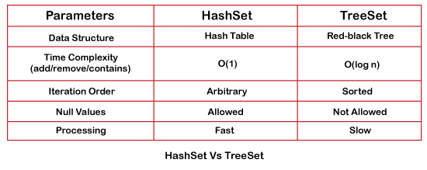
differences and similarities between HashSet and TreeSet.

Slide 71
Map Interface
A map contains values on the basis of key, i.e. key and value pair. Each key and value pair is known as an entry. A Map contains unique keys.
A Map is useful if you have to search, update or delete elements on the basis of a key.
A Map doesn't allow duplicate keys, but you can have duplicate values. HashMap and LinkedHashMap allow null keys and values, but TreeMap doesn't allow any null key or value.

Slide 72
Java Map Example: Non-Generic (Old Style)
//Non-generic
import java.util.*;
public class MapExample1 {
public static void main(String[] args) {
Map map=new HashMap();
//Adding elements to map
map.put(1,"Amit");
map.put(5,"Rahul");
map.put(2,"Jai");
map.put(6,"Amit");
//Traversing Map
Set set=map.entrySet();//Converting to Set so that we can traverse
Iterator itr=set.iterator();
while(itr.hasNext()){
//Converting to Map.Entry so that we can get key and value separately
Map.Entry entry=(Map.Entry)itr.next();
System.out.println(entry.getKey()+" "+entry.getValue());
}
}
}

Slide 73
Java Map Example: Generic (New Style)
import java.util.*;
class MapExample2{
public static void main(String args[]){
Map<Integer,String> map=new HashMap<Integer,String>();
map.put(100,"Amit");
map.put(101,"Vijay");
map.put(102,"Rahul");
//Elements can traverse in any order
for(Map.Entry m:map.entrySet()){
System.out.println(m.getKey()+" "+m.getValue());
}
}
}

Slide 74
Java Map Example: comparingByKey()
import java.util.*;
class MapExample3{
public static void main(String args[]){
Map<Integer,String> map=new HashMap<Integer,String>();
map.put(100,"Amit");
map.put(101,"Vijay");
map.put(102,"Rahul");
//Returns a Set view of the mappings contained in this map
map.entrySet()
//Returns a sequential Stream with this collection as its source
.stream()
//Sorted according to the provided Comparator
.sorted(Map.Entry.comparingByKey())
//Performs an action for each element of this stream
.forEach(System.out::println);
}
}

Slide 75
Java Map Example: comparingByKey() in Descending Order
import java.util.*;
class MapExample4{
public static void main(String args[]){
Map<Integer,String> map=new HashMap<Integer,String>();
map.put(100,"Amit");
map.put(101,"Vijay");
map.put(102,"Rahul");
//Returns a Set view of the mappings contained in this map
map.entrySet()
//Returns a sequential Stream with this collection as its source
.stream()
//Sorted according to the provided Comparator
.sorted(Map.Entry.comparingByKey(Comparator.reverseOrder()))
//Performs an action for each element of this stream
.forEach(System.out::println);
}
}

Slide 76
Java Map Example: comparingByValue()
import java.util.*;
class MapExample5{
public static void main(String args[]){
Map<Integer,String> map=new HashMap<Integer,String>();
map.put(100,"Amit");
map.put(101,"Vijay");
map.put(102,"Rahul");
//Returns a Set view of the mappings contained in this map
map.entrySet()
//Returns a sequential Stream with this collection as its source
.stream()
//Sorted according to the provided Comparator
.sorted(Map.Entry.comparingByValue())
//Performs an action for each element of this stream
.forEach(System.out::println);
}
}

Slide 77
Java Map Example: comparingByValue() in Descending Order
import java.util.*;
class MapExample6{
public static void main(String args[]){
Map<Integer,String> map=new HashMap<Integer,String>();
map.put(100,"Amit");
map.put(101,"Vijay");
map.put(102,"Rahul");
//Returns a Set view of the mappings contained in this map
map.entrySet()
//Returns a sequential Stream with this collection as its source
.stream()
//Sorted according to the provided Comparator
.sorted(Map.Entry.comparingByValue(Comparator.reverseOrder()))
//Performs an action for each element of this stream
.forEach(System.out::println);
}
}

Slide 78
Java HashMap
Java HashMap class implements the Map interface which allows us to store key and value pair, where keys should be unique. If you try to insert the duplicate key, it will replace the element of the corresponding key. It is easy to perform operations using the key index like updation, deletion, etc. HashMap class is found in the java.util package.
HashMap in Java is like the legacy Hashtable class, but it is not synchronized. It allows us to store the null elements as well, but there should be only one null key. Since Java 5, it is denoted as HashMap<K,V>, where K stands for key and V for value. It inherits the AbstractMap class and implements the Map interface.

Slide 79
Example
import java.util.*;
public class HashMapExample1{
public static void main(String args[]){
HashMap<Integer,String> map=new HashMap<Integer,String>();//Creating HashMap
map.put(1,"Mango"); //Put elements in Map
map.put(2,"Apple");
map.put(3,"Banana");
map.put(4,"Grapes");
System.out.println("Iterating Hashmap...");
for(Map.Entry m : map.entrySet()){
System.out.println(m.getKey()+" "+m.getValue());
}
}
}

Slide 80
No Duplicate Key on HashMap
import java.util.*;
public class HashMapExample2{
public static void main(String args[]){
HashMap<Integer,String> map=new HashMap<Integer,String>();//Creating HashMap
map.put(1,"Mango"); //Put elements in Map
map.put(2,"Apple");
map.put(3,"Banana");
map.put(1,"Grapes"); //trying duplicate key
System.out.println("Iterating Hashmap...");
for(Map.Entry m : map.entrySet()){
System.out.println(m.getKey()+" "+m.getValue());
}
}
}

Slide 81
Java HashMap example to add() elements
import java.util.*;
class HashMap1{
public static void main(String args[]){
HashMap<Integer,String> hm=new HashMap<Integer,String>();
System.out.println("Initial list of elements: "+hm);
hm.put(100,"Amit");
hm.put(101,"Vijay");
hm.put(102,"Rahul");
System.out.println("After invoking put() method ");
for(Map.Entry m:hm.entrySet()){
System.out.println(m.getKey()+" "+m.getValue());
}
hm.putIfAbsent(103, "Gaurav");
System.out.println("After invoking putIfAbsent() method ");
for(Map.Entry m:hm.entrySet()){
System.out.println(m.getKey()+" "+m.getValue());
}
HashMap<Integer,String> map=new HashMap<Integer,String>();
map.put(104,"Ravi");
map.putAll(hm);
System.out.println("After invoking putAll() method ");
for(Map.Entry m:map.entrySet()){
System.out.println(m.getKey()+" "+m.getValue());
}
}
}

Slide 82
Java HashMap example to remove() elements
import java.util.*;
public class HashMap2 {
public static void main(String args[]) {
HashMap<Integer,String> map=new HashMap<Integer,String>();
map.put(100,"Amit");
map.put(101,"Vijay");
map.put(102,"Rahul");
map.put(103, "Gaurav");
System.out.println("Initial list of elements: "+map);
//key-based removal
map.remove(100);
System.out.println("Updated list of elements: "+map);
//value-based removal
map.remove(101);
System.out.println("Updated list of elements: "+map);
//key-value pair based removal
map.remove(102, "Rahul");
System.out.println("Updated list of elements: "+map);
}
}

Slide 83
Java HashMap example to replace() elements
import java.util.*;
class HashMap3{
public static void main(String args[]){
HashMap<Integer,String> hm=new HashMap<Integer,String>();
hm.put(100,"Amit");
hm.put(101,"Vijay");
hm.put(102,"Rahul");
System.out.println("Initial list of elements:");
for(Map.Entry m:hm.entrySet())
{
System.out.println(m.getKey()+" "+m.getValue());
}
System.out.println("Updated list of elements:");
hm.replace(102, "Gaurav");
for(Map.Entry m:hm.entrySet())
{
System.out.println(m.getKey()+" "+m.getValue());
}
System.out.println("Updated list of elements:");
hm.replace(101, "Vijay", "Ravi");
for(Map.Entry m:hm.entrySet())
{
System.out.println(m.getKey()+" "+m.getValue());
}
System.out.println("Updated list of elements:");
hm.replaceAll((k,v) -> "Ajay");
for(Map.Entry m:hm.entrySet())
{
System.out.println(m.getKey()+" "+m.getValue());
}
}
}

Slide 84
Java HashMap Example: Book
import java.util.*;
class Book {
int id;
String name,author,publisher;
int quantity;
public Book(int id, String name, String author, String publisher, int quantity) {
this.id = id;
this.name = name;
this.author = author;
this.publisher = publisher;
this.quantity = quantity;
}
}
public class MapExample {
public static void main(String[] args) {
//Creating map of Books
Map<Integer,Book> map=new HashMap<Integer,Book>();
//Creating Books
Book b1=new Book(101,"Let us C","Yashwant Kanetkar","BPB",8);
Book b2=new Book(102,"Data Communications & Networking","Forouzan","Mc Graw Hill",4);
Book b3=new Book(103,"Operating System","Galvin","Wiley",6);
//Adding Books to map
map.put(1,b1);
map.put(2,b2);
map.put(3,b3);
//Traversing map
for(Map.Entry<Integer, Book> entry:map.entrySet()){
int key=entry.getKey();
Book b=entry.getValue();
System.out.println(key+" Details:");
System.out.println(b.id+" "+b.name+" "+b.author+" "+b.publisher+" "+b.quantity);
}
}
}

Slide 85
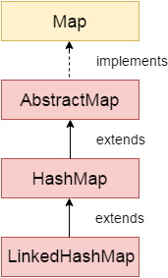
LinkedHashMap
Java LinkedHashMap class is Hashtable and Linked list implementation of the Map interface, with predictable iteration order. It inherits HashMap class and implements the Map interface.
import java.util.*;
class LinkedHashMap1{
public static void main(String args[]){
LinkedHashMap<Integer,String> hm=new LinkedHashMap<Integer,String>();
hm.put(100,"Amit");
hm.put(101,"Vijay");
hm.put(102,"Rahul");
for(Map.Entry m:hm.entrySet()){
System.out.println(m.getKey()+" "+m.getValue());
}
}
}

Slide 86
Java LinkedHashMap Example: Key-Value pair
import java.util.*;
class LinkedHashMap2{
public static void main(String args[]){
LinkedHashMap<Integer, String> map = new LinkedHashMap<Integer, String>();
map.put(100,"Amit");
map.put(101,"Vijay");
map.put(102,"Rahul");
//Fetching key
System.out.println("Keys: "+map.keySet());
//Fetching value
System.out.println("Values: "+map.values());
//Fetching key-value pair
System.out.println("Key-Value pairs: "+map.entrySet());
}
}

Slide 87
Java LinkedHashMap Example:remove()
import java.util.*;
public class LinkedHashMap3 {
public static void main(String args[]) {
Map<Integer,String> map=new LinkedHashMap<Integer,String>();
map.put(101,"Amit");
map.put(102,"Vijay");
map.put(103,"Rahul");
System.out.println("Before invoking remove() method: "+map);
map.remove(102);
System.out.println("After invoking remove() method: "+map);
}
}

Slide 88
Java LinkedHashMap Example: Book
import java.util.*;
class Book {
int id;
String name,author,publisher;
int quantity;
public Book(int id, String name, String author, String publisher, int quantity) {
this.id = id;
this.name = name;
this.author = author;
this.publisher = publisher;
this.quantity = quantity;
}
}
public class MapExample {
public static void main(String[] args) {
//Creating map of Books
Map<Integer,Book> map=new LinkedHashMap<Integer,Book>();
//Creating Books
Book b1=new Book(101,"Let us C","Yashwant Kanetkar","BPB",8);
Book b2=new Book(102,"Data Communications & Networking","Forouzan","Mc Graw Hill",4);
Book b3=new Book(103,"Operating System","Galvin","Wiley",6);
//Adding Books to map
map.put(2,b2);
map.put(1,b1);
map.put(3,b3);
//Traversing map
for(Map.Entry<Integer, Book> entry:map.entrySet()){
int key=entry.getKey();
Book b=entry.getValue();
System.out.println(key+" Details:");
System.out.println(b.id+" "+b.name+" "+b.author+" "+b.publisher+" "+b.quantity);
}
}
}

Slide 89
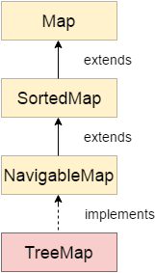
TreeMap
Java TreeMap class is a red-black tree based implementation. It provides an efficient means of storing key-value pairs in sorted order.
The important points about Java TreeMap class are:
Java TreeMap contains values based on the key. It implements the NavigableMap interface and extends AbstractMap class.
Java TreeMap contains only unique elements.
Java TreeMap cannot have a null key but can have multiple null values.
Java TreeMap is non synchronized.
Java TreeMap maintains ascending order.

Slide 90
Java TreeMap Example
import java.util.*;
class TreeMap1{
public static void main(String args[]){
TreeMap<Integer,String> map=new TreeMap<Integer,String>();
map.put(100,"Amit");
map.put(102,"Ravi");
map.put(101,"Vijay");
map.put(103,"Rahul");
for(Map.Entry m:map.entrySet()){
System.out.println(m.getKey()+" "+m.getValue());
}
}
}

Slide 91
Java TreeMap Example: remove()
import java.util.*;
public class TreeMap2 {
public static void main(String args[]) {
TreeMap<Integer,String> map=new TreeMap<Integer,String>();
map.put(100,"Amit");
map.put(102,"Ravi");
map.put(101,"Vijay");
map.put(103,"Rahul");
System.out.println("Before invoking remove() method");
for(Map.Entry m:map.entrySet())
{
System.out.println(m.getKey()+" "+m.getValue());
}
map.remove(102);
System.out.println("After invoking remove() method");
for(Map.Entry m:map.entrySet())
{
System.out.println(m.getKey()+" "+m.getValue());
}
}
}

Slide 92
Java TreeMap Example: NavigableMap
import java.util.*;
class TreeMap3{
public static void main(String args[]){
NavigableMap<Integer,String> map=new TreeMap<Integer,String>();
map.put(100,"Amit");
map.put(102,"Ravi");
map.put(101,"Vijay");
map.put(103,"Rahul");
//Maintains descending order
System.out.println("descendingMap: "+map.descendingMap());
//Returns key-value pairs whose keys are less than or equal to the specified key.
System.out.println("headMap: "+map.headMap(102,true));
//Returns key-value pairs whose keys are greater than or equal to the specified key.
System.out.println("tailMap: "+map.tailMap(102,true));
//Returns key-value pairs exists in between the specified key.
System.out.println("subMap: "+map.subMap(100, false, 102, true));
}
}

Slide 93
Java TreeMap Example: SortedMap
import java.util.*;
class TreeMap4{
public static void main(String args[]){
SortedMap<Integer,String> map=new TreeMap<Integer,String>();
map.put(100,"Amit");
map.put(102,"Ravi");
map.put(101,"Vijay");
map.put(103,"Rahul");
//Returns key-value pairs whose keys are less than the specified key.
System.out.println("headMap: "+map.headMap(102));
//Returns key-value pairs whose keys are greater than or equal to the specified key.
System.out.println("tailMap: "+map.tailMap(102));
//Returns key-value pairs exists in between the specified key.
System.out.println("subMap: "+map.subMap(100, 102));
}
}

Slide 94
Java TreeMap Example: Book
import java.util.*;
class Book {
int id;
String name,author,publisher;
int quantity;
public Book(int id, String name, String author, String publisher, int quantity) {
this.id = id;
this.name = name;
this.author = author;
this.publisher = publisher;
this.quantity = quantity;
}
}
public class MapExample {
public static void main(String[] args) {
//Creating map of Books
Map<Integer,Book> map=new TreeMap<Integer,Book>();
//Creating Books
Book b1=new Book(101,"Let us C","Yashwant Kanetkar","BPB",8);
Book b2=new Book(102,"Data Communications & Networking","Forouzan","Mc Graw Hill",4);
Book b3=new Book(103,"Operating System","Galvin","Wiley",6);
//Adding Books to map
map.put(2,b2);
map.put(1,b1);
map.put(3,b3);
//Traversing map
for(Map.Entry<Integer, Book> entry:map.entrySet()){
int key=entry.getKey();
Book b=entry.getValue();
System.out.println(key+" Details:");
System.out.println(b.id+" "+b.name+" "+b.author+" "+b.publisher+" "+b.quantity);
}
}
}

Slide 95
Hashtable
Java Hashtable class implements a hashtable, which maps keys to values. It inherits Dictionary class and implements the Map interface.
import java.util.*;
class Hashtable1{
public static void main(String args[]){
Hashtable<Integer,String> hm=new Hashtable<Integer,String>();
hm.put(100,"Amit");
hm.put(102,"Ravi");
hm.put(101,"Vijay");
hm.put(103,"Rahul");
for(Map.Entry m:hm.entrySet()){
System.out.println(m.getKey()+" "+m.getValue());
}
}
}

Slide 96
Java Hashtable Example: remove()
import java.util.*;
public class Hashtable2 {
public static void main(String args[]) {
Hashtable<Integer,String> map=new Hashtable<Integer,String>();
map.put(100,"Amit");
map.put(102,"Ravi");
map.put(101,"Vijay");
map.put(103,"Rahul");
System.out.println("Before remove: "+ map);
// Remove value for key 102
map.remove(102);
System.out.println("After remove: "+ map);
}
}

Slide 97
Java Hashtable Example: getOrDefault()
import java.util.*;
class Hashtable3{
public static void main(String args[]){
Hashtable<Integer,String> map=new Hashtable<Integer,String>();
map.put(100,"Amit");
map.put(102,"Ravi");
map.put(101,"Vijay");
map.put(103,"Rahul");
//Here, we specify the if and else statement as arguments of the method
System.out.println(map.getOrDefault(101, "Not Found"));
System.out.println(map.getOrDefault(105, "Not Found"));
}
}

Slide 98
Java Hashtable Example: putIfAbsent()
import java.util.*;
class Hashtable4{
public static void main(String args[]){
Hashtable<Integer,String> map=new Hashtable<Integer,String>();
map.put(100,"Amit");
map.put(102,"Ravi");
map.put(101,"Vijay");
map.put(103,"Rahul");
System.out.println("Initial Map: "+map);
//Inserts, as the specified pair is unique
map.putIfAbsent(104,"Gaurav");
System.out.println("Updated Map: "+map);
//Returns the current value, as the specified pair already exist
map.putIfAbsent(101,"Vijay");
System.out.println("Updated Map: "+map);
}
}

Slide 99
Java Hashtable Example: Book
import java.util.*;
class Book {
int id;
String name,author,publisher;
int quantity;
public Book(int id, String name, String author, String publisher, int quantity) {
this.id = id;
this.name = name;
this.author = author;
this.publisher = publisher;
this.quantity = quantity; }
}
public class HashtableExample {
public static void main(String[] args) {
//Creating map of Books
Map<Integer,Book> map=new Hashtable<Integer,Book>();
//Creating Books
Book b1=new Book(101,"Let us C","Yashwant Kanetkar","BPB",8);
Book b2=new Book(102,"Data Communications & Networking","Forouzan","Mc Graw Hill",4);
Book b3=new Book(103,"Operating System","Galvin","Wiley",6);
//Adding Books to map
map.put(1,b1);
map.put(2,b2);
map.put(3,b3);
//Traversing map
for(Map.Entry<Integer, Book> entry:map.entrySet()){
int key=entry.getKey();
Book b=entry.getValue();
System.out.println(key+" Details:");
System.out.println(b.id+" "+b.name+" "+b.author+" "+b.publisher+" "+b.quantity);
}
}
}

Slide 100
EnumSet
Java EnumSet class is the specialized Set implementation for use with enum types. It inherits AbstractSet class and implements the Set interface.
import java.util.*;
enum days {
SUNDAY, MONDAY, TUESDAY, WEDNESDAY, THURSDAY, FRIDAY, SATURDAY
}
public class EnumSetExample {
public static void main(String[] args) {
Set<days> set = EnumSet.of(days.TUESDAY, days.WEDNESDAY);
// Traversing elements
Iterator<days> iter = set.iterator();
while (iter.hasNext())
System.out.println(iter.next());
}
}

Slide 101
Java EnumSet Example: allOf() and noneOf()
import java.util.*;
enum days {
SUNDAY, MONDAY, TUESDAY, WEDNESDAY, THURSDAY, FRIDAY, SATURDAY
}
public class EnumSetExample {
public static void main(String[] args) {
Set<days> set1 = EnumSet.allOf(days.class);
System.out.println("Week Days:"+set1);
Set<days> set2 = EnumSet.noneOf(days.class);
System.out.println("Week Days:"+set2);
}
}

Slide 102
EnumMap
Java EnumMap class is the specialized Map implementation for enum keys. It inherits Enum and AbstractMap classes.
import java.util.*;
public class EnumMapExample {
// create an enum
public enum Days {
Monday, Tuesday, Wednesday, Thursday
};
public static void main(String[] args) {
//create and populate enum map
EnumMap<Days, String> map = new EnumMap<Days, String>(Days.class);
map.put(Days.Monday, "1");
map.put(Days.Tuesday, "2");
map.put(Days.Wednesday, "3");
map.put(Days.Thursday, "4");
// print the map
for(Map.Entry m:map.entrySet()){
System.out.println(m.getKey()+" "+m.getValue());
}
}
}

Slide 103
import java.util.*;
class Book {
int id;
String name,author,publisher;
int quantity;
public Book(int id, String name, String author, String publisher, int quantity) {
this.id = id;
this.name = name;
this.author = author;
this.publisher = publisher;
this.quantity = quantity;
}
}
public class EnumMapExample {
// Creating enum
public enum Key{
One, Two, Three
};
public static void main(String[] args) {
EnumMap<Key, Book> map = new EnumMap<Key, Book>(Key.class);
// Creating Books
Book b1=new Book(101,"Let us C","Yashwant Kanetkar","BPB",8);
Book b2=new Book(102,"Data Communications & Networking","Forouzan","Mc Graw Hill",4);
Book b3=new Book(103,"Operating System","Galvin","Wiley",6);
// Adding Books to Map
map.put(Key.One, b1);
map.put(Key.Two, b2);
map.put(Key.Three, b3);
// Traversing EnumMap
for(Map.Entry<Key, Book> entry:map.entrySet()){
Book b=entry.getValue();
System.out.println(b.id+" "+b.name+" "+b.author+" "+b.publisher+" "+b.quantity);
}
}
}

Slide 104
Comparable interface
Java Comparable interface is used to order the objects of the user-defined class. This interface is found in java.lang package and contains only one method named compareTo(Object). It provides a single sorting sequence only,

Slide 105
class Student implements Comparable<Student>{
int rollno;
String name;
int age;
Student(int rollno,String name,int age){
this.rollno=rollno;
this.name=name;
this.age=age;
}
public int compareTo(Student st){
if(age==st.age)
return 0;
else if(age>st.age)
return 1;
else
return -1;
}
}

Slide 106
import java.util.*;
public class TestSort1{
public static void main(String args[]){
ArrayList<Student> al=new ArrayList<Student>();
al.add(new Student(101,"Vijay",23));
al.add(new Student(106,"Ajay",27));
al.add(new Student(105,"Jai",21));
Collections.sort(al);
for(Student st:al){
System.out.println(st.rollno+" "+st.name+" "+st.age);
}
}
}

Slide 107
Comparable Example: reverse order
class Student implements Comparable<Student>{
int rollno;
String name;
int age;
Student(int rollno,String name,int age){
this.rollno=rollno;
this.name=name;
this.age=age;
}
public int compareTo(Student st){
if(age==st.age)
return 0;
else if(age<st.age)
return 1;
else
return -1;
}
}

Slide 108
import java.util.*;
public class TestSort2{
public static void main(String args[]){
ArrayList<Student> al=new ArrayList<Student>();
al.add(new Student(101,"Vijay",23));
al.add(new Student(106,"Ajay",27));
al.add(new Student(105,"Jai",21));
Collections.sort(al);
for(Student st:al){
System.out.println(st.rollno+" "+st.name+" "+st.age);
}
}
}

Slide 109
Comparator interface
Java Comparator interface is used to order the objects of a user-defined class.
This interface is found in java.util package and contains 2 methods compare(Object obj1,Object obj2) and equals(Object element).
It provides multiple sorting sequences, i.e., you can sort the elements on the basis of any data member, for example, rollno, name, age or anything else.

Slide 110
class Student {
int rollno;
String name;
int age;
Student(int rollno,String name,int age){
this.rollno=rollno;
this.name=name;
this.age=age;
}
public int getRollno() {
return rollno;
}
public void setRollno(int rollno) {
this.rollno = rollno;
}
public String getName() {
return name;
}
public void setName(String name) {
this.name = name;
}
public int getAge() {
return age;
}
public void setAge(int age) {
this.age = age;
}
}

Slide 111
import java.util.*;
public class TestSort1{
public static void main(String args[]){
ArrayList<Student> al=new ArrayList<Student>();
al.add(new Student(101,"Vijay",23));
al.add(new Student(106,"Ajay",27));
al.add(new Student(105,"Jai",21));
/Sorting elements on the basis of name
Comparator<Student> cm1=Comparator.comparing(Student::getName);
Collections.sort(al,cm1);
System.out.println("Sorting by Name");
for(Student st: al){
System.out.println(st.rollno+" "+st.name+" "+st.age);
}
//Sorting elements on the basis of age
Comparator<Student> cm2=Comparator.comparing(Student::getAge);
Collections.sort(al,cm2);
System.out.println("Sorting by Age");
for(Student st: al){
System.out.println(st.rollno+" "+st.name+" "+st.age);
}
}
}

Slide 112
Java 8 Comparator Example: nullsFirst() and nullsLast() method
class Student {
int rollno;
String name;
int age;
Student(int rollno,String name,int age){
this.rollno=rollno;
this.name=name;
this.age=age;
}
public int getRollno() {
return rollno;
}
public void setRollno(int rollno) {
this.rollno = rollno;
}
public String getName() {
return name;
}
public void setName(String name) {
this.name = name;
}
public int getAge() {
return age;
}
public void setAge(int age) {
this.age = age;
}
}

Slide 113
Generics
The Java Generics programming is introduced in J2SE 5 to deal with type-safe objects. It makes the code stable by detecting the bugs at compile time.
Before generics, we can store any type of objects in the collection, i.e., non-generic. Now generics force the java programmer to store a specific type of objects.

Slide 114
Advantage of Java Generics
Type-safety: We can hold only a single type of objects in generics. It doesnot allow to store other objects.
Type casting is not required: There is no need to typecast the object.
Compile-Time Checking: It is checked at compile time so problem will not occur at runtime. The good programming strategy says it is far better to handle the problem at compile time than runtime.

Slide 115
Type Safety
Without Generics, we can store any type of objects.
List list = new ArrayList();
list.add(10);
list.add("10");
With Generics, it is required to specify the type of object we need to store.
List<Integer> list = new ArrayList<Integer>();
list.add(10);
list.add("10");// compile-time error

Slide 116
Type casting is not required
There is no need to typecast the object.
Before Generics, we need to type cast.
List list = new ArrayList();
list.add("hello");
String s = (String) list.get(0);//typecasting
After Generics, we don't need to typecast the object.
List<String> list = new ArrayList<String>();
list.add("hello");
String s = list.get(0);

Slide 117
Example1
import java.util.*;
class TestGenerics1{
public static void main(String args[]){
ArrayList<String> list=new ArrayList<String>();
list.add("rahul");
list.add("jai");
//list.add(32);//compile time error
String s=list.get(1);//type casting is not required
System.out.println("element is: "+s);
Iterator<String> itr=list.iterator();
while(itr.hasNext()){
System.out.println(itr.next());
}
}
}
import java.util.*;
class TestGenerics1{
public static void main(String args[]){
ArrayList<String> list=new ArrayList<String>();
list.add("rahul");
list.add("jai");
//list.add(32);//compile time error
String s=list.get(1);//type casting is not required
System.out.println("element is: "+s);
Iterator<String> itr=list.iterator();
while(itr.hasNext()){
System.out.println(itr.next());
}
}
}

Slide 118
Example2
import java.util.*;
class TestGenerics2{
public static void main(String args[]){
Map<Integer,String> map=new HashMap<Integer,String>();
map.put(1,"vijay");
map.put(4,"umesh");
map.put(2,"ankit");
//Now use Map.Entry for Set and Iterator
Set<Map.Entry<Integer,String>> set=map.entrySet();
Iterator<Map.Entry<Integer,String>> itr=set.iterator();
while(itr.hasNext()){
Map.Entry e=itr.next();//no need to typecast
System.out.println(e.getKey()+" "+e.getValue());
}
}
}

Slide 119
Generic class
A class that can refer to any type is known as a generic class. Here, we are using the T type parameter to create the generic class of specific type.
Creating a generic class:
class MyGen<T>{
T obj;
void set(T obj){this.obj=obj;}
T get(){return obj;}
}
The T type indicates that it can refer to any type (like String, Integer, and Employee). The type you specify for the class will be used to store and retrieve the data.

Slide 120
Using generic class
class TestGenerics3{
public static void main(String args[]){
MyGen<Integer> m=new MyGen<Integer>();
m.add(2);
//m.add("vivek");//Compile time error
System.out.println(m.get());
}
}

Slide 121
class TestGenerics3 {
public static void main(String args[] ) {
MyGen<Integer> m=new MyGen<Integer>();
m.add(2);
//m.add("vivek");//Compile time error
System.out.println(m.get());
}
}

Slide 122
Example 2
class Pair<K, V> {
private K key; private V value; public void setKey(K key) { this.key = key; } public void setValue(V value) { this.value = value; } public K getKey() { return key; } public V getValue() { return value; }
}

Slide 123
class HelloWorld {
public static void main(String[] args) {
Pair<Integer,String> p = new Pair<Integer,String>();
p.setKey(1);
p.setValue("abc");
System.out.println(p.getKey() + p.getValue());
}
}

Slide 124
Type Parameters
The type parameters naming conventions are important to learn generics thoroughly. The common type parameters are as follows:
T - Type
E - Element
K - Key
N - Number
V - Value

Slide 125
Generic Method
Like the generic class, we can create a generic method that can accept any type of arguments. Here, the scope of arguments is limited to the method where it is declared. It allows static as well as non-static methods.
Let's see a simple example of java generic method to print array elements. We are using here E to denote the element.
public class TestGenerics4{
public static < E > void printArray(E[] elements) {
for ( E element : elements){
System.out.println(element );
}
System.out.println();
}
public static void main( String args[] ) {
Integer[] intArray = { 10, 20, 30, 40, 50 };
Character[] charArray = { 'J', 'A', 'V', 'A', 'T','P','O','I','N','T' };
System.out.println( "Printing Integer Array" );
printArray( intArray );
System.out.println( "Printing Character Array" );
printArray( charArray );
}
}

Slide 126
Wildcard in Java Generics
The ? (question mark) symbol represents the wildcard element. It means any type. If we write <? extends Number>, it means any child class of Number, e.g., Integer, Float, and double. Now we can call the method of Number class through any child class object.
We can use a wildcard as a type of a parameter, field, return type, or local variable. However, it is not allowed to use a wildcard as a type argument for a generic method invocation, a generic class instance creation, or a supertype.
import java.util.*;
aabstract void draw();
}
bstract class Shape{
class Rectangle extends Shape{
void draw(){System.out.println("drawing rectangle");}
}
class Circle extends Shape{
void draw(){System.out.println("drawing circle");}
}
class GenericTest{
//creating a method that accepts only child class of Shape
public static void drawShapes(List<? extends Shape> lists){
for(Shape s:lists){
s.draw();//calling method of Shape class by child class instance
}
}
public static void main(String args[]){
list1.add(newList<Rectangle> list1=new ArrayList<Rectangle>();
Rectangle());
List<Circle> list2=new ArrayList<Circle>();
list2.add(new Circle());
list2.add(new Circle());
drawShapes(list1);
drawShapes(list2);
}
}

Slide 127
Example
import java.util.ArrayList;
public class UpperBoundWildcard {
private static Double add(ArrayList<? extends Number> num) {
double sum=0.0;
for(Number n:num)
{
sum = sum+n.doubleValue();
}
return sum;
}
public static void main(String[] args) {
ArrayList<Integer> l1=new ArrayList<Integer>();
l1.add(10);
l1.add(20);
System.out.println("displaying the sum= "+add(l1));
ArrayList<Double> l2=new ArrayList<Double>();
l2.add(30.0);
l2.add(40.0);
System.out.println("displaying the sum= "+add(l2));
}
}

Slide 128
Upper Bounded Wildcards
The purpose of upper bounded wildcards is to decrease the restrictions on a variable. It restricts the unknown type to be a specific type or a subtype of that type. It is used by declaring wildcard character ("?") followed by the extends (in case of, class) or implements (in case of, interface) keyword, followed by its upper bound.
Syntax
List<? extends Number>
? is a wildcard character.
extends, is a keyword.
Number, is a class present in java.lang package
Suppose, we want to write the method for the list of Number and its subtypes (like Integer, Double). Using List<? extends Number> is suitable for a list of type Number or any of its subclasses whereas List<Number> works with the list of type Number only. So, List<? extends Number> is less restrictive than List<Number>.

Slide 129
import java.util.ArrayList;
public class UpperBoundWildcard {
private static Double add(ArrayList<? extends Number> num) {
double sum=0.0;
for(Number n:num)
{
sum = sum+n.doubleValue();
}
return sum;
}
public static void main(String[] args) {
ArrayList<Integer> l1=new ArrayList<Integer>();
l1.add(10);
l1.add(20);
System.out.println("displaying the sum= "+add(l1));
ArrayList<Double> l2=new ArrayList<Double>();
l2.add(30.0);
l2.add(40.0);
System.out.println("displaying the sum= "+add(l2));
}
}

Slide 130
Unbounded Wildcards
The unbounded wildcard type represents the list of an unknown type such as List<?>. This approach can be useful in the following scenarios: -
When the given method is implemented by using the functionality provided in the Object class.
When the generic class contains the methods that don't depend on the type parameter.
Example of Unbounded Wildcards
import java.util.Arrays;
import java.util.List;
public class UnboundedWildcard {
public static void display(List<?> list)
{
for(Object o:list)
{
System.out.println(o);
}
}
public static void main(String[] args) {
List<Integer> l1=Arrays.asList(1,2,3);
System.out.println("displaying the Integer values");
display(l1);
List<String> l2=Arrays.asList("One","Two","Three");
System.out.println("displaying the String values");
display(l2);
}
}

Slide 131
Lower Bounded Wildcards
The purpose of lower bounded wildcards is to restrict the unknown type to be a specific type or a supertype of that type. It is used by declaring wildcard character ("?") followed by the super keyword, followed by its lower bound.
Syntax
List<? super Integer>
Here,
? is a wildcard character.
super, is a keyword.
Integer, is a wrapper class.
Suppose, we want to write the method for the list of Integer and its supertype (like Number, Object). Using List<? super Integer> is suitable for a list of type Integer or any of its superclasses whereas List<Integer> works with the list of type Integer only. So, List<? super Integer> is less restrictive than List<Integer>.

Slide 132
import java.util.Arrays;
import java.util.List;
public class LowerBoundWildcard {
public static void addNumbers(List<? super Integer> list) {
for(Object n:list)
{
System.out.println(n);
}
}
public static void main(String[] args) {
List<Integer> l1=Arrays.asList(1,2,3);
System.out.println("displaying the Integer values");
addNumbers(l1);
List<Number> l2=Arrays.asList(1.0,2.0,3.0);
System.out.println("displaying the Number values");
addNumbers(l2);
}
}

Slide 133
Annotation
Java Annotation is a tag that represents the metadata i.e. attached with class, interface, methods or fields to indicate some additional information which can be used by java compiler and JVM.
Annotations in Java are used to provide additional information, so it is an alternative option for XML and Java marker interfaces.

Slide 134
Built-In Java Annotations
Built-In Java Annotations used in Java code
@Override
@SuppressWarnings
@Deprecated
Built-In Java Annotations used in other annotations
@Target
@Retention
@Inherited
@Documented

Slide 135
@Override
@Override annotation assures that the subclass method is overriding the parent class method. If it is not so, compile time error occurs.
Sometimes, we does the silly mistake such as spelling mistakes etc. So, it is better to mark @Override annotation that provides assurity that method is overridden.
class Animal{
void eatSomething() { System.out.println("eating something"); }
}
class Dog extends Animal{
@Override
void eatsomething() { System.out.println("eating foods"); }//should be eatSomething
}
class TestAnnotation1{
public static void main(String args[]) {
Animal a=new Dog();
a.eatSomething();
}
}

Slide 136
@SuppressWarnings
@SuppressWarnings annotation: is used to suppress warnings issued by the compiler.
If you remove the @SuppressWarnings("unchecked") annotation, it will show warning at compile time because we are using non-generic collection.
import java.util.*;
class TestAnnotation2{
@SuppressWarnings("unchecked")
public static void main(String args[]){
ArrayList list=new ArrayList();
list.add("sonoo");
list.add("vimal");
list.add("ratan");
for(Object obj:list)
System.out.println(obj);
}
}

Slide 137
@Deprecated
@Deprecated annoation marks that this method is deprecated so compiler prints warning. It informs user that it may be removed in the future versions. So, it is better not to use such methods.
class A{
void m(){ System.out.println("hello m"); }
@Deprecated
void n(){System.out.println("hello n");}
}
class TestAnnotation3{
public static void main(String args[]){
A a=new A();
a.n();
}
}

Slide 138
Java Custom Annotations/ Java User-defined annotations
are easy to create and use.
The @interface element is used to declare an annotation. For example:
@interface MyAnnotation{}
Here, MyAnnotation is the custom annotation name.
There are few points that should be remembered by the programmer.
Method should not have any throws clauses
Method should return one of the following: primitive data types, String, Class, enum or array of these data types.
Method should not have any parameter.
We should attach @ just before interface keyword to define annotation.
It may assign a default value to the method.

Slide 139
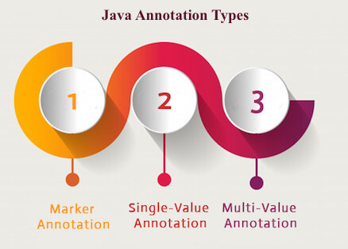
Types of Annotation

Slide 140
Marker Annotation
An annotation that has no method, is called marker annotation. For example:
@interface MyAnnotation{}
The @Override and @Deprecated are marker annotations.

Slide 141
Single-Value Annotation
An annotation that has one method, is called single-value annotation. For example
@interface MyAnnotation{
int value();
}
We can provide the default value also. For example:
@interface MyAnnotation{
int value() default 0;
}
How to apply Single-Value Annotation
Let's see the code to apply the single value annotation.
@MyAnnotation(value=10)
The value can be anything.

Slide 142
Multi-Value Annotation
An annotation that has more than one method, is called Multi-Value annotation. For example:
@interface MyAnnotation {
int value1();
String value2();
String value3();
}
We can provide the default value also. For example:
@interface MyAnnotation {
int value1() default 1;
String value2() default "";
String value3() default "xyz";
}
How to apply Multi-Value Annotation
Let's see the code to apply the multi-value annotation.

Slide 143
Built-in Annotations used in custom annotations in java
@Target
@Retention
@Inherited
@Documented

Slide 144
@Target
@Target tag is used to specify at which type, the annotation is used.
The java.lang.annotation. ElementType enum declares many constants to specify the type of element where annotation is to be applied such as TYPE, METHOD, FIELD etc. Let's see the constants of ElementType enum:
Element Types | Where the annotation can be applied
TYPE | class, interface or enumeration
FIELD | fields
METHOD | methods
CONSTRUCTOR | constructors
LOCAL_VARIABLE | local variables
ANNOTATION_TYPE | annotation type
PARAMETER | parameter

Slide 145
Example
Example to specify annoation for a class
@Target(ElementType.TYPE)
@interface MyAnnotation{
int value1();
String value2();
}
Example to specify annotation for a class, methods or fields
@Target({ElementType.TYPE, ElementType.FIELD, ElementType.METHOD})
@interface MyAnnotation{
int value1();
String value2();
}

Slide 146
@Retention
@Retention annotation is used to specify to what level annotation will be available.
RetentionPolicy | Availability
RetentionPolicy.SOURCE | refers to the source code, discarded during compilation. It will not be available in the compiled class.
RetentionPolicy.CLASS | refers to the .class file, available to java compiler but not to JVM . It is included in the class file.
RetentionPolicy.RUNTIME | refers to the runtime, available to java compiler and JVM .

Slide 147
@Retention(RetentionPolicy.RUNTIME)
@Target(ElementType.TYPE)
@interface MyAnnotation{
int value1();
String value2();
}

Slide 148
Example
File: Test.java
//Creating annotation
import java.lang.annotation.*;
import java.lang.reflect.*;
@Retention(RetentionPolicy.RUNTIME)
@Target(ElementType.METHOD)
@interface MyAnnotation{
int value();
}
//Applying annotation
class Hello{
@MyAnnotation(value=10)
public void sayHello(){System.out.println("hello annotation");}
}
//Accessing annotation
class TestCustomAnnotation1{
public static void main(String args[])throws Exception{
Hello h=new Hello();
Method m=h.getClass().getMethod("sayHello");
MyAnnotation manno=m.getAnnotation(MyAnnotation.class);
System.out.println("value is: "+manno.value());
}}

Slide 149
@Inherited
By default, annotations are not inherited to subclasses. The @Inherited annotation marks the annotation to be inherited to subclasses.
@Inherited
@interface ForEveryone { }//Now it will be available to subclass also
@interface ForEveryone { }
class Superclass{}
class Subclass extends Superclass{}

Slide 150
@Documented
The @Documented Marks the annotation for inclusion in the documentation.

Slide 151
Lambda Expression
Lambda expression is a new and important feature of Java which was included in Java SE 8.
It provides a clear and concise way to represent one method interface using an expression.
It is very useful in collection library. It helps to iterate, filter and extract data from collection.
The Lambda expression is used to provide the implementation of an interface which has functional interface. It saves a lot of code.
In case of lambda expression, we don't need to define the method again for providing the implementation.
Java lambda expression is treated as a function, so compiler does not create .class file.

Slide 152
Functional Interface
Lambda expression provides implementation of functional interface.
An interface which has only one abstract method is called functional interface.
Java provides an anotation @FunctionalInterface, which is used to declare an interface as functional interface.

Slide 153
Why use Lambda Expression
To provide the implementation of Functional interface.
Less coding.
Java Lambda Expression Syntax
(argument-list) -> {body}
Java lambda expression is consisted of three components.
1) Argument-list: It can be empty or non-empty as well.
2) Arrow-token: It is used to link arguments-list and body of expression.
3) Body: It contains expressions and statements for lambda expression.

Slide 154
Parameter Syntax
No Parameter Syntax
() -> {
//Body of no parameter lambda
}
One Parameter Syntax
(p1) -> {
//Body of single parameter lambda
}
Two Parameter Syntax
(p1,p2) -> {
//Body of multiple parameter lambda
}

Slide 155
Without Lambda Expression
interface Drawable{
public void draw();
}
public class LambdaExpressionExample {
public static void main(String[] args) {
int width=10;
//without lambda, Drawable implementation using anonymous class
Drawable d=new Drawable(){
public void draw(){System.out.println("Drawing "+width);}
};
d.draw();
}
}

Slide 156
Java Lambda Expression Example
@FunctionalInterface //It is optional
interface Drawable{
public void draw();
}
public class LambdaExpressionExample2 {
public static void main(String[] args) {
int width=10;
//with lambda
Drawable d2=()->{
System.out.println("Drawing "+width);
};
d2.draw();
}
}

Slide 157
Java Lambda Expression Example: No Parameter
interface Sayable{
public String say();
}
public class LambdaExpressionExample3{
public static void main(String[] args) {
Sayable s=()->{
return "I have nothing to say.";
};
System.out.println(s.say());
}
}

Slide 158
Java Lambda Expression Example: Single Parameter
interface Sayable{
public String say(String name);
}
public class LambdaExpressionExample4{
public static void main(String[] args) {
// Lambda expression with single parameter.
Sayable s1=(name)->{
return "Hello, "+name;
};
System.out.println(s1.say("Sonoo"));
// You can omit function parentheses
Sayable s2= name ->{
return "Hello, "+name;
};
System.out.println(s2.say("Sonoo"));
}
}

Slide 159
Java Lambda Expression Example: Multiple Parameters
interface Addable{
int add(int a,int b);
}
public class LambdaExpressionExample5{
public static void main(String[] args) {
// Multiple parameters in lambda expression
Addable ad1=(a,b)->(a+b);
System.out.println(ad1.add(10,20));
// Multiple parameters with data type in lambda expression
Addable ad2=(int a,int b)->(a+b);
System.out.println(ad2.add(100,200));
}
}

Slide 160
Java Lambda Expression Example: with or without return keyword
interface Addable{
int add(int a,int b);
}
public class LambdaExpressionExample6 {
public static void main(String[] args) {
// Lambda expression without return keyword.
Addable ad1=(a,b)->(a+b);
System.out.println(ad1.add(10,20));
// Lambda expression with return keyword.
Addable ad2=(int a,int b)->{
return (a+b);
};
System.out.println(ad2.add(100,200));
}
}

Slide 161
Java Lambda Expression Example: Foreach Loop
import java.util.*;
public class LambdaExpressionExample7{
public static void main(String[] args) {
List<String> list=new ArrayList<String>();
list.add("ankit");
list.add("mayank");
list.add("irfan");
list.add("jai");
list.forEach(
(n)->System.out.println(n)
);
}
}

Slide 162
Java Lambda Expression Example: Multiple Statements
@FunctionalInterface
interface Sayable{
String say(String message);
}
public class LambdaExpressionExample8{
public static void main(String[] args) {
// You can pass multiple statements in lambda expression
Sayable person = (message)-> {
String str1 = "I would like to say, ";
String str2 = str1 + message;
return str2;
};
System.out.println(person.say("time is precious."));
}
}

Slide 163
Java Lambda Expression Example: Creating Thread
public class LambdaExpressionExample9{
public static void main(String[] args) {
//Thread Example without lambda
Runnable r1=new Runnable(){
public void run(){
System.out.println("Thread1 is running...");
}
};
Thread t1=new Thread(r1);
t1.start();
//Thread Example with lambda
Runnable r2=()->{
System.out.println("Thread2 is running...");
};
Thread t2=new Thread(r2);
t2.start();
}
}

Slide 164
Java Lambda Expression Example: Comparator
import java.util.ArrayList;
import java.util.Collections;
import java.util.List;
class Product{
int id;
String name;
float price;
public Product(int id, String name, float price) {
super();
this.id = id;
this.name = name;
this.price = price;
}
}
public class LambdaExpressionExample10{
public static void main(String[] args) {
List<Product> list=new ArrayList<Product>();
//Adding Products
list.add(new Product(1,"HP Laptop",25000f));
list.add(new Product(3,"Keyboard",300f));
list.add(new Product(2,"Dell Mouse",150f));
System.out.println("Sorting on the basis of name...");
// implementing lambda expression
Collections.sort(list,(p1,p2)->{
return p1.name.compareTo(p2.name);
});
for(Product p:list){
System.out.println(p.id+" "+p.name+" "+p.price);
}
}
}

Slide 165
Java Lambda Expression Example: Filter Collection Data
import java.util.ArrayList;
import java.util.List;
import java.util.stream.Stream;
class Product{
int id;
String name;
float price;
public Product(int id, String name, float price) {
super();
this.id = id;
this.name = name;
this.price = price;
}
}
public class LambdaExpressionExample11{
public static void main(String[] args) {
List<Product> list=new ArrayList<Product>();
list.add(new Product(1,"Samsung A5",17000f));
list.add(new Product(3,"Iphone 6S",65000f));
list.add(new Product(2,"Sony Xperia",25000f));
list.add(new Product(4,"Nokia Lumia",15000f));
list.add(new Product(5,"Redmi4 ",26000f));
list.add(new Product(6,"Lenevo Vibe",19000f));
// using lambda to filter data
Stream<Product> filtered_data = list.stream().filter(p -> p.price > 20000);
// using lambda to iterate through collection
filtered_data.forEach(
product -> System.out.println(product.name+": "+product.price)
);
}
}

Slide 166
Java Lambda Expression Example: Event Listener
import javax.swing.JButton;
import javax.swing.JFrame;
import javax.swing.JTextField;
public class LambdaEventListenerExample {
public static void main(String[] args) {
JTextField tf=new JTextField();
tf.setBounds(50, 50,150,20);
JButton b=new JButton("click");
b.setBounds(80,100,70,30);
// lambda expression implementing here.
b.addActionListener(e-> {tf.setText("hello swing");});
JFrame f=new JFrame();
f.add(tf);f.add(b);
f.setDefaultCloseOperation(JFrame.EXIT_ON_CLOSE);
f.setLayout(null);
f.setSize(300, 200);
f.setVisible(true);
}
}

Slide 167
API
API (Application programming interface) is a document that contains a description of all the features of a product or software. It represents classes and interfaces that software programs can follow to communicate with each other. An API can be created for applications, libraries, operating systems, etc

Slide 168
JDBC
JDBC stands for Java Database Connectivity. JDBC is a Java API to connect and execute the query with the database. It is a part of JavaSE (Java Standard Edition). JDBC API uses JDBC drivers to connect with the database.
There are four types of JDBC drivers:
JDBC-ODBC Bridge Driver,
Native Driver,
Network Protocol Driver, and
Thin Driver
use JDBC API to access tabular data stored in any relational database. By the help of JDBC API, we can save, update, delete and fetch data from the database. It is like Open Database Connectivity (ODBC) provided by Microsoft.

Slide 169
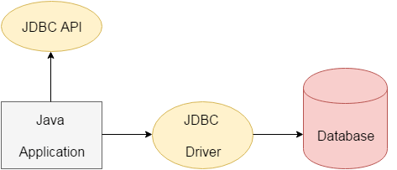
JDBC
The current version of JDBC is 4.3. It is the stable release since 21st September, 2017. It is based on the X/Open SQL Call Level Interface. The java.sql package contains classes and interfaces for JDBC API.

Slide 170
interfaces of JDBC API
Driver interface
Connection interface
Statement interface
PreparedStatement interface
CallableStatement interface
ResultSet interface
ResultSetMetaData interface
DatabaseMetaData interface
RowSet interface

Slide 171
classes of JDBC API
DriverManager class
Blob class
Clob class
Types class
Before JDBC, ODBC API was the database API to connect and execute the query with the database. But, ODBC API uses ODBC driver which is written in C language (i.e. platform dependent and unsecured). That is why Java has defined its own API (JDBC API) that uses JDBC drivers (written in Java language).
We can use JDBC API to handle database using Java program and can perform the following activities:
Connect to the database
Execute queries and update statements to the database
Retrieve the result received from the database.

Slide 172
JDBC Driver
JDBC Driver is a software component that enables java application to interact with the database.
There are 4 types of JDBC drivers:
JDBC-ODBC bridge driver
Native-API driver (partially java driver)
Network Protocol driver (fully java driver)
Thin driver (fully java driver)

Slide 173
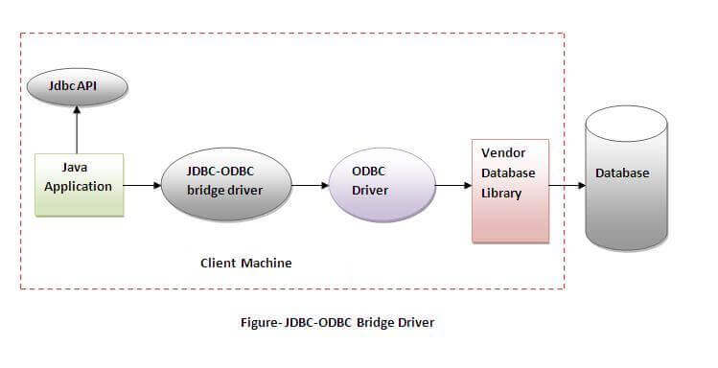
JDBC-ODBC bridge driver
The JDBC-ODBC bridge driver uses ODBC driver to connect to the database. The JDBC-ODBC bridge driver converts JDBC method calls into the ODBC function calls. This is now discouraged because of thin driver.
Oracle does not support the JDBC-ODBC Bridge from Java 8. Oracle recommends that you use JDBC drivers provided by the vendor of your database instead of the JDBC-ODBC Bridge.
Advantages:
easy to use.
can be easily connected to any database.
Disadvantages:
Performance degraded because JDBC method call is converted into the ODBC function calls.
The ODBC driver needs to be installed on the client machine.

Slide 174
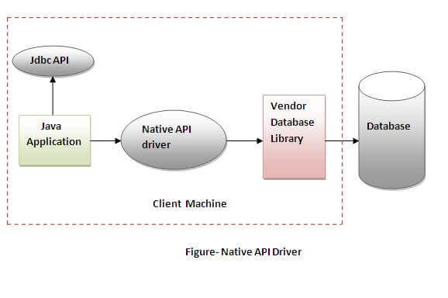
Native-API driver
The Native API driver uses the client-side libraries of the database. The driver converts JDBC method calls into native calls of the database API. It is not written entirely in java.
Advantage:
performance upgraded than JDBC-ODBC bridge driver.
Disadvantage:
The Native driver needs to be installed on the each client machine.
The Vendor client library needs to be installed on client machine.

Slide 175
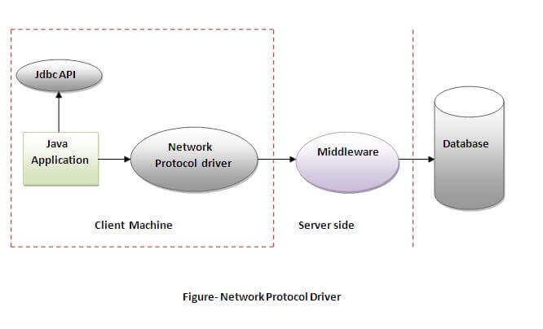
Network Protocol driver
The Network Protocol driver uses middleware (application server) that converts JDBC calls directly or indirectly into the vendor-specific database protocol. It is fully written in java.
Advantage:
No client side library is required because of application server that can perform many tasks like auditing, load balancing, logging etc.
Disadvantages:
Network support is required on client machine.
Requires database-specific coding to be done in the middle tier.
Maintenance of Network Protocol driver becomes costly because it requires database-specific coding to be done in the middle tier.

Slide 176
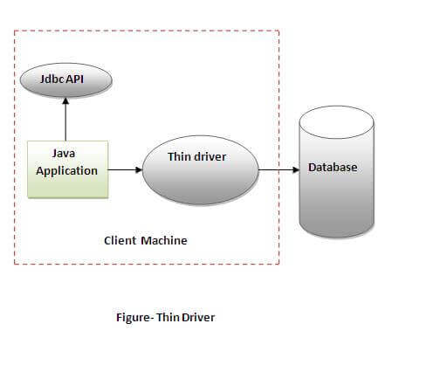
Thin driver
The thin driver converts JDBC calls directly into the vendor-specific database protocol. That is why it is known as thin driver. It is fully written in Java language. Advantage:
Better performance than all other drivers.
No software is required at client side or server side.
Disadvantage:
Drivers depend on the Database.

Slide 177
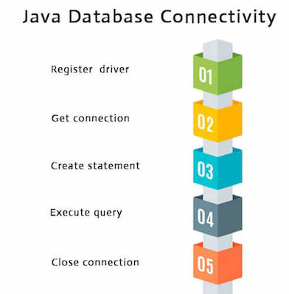
Database Connectivity with 5 Steps
There are 5 steps to connect any java application with the database using JDBC. These steps are as follows:

Slide 178
1) Register the driver class
The forName() method of Class class is used to register the driver class. This method is used to dynamically load the driver class.Syntax of forName() method
public static void forName(String className)throws ClassNotFoundException
Driver class: The driver class for the mysql database is com.mysql.jdbc.Driver.
Class.forName("com.mysql.jdbc.Driver");

Slide 179
2) Create the connection object
The getConnection() method of DriverManager class is used to establish connection with the database.
Syntax of getConnection() method
1) public static Connection getConnection(String url)throws SQLException
2) public static Connection getConnection(String url,String name,String password) throws SQLException
Connection URL: The connection URL for the mysql database is jdbc:mysql://localhost:3306/god where jdbc is the API, mysql is the database, localhost is the server name on which mysql is running, we may also use IP address, 3306 is the port number and god is the database name. We may use any database, in such case, we need to replace the god with our database name.
Connection con=DriverManager.getConnection( "jdbc:mysql://localhost:3306/god","root","root");

Slide 180
3) Create the Statement object
The createStatement() method of Connection interface is used to create statement. The object of statement is responsible to execute queries with the database.Syntax of createStatement() method
public Statement createStatement()throws SQLException
Example to create the statement object
Statement stmt=con.createStatement();

Slide 181
4) Execute the query
The executeQuery() method of Statement interface is used to execute queries to the database. This method returns the object of ResultSet that can be used to get all the records of a table.
Syntax of executeQuery() method
public ResultSet executeQuery(String sql)throws SQLException
Example to execute query
ResultSet rs=stmt.executeQuery("select * from emp");
while(rs.next()){
System.out.println(rs.getInt(1)+" "+rs.getString(2) + “ “ + rs.getInt(3));
}

Slide 182
5) Close the connection object
By closing connection object statement and ResultSet will be closed automatically. The close() method of Connection interface is used to close the connection.Syntax of close() method
public void close()throws SQLException
Example to close connection
con.close();

Slide 183
Java Database Connectivity with Oracle
Driver class: The driver class for the oracle database is oracle.jdbc.driver.OracleDriver.
Connection URL: The connection URL for the oracle10G database is jdbc:oracle:thin:@localhost:1521:xe where jdbc is the API, oracle is the database, thin is the driver, localhost is the server name on which oracle is running, we may also use IP address, 1521 is the port number and XE is the Oracle service name. You may get all these information from the tnsnames.ora file.
Username: The default username for the oracle database is system.
Password: It is the password given by the user at the time of installing the oracle database.

Slide 184
Example
Install MySQL
Create database god;
Use god;
create table emp(rno int,name varchar(30),age int);

Slide 185
Statement interface to insert, update and delete the record.
import java.sql.*;
class FetchRecord{
public static void main(String args[])throws Exception{
Class.forName(" com.mysql.jdbc.Driver ");
Connection con=DriverManager.getConnection(" jdbc:mysql://localhost:3306/god","root","root");
Statement stmt=con.createStatement();
//stmt.executeUpdate("insert into emp values(1,'Irfan',50000)");
//int result=stmt.executeUpdate("update emp set name='Vimal',salary=10000 where rno=1");
int result=stmt.executeUpdate("delete from emp where rno=1");
System.out.println(result+" records affected");
con.close();
}}

Slide 186
ResultSet
Class.forName(" com.mysql.jdbc.Driver ");
Connection con=DriverManager.getConnection(" jdbc:mysql://localhost:3306/god","root","root");
Statement stmt=con.createStatement();
ResultSet rs=stmt.executeQuery("select * from emp”);
while(rs.next()) {
System.out.println(rs.getInt(1)+" "+rs.getString(2)+" "+rs.getInt(3));
}
con.close();

Slide 187
PreparedStatement
import java.sql.*;
class InsertPrepared{
public static void main(String args[]){
try{
Class.forName(" com.mysql.jdbc.Driver ");
Connection con=DriverManager.getConnection(" jdbc:mysql://localhost:3306/god","root","root");
PreparedStatement stmt=con.prepareStatement("insert into emp values(?,?,?)");
stmt.setInt(1,1);//1 specifies the first parameter in the query
stmt.setString(2,"Ratan");
stmt.setInt(3,100000);
int i=stmt.executeUpdate();
System.out.println(i+" records inserted");
con.close();
}catch(Exception e){ System.out.println(e);}
}
}

Slide 188
Contd..
PreparedStatement stmt=con.prepareStatement("delete from emp where rno=?");
stmt.setInt(1,101);
int i=stmt.executeUpdate();
System.out.println(i+" records deleted");
PreparedStatement stmt=con.prepareStatement("select * from emp");
ResultSet rs=stmt.executeQuery();
while(rs.next()){
System.out.println(rs.getInt(1)+" "+rs.getString(2) + “ “ + getInt(3));
}

Slide 189
ResultSetMetaData
import java.sql.*;
class Rsmd{
public static void main(String args[]){
try{
Class.forName(" com.mysql.jdbc.Driver ");
Connection con=DriverManager.getConnection(" jdbc:mysql://localhost:3306/god","root","root");
PreparedStatement ps=con.prepareStatement("select * from emp");
ResultSet rs=ps.executeQuery();
ResultSetMetaData rsmd=rs.getMetaData();
System.out.println("Total columns: "+rsmd.getColumnCount());
System.out.println("Column Name of 1st column: "+rsmd.getColumnName(1));
System.out.println("Column Type Name of 1st column: "+rsmd.getColumnTypeName(1));
con.close();
}catch(Exception e){ System.out.println(e);}
}
}

Slide 190
Configuring
To connect java application with the mysql database, mysqlconnector.jar file is required to be loaded.
download the jar file mysql-connector.jar
Two ways to load the jar file:
Paste the mysqlconnector.jar file in jre/lib/ext folder
Set classpath
1) Paste the mysqlconnector.jar file in JRE/lib/ext folder:
Download the mysqlconnector.jar file. Go to jre/lib/ext folder and paste the jar file here.2) Set classpath:
There are two ways to set the classpath:temporary
permanent
How to set the temporary classpath
open command prompt and write:
C:>set classpath=c:\folder\mysql-connector-java-5.0.8-bin.jar;.;
How to set the permanent classpath
Go to environment variable then click on new tab. In variable name write classpath and in variable value paste the path to the mysqlconnector.jar file by appending mysqlconnector.jar;.; as C:\folder\mysql-connector-java-5.0.8-bin.jar;.;

