Slide 1




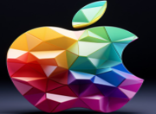
DATA SCIENCE
MICROSOFT
TESLA
APPLE
SHEIK ASHANUR RAHMAN

Slide 2
PROBLEMS STATEMEMT
What are the comparative descriptive statistic of the stock price of Microsoft, Tesla, and Apple?
What are the price trend of stock value showing charts?
What are the comparative value of Beta showing the progress of the stock and the risk value involved.
What are the regression model for the Microsoft, Tesla, and Apple

Slide 3

DESCRIPTIVE STATISTIC
&
MARKET BEHAVIOUR

Slide 4

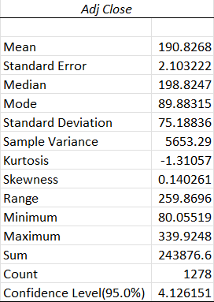
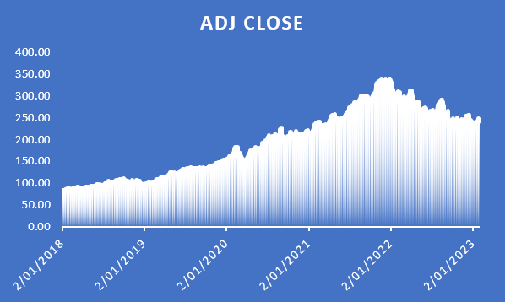
MICROSOFT
The Microsoft stock price has less than median price volatility and also no significance declines from 2018 to 2022 periods over 5years total. But it is clear shown that there is downward trend in future stock price after 2022 that will be impacted to the stock holder.

Slide 5

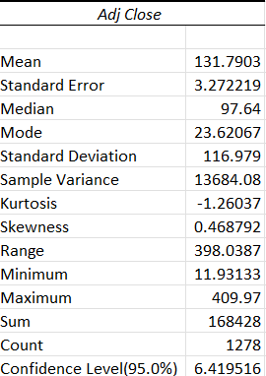
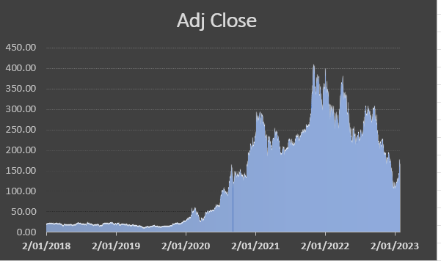
TESLA
The TESLA stock price has high price volatility, basically 2020 to 2022 and also very less significance declines from 2018 to 2020 periods with high growth over 5years total. But it is clear shown that there is vacillating downward trend in future stock price after 2022 that will be impacted to the stock holder.

Slide 6

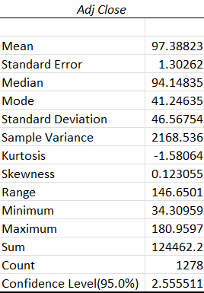
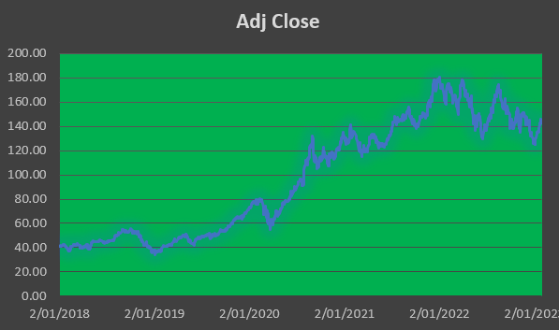
APPLE
The Apple stock price has high vacillating price volatility and also no significance declines from 2018 to 2022 periods over 5years total. But it is clear shown that there is downward trend in future stock price after 2022 that will be impacted to the stock holder.

Slide 7

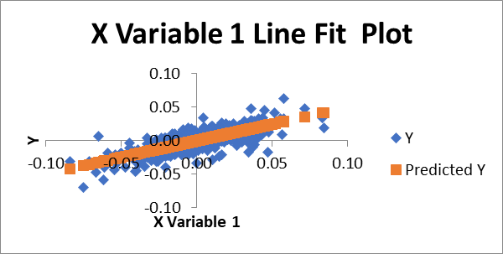
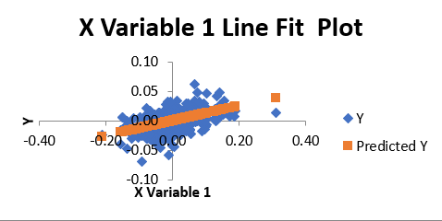
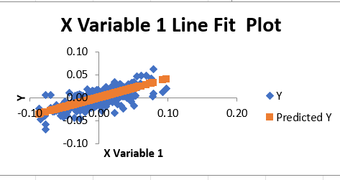
REGRATION ANALYSIS
Microsoft
Intercept -9.65313E-05
X Variable 1 0.494478178
Y= -0.000096 + 0.50 X
TESLA
Intercept 5.59603E-05
X Variable 1 0.12650446
Y= 0.000056 + 0.13 X
APPLE
Intercept -9.42198E-05
X Variable 1 0.410431143
Y= -0.000094 + 0.41 X

Slide 8


Conclusion:
We can find from the above that the value of beta are 0.50, 0.13, and 0.41 according of Microsoft, Tesla, and Apple. From this analysis, we can see that Apple is recommended for safe investors, Microsoft is for high risk investors, and Tesla is for medium investors.
This Photo by Unknown Author is licensed under CC BY

