Slide 1
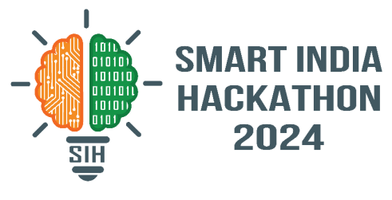
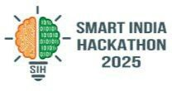
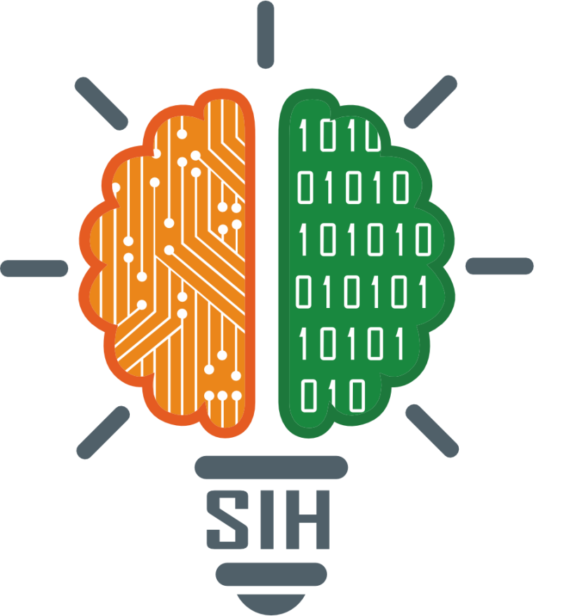
SMART INDIA HACKATHON 2024
TITLE PAGE
Problem Statement ID – SIH25134
Problem Statement Title - There is a need to design drones and robots that can solve some of the pressing challenges of India such as handling medical emergencies, search and rescue operations, etc
Theme - Robotics and Drones
PS Category - Software
Team ID -
Team Name – TEAM STARFLEET

Slide 2
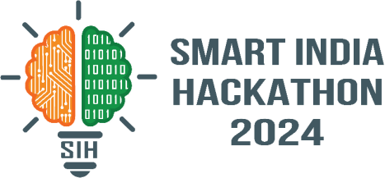
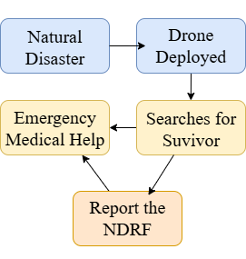
Red Dragonfly
TEAM
STARFLEET
PROPOSED SOLUTION
Detailed explanation : Developing autonomous drones and rugged robots equipped with AI, sensors, and real-time communication can deliver medical aid, locate victims, and support disaster rescue. These systems ensure rapid response, reduce human risk, and enhance India’s emergency preparedness capabilities.
How it addresses the problem:
Medical Emergency: Drones deliver essential supplies like, oxygen, and medicines within minutes, bypassing traffic and reaching remote villages.
Search & Rescue Operations: Thermal cameras, AI-based victim detection, and audio sensors on drones identify survivors under rubble.
Integration & Scalability: Scalable design allows deployment in both urban traffic scenarios and rural inaccessible regions.
The solution directly addresses the problem statement by using drones for speed and accessibility, and an integrated digital platform for coordination, making emergency handling and rescue faster, safer, and more reliable.
INNOVATION & UNIQUENESS
AI-powered Victim Detection: Uses multi-sensor fusion (thermal + visual + audio) with lightweight AI models to detect survivors.
Payload Customization: Drones are equipped with modular payload pods for medicines depending on the emergency type
Smart Dashboard & Analytics: Centralized command dashboard with live drone/robot feeds, GIS mapping, AI-based triage, and predictive analytics for decision-making and resource optimization during emergencies.

Slide 3
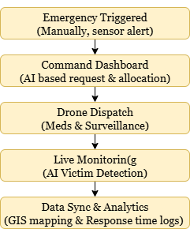








TECHNICAL APPROACH
TEAM STARFLEET
HARDWARE
TECHSTACK USED
FLOWCHARTF
Strong Plastic Frame
Brushless DC Motors (BLDC) – 935 KV
Propellers – 10-12 inch
Electronic Speed Controllers – 15-20 A
Flight Controller - Pixhawk
LiPo Battery 4s
Transmitter (TX) & Receiver (RX) – fs i10
GPS Module & Compass
Raspberry Pi
FPV Camera
Thermal Camera
Ground Support
Servo Motor – Hook/Drop
🚀 Frontend
Next.js, React, Tailwind CSS
🚀 Backend
Node.js, express.js, MongoDB Atlas
🚀 Dashboard & AI
Tensorflow Lite, Python, Mission Planner
🚀 Python Libraries
Numpy, math.lib, keras, scikit learn

Slide 4
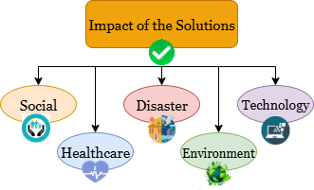
IMPACT AND BENEFITS
IMPACTS OF THE SOLUTIONS
Social
• Lives saved by reducing response times in accidents, and disasters.
• Helps people in remote villages, hilly areas, or flood-prone regions where ambulances struggle.
Healthcare
• First response within minutes – AEDs, medicines, and oxygen delivered much faster than conventional ambulances.
•Provides contactless services during pandemics to reduce infection spread.
Disaster Management Impact
• Drones provide real-time mapping of disaster-hit zones.
• Robots support search & rescue in collapsed or unsafe areas.
Environmental Impact
• Monitors forest fires, floods, landslides & pollution levels.
• Supports precision agriculture, reducing resource wastage.
Technological Impact
• Advances AI, IoT, robotics & drone technology.
• Opens opportunities for startups & MSMEs in robotics & automation
BENEFITS:
• Provides real-time mapping and surveillance of disaster-affected areas.
• Supports precision agriculture, cutting down water, fertilizer, and pesticide wastage.
• Reduces dependency on imported technologies by developing indigenous solutions.
• Helps in wildlife monitoring, habitat protection, and anti-poaching efforts.
• Improves overall emergency response speed, directly saving lives.
•Promotes sustainability and efficient resource management
5

Slide 5
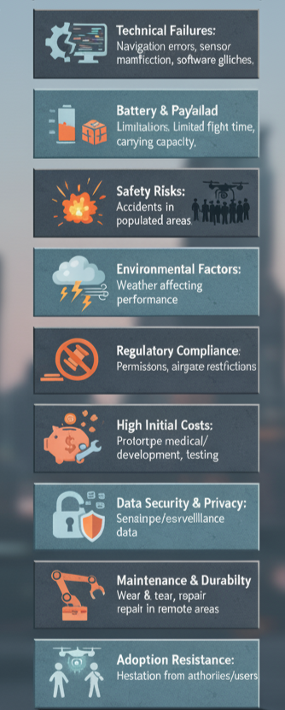
TEAM STARFLEET
FEASIBILITY AND VIABILITY
Feasibility of the idea
Potential challenges and risks
MARKET SIZE
Affordable & Scalable – Low-cost drone and robotic solutions can be developed using indigenous tech
Wide Applications – One design can be adapted for healthcare, disaster relief, agriculture, and environment.
Supportive Ecosystem – Govt. initiatives like Drone Shakti and Atmanirbhar Bharat encourage adoption.
Existing Tech Base – India already has drone policies, AI & IoT infrastructure to build on.
Market Demand: High need in healthcare, disaster management, agriculture, and environmental monitoring
Government Support: Backed by policies Atmanirbhar Bharat.
Commercialization: Viable as a startup model with applications in public and private sectors.
Research & identify key use-cases
Design modular prototype (drones/robots)
Develop hardware + software integration
Test in lab & controlled field environments
Optimize battery, payload & autonomy
Category | Converted Value (INR) (Approx. at 1 USD = ₹83)
Drone Market | 6,90,000 Crore
Commercial Market | 1,43,000 Crore
Industrial Robotics | 3,15,000 Crore
Collaborative Robots | 46,000 Crore
Advanced Robotics | 4,42,000 Crore
Viability
Implementation

Slide 6
RESEARCH AND REFERENCES
THE TEAM CODEX
ARTICLES & RESEARCH PAPER
1. Application of drone in disaster management: A scoping review – Article
2. Telecommunication Engineering Centre Department of Telecommunications Ministry of Communications Government of India – Use cases of drones in disaster management
3. National Institute of Health – Steps to build a DIY low-cost fixed-wing drone
4. IIT Madras – Drone Design and fabrication

