Slide 1
Team Halen
Mid Project report

Slide 2
Progress made till now
Real time feature extractor coded up. It takes the video as the input and tracks the feature points and outputs in which direction the camera has to move – left or right.
The same can be seen here:
https://iiitaphyd-my.sharepoint.com/:v:/g/personal/sarat_chandra_research_iiit_ac_in/EZw5OznYhgdOqbn3tmjXBeMBGAgI1ByCBmTZsP5jF7-VvA

Slide 3
Gazebo simulation to check the FeatureExtractor in different simulated worlds. The simulated robot is equipped with a camera that broadcasts live feed of the surroundings. We need to make the camera joint revolve as of now. Hasn’t been done yet due lot of ambiguity in reference sites and different notations.

Slide 5
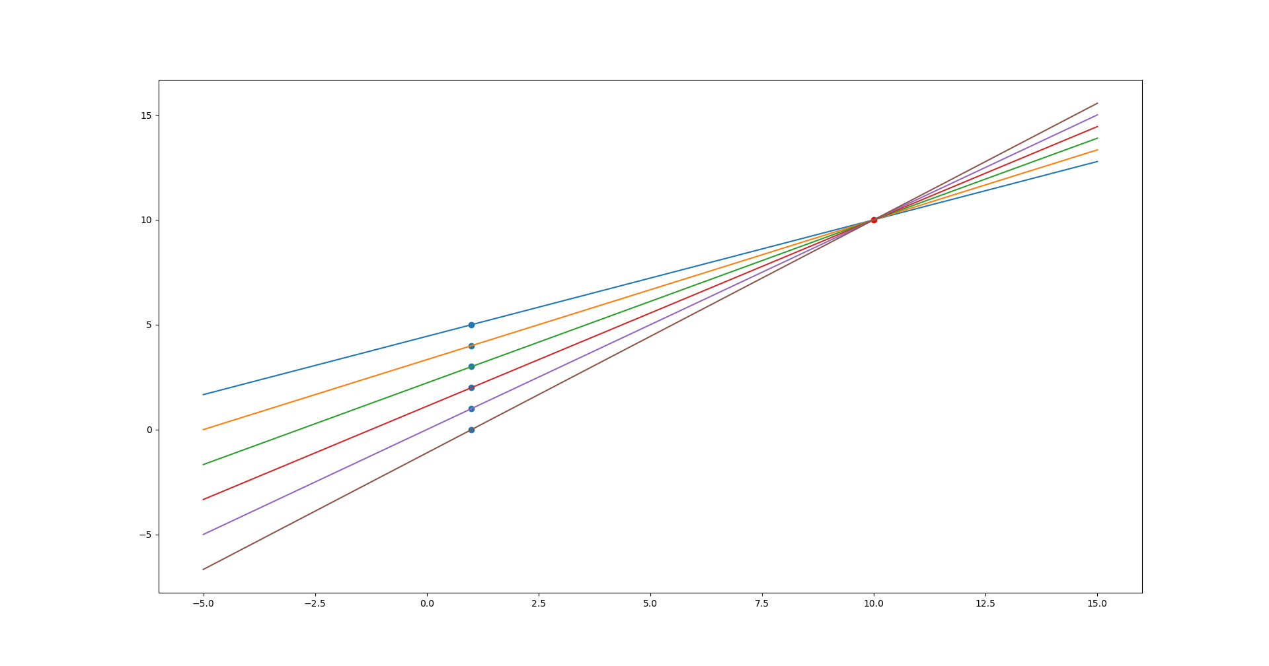
When we get different odometries from gazebo, the mapper function maps out the feature points.

Slide 6
Challenges now -
Unfamiliarity with urdf modification to achieve desired motion in camera joints.
Plan Ahead:
Extending from 2D to 3d mapper.
Implementation in gazebo, modifying urdf file.
Implementation of SLAM using standard libraries and comparison of results.

