Slide 1
Timescales methods comparison

Slide 2
4 datasets
ISI_full: standard ISI method, whole timeseries, task-agnostic
ISI_ac: Murray method, using 1 second immediately preceding task start
ISI_rest: standard ISI method only using spikes during ITI
ISI_task: standard ISI method only using spikes during active task behavior
NB: didn’t re-run human neurons bc of poor data organization

Slide 3
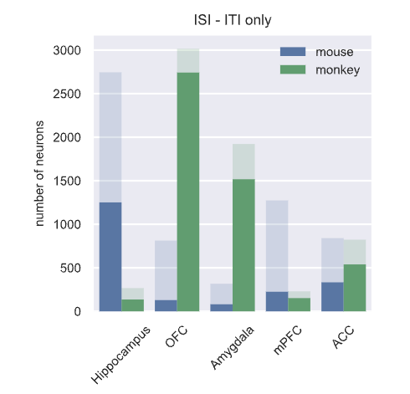
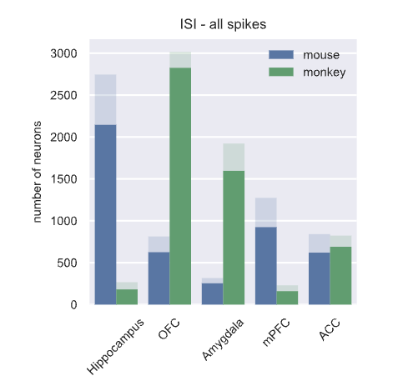
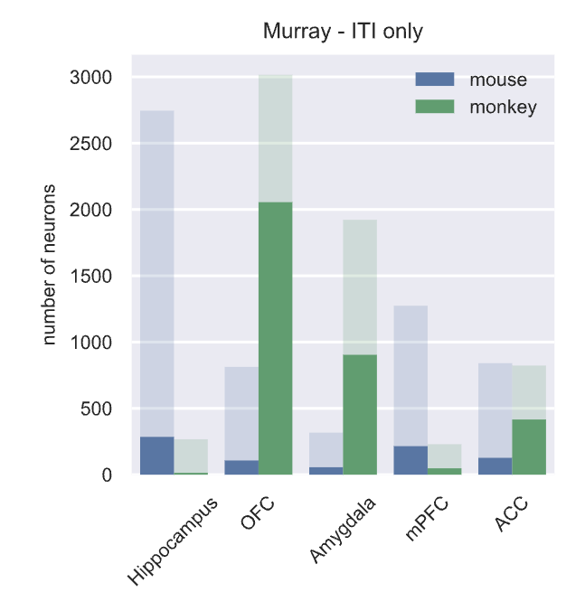
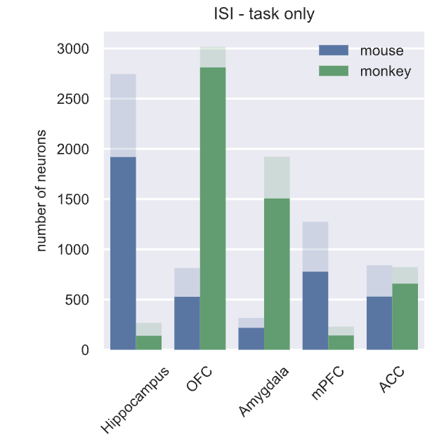
Notes:
* Get numbers

Slide 4
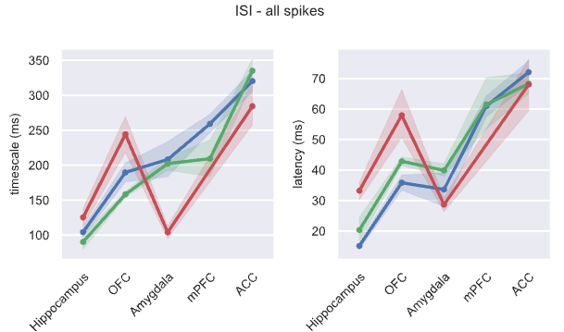
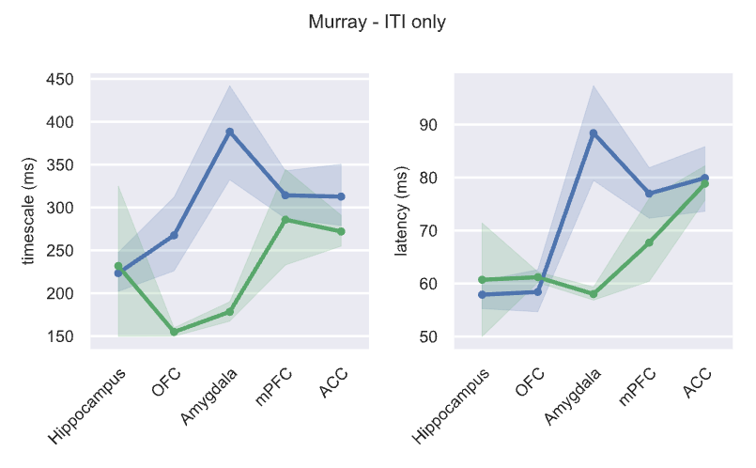
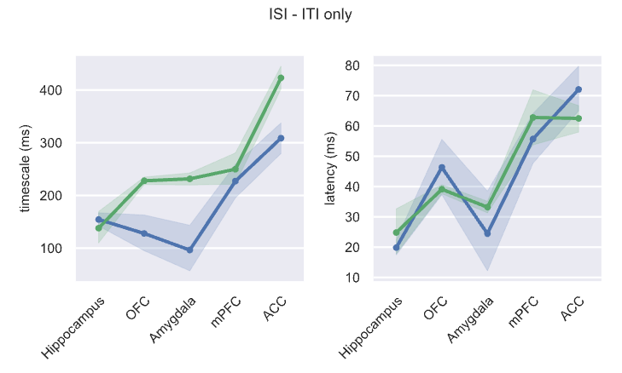
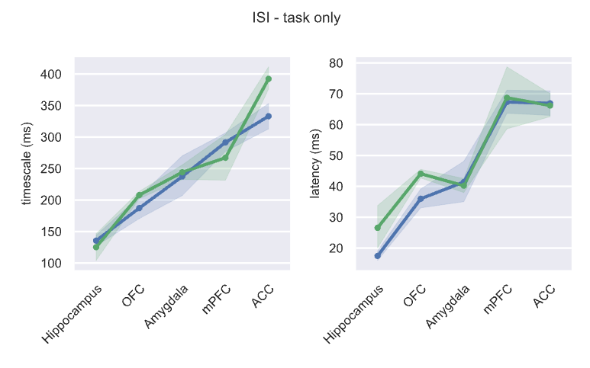
Hierarchies are maintained (for ISI, at least)

Slide 5
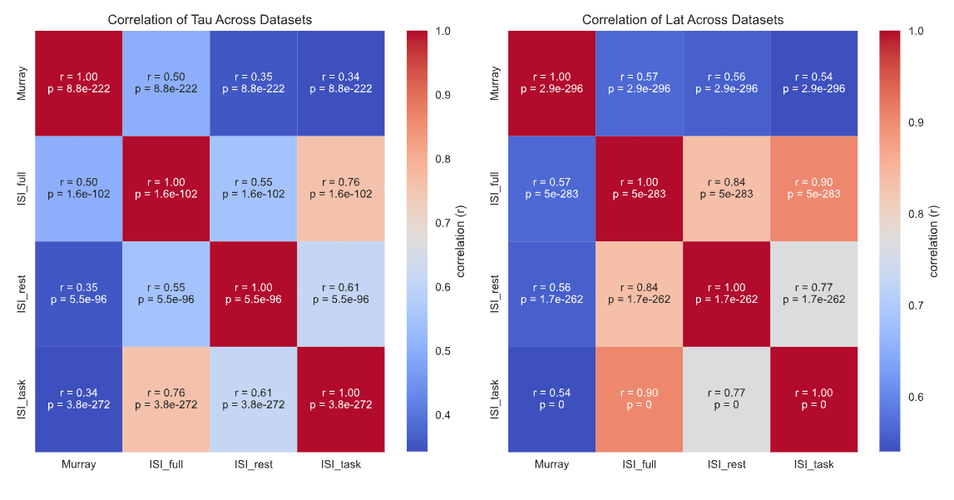
All methods are significantly correlated

Slide 6
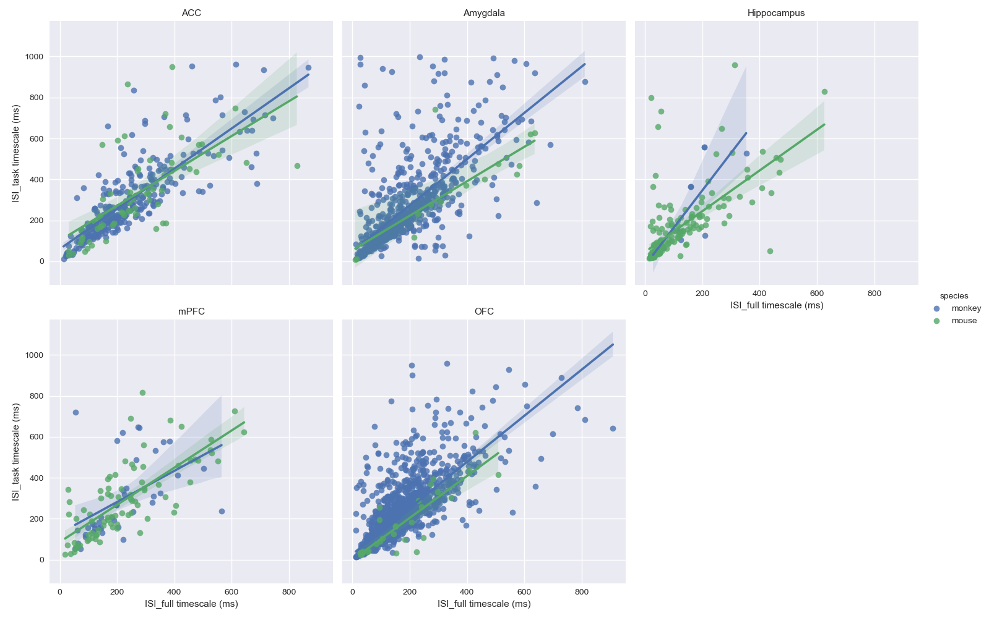
ISI_full and ISI_task are nearly perfectly correlated

Slide 7
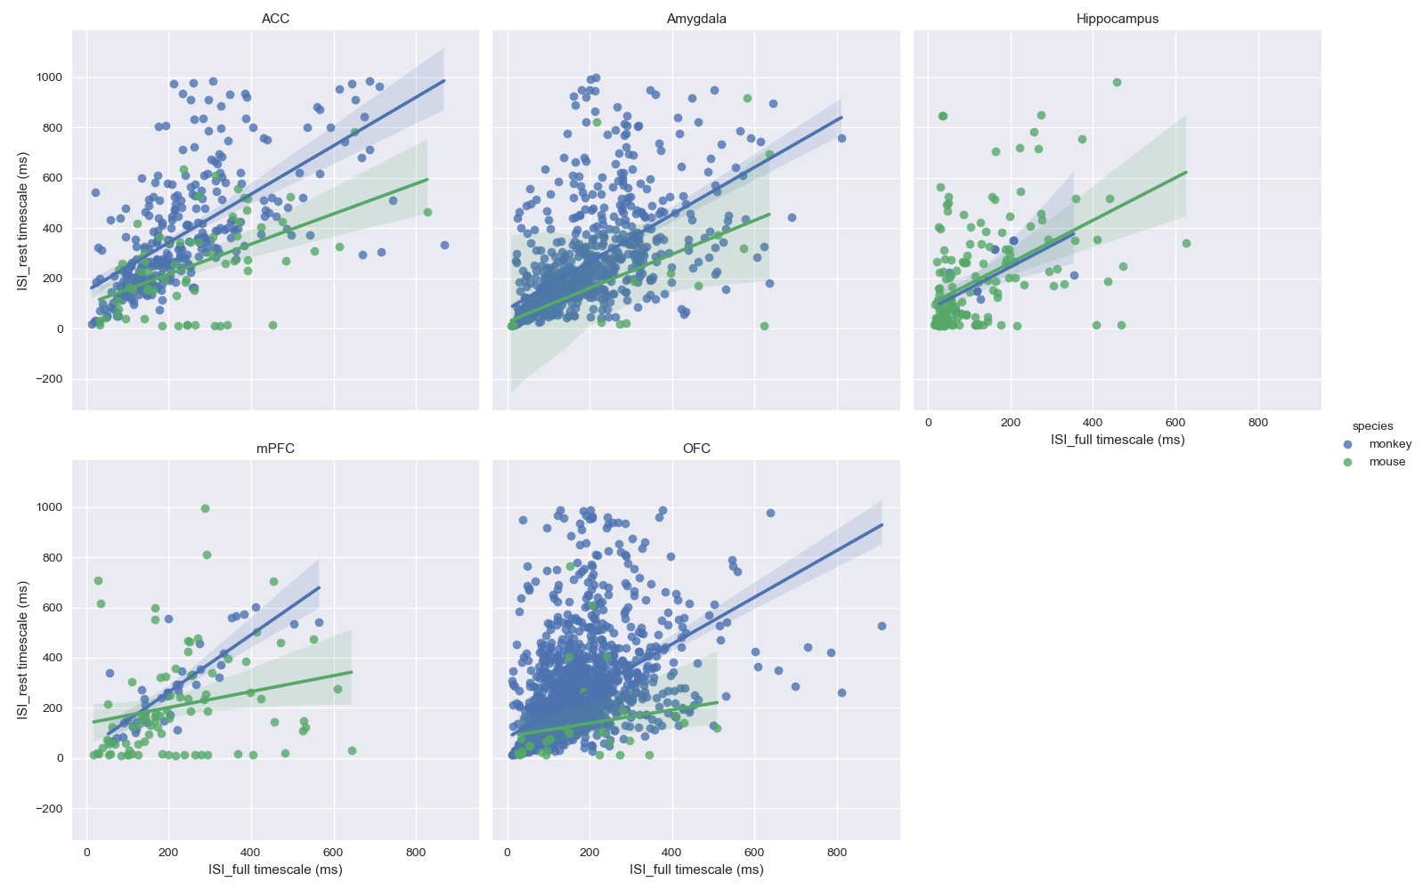
ISI_full and ISI_rest are well, but not perfectly, correlated

Slide 8
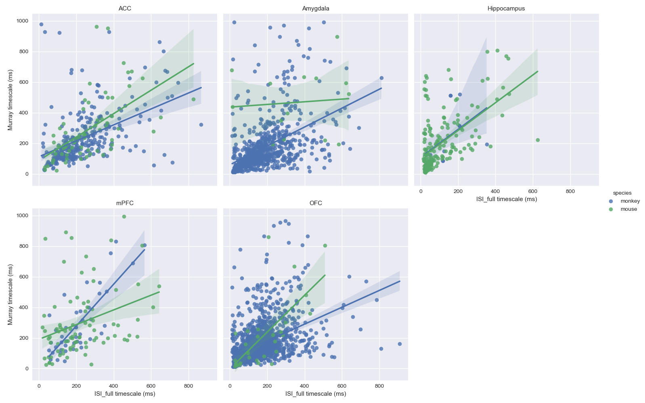
ISI_full and Murray are poorly correlated bc of few fit units

