Slide 1
Employee Data Analysis using Excel
STUDENT NAME: RUDHINA M
REGISTER NO: 2213331042135
DEPARTMENT: B.COM
COLLEGE: Bharathi women's college

Slide 2
PROJECT TITLE
Employee Attendance analysis using Ms excel

Slide 3


AGENDA
Review of Attendance Data
Identification of Attendance Trends
Impact on Business Operations
Employee Feedback and Concerns
Attendance Policy Review
Strategies for Improvement
Action Plan and Goal Setting
3/21/2024 Annual Review

Slide 4

Review of Attendance Data
Total absences: 150 days in the last quarter
Top reasons for absences: illness, family emergencies, and transportation issues
Average days lost per employee: 10 days/year

Slide 5

Identification of Attendance Trends
.
- Peak absence times: Mondays and Fridays
- Departments with highest absenteeism: Sales and Marketing
- Common absence patterns: consecutive days off

Slide 6

Impact on Business Operations
- Productivity loss: 10%
- Overtime costs: $10,000
- Customer satisfaction impact: 5% decrease
- Employee morale impact: 10% decrease

Slide 7

Employee Feedback and Concerns
- Common concerns:
- Flexible work arrangements
- Additional leave days
- Support for health and wellness
- Recognition and rewards

Slide 8
Attendance Policy Review
- Current policy strengths:
- Clear expectations
- Fair consequences
- Current policy weaknesses:
- Limited flexibility
- Inconsistent enforcement

Slide 9

Strategies for Improvement
- Flexible work arrangements
- Employee wellness programs
- Recognition and rewards
- Improved communication and feedback
- Attendance incentives
3/21/2024 Annual Review
9

Slide 10
Action Plan and Goal Setting
- Goal: Reduce absenteeism by 5% in the next quarter
- Objectives:
- Implement flexible work arrangements
- Launch employee wellness program
- Develop recognition and rewards system
- Timeline:
- Month 1: Implement flexible work arrangements
- Month 2-3: Launch wellness program
- Month 4: Develop recognition system
10

Slide 11
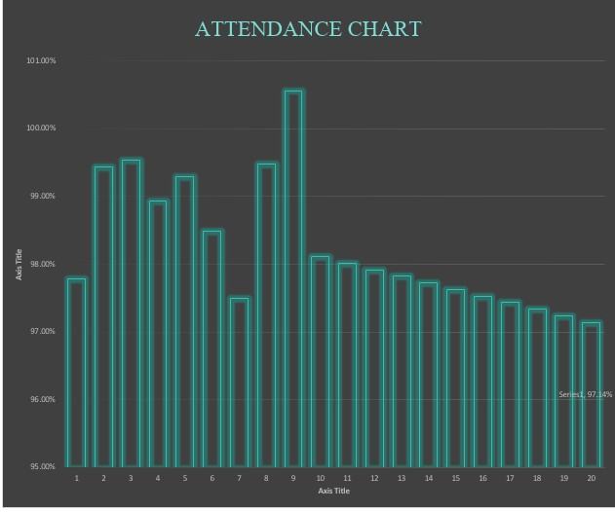
RESULTS
11

Slide 12
conclusion
"In conclusion, our attendance analysis highlights areas for improvement. We will address root causes, implement new initiatives, and support employee well-being to reduce absenteeism and boost productivity. Let's work together to create a more supportive and productive

Slide 13
Thank you

