Slide 1
INDUSTRIAL ORIENTED MINI PROJECT
3-2 SUMMER INTERNSHIP
Parkinson’s disease classification using machine learning
Presented by
P. Rudhir Babu-17311A12G0
M. Babu Rao – 17311A12G1
Section:ITF3

Slide 2
Contents
Abstract
Architecture
• Problem Statement
• Data Set
• Steps used to solve the problem • Results
• Statistical test
• Conclusion

Slide 3
Abstract
Abstract:
Parkinson’s Disease is one of the most wide spread diseases in elderly people. This disease largely limits the patient’s movement and speech abilities. The patient develops a tendency to fall frequently hence, ending up hurt with various injuries. Thus, it is very important to monitor and notify either the patients or their caregivers about the severity of the disease. This work showcases a comparative study of the various datasets, algorithms and techniques available for the classification of Parkinson’s Disease. This project aims to apply multiple algorithms for classification on UCI Spiral dataset for Parkinson’s Disease.
The data set of Parkinson’s patient is available from the UCI repository and classification algorithms are applied for classifying the healthy patients from the people having Parkinson’s disease using a set of voice recording values as the attributes of the data set.
Existing System:
The existing system uses Support Vector Machine (SVM) one of the main issues with this is that it need the data to be linearly separable. The system also does not provide enough preprocessing and visualization or Exploratory Data Analysis(EDA).

Slide 4
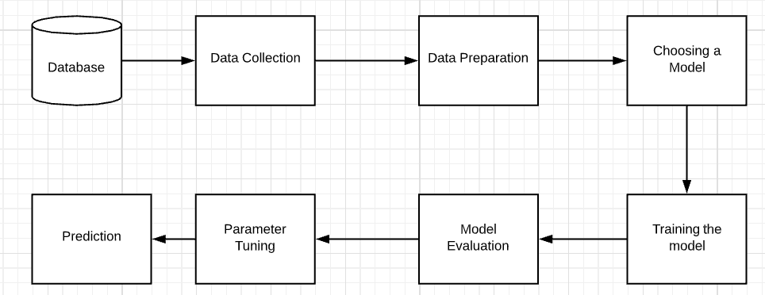
Architecture

Slide 5
Problem Statement
Parkinson’s disease is neurodegenerative disorder that affects millions of people
around the globe. Detecting Parskinson’s disease at an earlier stage could help to better diagnose the disease.
This disease largely limits the patient’s movement and speech abilities. The patient develops a tendency to fall frequently hence, ending up hurt with various injuries.Thus, it is very important to monitor and notify either the patients or their caregivers about the severity of the disease.
Popular machine learning algorithms are applied on the given dataset so as to classify people whether they are affected or not.

Slide 6
Dataset
• We have use Spiral dataset for Parkinson’s Disease.
Our dataset is from Kaggle listed under the name “Parkinson’s Disease Classification” and it initially included about 3 million data points. It contained 27 features and 1 label which can be examined . Two data points from the unprocessed dataset We processed some of the existing features, created new features that we thought could be useful for prediction and discarded some features using the library Pandas.

Slide 7
Dataset information
The PD database consists of training and test files. The training data belongs to 20 PWP (6 female, 14 male) and 20 healthy individuals (10 female, 10 male) who appealed at the Department of Neurology in Cerrahpasa Faculty of Medicine, Istanbul University. From all subjects, multiple types of sound recordings (26 voice samples including sustained vowels, numbers, words and short sentences) are taken. A group of 26 linear and time frequency based features are extracted from each voice sample. UPDRS ((Unified Parkinson’s Disease Rating Scale) score of each patient which is determined by expert physician is also available in this dataset. During the collection of this dataset, 28 PD patients are asked to say only the sustained vowels 'a' and 'o' three times respectively which makes a total of 168 recordings. The same 26 features are extracted from voice samples of this dataset. This dataset can be used as an independent test set to validate the results obtained on training set.

Slide 8
Steps used for solving the problem
Read the Input dataset.
Perform all necessary Data Normalization, Standardization processing to prepare the transformed format of given input dataset.
Impute Missing values
Perform Exploratory Data Analysis/Visualization and bring insights of the predictor variables.
Apply Logistic Regression Classification, Gaussian Naïve bayes and Decision tree classifier by splitting data into train and test.
Measure the Performance of model using K-fold Cross Validation and obtain the values of Accuracy, Precision and Recall.
Apply statistical test to explain the goodness of fit.

Slide 9
Dataset
• Read the Input dataset.
The shape of the dataset is: (1208,29)
After the test and train concatenation respective columns in the dataset are:
column1:Subject_id colum2-27:features features1-5:Jitter(local), Jitter(local,absolute), Jitter(rap), Jitter(ppq5), Jitter(ddp), features6-11:
Shimmer(local),Shimmer(local,dB),Shimmer(apq3),Shimmer(apq5),Shimmer(apq11),Shimmer(dda), features12-14:AC,NTH,HTN, features15-19:Median_pitch,Mean_pitch,Standard_deviation,Minimum_pitch,Maximum_pitch, features 20-23: Number of pulses, Number of periods, Mean period, Standard deviation of period,
features 24-26: Fraction of locally unvoiced frames, Number of voice breaks, Degree of voice breaks
column28:UPDRS column 29: class information

Slide 10

loading the dataset
The first step you should be doing is to load the dataset in an object.
.read_csv() is a method in pandas to load a csv file.
we will find the dataset loaded in an object df below.
df = pd.read_csv(‘Parkinsons_data.csv' )

Slide 11
Missing impute values
Replacing Outliers with median values
In this technique, we replace the extreme values with median values. It is advised to not use mean values as they are affected by outliers. The first line of code below prints the 50th percentile value, or the median, which comes out to be 140. The second line prints the 95th percentile value, which comes out to be around 326. The third line of code below replaces all those values ' variable, which are greater than the 95th percentile, with the median value. Finally, the fourth line prints summary statistics after all these techniques have been employed for outlier treatment.

Slide 12
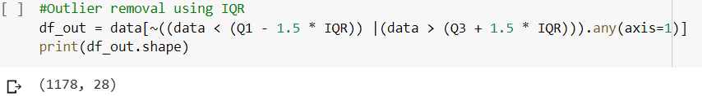
Contd..
Contd..
Therefore we have replaced all the outlier values with median values.And again we are performing the Interquantile range method to sort out the data without outliers and storing it into a new dataframe named ‘df_out’.

Slide 13
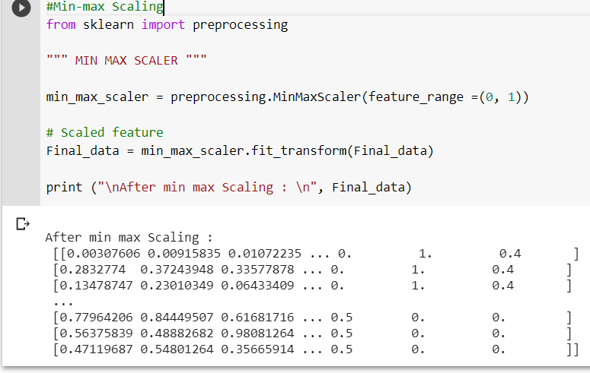
t
Normalization
Min-max feature scaling:
Min-max normalization is one of the most common ways to normalize data. For every feature, the minimum value of that feature gets transformed into a 0, the maximum value gets transformed into a 1, and every other value gets transformed into a decimal between 0 and 1.

Slide 14
Visualization
• figures/histograms/charts/heatmaps.
observations from the visualizations.

Slide 15
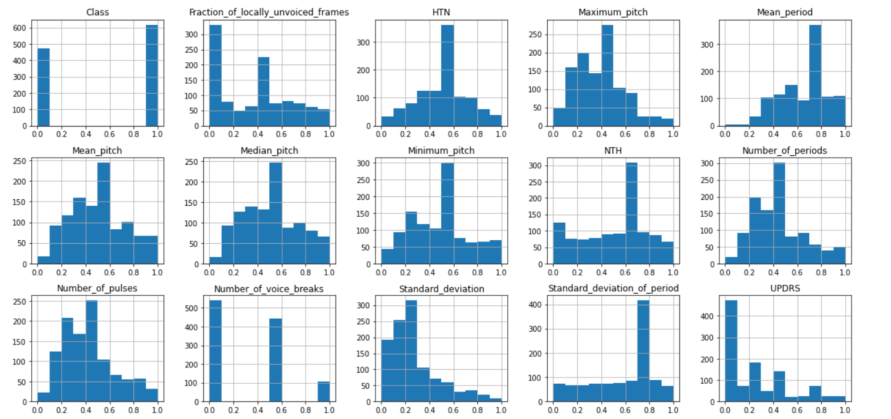

Slide 16
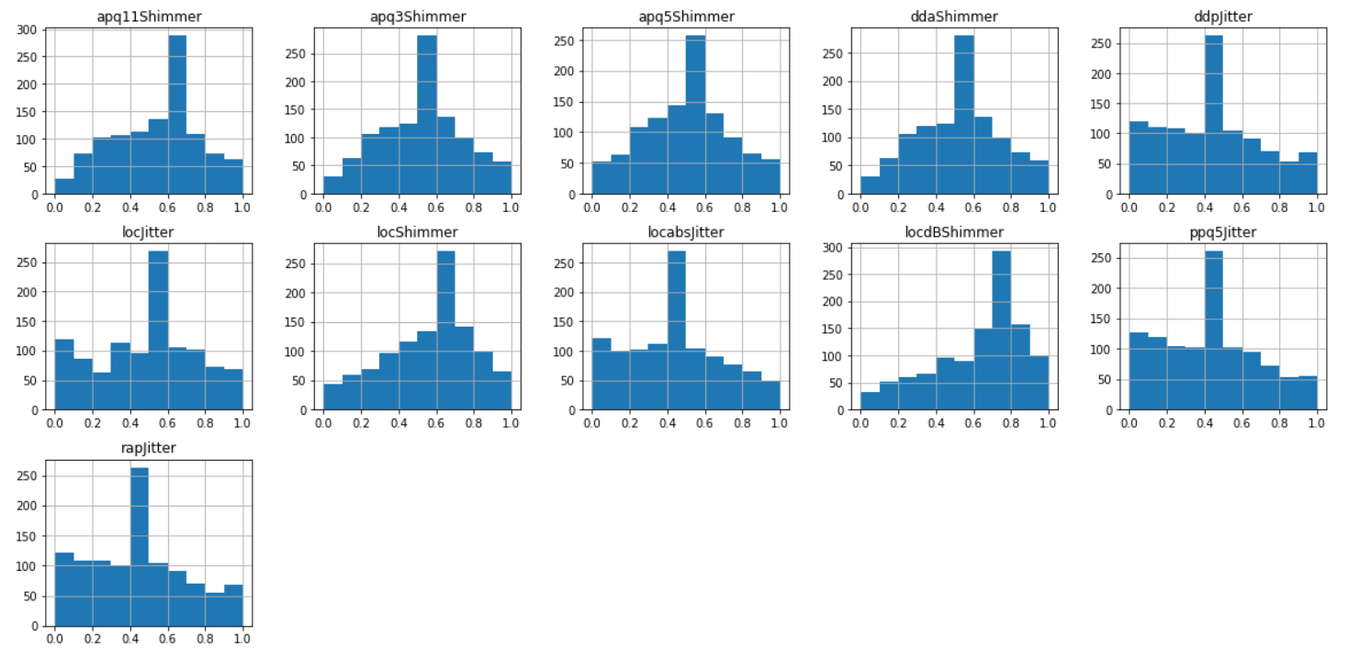

Slide 17
Feature Selection
Feature Selection is the process where you automatically or manually select those features which contribute most to your prediction variable or output in which you are interested in.
Having irrelevant features in your data can decrease the accuracy of the models and make your model learn based on irrelevant features.
Sequential forward selection (SFS):
First, the best single feature is selected (i.e., using some criterion function). • Then, pairs of features are formed using one of the remaining features and this best feature, and the best pair is selected.
For performing this operation we have to import ‘SequentialFeatureSelector’ from mlxtend.featureselection and we are applying the prediction plot based on Linear regression classifier with kfeatures.

Slide 18
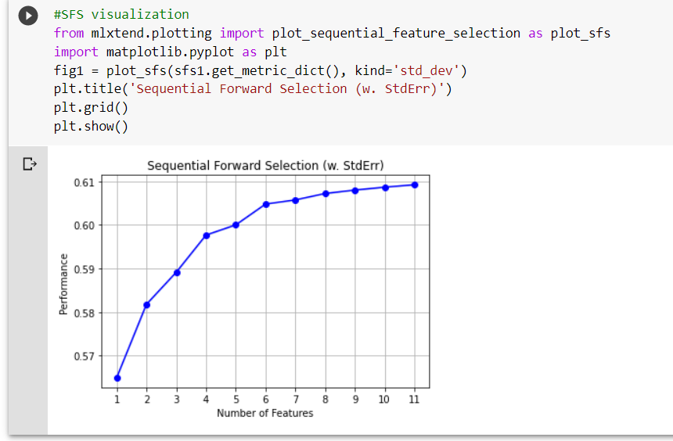
Contd..
As it is resulting only the n features we also have to verify the curse of dimensionality point, by plotting features one at a time on X-axis vs ‘Class’ target label on the Y-axis.
For performing this operation we have to import ‘SequentialFeatureSelector’ from mlxtend.featureselection and we are applying the prediction plot based on classifier with kfeatures.

Slide 19
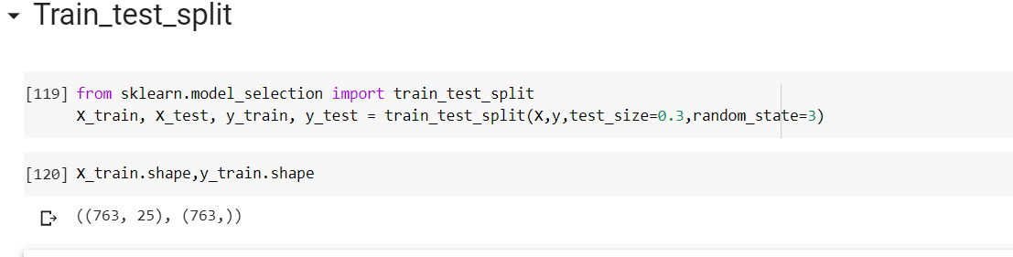
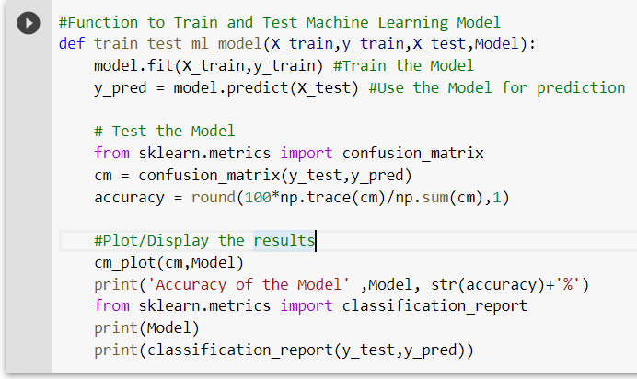
Data_split and function declaration
Function declaration
Function to Train and Test Machine Learning Model
Importing the necessary packages

Slide 20
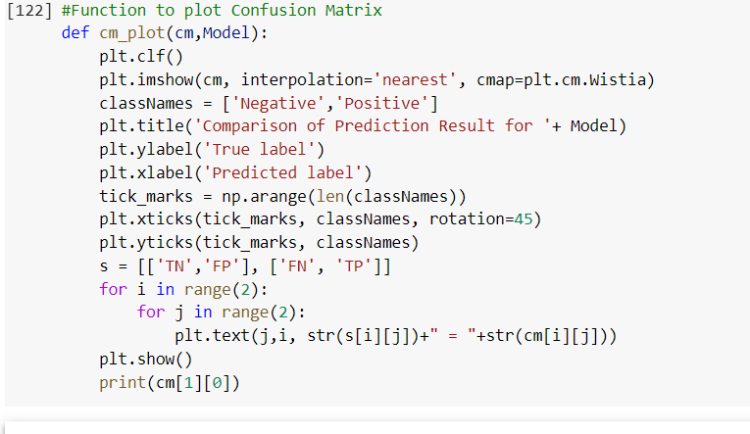
The above defined functions will fit the corresponding classification Model given in the function calling, thus fit(X_train,y_train) function will train the machine with percentage of training sample data once it is invoked with ‘model’ .we are plotting confusion matrix and calculating accuracy.

Slide 21
Applying Classification algorithms
• We have applied the following algorithms
Logistic Regression Classifier
Gaussian Naïve Bayes Classifier
Decision tree classifier

Slide 22
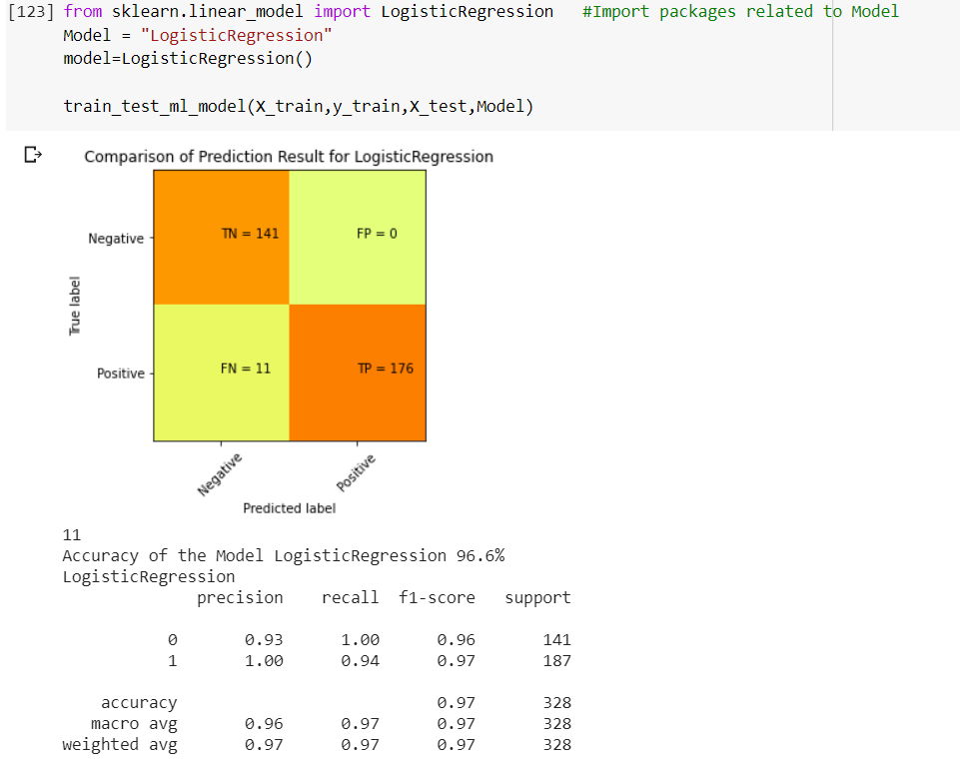
1.Logistic Regression
1.Logistic Regression
Logistic regression is a classification algorithm used to assign observations to a discrete set of classes. Logistic regression transforms its output using the logistic sigmoid function to return a probability value.

Slide 23
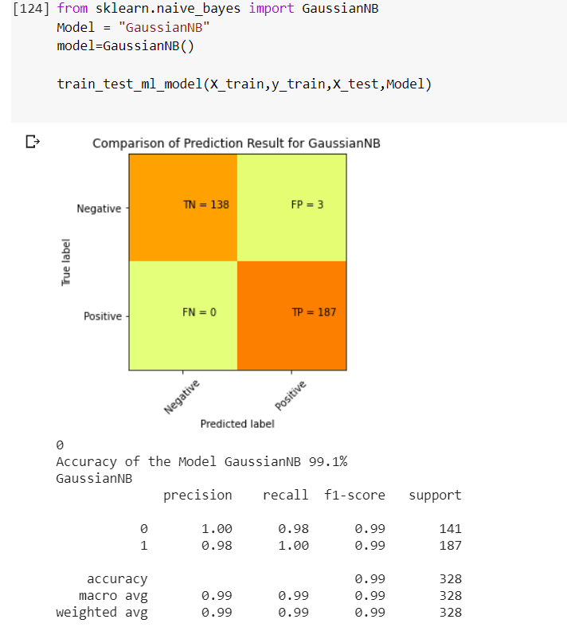
2.Gaussian Naive Bayes Classifier
Naive Bayes classifiers are a collection of classifications algorithms based on Bayes’ Theorem. Its a family of algorithms
where all of them share a common principle, i.e. every pair of features being classified are independent of each other.

Slide 24
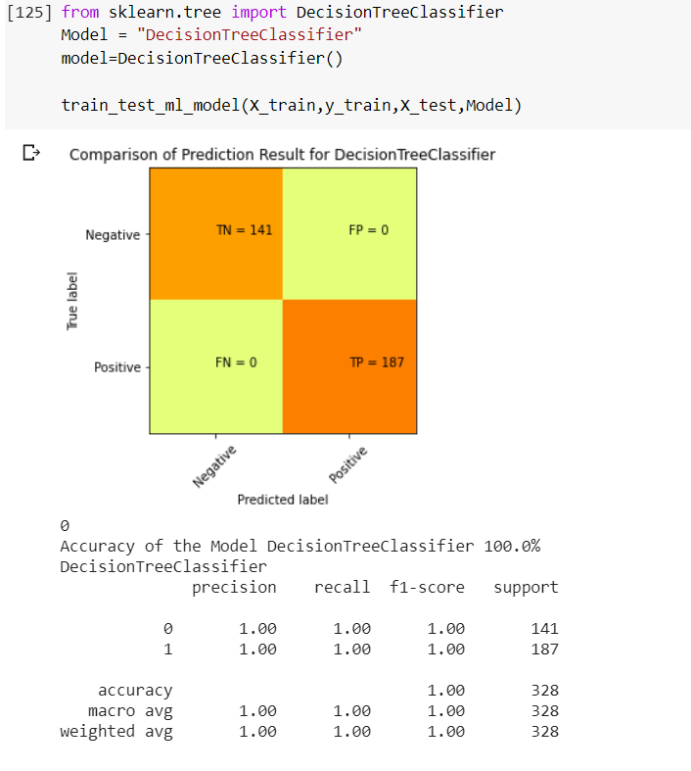
3.Decision Tree Classifier
The decision criteria are different for classification and regression trees. Decision trees use multiple algorithms to decide to split a node into two or more sub-nodes. ... The decision tree splits the nodes on all available variables and then selects the split which results in most homogeneous sub-nodes.

Slide 25
Results
Algorithm | Accuracy | Precision | Recall | F-score
Logistic Regression | 0.97 | 1.00 | 0.94 | 0.97
Gaussian Naïve Bayes | 0.99 | 0.98 | 1.00 | 0.99
Decision tree Classifier | 1.00 | 1.00 | 1.00 | 1.00

Slide 26
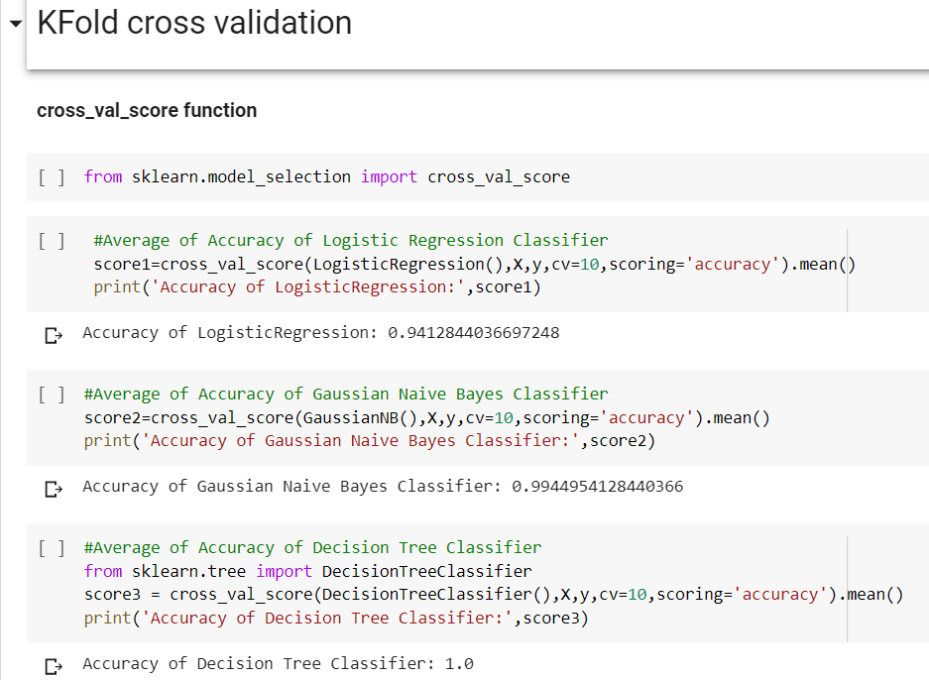
K Fold Cross validation
k-Fold Cross-Validation. Cross-validation is a resampling procedure used to evaluate machine learning models on a limited data sample. The procedure has a single parameter called k that refers to the number of groups that a given data sample is to be split into.
Parameter tuning using k fold cross validation.

Slide 27
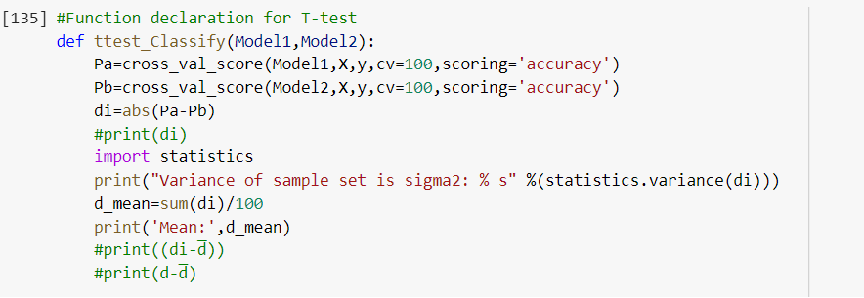
Statistical test
Comparing the performance of machine learning (ML) methods for a given task and selecting a final method is a common operation in applied ML.
The purpose of this post is to, initially, demonstrate why we need to use statistical methods for choosing the final model. Then, it explains why one the frequently used statistical hypothesis tests (i.e., paired Student’s t-test) is inadequate for comparing the performance of ML models. Finally, this post demonstrates how the corrected version of the paired Student’s t-test can be implemented for examining the performance of ML models.

Slide 28
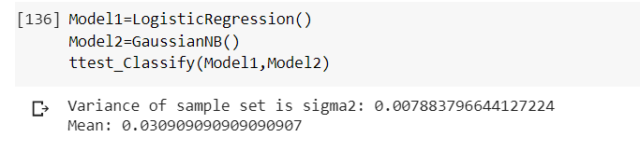
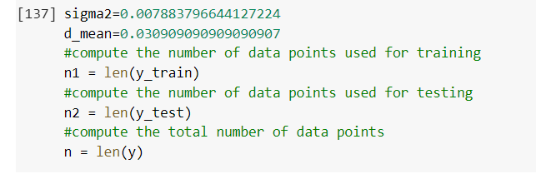
Contd..

Slide 29
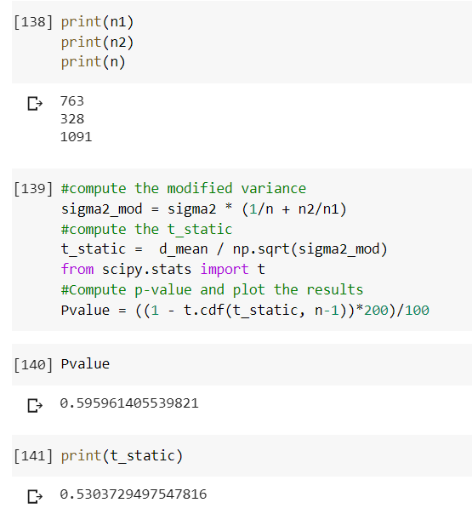
Contd..

Slide 30
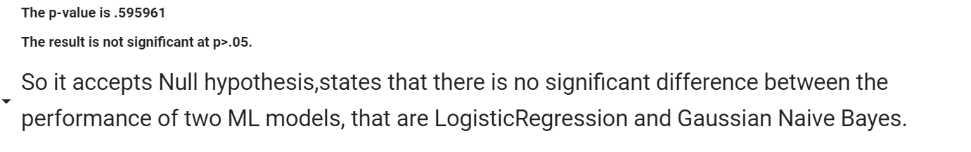
Conclusion

Slide 31
Summary
• Problem Statement: To detect if a person has Parkinson’s disease or not using multiple type of sound recordings.
All the models are compared using a table where the accuracy, precision, recall and F-score has been
mentioned. Although Gaussian Naive Bayes has the highest accuracy value, the T-test will confirm which model is best fit for the given dataset.
Dataset: The dataset consists of: Train:(1040,29) Test:(168,28)
Steps used to solve the problem:Based on the least RMSE value of the particular algorithm, the data used was normalized or standardized or raw.
Results: T – test: The T-Test is performed between all the models taken two at a time and the only set where the null hypothesis was accepted is when the test was performed between Naive bayes and Logistic Regression .
Conclusion: Hence, Logistic Regression and Naive Bayes are our best fit model.

