Slide 1
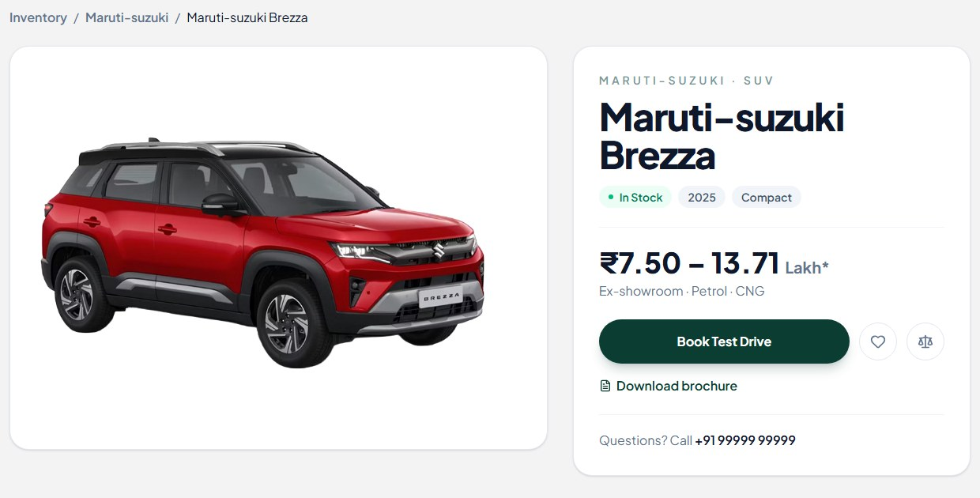
DIGITAL SHOWROOM PLATFORM
VirtualDrive
Your cars, available online: from the first look to a booked car
INSIDE THIS PRESENTATION
01 The challenge
04 Your team’s control
02 The VirtualDrive solution
05 Getting started
03 The customer journey
06 Future scope
PRODUCT OVERVIEW | OCTOBER 2026
Notes:
Welcome everyone. In the next 20 minutes I will show you how a customer can discover, explore, test drive and book your cars online, and how your team stays in control of everything customers see. No technical knowledge is needed. I'll only touch on how the information is stored, in one short slide.

Slide 2



Buying a car still takes too many steps
Many showroom visits
Unclear final price
Test drives by phone
Buyers travel to see, compare and ask the same questions again and again.
The number on the brochure is rarely the number on the bill.
Calls, callbacks and waiting just to fix a time to drive.
Every extra step is a chance for a serious buyer to give up. We remove the steps.
Notes:
Start from the buyer's point of view. Ask the room: how many times does a buyer visit before deciding? Then land the point: each extra step is a place where we can lose a customer.

Slide 3




VirtualDrive is a digital showroom for your cars
1 Discover
2 Explore
3 Try
4 Book
Find the right car by budget, fuel and body type
Price, specs, brochure, 360° view and colours
Book a test drive at a time and place they choose
Reserve the car with a small online payment
All of it online, from a phone or laptop, at any hour. Let's walk through what the customer sees.
Notes:
This is the whole product in four steps. The next slides show each one with real screens from our working website.

Slide 4
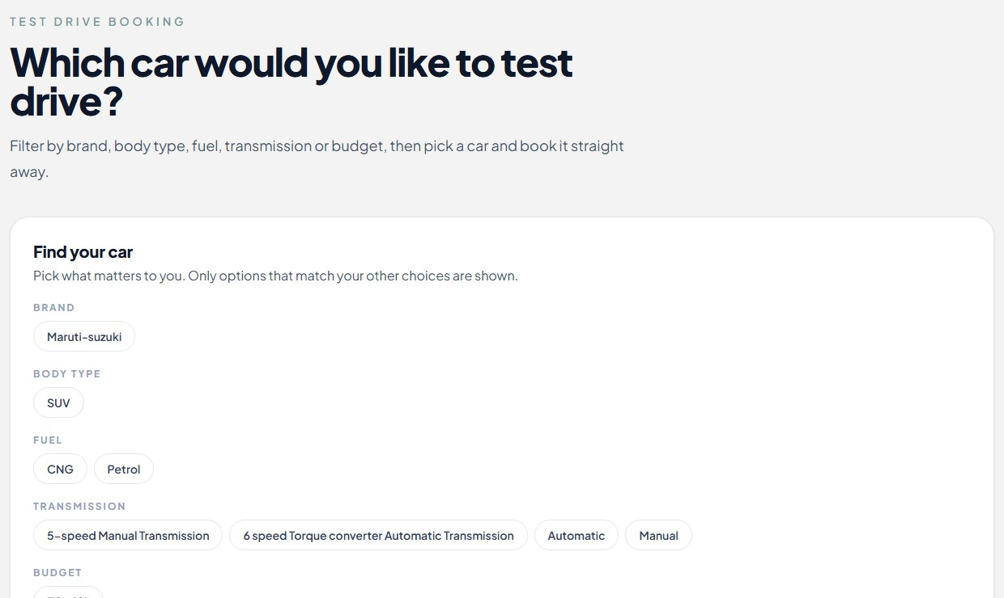
Step 1: Find the right car in seconds
Pick what matters
Brand, body type, fuel, transmission and budget.
No dead ends
Only options that match their other choices are shown.
Straight to booking
From the result, one click to book a test drive.
Notes:
Real screen. The customer narrows down by what matters to them. Notice there are no empty results: filters only offer combinations that exist in your catalogue.

Slide 5
Step 2: See the price, the details and the brochure
Clear pricing up front
Price range and fuel options at the top of the page.
Availability at a glance
In-stock status and model year.
One click to act
Book a test drive or download the official brochure.
Notes:
Everything a buyer wants in the first screen: price, whether it is available, and what to do next. The brochure is your own document, uploaded by your team.

Slide 6
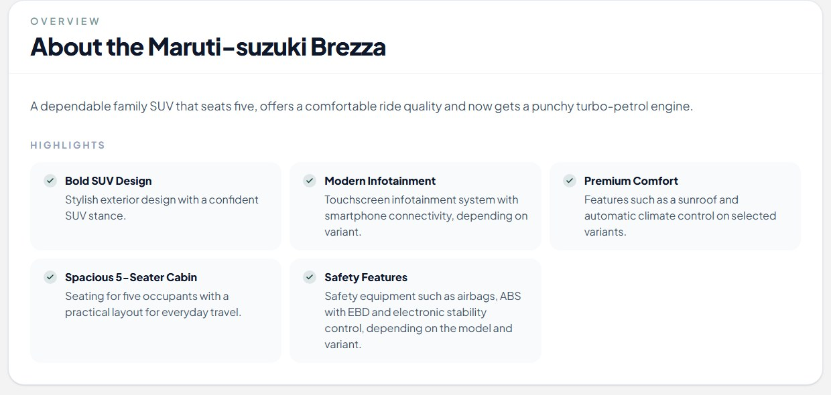
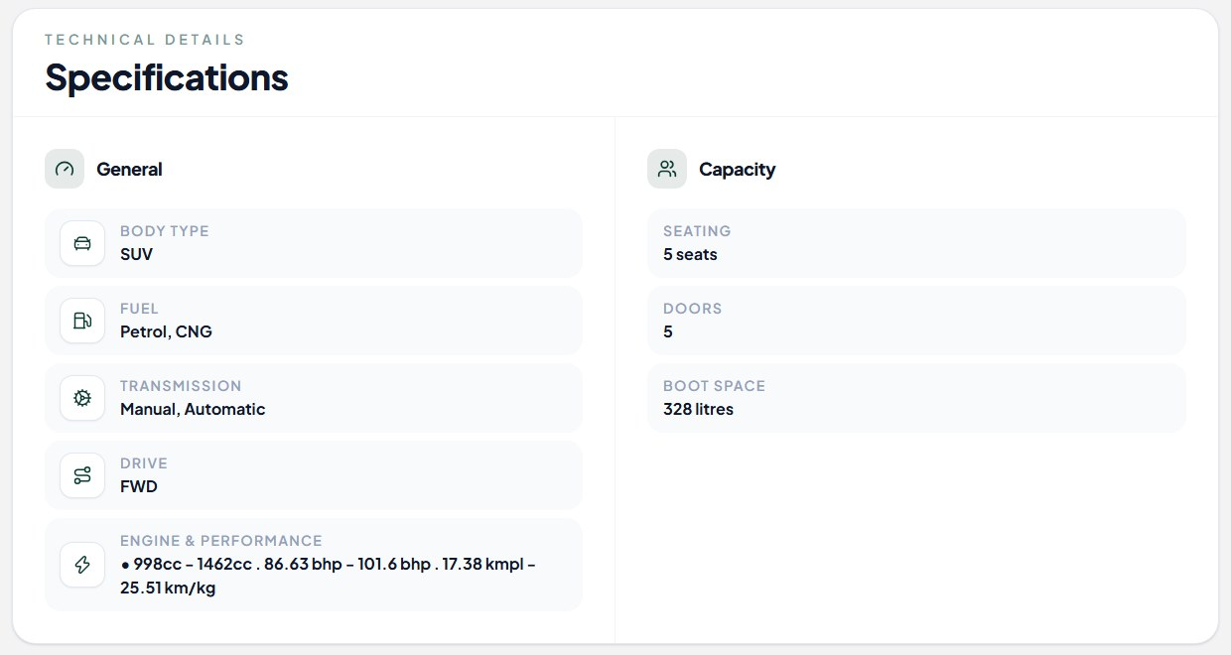
Every question a buyer has, answered on one page
Highlights in plain language
Specifications and variants
Short, readable reasons to love the car, written by your team.
Fuel, transmission, seating, boot space and every variant with its price.
Notes:
This is the content your team enters once, and every customer sees it, consistently and in your words.

Slide 7
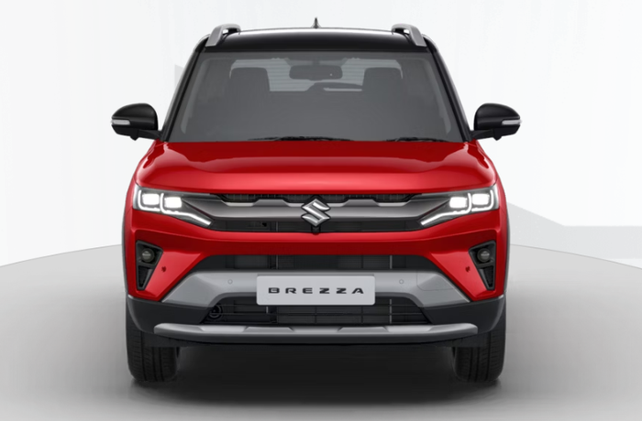
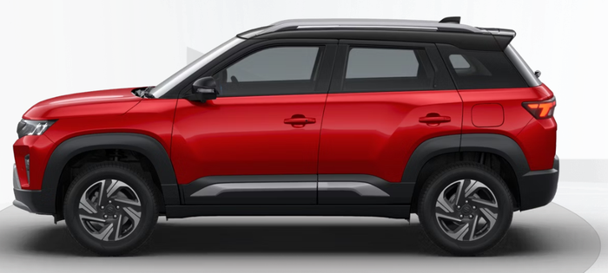
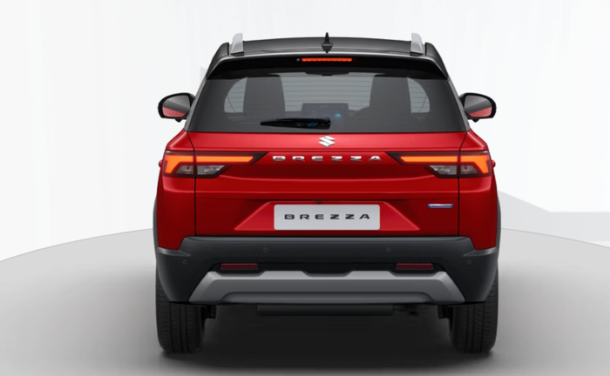
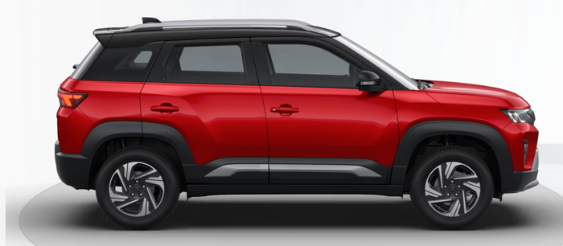


Walk around the car without leaving home
Spin it 360°
Try any colour
Fewer surprises
Customers drag to turn the car and see every side, inside the page.
They pick a colour and the car repaints on screen, including two-tone roofs.
Buyers arrive at the test drive already in love with the car.
Notes:
Demo moment if you have the live site open: drag the car around, then change the colour. This is built from photographs, so it shows your real cars. We need a set of photos per model to switch it on.

Slide 8
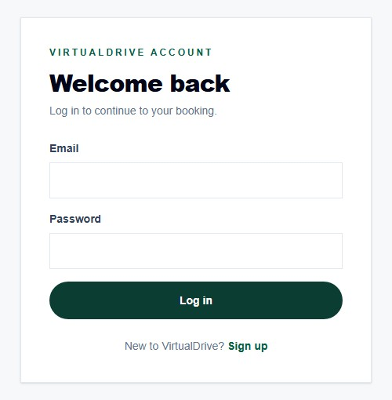
Browse freely, log in only when you commit
1
Anyone can browse
Cars, prices, brochures and the 360° view need no account.
2
Asked to log in at the right moment
When a customer goes to book a test drive or reserve a car, they are asked to log in or sign up first.
3
Then carry on booking
With an account, they continue straight into their booking.
Every booking belongs to a real customer account.
Notes:
Anyone can look around freely, which keeps the barrier low. The moment someone tries to book a test drive or reserve a car, they are asked to log in or create an account. That means every request is tied to a real customer account, not an anonymous form.

Slide 9




Step 3: Book a test drive in under a minute
Log in
Choose the car
Pick a slot
Get a reference
A quick account keeps bookings safe
Model and variant they want to drive
Date, time, location and phone number
A booking number confirms it instantly
What your team receives: the customer's name, phone number, chosen car, date, time and location, all saved together under one booking reference. A customer cannot book the same variant twice, so there are no duplicate requests.
Notes:
The key point for your sales team: each request arrives complete. No missing phone numbers, no double entries.

Slide 10



Step 4: Reserve the car with a small online payment
Choose the variant
Pay a small booking amount
Payment is verified
Booking confirmed
Exact model, fuel and colour
Securely, through Razorpay
We confirm it before anything is saved
The customer gets a reference number
Committed buyers, not casual enquiries. A customer who has paid a booking amount is serious. The same variant cannot be paid for twice by the same customer, and the system checks this before any money is taken.
Notes:
The payment amount is set by us in the system and can be agreed with you. Today it runs against the payment provider's test mode, so no real money moves in the demo. Real payments are switched on with live keys.

Slide 11
Why buyers choose to buy from us
Typical dealership
VirtualDrive
TO BOOK YOUR CAR
Higher processing charges
Add-ons and accessories bundled into the bill
Large advance and negotiation at the showroom
Zero processing cost
The car direct from us, as it is, without dealer add-ons
Pay only a small booking amount, online
₹10,000
is all it takes. Processing cost: ₹0.
Buy directly from us, at the lowest cost. No dealer processing fee, just ₹10,000 to book.

Slide 12
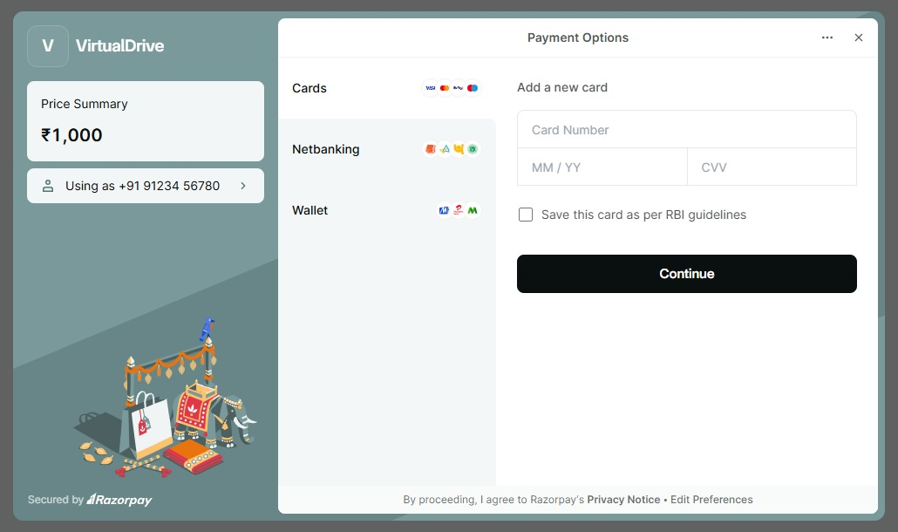


Secure payments, powered by Razorpay
Card details stay with Razorpay
Customers enter payment details in Razorpay's own secure window. VirtualDrive never sees or stores card numbers.
Verified before it counts
We check Razorpay's confirmation of the payment before a booking is saved.
Familiar ways to pay
Cards, net banking and wallets, in a screen customers already know.
Razorpay's checkout in test mode: no real money moves in the demo
Notes:
When a customer reserves a car, a Razorpay window opens on top of our page. Razorpay is a well-known Indian payment company, and it handles the card or bank details itself. We only receive confirmation that the payment went through, and we check that confirmation before saving the booking. The screen you see here is Razorpay's test mode, which is how we demonstrate it without moving real money. Going live means switching to real Razorpay credentials in the company's own Razorpay account.

Slide 13




How the information flows, in plain words
1 Saved
2 Shown
Your team
Secure database
Website customers see
adds cars, prices, photos and brochures in the admin panel
(MongoDB) keeps everything safely in one place
shows the latest information to every visitor
3 And back again. When a customer books a test drive or reserves a car, that booking is saved in the same secure database, tied to their account.
Notes:
This is the only technical slide. Keep it to three sentences: your team enters data, it is stored in a database called MongoDB, and the website reads from it to show customers. When customers book, those bookings are stored in the same place. Nothing more to know.

Slide 14
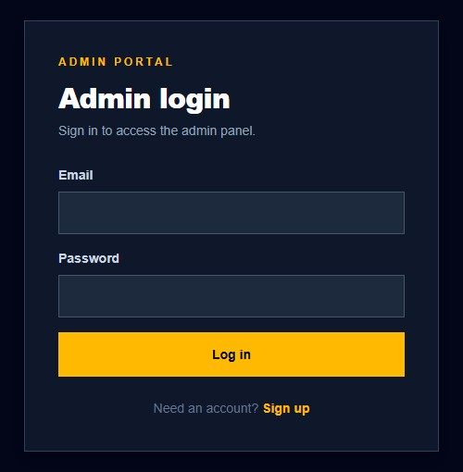
How your team puts cars online
Brand
The manufacturer: name, logo and history
Model
For example Brezza: photos, specs, highlights and brochure
Variant
For example ZXi: fuel, gearbox and price
Sub-variant
The exact engine, paint and every colour on offer
Admins sign in on their own secure login, and can log out any time from the top bar.
Added step by step, from the brand down to the exact configuration.
Notes:
This is how the catalogue is built. The admin signs in, adds a brand, then its models, then each variant, and finally the sub-variants: the exact engine, gearbox, paint and colours a customer can choose. As soon as it is saved, customers can see it. The admin can log out at any time from the top bar.

Slide 15




Your team stays in control of what customers see
Brand and line-up
Models and details
You decide
Which models appear
What the price says
Which photos and brochure customers see
When a model goes live
Your logo, history and the models you want to list
Descriptions, highlights, dimensions, photos and brochures
Variants and prices
Publish or hide
Each variant, its fuel, gearbox, colours and price
Switch a model on or off without deleting it
Notes:
Change a price or hide a model in the admin panel and customers see the update the next time they open the page. Admins sign in with their own login and can log out from the top bar.

Slide 16



What your brands get from VirtualDrive
A showroom that never closes
Complete, ready-to-call requests
Your full line-up, open to buyers at any hour, with the same quality of presentation for every model.
Name, phone, car, date, time and place for every test drive. Nothing to chase.
Serious buyers
Full control of your brand
Online booking payments separate real intent from casual browsing.
You set the models, prices, photos and brochures. We never change them.
Notes:
Tie each benefit back to something they saw in the walkthrough.

Slide 17
A simple way to start
1
2
3
4
Agree
Load the catalogue
Pilot launch
Go live
JM & TM approve listing their models on VirtualDrive
Photos, specs, variants and brochures added for your review
A small start with selected models to see it working
Open the full line-up to customers
Coming next: a booking dashboard and reports for your sales team, so every request and reservation can be reviewed in one view.
Notes:
Be clear about what exists today and what is coming. Today bookings are captured and stored. A dedicated dashboard to view and manage them is the next feature. Commercial terms are to be discussed together.

Slide 18
Future scope: the full product
A more professional, user-friendly interface
A cleaner, more polished design that is easy to use on every phone and laptop.
1
Exact specifications for every selected model
Full interior and exterior details added for each and every car we list.
2
New bookings alert the admin
When a customer books a test drive or buys a car, the saved details appear on the admin dashboard as a new, unchecked notification.
3
Instant notifications for customers
When a customer makes a booking, a notification pops up on their side straight away.
4

Slide 19


Let's put your brand in front of more buyers
We would like your permission to list and sell your company cars on VirtualDrive.
₹0
Processing cost
₹10,000
To book your car
360°
Views and colours online
24/7
A showroom that never closes
Notes:
Close by asking for the decision: permission to proceed with the first step, agreeing which models to start with.

