Slide 1
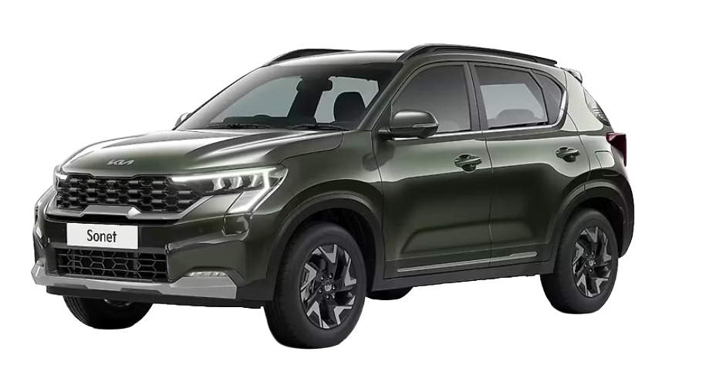
TEST-DRIVE & CAR-BUYING PLATFORM
VirtualDrive
Project analysis: architecture, features, data model and next steps
car-demo · Next.js 16 · React 19 · MongoDB
Notes:
VirtualDrive is a Next.js app where customers browse cars, explore them in 360 degrees, book test drives and pay a booking amount, while admins manage the catalogue.

Slide 2
A full-stack car showroom, built in about a month
~9.3K
22
20
3
lines of TypeScript / TSX
pages (customer + admin)
API route handlers
MongoDB databases: users, catalogue, admin
Customer side
Browse brands and models, filter by body type, fuel and budget, spin a 360° view, recolour the car and book a test drive or pay a booking amount.
Admin side
A separate dashboard to manage brands, models, variants and sub-variants, with its own login.
Where it stands
Core flows work end to end. Open items are security hardening, tests and removing hard-coded demo content.
Notes:
History: 23 commits between 21 Sep and 21 Oct 2026. Line count covers .ts and .tsx files tracked by git.

Slide 3






Tech stack
Next.js 16.3.5
React 19 + TypeScript 5
Tailwind CSS 4
App Router, server components, route handlers
29 client components, typed catalogue models
Utility styling via the PostCSS plugin
MongoDB driver 6.17
bcryptjs + Node crypto
Razorpay (REST)
Direct driver, no ORM; indexes created in code
Password hashing and HMAC-signed sessions
Orders API called with fetch, HMAC payment check
Also: lucide-react icons, ESLint 9 with eslint-config-next. Images come from /public and images.unsplash.com.

Slide 4
Architecture at a glance
Browser
Next.js app (app/)
External services
Server-rendered pages
29 client components: navbar, forms, 360° viewer, checkout
Razorpay checkout widget
httpOnly session cookies
22 pages in the App Router, catalogue pages query MongoDB directly (force-dynamic)
20 route handlers: /api/auth, /api/admin, /api/catalog, /api/bookings, /api/razorpay
app/lib: auth, bookings, Mongo clients, 360° and recolour helpers
MongoDB: users db, catalogue db, admin db
Razorpay: order creation and signature check
Unsplash: remote images
Notes:
No middleware or proxy file exists. Access control is enforced inside each page, layout or route handler.

Slide 5





The customer journey
1. Home
›
2. Browse
›
3. Explore
›
4. Configure
›
5. Commit
Hero, trust strip, FAQ, inventory carousel
/cars with brand, type, fuel, budget and search filters
Gallery, 360° viewer and live colour preview
Variant and sub-variant, colour choice
Test drive form, or ₹1,000 booking via Razorpay
Guard rails: login is required to book; a user cannot book the same variant twice with the same action, and the Razorpay order is refused before payment if it would be a duplicate.

Slide 6
Data model
Brand
Users (own database)
name, slug, logo, sales and service-centre counts
Unique email index, bcrypt password hash
Embedded bookings[]: action, reference, car, contact, date, time, location, paymentId
▼
Model
type, fuels, price range, specs, dimensions, images, brochure, published flag
▼
Variant
Admins (own database)
fuel, transmission, price, specs
Separate collection and cookie; passwords hashed with bcrypt.
▼
Sub-variant
engine, paint, colours, price override (embedded in Variant)
Catalogue collections are linked by string ids (brandId, modelId), with unique slug indexes on brands and models.

Slide 7


Standout features
360° viewer
In-browser recolour
38 Brezza frames are discovered on the server from public/carImages and scrubbed on a canvas.
Body-coloured pixels are repainted per chosen colour, with a second tone for the roof on dual-tone cars.
Atomic duplicate guard
Notifications and mega menu
One updateOne with $not/$elemMatch pushes a booking, so two simultaneous requests cannot both save.
A notification dropdown and a brand-aware inventory mega menu in a 500-line navbar.

Slide 8
Admin dashboard
Brands
Create, edit and delete; logo, established year, sales and service-centre figures
Under the hood
Route group app/admin/(dashboard) guarded in its layout
10 admin API routes, each calling getAdminUser()
Separate admin_session cookie and admins collection
Breadcrumbs and drill-down: brand → model → variant
Models
398-line form: segment, drivetrain, dimensions, capacity, images, brochure, publish toggle
Variants
Per-model variants with fuel, transmission, specs and price
Sub-variants
Engine, paint, colours and price overrides edited inline

Slide 9
Where the code lives
Admin is half the API: every catalogue write goes through it. Customer-facing reads are only 3 catalogue routes, because most pages query MongoDB directly on the server.

Slide 10


What is done well
Sessions
HS256-signed tokens with a 7-day expiry, timing-safe signature check, httpOnly + sameSite cookies, secure in production.
Passwords
bcrypt hashing, with a 72-byte guard so long passwords cannot be silently truncated.
Payments
Server creates the order and verifies the HMAC signature; secrets never reach the client.
Input handling
Request bodies are trimmed and length-capped through cleanString; JSON parse errors return 400.

Slide 11
Findings to fix first
Anyone can become an admin
POST /api/admin/signup has no invite code or existing-admin check.
High
User and admin tokens are interchangeable
Both are signed with the same secret and carry no role. A user can copy their session token into the admin_session cookie.
High
Payment verify trusts the client
carId, carName and price come from the request body; the order is not matched to the car or amount.
Medium
Index calls on every request
getXCollection() runs createIndex each time, and two separate MongoClient setups exist.
Low
Notes:
Admin token finding: DashboardLayout and getAdminUser only call verifySessionToken on the admin_session cookie. The token format is identical to the user session token, so a logged-in customer's token validates as an admin. Fix by adding a role claim (or separate secret) and checking it.

Slide 12



Other gaps
No automated tests
Boilerplate README
package.json has no test script and no test files are tracked.
Still the create-next-app text: no setup steps or the required env vars (MONGODB_URI, MONGODB_DB, MONGODB_CATALOG_DB, MONGODB_ADMIN_DB, AUTH_SECRET, RAZORPAY_*).
Hard-coded demo content
No middleware or rate limiting
A dedicated /maruti-suzuki/breeza page and Brezza-only 360° frames sit outside the catalogue.
Login, signup and booking endpoints can be called without throttling.

Slide 13
Recommended next steps
1
Lock down admin access
Close open signup, add a role claim to tokens, check it in every admin entry point.
2
Harden payments
Store the order against the user and car at creation; verify against it instead of trusting the body.
3
Add tests and a real README
Cover auth, bookings and the duplicate guard; document env vars and seeding.
4
Consolidate data access
One shared Mongo client, indexes created once at startup.
5
Make the demo data-driven
Move the Brezza page and 360° frames behind the catalogue.

Slide 14
The foundation is solid; harden it before it faces users
Strong
Fix first
Then
Clean separation of catalogue, users and admins; polished 360° and recolour features.
Open admin signup and interchangeable tokens.
Tests, README, shared data layer.

