Slide 1
Predict the Onset of Type 2 Diabetes Using Survey Data
John Semerdjian and Spencer Frank
University of California Berkeley

Slide 2
The Problem
Type 2 Diabetes affects millions of people worldwide
Use Machine Learning to determine the probability of developing diabetes based on survey data
If we can predict the onset of diabetes, healthcare professional can notify patients of their elevated risk of developing diabetes sooner
Early diagnosis ➔ Lifestyle changes ➔ Disease Mitigation

Slide 3
The Data - NHANES
National Health and Nutrition Examination Survey (NHANES) from the Center for Disease Control
3 waves of data collected between 1999-2004
Chose 16 out of >100 features
Chosen based on feature importance's from Random Forests
Missing data
5515 people (samples) divided into 80/20 training & test sets

Slide 4
Top 5 Features
Feature | Importance
Age at time of screening | 0.169
Waist circumference(cm) | 0.107
Blood relatives have diabetes? | 0.087
Total cholesterol (mg/dL) | 0.085
Height (cm) | 0.086

Slide 5
Ensemble Model
Trained Model 1
Logistic Regression
Trained Model 2
KNN
Ensemble Model
Trained Model 3
Random Forests
Trained Model 4
Gradient Boosting
Each model tuned and trained individually
Trained Model 5
Support Vector Machine

Slide 6
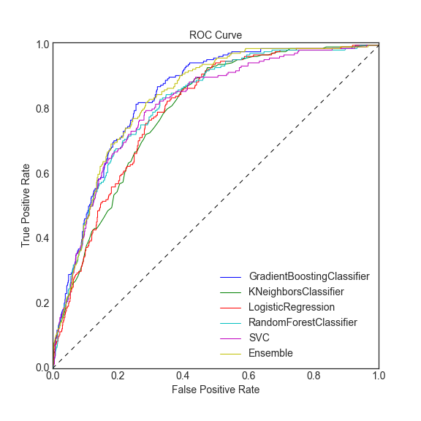
Results - Model Performance
AUC_{GBoost} = 0.840
AUC_{Ensemble}= 0.834

Slide 7
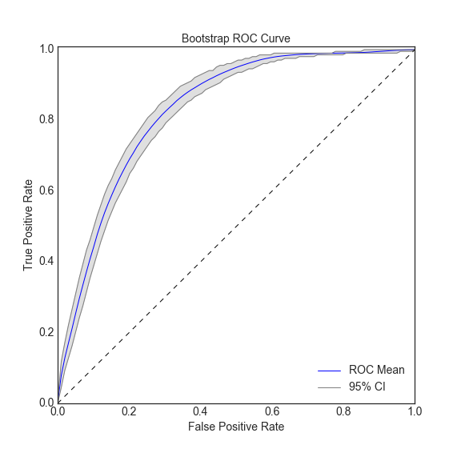
Bootstrap ROC
AUC_{GBoost} = 0.840 +/- 0.1
(95% CI)

Slide 8
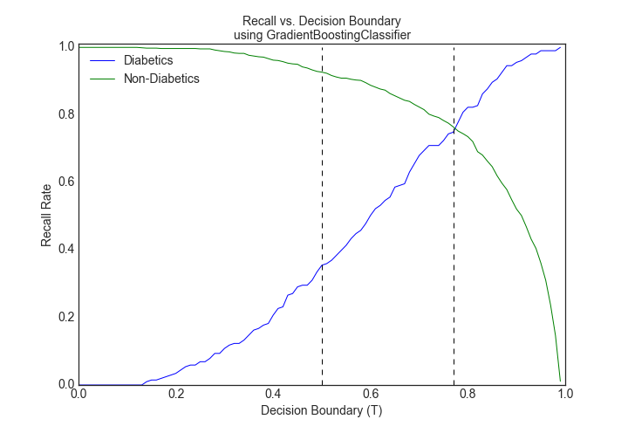
The result that really matters - Recall

Slide 9
Application
What does a recall rate of 0.75 for both classes tell us?
Of our sample, we can eliminate 60% as non-diabetics and ensure that we detect at least 75% of the diabetics from the remaining 40% of our population

