Slide 1
RALD-LARD MACHINES
Models of computation exam
Worou Akiyo
aworou@student.ethz.ch
aworou | 20-909-594

Slide 2
Model definition

Slide 3
Input and output modalities
Input modality : OCCCC…CC or CCCC…CCO
Output modality : CCCC…CCOCCCC…CC
Meaningful output : CCCC…CCO or OCCCC…CC
O : delimiter and C : repeated character
n≥0
n≥0
n≥0
m≥0
n≥0
n≥0

Slide 4
Rules
Add and delete C on the right or on the left of the delimiter for a specific input
If deletion is impossible the machine will stop
Take set of instructions executed in a loop
The instructions are assigned to a specific input

Slide 5
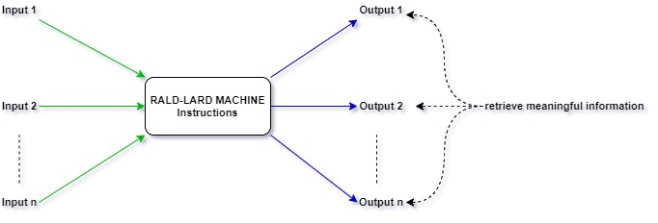
Model representation

Slide 6
Model instructions
One line of instructions : Delete/Add Left/Right input id
To make things easier let denote
D:= Delete
A:=Add
L:=Left
R:=Right
Example : D L 1 ===> Delete C on the left of O for the first input

Slide 7
Model loop of instructions
Input 1 : OCC
Input 2 : OC
Steps | Instructions | Input 1 | Input 2
1 | D R 1 | OC | OC
2 | A L 1 | COC | OC
3 | D R 2 | COC | O
4 | A R 1 | COCC | O
5 | D R 1 | COC | O
6 | A L 1 | CCOC | O
7 | D R 2 | CCOC | halt
D R 1
A L 1
D R 2
A R 1

Slide 8
Properties
When there is only one input the model is called mono RALD-LARD machine and the input id can be omitted in the instructions
Validity : A set of instructions is valid if there at least one meaningful output
Halting : The machine will always halt if in the instructions there is more deletion than appending for at least one input

Slide 9
Computational processes in action
Mono RALD-LARD Machines

Slide 10
Compute n+1 and n-1
Input : OCCC…CCC
Ouput : OCCC…CCCC
Instructions :
Steps : 1
Input : OCCC…CCC
Ouput : OCCC…CCCC
Instructions :
Steps : 1
Input
OCCCC
OCCC
halt
Input
OCCCC
OCCCCC
halt
n
n-1
n+1
D R
D L
A R
D L

Slide 11
Compute n//2
Input | Input
OCCCC | OCCC
OCCC | OCC
OCC | OC
COCC | COC
COC | CO
CO | halt
CCO
halt
Input : OCCC…CCC
Ouput : CCC…CCO
Instructions :
Steps : 3n//2
Bonus : n//m is possible with
n
n//2
D R
D R
A L
D R
D R
…
…
D R
A L
m

Slide 12
Compute 2n
Input
OCCC
OCC
COCC
CCOCC
CCOC
CCCOC
CCCCOC
CCCCO
CCCCCO
CCCCCCO
halt
Input : OCCC…CCC
Ouput : CCC…CCCCCCCO
Instructions :
Steps : 3n
Bonus : mxn is possible with
n
2n
D R
A L
A L
D R
A L
A L
…
…
A L
m
Notes:
Steps bonus in (m+1)*n

Slide 13
Parity
Input | Input
OCCCC | OCCC
OCCC | OCC
COCCC | COCC
COCC | COC
OCC | OC
OC | O
COC | CO
CO | halt
O
halt
Input : OCCC…CCC
Ouput : CO if n odd and O else
Instructions :
Steps : 2n
Bonus : check if n is divisible by m
n
D R
A L
D R
D L
D R
A L
D R
D R
…
…
D R
D L
m-1
Notes:
Steps bonus : around int( (m+2)n/m )

Slide 14
Computational processes in action
RALD-LARD Machines with 2 inputs

Slide 15
Compute n+m
Input 1 | Input 2
OCCC | OCC
OCCC | OC
OCCCC | OC
OCCCC | O
OCCCCC | O
 | halt
Input 1 : OCCC…CCC
Input 2 : OCCC…CCC
Outputs :
Output 1 : OCCC…CCC | Output 2 : O
Instructions :
Steps : 2m
Tips : Choosing input 2 such as m≤n
n
m
n+m
D R 2
A R 1

Slide 16
Compute n-m
Input 1 | Input 2
OCCC | OCC
OCCC | OC
OCC | OC
OCC | O
OC | O
 | halt
Input 1 : OCCC…CCC
Input 2 : OCCC…CCC
Outputs :
Output 1 : OCCC…CCC | Output 2 : O ===> m≤n
Output 1 : O | Output 2 : OCC…CCC ===> m>n
Instructions :
Steps : 2min(n,m)
n
m
n-m
D R 2
D R 1

Slide 17
Compare n and m
Input 1 | Input 2
OCCC | OCC
OCC | OCC
COCC | OCC
COCC | OC
OCC | OC
OC | OC
COC | OC
COC | O
OC | O
O | O
CO | O
 | halt
Input 1 | Input 2
OCC | OCC
OC | OCC
COC | OCC
COC | OC
OC | OC
O | OC
CO | OC
O | O
halt
Input 1 : OCCC…CCC
Input 2 : OCCC…CCC
Outputs :
Output 1 : O | Output 2 : O ===> n=m
Output 1 : COCCC…CCC or OCC…CCC | Output 2 : O ===> m<n
Output 1 : O | Output 2 : COCCC…CCC or OCC…CCC ===> m>n
Instructions :
Steps : ≤ 4min(n,m)
n
m
D R 1
A L 1
D R 2
D L 1
Notes:
Issue with n-m in some cases

Slide 18
RALD-LARD Machines into the world of models

Slide 19
Observations
Can easily do some basic arithmetic computations
Cannot do some recursion based computation : mxn for 2 inputs
Cannot reuse multiple times an input because of the halting definition
Cannot solve easily solve non-arithmetic based problems
The model does not have states so it cannot solve state based problems

Slide 20
Comparison with Cyclic tag systems
Similar to cyclic tag system for the instructions loop
Contrary to cyclic tag it does not delete the odd characters but have the ability to delete
The transformation is executed at the delimiter position, so the machine only needs to know the closest neighboors if they exist

Slide 21
Simulation of another models
Cannot simulate one of the models seen in class ( at least I was not able to do it)

Slide 22
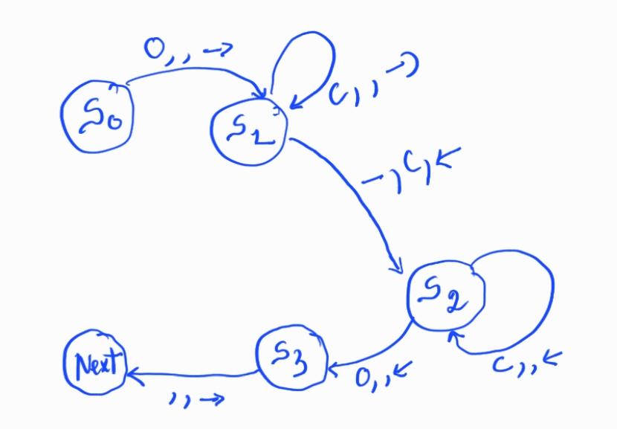

Turing machine that simulates RALD-LARD Machine
We can consider a TM with input _CCOCC_
A R can be encoded like :

Slide 23
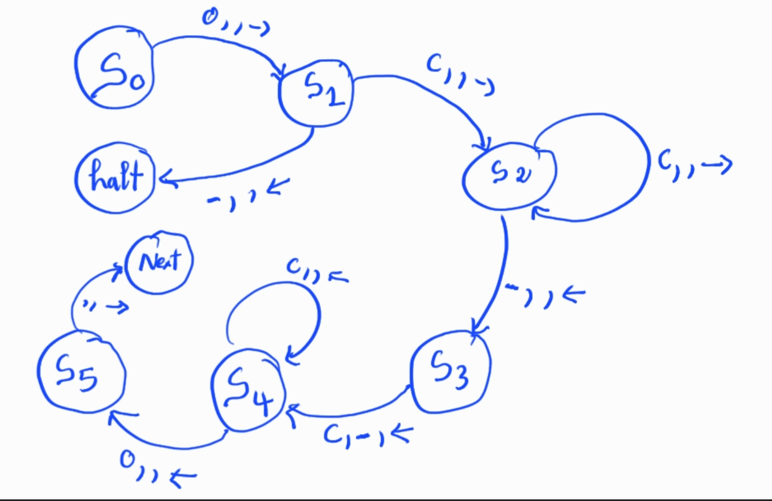

Turing machine that simulates RALD-LARD Machine
D R can be encoded like :

Slide 24
Turing machine that simulates RALD-LARD Machines
We can then replace Next by the next instruction and make the loop
Example :

Slide 25
Solving the recursion issue?
RALD-LARD Machines stacking

Slide 26
Stacking overview
Multiple machines
Simple transition after a machine halts
Instruction transition : apply a set of instructions, not necessarily in a loop
When an instruction transition failed the entire model stops

Slide 27
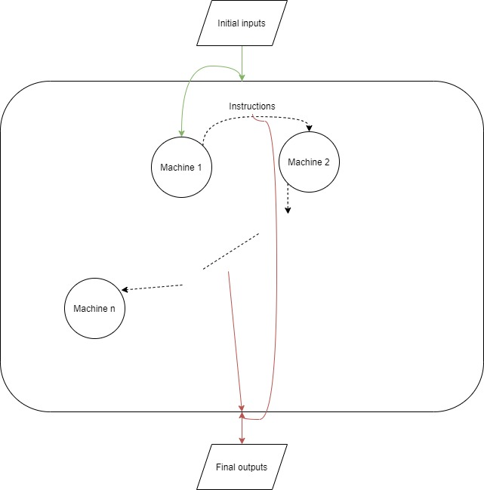

Slide 28
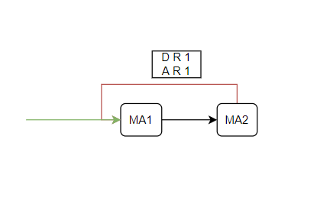
Computing 2^{n}
Input 1 : OCCC…CCC
Input 2 : OC (m = 1 )
Output 1 : O
Output 2 : OCCC…CCC
Machine 1 (MA1) : compute n – 1
Machine 2 (MA2) : compute 2m
n
Stack : 2^{n}
2^{n}

Slide 29
Conclusion
Interesting model even if it is a bit limited
Work on RALD or LARD versions
Maybe add more possibilities
Variation in the meaning of the output
Stacking can be powerful

