Slide 1
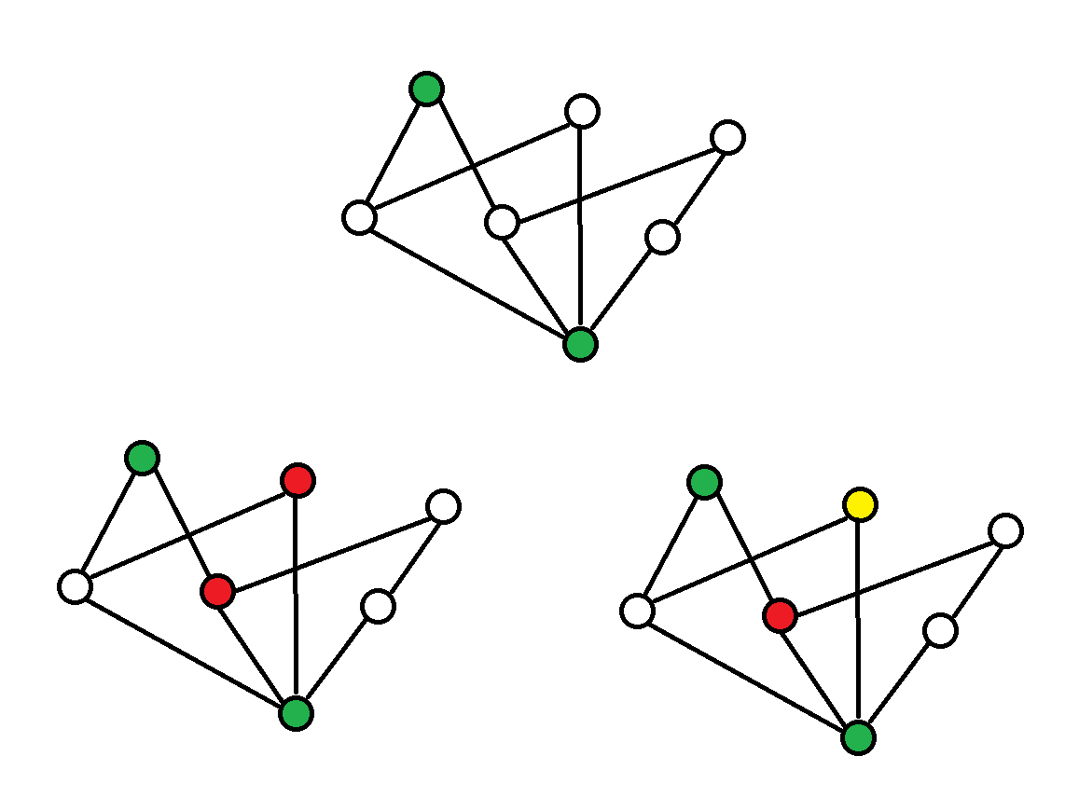
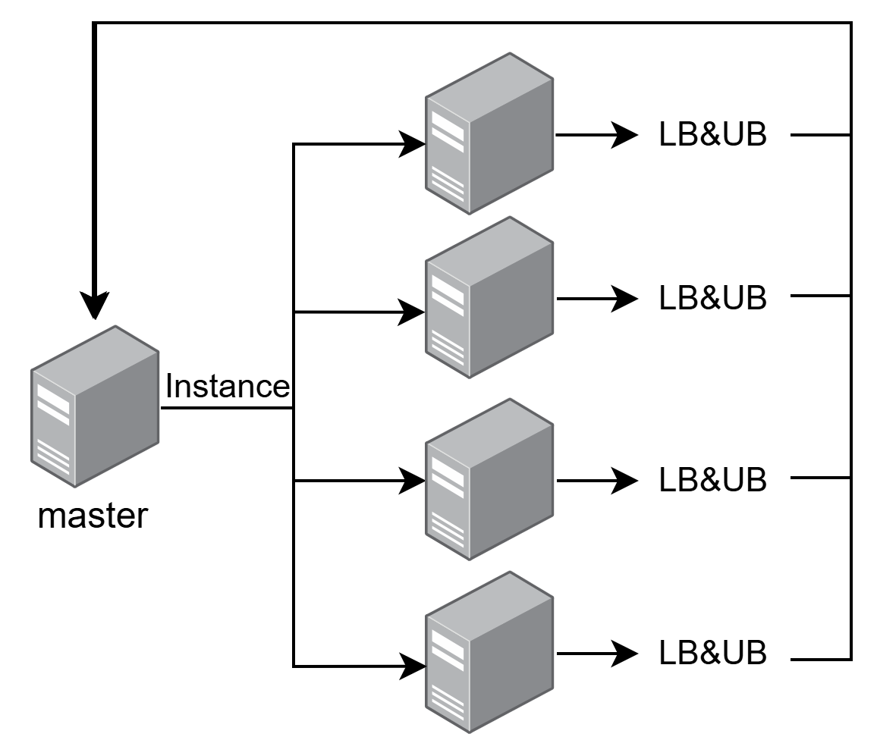

Branch-and-bounds Approach to Graph Coloring
Alesio Demiri
Politecnico di Milano
alesio.demiri@mail.polimi.it
Davide Villani
Politecnico di Milano
davide2.villain@mail.polimi.it
Thomas Gantz
Sorbonne University
gantz.thomas.gantz@gmail.com
Tsvetelin Kostadinov
Sofia University
tsvetelinkostadinovts@gmail.com
Objective
The goal of this project is to investigate the application of the branch-and-bound (B&B) algorithm for graph coloring in the context of High Performance Computing (HPC). Traditional graph coloring approaches typically aim for a fully parallelized direct solution. However, B&B provides intermediate results that can be valuable depending on the application, making it particularly appealing for real-world use cases. Additionally, its hierarchical structure naturally facilitates parallelization, making it a promising candidate for HPC implementations.
Techniques
To ensure convergence to the exact chromatic number, we employ multiple algorithms to compute lower and upper bounds:
Bron–Kerbosch algorithm: Identifies the maximum clique in the graph, providing a lower bound.
DSatur: A heuristic algorithm that finds a proper coloring, establishing an upper bound.
We utilize MPI to distribute and coordinate subproblems efficiently. These subproblems are managed through a shared task stack, where worker processes retrieve and process them dynamically. Each instance computes updated upper and lower bounds, which the master node acts as a reducer checking if an optimal solution has been reached.
Vertex cnt | Edge cnt | χ(G) | T (ms)
80 | 508 | 10 | 700029
36 | 580 | 8 | 700030
74 | 602 | 11 | 700027
87 | 812 | 11 | 41
128 | 774 | 8 | 5
Outcome
We have developed an application tested on the VEGA supercomputer. It successfully computes the chromatic number for all instances in our dataset, demonstrating its correctness within the tested scope. While this provides strong empirical evidence of its reliability, further evaluation is needed to confirm its accuracy on arbitrary graphs. The results highlight the effectiveness of our branch-and-bound approach in a high-performance computing environment.
Achievements
Successfully developed a proof of concept for the branch and bounds algorithm for graph coloring. Even in it’s early stages of development, it has shown potential for applications in real-world scenarios.
A key strength of our application is the extensibility – new algorithms, heuristics and approaches can be seamlessly integrated in order to contribute to the overall performance of the project. New modules can be developed and used in order to make the convergence faster.
References
[1] Aloysius, Dewayne Rocky. "Bron-kerbosch algorithm." (2012).
[2] Brélaz, Daniel. "New Methods to Color the Vertices of." (1979).
This project has received funding from the European High
Performance Computing Joint Undertaking under grant
agreement No XXXX.

