Slide 1
EventConnect
CSS

Slide 2
Introduction
Team BitBots is here to make your events awesome!
Planning a party, wedding, or any special gathering?
We’re here to make it as easy as possible.

Slide 3
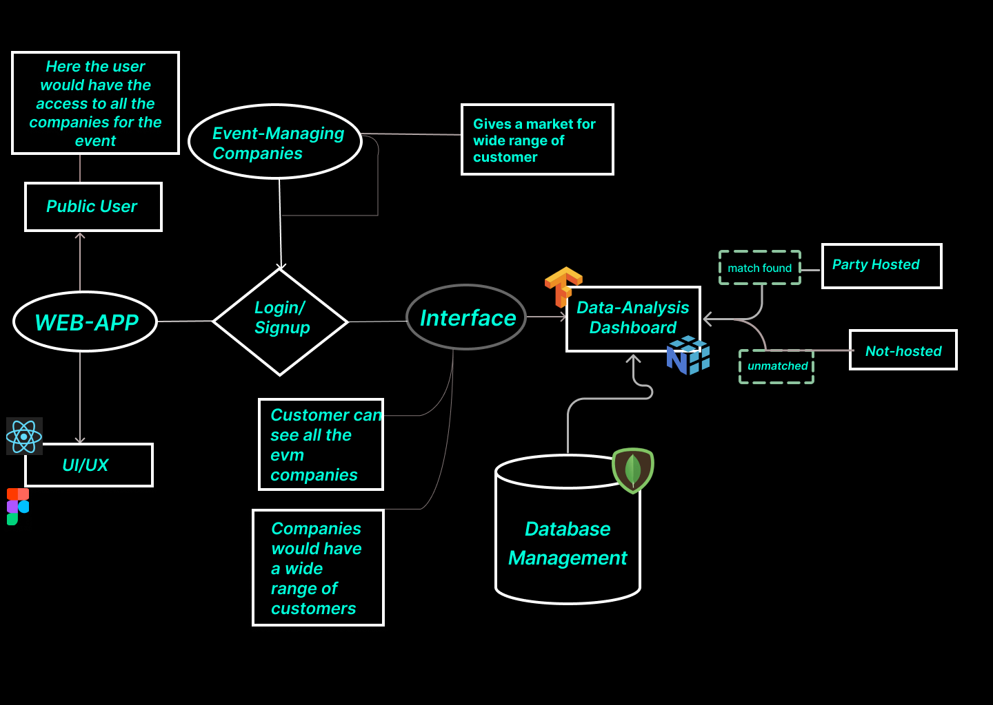
Authentication/profile check

Slide 4
Key features
Networking
Regional Events
Our event management platform serves as a bridge, seamlessly connecting individuals with the right professionals and evm companies. Networking within the event industry is facilitated, allowing customers to establish meaningful connections with vendors, venues, and professionals.
Our web-app also provides event management companies to specific region to host or manage regional event gatherings like :weddings,sangeet,
Affordable
Efficient
We help customers optimize their budget by providing access to a range of options. From venues to vendors, our platform empowers customers to make informed decisions that suit their financial plan.
Experience a trifecta of efficiency as our platform streamlines event planning, saving you time, cutting costs, and conserving energy by connecting you promptly with the right professionals.

Slide 5
For customers
Efficient event management
For Event managing companies

Slide 6
Importance to Customers
1)Personalized Service: We understand that every event is unique. By allowing customers to input their specific needs, we tailor our services to match their vision precisely.
2)Time and Effort Savings: Our platform streamlines the search, instantly connecting customers with the perfect professionals.
3)Expert Connections: Our platform ensures that customers are linked with the right experts who can bring their ideas to life.
4)Seamless Communication: Our platform facilitates clear and efficient communication between customers and service providers. This ensures that everyone is on the same page, reducing misunderstandings and enhancing the overall experience.

Slide 7
Importance to companies
1)Increased Visibility: Being listed on our website exposes companies to a broader audience actively seeking event-related services. This heightened visibility can attract potential clients and collaborators.
2) Network Expansion: increased visibility and no regional boundaries would help the company to expand beyond their scope of their capability.
3) Awareness of Trends and Competition: A company on our platform would be aware of their corresponding competition and would also be aware of the latest trends.

Slide 8



Tech Stack
HTML
CSS
Javascript
Standard markup language for creating the structure of web pages. Defines the basic elements and content on a website.
Stylesheet language used for describing the presentation of a document written in HTML. Controls the layout, design, and visual aspects of the website.
Programming language that enables interactive and dynamic elements on web pages. Used for client-side scripting to enhance user experience.

Slide 9



Tech Stack
MongoDB
NodeJS
ReactJS
NoSQL database that stores data in a flexible, JSON-like format. Ideal for handling large amounts of unstructured or semi-structured data.
Server-side JavaScript runtime that allows the execution of JavaScript code on the server. Enables building scalable and high-performance web applications.
JavaScript library for building user interfaces, particularly single-page applications. Allows for the creation of reusable UI components, enhancing code maintainability.

Slide 10
Computer mockup

Slide 11
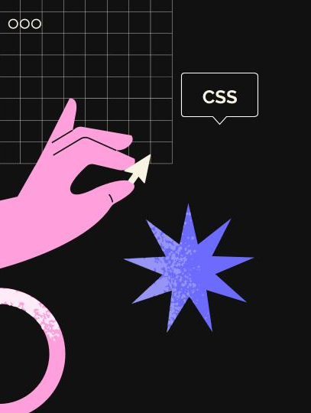
Tablet mockup
”

Slide 12
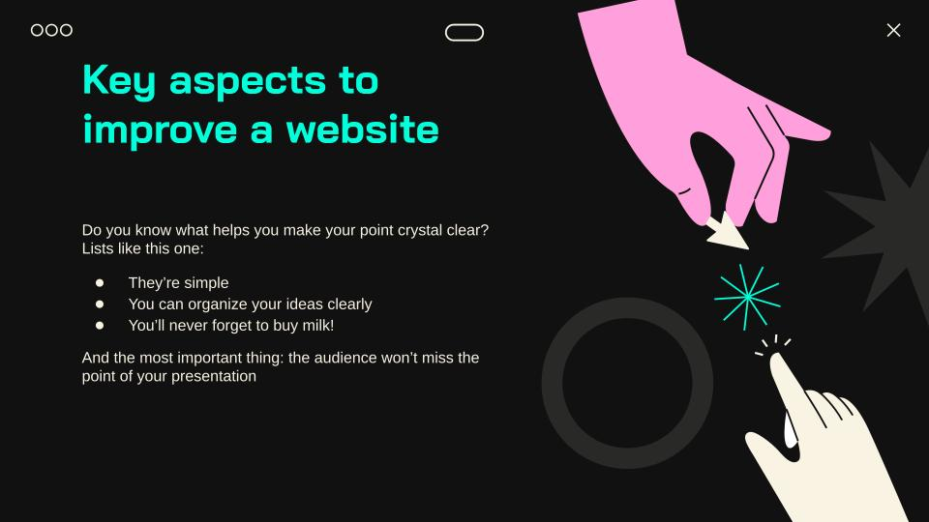
Phone mockup

Slide 13
Team Members
Rudra Pratap Dash
Team Leader
Aryan Pahuja
Team Member
Ishmeet Singh Nagi
Team Member
Aditya Goel
Team Member

