Slide 1
Total Records
After Deduplication
2,772
1,337
Medical Insurance
Cost Prediction
Regression Models
Best R² Score
7
0.9108
End-to-End Machine Learning Project
Python
Pandas
Scikit-learn
XGBoost
MLflow
Streamlit
Best RMSE
Smoker Rate
$4,048
20.3%
Rudra Barman · Healthcare & Insurance Domain

Slide 2
Project Overview
End-to-end regression pipeline to predict individual medical insurance costs
🎯 Problem Statement
📦 Dataset
🔧 Approach
Predict individual insurance charges based on age, sex, BMI, smoking status, children & region using regression models.
1,337 unique records · 7 features · Target: annual charges ($1,122 – $63,770) · Healthcare & Insurance domain.
Data Preprocessing → EDA → Feature Engineering → Train 7 Models → MLflow Tracking → Streamlit Deployment.
🏆 Best Result
⚙️ Feature Engineering
🚀 Deployment
Linear Regression achieved R²=0.9108, RMSE=$4,048 — outperforming XGBoost due to engineered interaction features.
5 new features: BMI category, age group, smoker×BMI, smoker×age, obese-smoker flag — linearized non-linear relationships.
Interactive Streamlit app with live EDA charts, 7-model comparison table & real-time insurance cost prediction.

Slide 3
Dataset Overview
medical_insurance.csv · 1,337 clean records · 7 features · No missing values
Feature | Type | Description | Range / Values
age | Numeric | Age of primary beneficiary | 18 – 64 years
sex | Categorical | Gender of the insured | male / female
bmi | Numeric | Body Mass Index | 16.0 – 53.1
children | Numeric | Number of dependents covered | 0 – 5
smoker | Categorical | Smoking status | yes / no
region | Categorical | Residential area in the US | NE / NW / SE / SW
charges | Numeric (🎯) | Annual medical insurance cost (TARGET) | $1,122 – $63,770
Average Charges
Median Charges
Maximum Charges
Average BMI
Average Age
$13,261
$9,333
$63,770
30.7
39.1 yrs

Slide 4
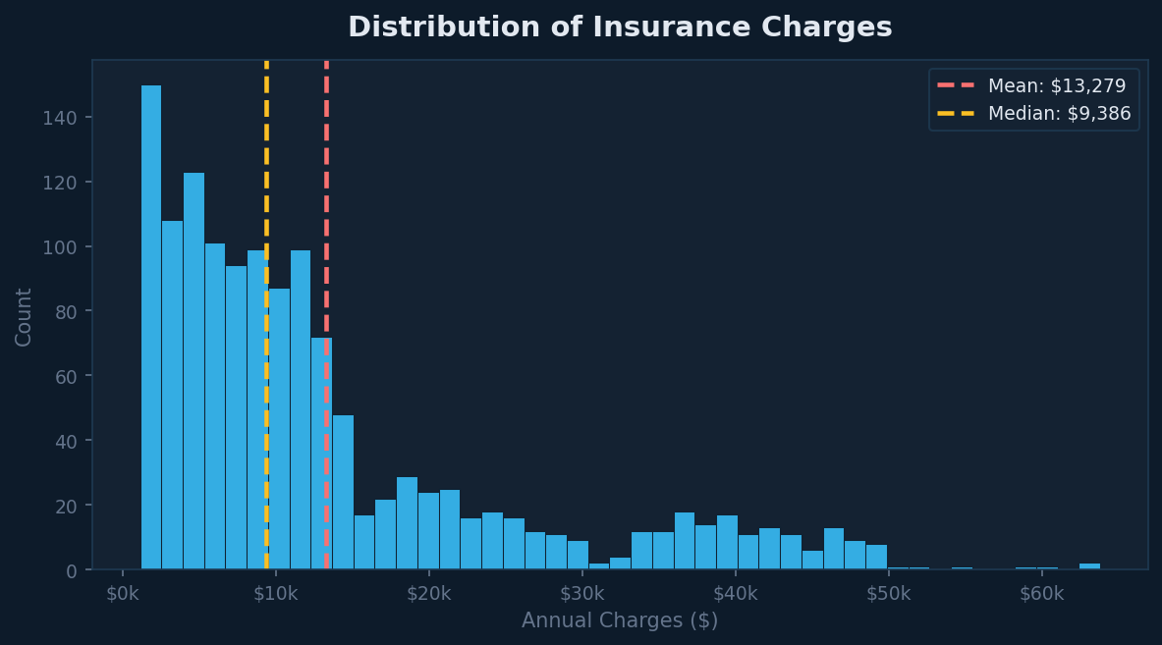
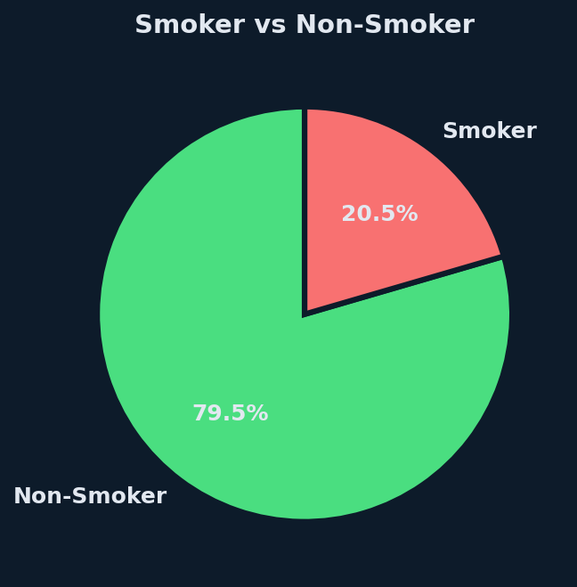
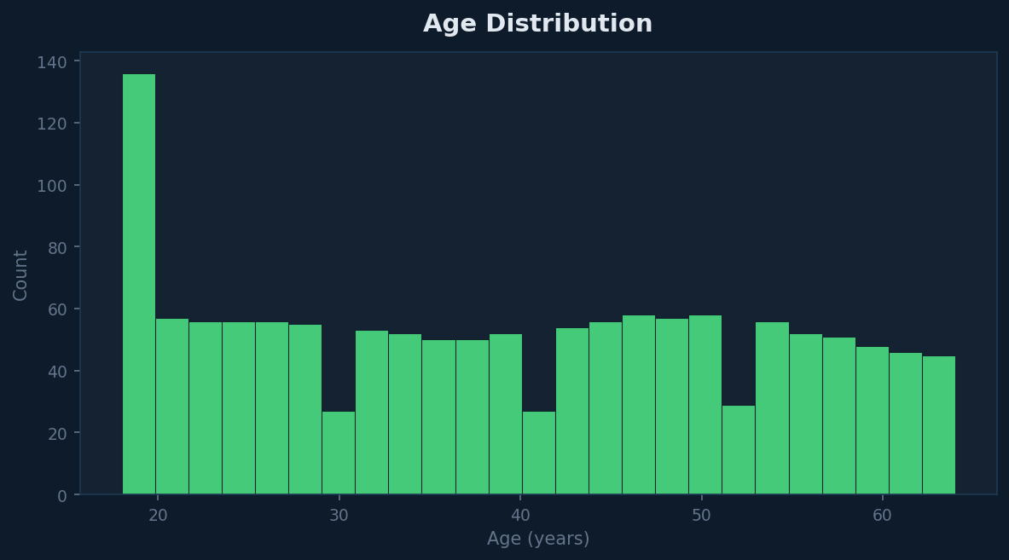
EDA — Univariate Analysis
Distribution of key variables
💡 Key Insight: Charges are right-skewed (mean $13,261 > median $9,333) — a small group of high-cost patients drives the average up. 79.5% are non-smokers. Age distribution is fairly uniform (18–64).

Slide 5
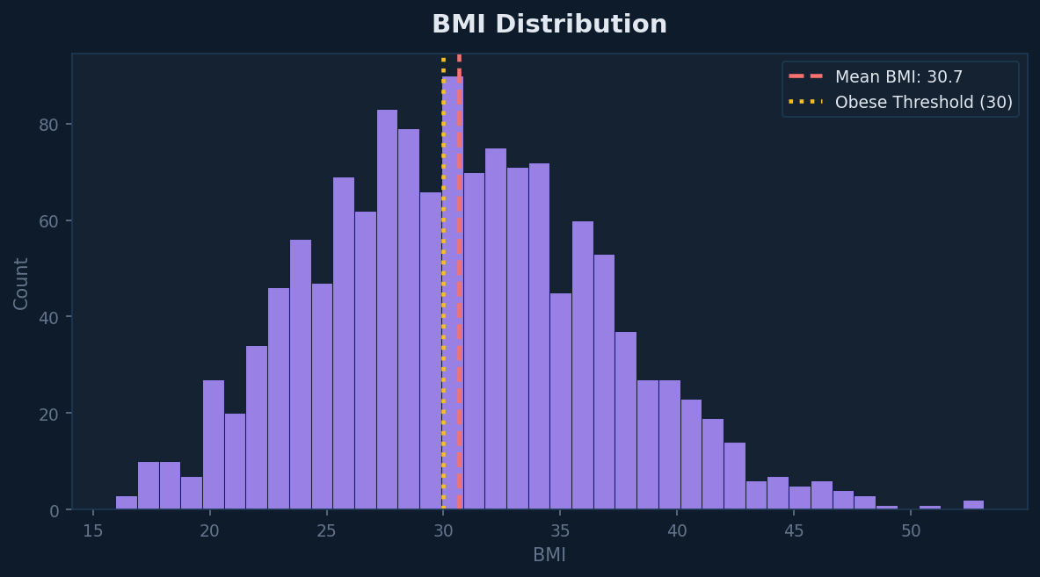
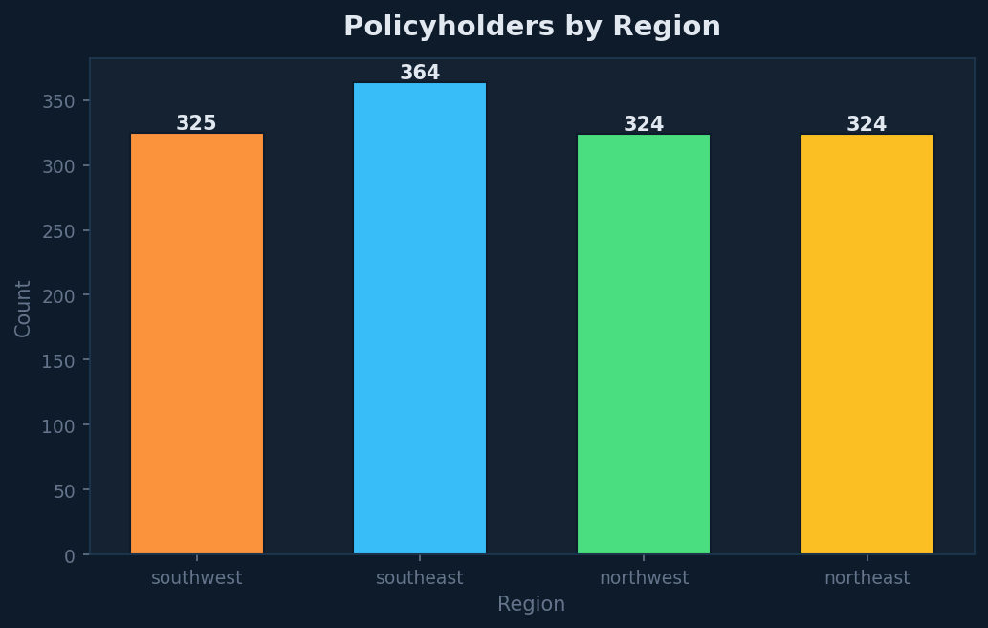
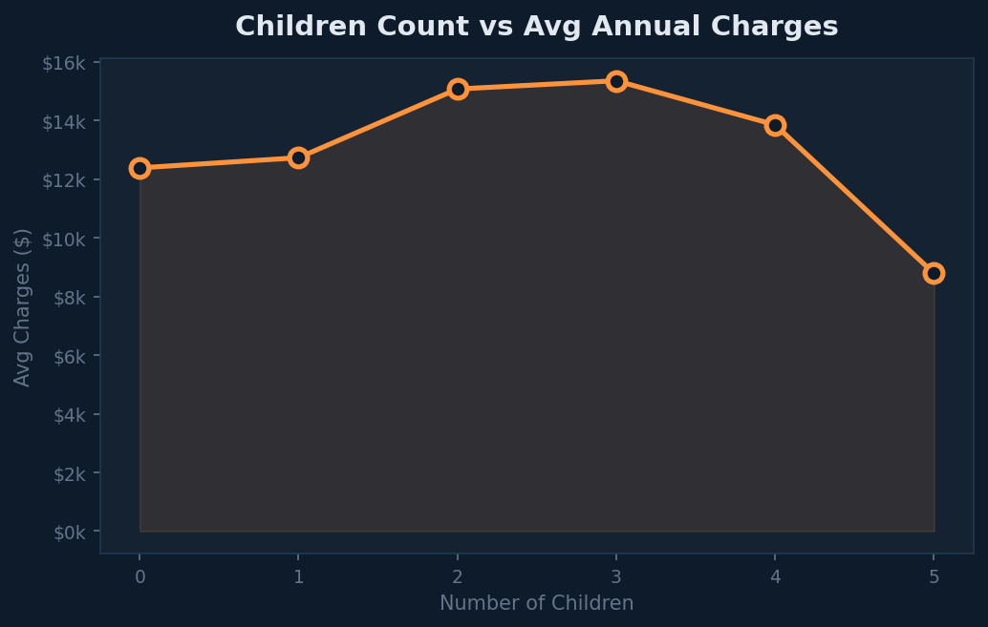
EDA — Univariate Analysis (Cont.)
BMI, Region & Children distributions
Mean BMI = 30.7 — average policyholder is technically obese
Southeast has most policyholders (383); others roughly equal
56% have no children; charges peak at 2-3 dependents

Slide 6
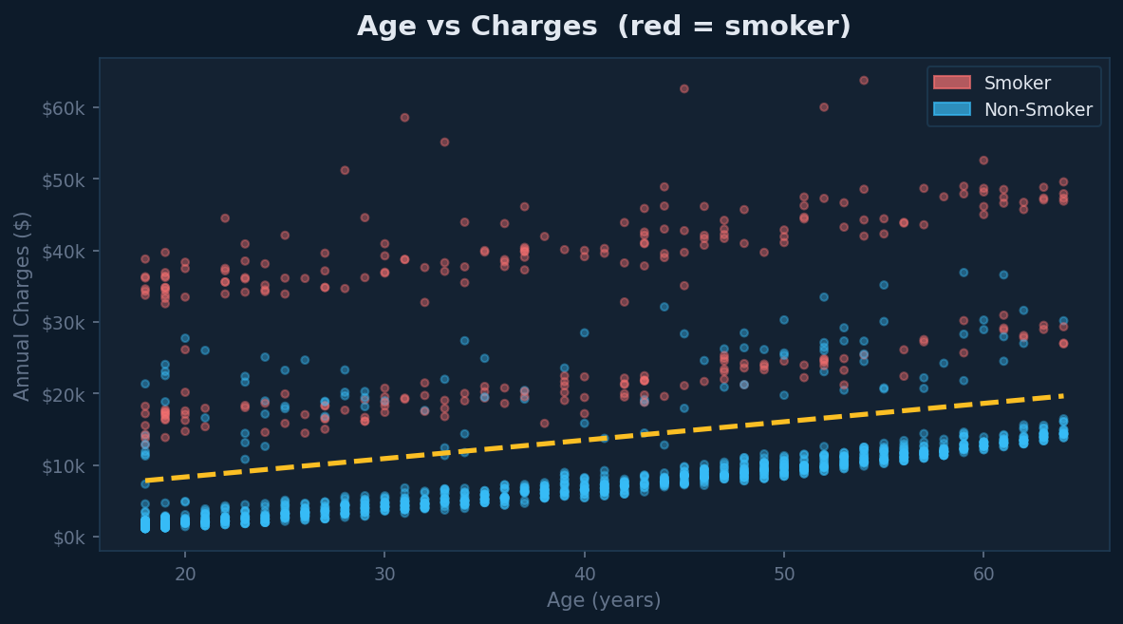
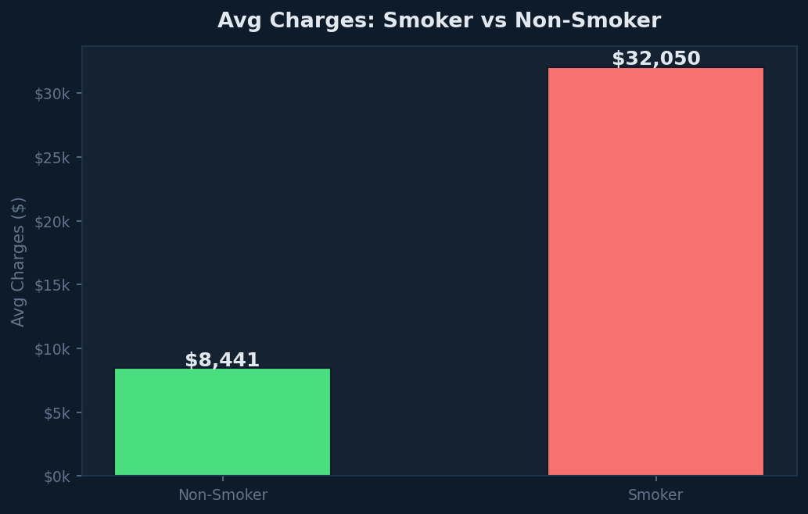
EDA — Bivariate Analysis
How individual features relate to insurance charges
Non-Smoker
Avg Cost
Smoker
Avg Cost
Smoking
Premium
Extra Cost
per Year of Age
$8,418
$32,223
+283%
~$200

Slide 7
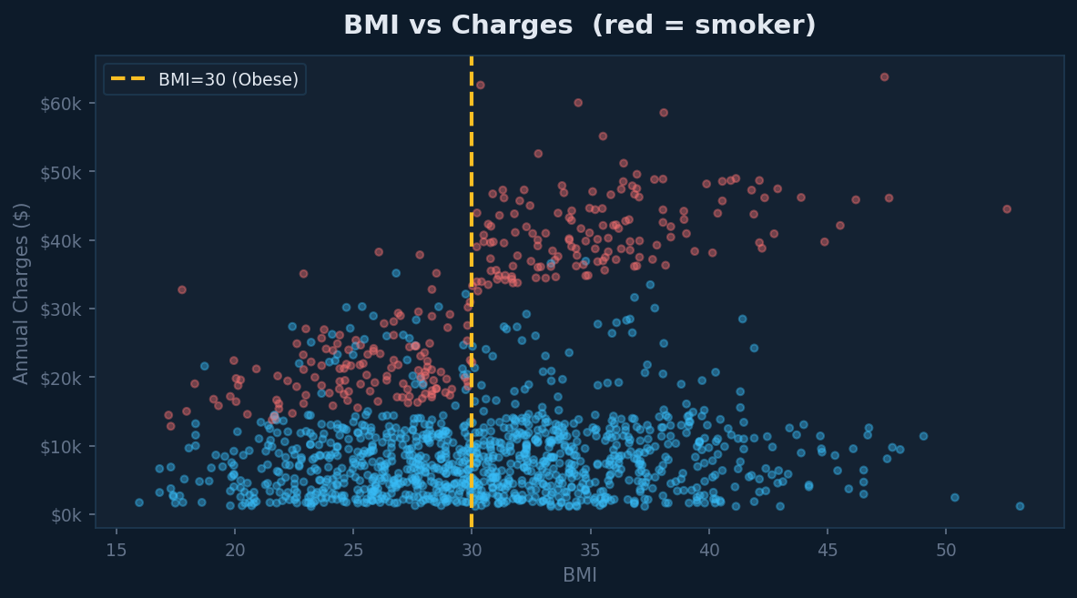
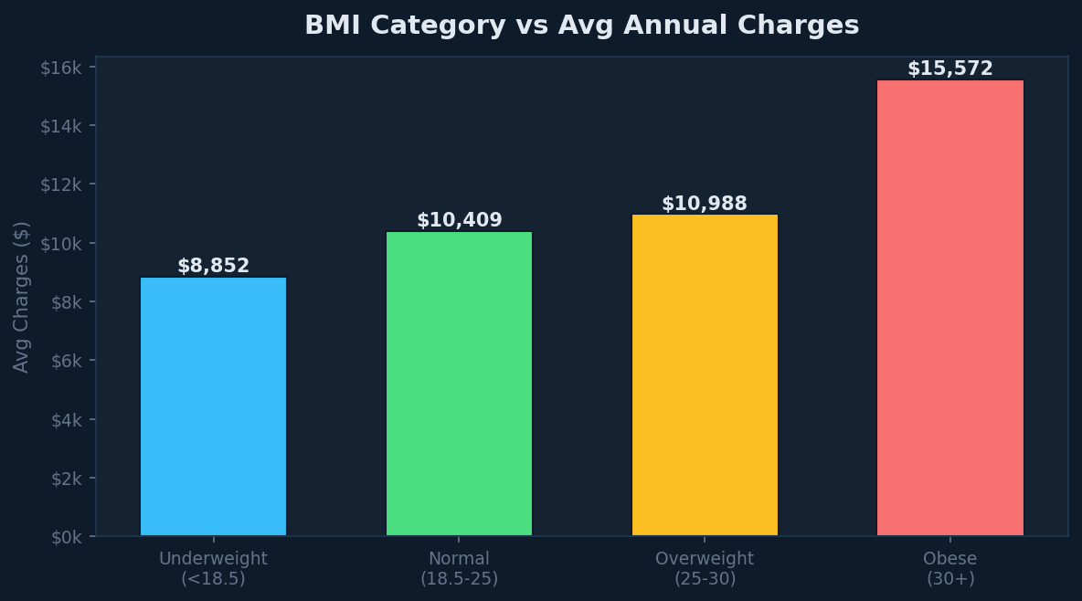
EDA — BMI Impact on Charges
BMI is a significant predictor — especially combined with smoking
💡 Critical Finding: Non-smokers (blue) show FLAT charges regardless of BMI. But smokers (red) with BMI>30 show an explosive cost increase — this interaction is captured by the engineered smoker_bmi and obese_smoker features, which are key drivers of model accuracy.

Slide 8
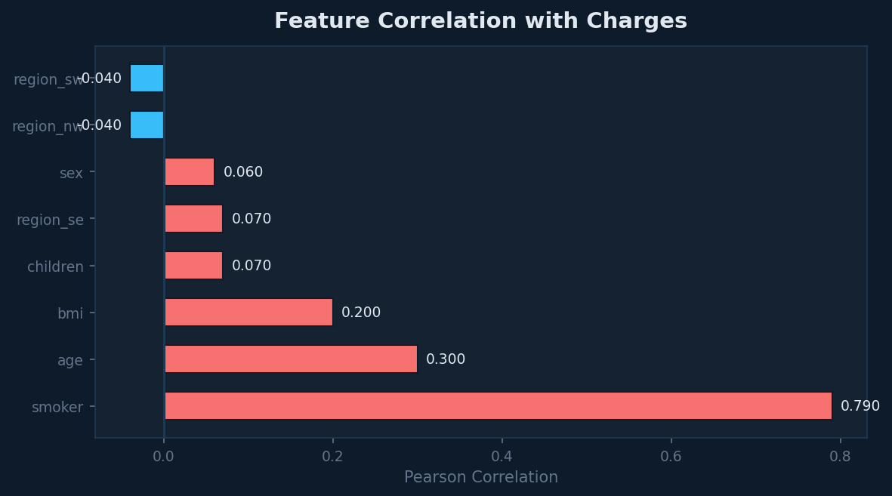
EDA — Correlation Analysis
Pearson correlation of all features with annual insurance charges
🥇
smoker
0.790
Very Strong
🥈
age
0.300
Moderate
🥉
bmi
0.200
Moderate
4
children
0.070
Weak
5
sex
0.060
Very Weak
💡 Key Takeaway: Smoking (r=0.79) is the dominant predictor — far stronger than age (0.30) or BMI (0.20). No multicollinearity exists between features, making linear models stable.

Slide 9
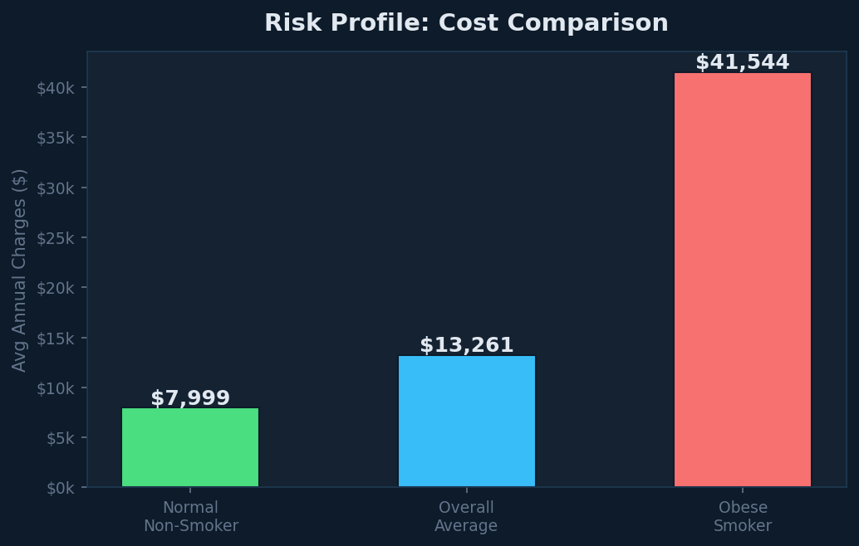
EDA — Risk Profile Comparison
Combined effect of obesity and smoking on insurance costs
LOW RISK
Normal BMI + Non-Smoker
$7,999/yr
MEDIUM RISK
Overall Average
$13,261/yr
VERY HIGH RISK
Obese (BMI≥30) + Smoker
💡 Insight: An obese smoker pays 5.2× more than a healthy non-smoker. This massive gap justifies creating the obese_smoker interaction feature in our model.
$41,544/yr

Slide 10
Feature Engineering
Transforming raw features into ML-ready predictors
ORIGINAL 9 FEATURES
5 NEW ENGINEERED FEATURES
· age
bmi_category
· sex (encoded)
0=Underweight, 1=Normal, 2=Overweight, 3=Obese
· bmi
age_group
0=18-25, 1=26-35, 2=36-45, 3=46-55, 4=56-64
· children
➕5
· smoker (encoded)
smoker_bmi
smoker × bmi — captures obesity+smoking interaction
· region_northwest (bool)
· region_southeast (bool)
smoker_age
smoker × age — older smokers cost much more
· region_southwest (bool)
obese_smoker
· charges (target)
flag: 1 if BMI≥30 AND smoker — highest risk group
9 features → 13 features · These features linearized non-linear relationships, enabling Linear Regression to outperform XGBoost.

Slide 11
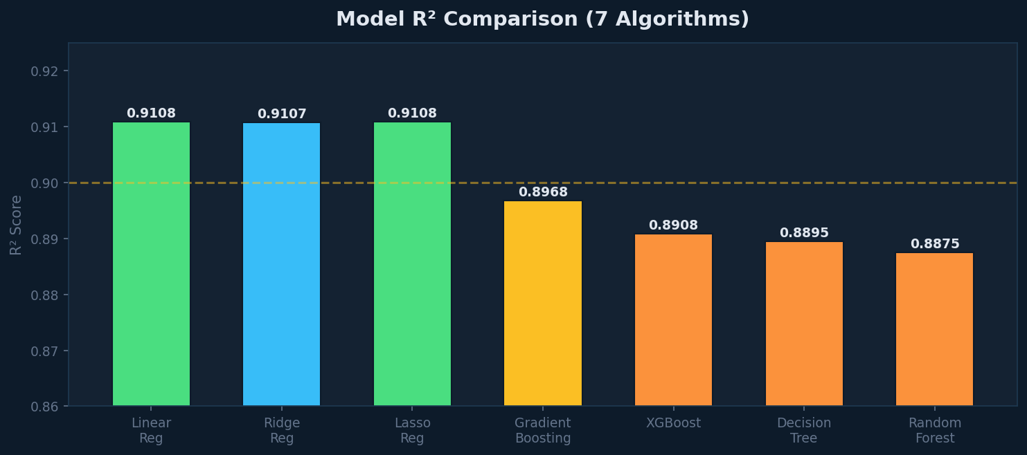
Model Training & Evaluation
7 regression algorithms trained and compared
Model | R² | RMSE | MAE
🥇 Linear Regression | 0.9108 | $4,048 | $2,268
🥈 Lasso Regression | 0.9108 | $4,049 | $2,268
🥉 Ridge Regression | 0.9107 | $4,050 | $2,265
Gradient Boosting | 0.8968 | $4,355 | $2,488
XGBoost | 0.8908 | $4,479 | $2,563
Decision Tree | 0.8895 | $4,506 | $2,662
Random Forest | 0.8875 | $4,547 | $2,548
🏆 Surprise Finding: Linear Regression beats XGBoost! Feature engineering transformed non-linear interactions into linear signals. smoker_bmi and obese_smoker made the relationship linear — removing the advantage of tree-based models. R²=0.9108 means the model explains 91% of cost variance.

Slide 12
MLflow Experiment Tracking
Full ML lifecycle management — logging, tracking & model registry
01
02
03
04
Setup Experiment
Log Each Model Run
Track 7 Experiments
Register Best Model
mlflow.set_experiment(
"Medical_Insurance_Cost_Prediction")
Log params, metrics (R², RMSE, MAE)
and model artifacts per run
All 7 models logged with unique
run IDs, hyperparams & performance
mlflow.register_model()
"MedicalInsuranceCostPredictor v1"
Parameters
model_type, test_size, n_features, n_train_samples, all hyperparameters
Metrics
R² Score, RMSE (Root Mean Squared Error), MAE (Mean Absolute Error)
Artifacts
Trained model pickle, input/output signature for each of 7 runs
Registry
MedicalInsuranceCostPredictor v1 — Status: READY — Best: Linear Regression

Slide 13
Streamlit App — Features & UI
Interactive web application with live insurance cost prediction
Tab 1
Tab 2
Tab 3
Tab 4
📊
EDA Overview
🔬
EDA Deep Dive
🤖
Model Performance
💰
Predict My Cost
Charges distribution histogram
BMI vs Charges scatter
7-model comparison table
Age & BMI sliders
Smoker pie chart
Age × Smoking scatter
R² / RMSE / MAE bars
Sex / Smoker / Region inputs
Age distribution
Smoker comparison boxplot
Actual vs Predicted chart
BMI category indicator
Region bar chart
Correlation heatmap
Residuals distribution
Annual + Monthly cost output
Children trend line
Region × Gender bar chart
Best model highlighted
Risk badge (Low→Very High)
4 KPI insight cards
6-factor contribution bars

Slide 14
How to Run the Streamlit App
Step-by-step setup guide — run locally in under 2 minutes
Clone / Download Files
✅ What Happens Next
01
# Make sure these 2 files are in same folder:
app.py
medical_insurance.csv
🌐
Browser opens automatically at http://localhost:8501
⚡
App loads in 10–15 seconds (model trains on startup)
Install Dependencies
02
📊
Navigate EDA charts across 4 interactive tabs
pip install streamlit pandas numpy matplotlib
pip install seaborn scikit-learn xgboost
🎛️
Adjust sliders — age, BMI, children (0–5)
Open Terminal / CMD
🔽
Select sex, smoker status and US region
03
# Navigate to the folder containing app.py
cd path/to/your/folder
💰
Click Estimate → see annual cost + monthly premium
🏷️
Risk badge: Low / Medium / High / Very High
Run the App
04
📈
Cost factor bars show what drives your premium
streamlit run app.py
💡 Tip: To stop the app, press Ctrl + C in the terminal. Share with team: streamlit run app.py --server.address 0.0.0.0

Slide 15
Model Predictions — Live Examples
Custom input predictions using best model (Linear Regression, R²=0.9108)
Young Healthy Male
$4,444
Age: 25 · Male · BMI: 22.0 (Normal) · Smoker: No
LOW RISK
$370 / month
Middle-aged Obese Female
$11,198
Age: 45 · Female · BMI: 32.5 (Obese) · Smoker: No
MEDIUM RISK
$933 / month
Smoker, Slightly Overweight
$23,025
Age: 38 · Male · BMI: 29.0 (Overweight) · Smoker: Yes
HIGH RISK
$1,919 / month
Obese Smoker, 3 Children
$47,922
Age: 55 · Female · BMI: 38.0 (Obese) · Smoker: Yes
VERY HIGH RISK
$3,994 / month

Slide 16
Best R² Score
Best RMSE
0.9108
$4,048
Project
Summary
✅ Dataset cleaned — 1,337 unique records
Best MAE
Models Trained
$2,268
7
📊 5 EDA sections — uni, bi, multi, corr, outlier
⚙️ Feature Engineering — 9 → 13 features
🤖 7 models trained — R² 0.88 to 0.91
🏆 Best: Linear Regression (R²=0.9108)
New Features
Clean Records
5
1,337
📈 MLflow — 7 runs logged + model registered
🚀 Streamlit app with live prediction
Medical Insurance Cost Prediction · Rudra Barman · Healthcare & Insurance Domain

